Slide 1
GN4-3 WP4
Cloud Offerings – Task 3
Dan Still
4th SIG CISS CERN
May 29th 2019

Slide 2
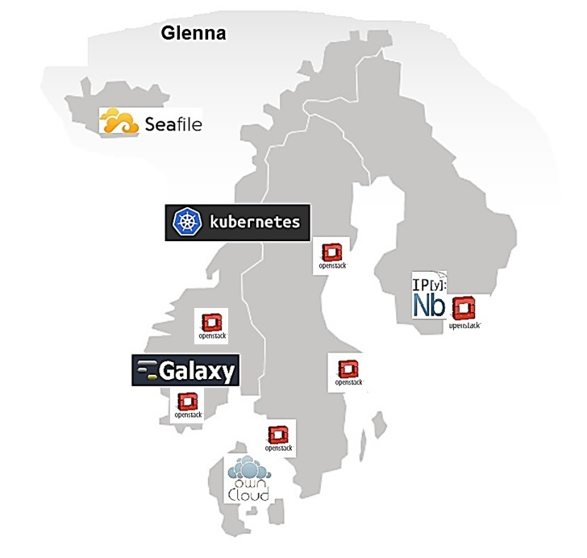
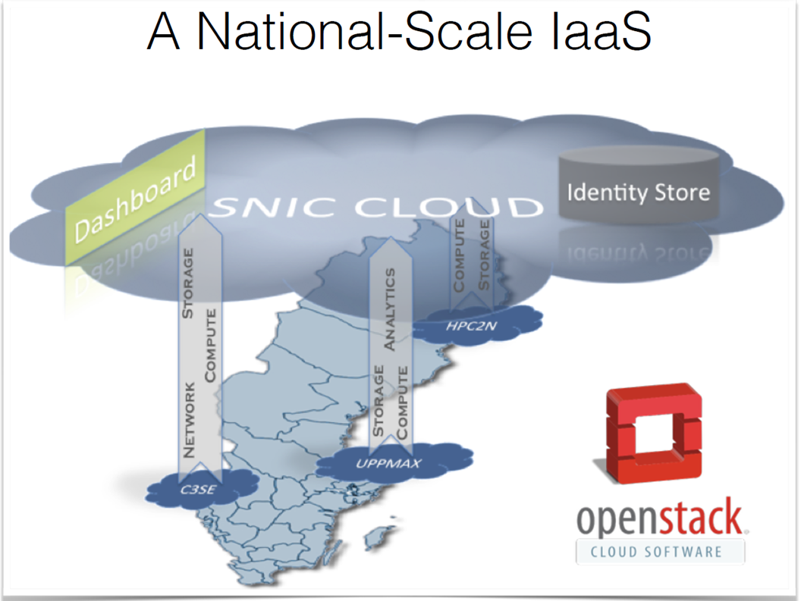
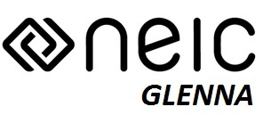
Background: The Nordic Cloud (Glenna)
The Glenna project is funded by NeIC - Nordforsk https://neic.no/

Slide 3
Work Package 4: Online Services Development and Delivery
Objective
The purpose of WP4 is to help R&E users with their computation and communication needs and enable them to collaborate online, across different organisations and countries. WP4 aims to put such offerings in place, by aggregating NREN expertise and community demand, underpinned by a platform which allows for service acquisition and delivery at a pan-European scale.

Slide 4
Work Package 4: Online Services Development and Delivery
Tasks
Task 0: Work Package Leadership (Work Package Leader: Andres Steijaert –SURFnet)
Task 1: Service Delivery: Platform and Business Desk (Task Leader: Garvan McFeeley –HEAnet)
Task 2: Service Development: Videoconferencing Infrastructure (Task Leader: Bartlomiej Idzikowski –PSNC)
Task 3: Service Development: Cloud Offerings (Task Leader: Dan Still -NORDUnet)
Task 4: Service Adoption Support (Task Leader: Maria Ristkok –EENet)

Slide 5
Task3 Cloud Offerings Objectives
Aggregate and scale up capable national service offerings to a pan-European level.
  Help NRENs indentify suitable services to offer jointly, paying special attention to services offering container-based virtualisation capabilities.
  Support and coordinate development efforts which establish such pan-European services, with NRENs pooling resources and collaborating on the delivery.
Connect commercial and community service offerings to the GÉANT and NRENs infrastructures, including:
  Network peerings and connections: liaise between providers and the GEANT network teams / project activities.
  Trust and identity systems: liaise between providers and the GEANT IdM teams / project activities.
  Explore and when deemed feasible, provide multi-cloud management capabilities, to manage workloads and move these between multiple providers, through a single interface.
  Collaborate with the SIG-CISS community.

Slide 6
Breaking down the task
It seems this project should not immediately tackle network peerings to commercial providers.
“Trust and identity systems” is relevant to the collaboration on delivery. The multicloud services are a bit separate issue a layer above our services.
The collaborate with SIG-CISS is obvious
Here is a suggestion for one sentence with the core of what we should do:
Work together to make sure end-users can access our services as easily as possible, in a common way, and we will use Geant tools where possible.
In general this would mean moving from a “one provider – many users providers to a many providers - many users” model, and we need to come up with a solution:

Slide 7
Step 1
Step 1: Geant as a service catalog (GaaS)
Basically the outcome of this project is a web page, with a list of services, and contact email addresses. A bit like EOSC-Portal.
User workflow:
Find the Geant site
Find the service you want to use
Contact the provider
Negotiate a contract
Set up usernames, passwords, projects
Use service
Repeat 2-6 as needed

Slide 8
Step 1 Continued
What does this solve?
There is a common understanding that community cloud services can be bought via Geant.
There is a place to point the users to when they ask about it.
This is not usable only for IaaS, but any sellable service.
What does this not solve?
Users still need credentials to each service they want to use.
Any contracts and billing processes are still bilateral.
Missing components:
A set of services which the providers can commit to sell in the Geant context.
A definition of the minimum amount of info about the services. (e.g. ToU, SLA, etc.)
A web page with the list of services.
Opinion: This is rather low ambition, and mostly useless for users. It’s also duplicating the EOSC catalog work. But, it could be starting point and a quick win.

Slide 9
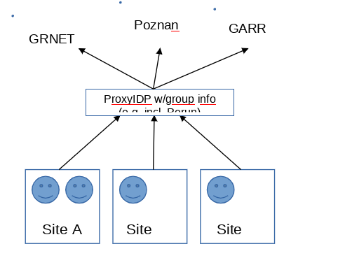
Step 2: Single access point to request and log into services
If we want to build something scalable, easier for users, and more lightweight for the providers, we need something more:
Currently federation authentication is useful, if
Authentication is enough to use the service, authorization is not required - or
authorization to the service is per user, not per group or project.
If we need a concept of a ”project” or ”group” we can’t get that information from the federation. We have to have all grouping information internally within the provider organization – i.e. provider specific credentials for each service the end-users use.

Slide 10
Step 2
There is a need for federated groups/projects, especially for OpenStack. If we can get group information from the federation, and give service access per group, it fits many of our internal modes of working.
This would allow users to access the services without provider-site specific credentials, i.e the whole stack should work with federated authN/authZ.
We would need a federated equivalent of a project, which is available to all provider sites, as opposed to this information living in a single provider’s interal system.
Suggestion: We use users for authentication, projects/groups for authorization

Slide 11
Step 3
This option is like option 2, but with added organizational contract work, and the willingness of Geant to be a reseller.
Technically this wouldn’t change much from the end user point of view, but Geant would be a single point of contact for the users.
Geant would handle the billing and reporting, and just buy services in bulk from the providers. Providers would provide support.
Some complexity would show through to the end users, as SLAs, Terms of use etc. will not be harmonized.

Slide 12
Step 3: First Year Effort
Task 3 will, in year 1:
• Identify suitable services to offer in a community clouds model in interaction with SIG-MSP and SIG-CISS.
• Put in place a delivery and ‘business’ plan for community clouds, using the GÉANT PLM.
Deliverable: D4.1 Community clouds delivery plan services selection, business models and development roadmap
• Commence the development of the first community clouds offering.
Milestone: M4.2 Community clouds, launch joint development efforts
• Connect commercial and community service offerings to the GÉANT and NRENs network and identity management systems.
• Start working on a business case for multi-cloud orchestration system, to assess suitable roles for NRENs and GÉANT.
Questions:
- How can we help more NRENs deliver cloud services at a larger scale?
- Balance between commercial and community clouds (how to scale up national clouds to a pan-European level?)
- Our position and visibility as GÉANT and NRENs in the European Open Science Cloud.

Slide 13
Questions
the level of ambition: who is willing and able to be part of a pan European scale?
multi-cloud orchestration system, to assess suitable roles for NRENs and GÉANT?
comments&thoughts on fedareted platforms and duplication of data?
file sharing and cloud storage: sync & share?
the current status of NREN Container-based virtualisation capabilities?
selection of cloud delivery models IaaS, PaaS, SaaS ...?

Slide 14
Development roadmap – Proposal for T3 (1/2)
We need to be able to price our services. In order to provide cloud IaaS, PaaS or whatnot we need to understand the real cost. There’s typically a large body of work needed to run a cloud service in production and often the ability to “price” the service is a measure of organizational readiness to really provide the service.
We need an better understanding of users needs, but an provocative statement is: what they want is Vanilla (!) …… i.e. IaaS, some not too advanced services like databases and potentially some type of collaborative platform google docs –style.
Build a mechanism for access to the services – a core Geant capability – groups concept to access cloud services as earlier described – potentially OpenStack regions concept etc.
  We should work with others in Geant on AAI

Slide 15
Development roadmap – Proposal for T3 (2/2)
Make comparison on price vis a vis commercials. This has been part of earlier Geant efforts and need to continue to benchmark our capability.
Service models: IaaS, SaaS (OnlyOffice some other applications), PaaS (Kubernetes) as a technical exercise but not many of us do K8 in production today. There is still lot’s of work to be done.
Geo redundancy – regions for IaaS – potential for collaboration
At later stage: offer a Multi Cloud portal – SURFnet example is quite promising. There are pros and cons but we should investigate and potentially implement at a later stage.
Question-marks: should we work on sync&share? CS3 community just got funding (Mesh project?). Services at participating NREN sites are very national in scope, there is also EOSC overlap i.e. EUDAT?

Slide 16
Task3: Use Cases
Elixir – Elixir AAI?
ESA case?
Meteorological use case?

Slide 17
BOLD suggestion: Start influencing policy makers
We need significant European cloud resource(s) a ’la Euro HPC.

