Slide 1
Why is SWITCH building a Long Term Storage Service when ‘everyone’ has local storage and there’s no national or international funding for it?
Ann Harding
ann.harding@switch.ch
Geneva, May 2019

Slide 2

Alternative title
SWISS

Slide 3


The SWITCH cloud offerings
SWITCHengines
SWITCHengines as an IaaS solution for the education and research sector in Switzerland
SWITCHdrive
Sync & Share on Swiss servers.
Owncloud/SWITCHengines
Commercial Cloud Services
Various contractual agreements for using commercial cloud solutions.
Notes:
The two SWITCH offerings should be viewed as complimentary
SWITCH aims to offer a broad solution of services in order to satisfy the needs of the higher Swiss education sector
August 2015 – September 2018 – Scale UP project
In house, classic commercial cloud, hybrid.
SDSC
National Services
Institutional portals
SNF / Innosuisse projects
Education and research users.

Slide 4

The storage shaped gap
Open Data
Audits
Backups
FAIR Data
Collaboration
Reproducible Science

Slide 5

The storage shaped gap
Data Protection
How much????
What, network charges too???
Jurisdiction
Who’s paying?
What if I need it sooner?

Slide 6
Please indicate where data must be stored that is collected or generated in connection with your activity at your institution?

Slide 7
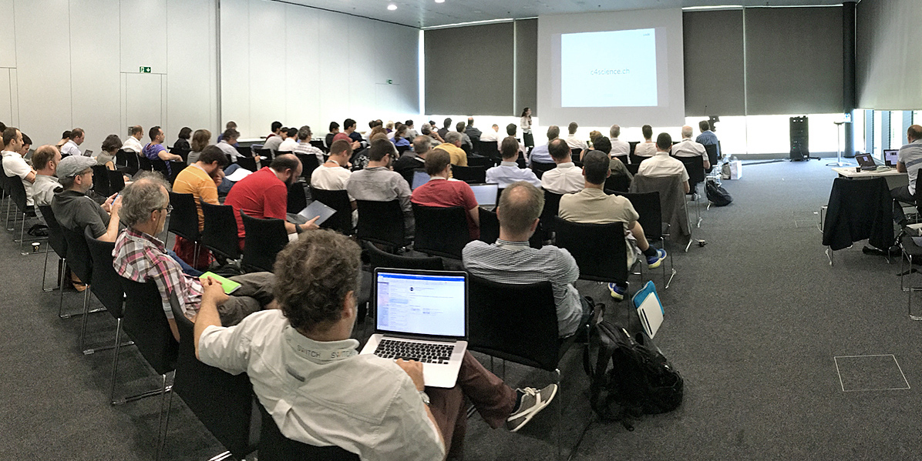

A challenge - 2017
Prof. E Bugnion, VP Information Systems EPFL
Build a national academic vault for research data
Competitive with commercial solutions
Free bandwidth
High bandwidth
Notes:
Disk not tape!

Slide 8

How do you compete with commercial providers?
The AWS Cloud spans 55 Availability Zones within 18 geographic Regions and 1 Local Region around the world, with announced plans for 12 more Availability Zones
  https://aws.amazon.com/about-aws/global-infrastructure/
Half a Million Square Feet of Amazon Data Center Space Under Construction in Virginia
  https://www.datacenterknowledge.com/amazon/half-million-square-feet-amazon-data-center-space-under-construction-virginia
.
Notes:
Every day, AWS adds enough new server capacity to support all of Amazon’s global
infrastructure when it was a $7B annual revenue enterprise
The AWS Cloud spans 55 Availability Zones within 18 geographic Regions and 1 Local Region around the world, with announced plans for 12 more Availability Zones and four more Regions in Bahrain, Hong Kong SAR, Sweden, and a second AWS GovCloud Region in the US. - https://aws.amazon.com/about-aws/global-infrastructure/
Half a Million Square Feet of Amazon Data Center Space Under Construction in Virginia - https://www.datacenterknowledge.com/amazon/half-million-square-feet-amazon-data-center-space-under-construction-virginia
If each availability zone scaled similarly 2.5M m2
523 Swiss francs per square meter in 2016 (Winterthur) 1300M
180 francs per square (Glarus) 450M

Slide 9




Think about what we are good at…
SWITCH Community
  Combining our resources for economies of scale
SWITCH Services
  Integrated offerings e.g. AAI/eduID
  No ingress/egress costs
  Data located within the academic community network
    Performance
    Governance
Extended community
  Tailored support to research
Notes:
Foundation – fully controls SWITCH
What will amazon/google do in 5 years time? What external pressures will they hve?

Slide 10
SWITCH contribution to the challenge
On site storage
Tapes
Commercial solution
???
Data Management
IT Services or
Research Community
Policy Support
Future Integration
SWITCH LTS
Notes:
Grey – could be tape etc

Slide 11


Building LTS: The Solution
Data Mgmt Applications
Data Mgmt Applications
Simple Technical Interface
  S3
  Building block to integrate
Object Storage
  Replication & distribution
Competitive on price
  Duration & order size
  Disks not tape!
Scale out
Policy Support
SWITCH LTS Object Storage
Notes:
Emphasis on building block
Target price of less than 100 CHF/TB pa
7 insitutions consulted in initial round – current costs 100-500
“substantialy below commercial costs” for the right circumstances which match your needs.
Any kind of app or tool that can speak S3
Why S3?
Tape solutions exist and is well covered – disk is evolving. This is the future.
Tech will evolve underlying so interface is important.
Ability to add a layer below.

Slide 12



How to build it?
One big infra vs. fully separate?
  Separate
Same software/hardware approach vs. something different?
  Ceph CAN do this
  We have the skills
  But we maybe try something different
Not all appliances are equal
  Enterprisey vs. cloudy
Keep the user in OUR garden
  Admin UI

Slide 13

Building LTS: The Project
Phase 1
  Working with EPFL and Uni Lausanne on potential use cases
    IT services & research
  Procuring pilot infrastructure
  First data Q3 2019
Evolution
  Further use cases
  Build out capacity
  Scientific Information P-5 Program and follow on programs
Notes:
Partners for future submissions
SNF study on state of the art for data management -> influence future submissions

Slide 14

Why go it alone?
Funding bodies strategy is still evolving
  Focussing on earlier calls on technology or sector not general capability
Demand & partnership is there now
  Built with EPFL as a partner
  Market analysis 5 year forecasts
  Funded platforms are interested
Innovation mandate from board/community

Slide 15

Working for a better digital world

