Slide 1
Pilot Coordination
Status update and outcomes
Michał Zimniewicz
Poznan Supercomputing and Networking Center
5th Up2U General Assembly, Poznan, Poland
11th September 2019

Slide 2
Agenda
Status update and outcomes
  WP7 and pilot coordination overview
  Past activities
  The work plan
Case studies – Greece, Italy, Lithuania, Poland
Future steps planned by each pilot country

Slide 3
Work Package 7
Pilot Coordination
  operating pilot technology and processes
  not developing software, not designing pedagogical side
Collecting data for pilot evaluation
Collecting MVP suggestions
Quality Control
  Functional testing
  Report issues: https://wiki.geant.org/display/UP2U/Issue+tracking
  Performance testing
Risk management

Slide 4
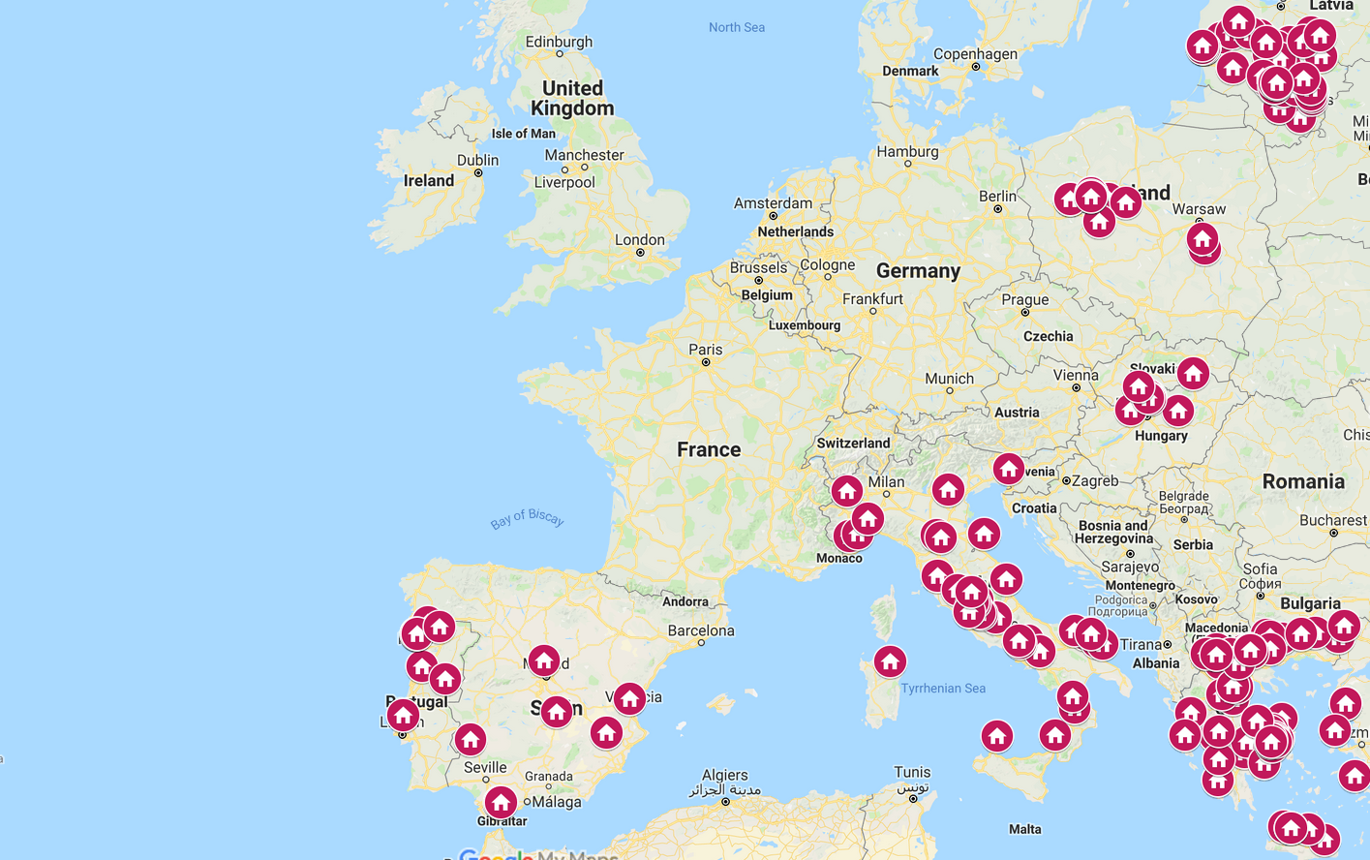
Pilot Countries
Notes:
Greece, Hungary, Italy, Lithuania, Poland, and Portugal
Spain
Germany

Slide 5
KPI in the New Workplan
The number of pilot schools
  Request to the EC for changing 1500 to 1000
University enrolment rate – To be considered as irrelevant
  Success rate of student enrolments to university across the pilot schools in Europe: Year 1: baseline, Year 2: +15%, Year 3: +20%
  Weak correlation with the project’s impact
  Debatable feasibility to collect meaningful data

Slide 6
Pilot – Definition
Students using the Up2U Application Toolbox
to bridge the gap between secondary and higher education,
i.e. practice the key competences identified by WP5.
Notes:
An outcome of the WP5-WP7 meeting
The competences are: Critical thinking, collaboration, creative thinking, etc.

Slide 7
Pilot Evaluation by WP5
Collect web and learning analytics data on each school
Implement uniform pre- and post- surveys
for teachers and students in each school
Ask at least one teacher in each school
to define a collaborative assignment for students
and then send statistical assessment data back to us
And other optional means
Notes:
Internal KPIs to be able to evaluate what students do in pilots

Slide 8
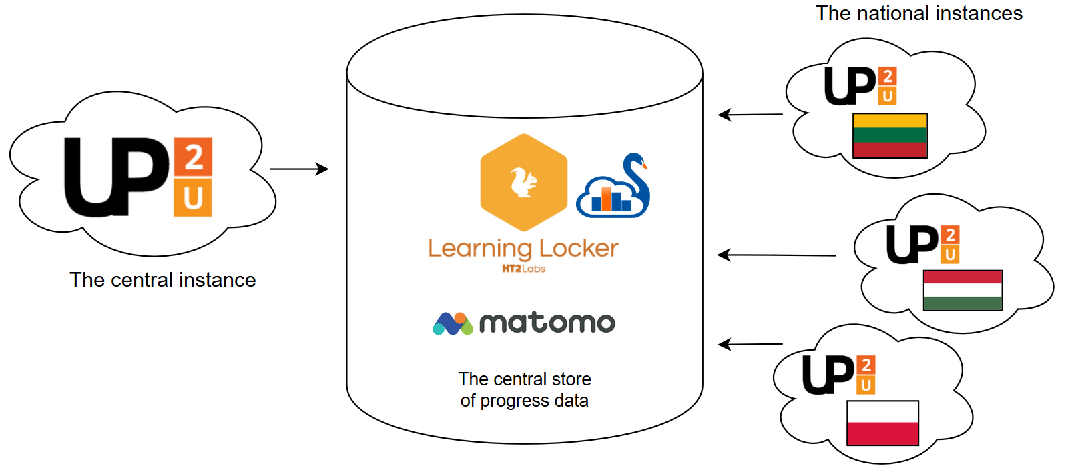
Evaluation across
Application Toolbox Instances
Notes:
Agreed upon (WP5-WP7) to implement this setup to support evaluation: Central and national instances to report data to central stores (Learning Locker, Matomo).

Slide 9
Pilot Coordination – Past
Monthly reports to EC from November 2018 to June 2019
The launch of pilots:
  Lithuania – October 2018
  Germany – still looking for opportunities
  The 6 other countries – February/March 2019

Slide 10
Pilots up to July 2019
Country | Training |  | Pilots
 | Schools | Teachers | Schools | Students
Germany
Greece | 10 | 80 | 5 | 50
Hungary | 8 | 66 | 3 | 42
Italy | 79 | 100 * | 6 | 72
Lithuania | 185 | 341 | 133 | 15.000
Poland | 26 | 47 | 11 | 300
Portugal | 7 | 50 * | 1 | ?
Spain | 6 | 17 | 1 | 100
* - training in progress

Slide 11
Next Steps
Translate the evaluation materials to national languages
Validate technical feasibility of the evaluation methodology
  No group mgmt – problems in recognizing schools,
  and also teachers from students
New pilots from now on up to March 2020

Slide 12
Breaking down the Total KPI
Country | Michal’s proposal | Country’s proposal
Germany | 50 | 20
Greece | 180 | 70
Hungary | 180 | 50
Italy | 180 | 50
Lithuania | 225 | 225
Poland | 180 | 180
Portugal | 180 | 8-16
Spain | 100 | 25-50
TOTAL | 1275 | 628-661

Slide 13
Breaking down the Total KPI
Country | Michal’s proposal | Country’s proposal
Germany | 50 | 20
Greece | 180 | 70
Hungary | 180 | 50
Italy | 180 | 50
Lithuania | 225 | 225
Poland | 180 | 180
Portugal | 180 | 8-16
Spain | 100 | 25-50
TOTAL | 1275 | 628-661

Slide 14
Getting to the KPI
The webinar for other NRENs, more countries involved
Focusing on other numbers than only schools: students, teachers, …
…

Slide 15
Risks
Other main risks re. pilots:
Solving GDPR issues in the platform
No solution for group management
  It affects LA, scalability, usefulness
Missing LA implementation in different tools
Pilot evaluation design and materials
Notes:
Critical risks re. WP7
Re. risks no. 2 & 3 – effect might be serious problems in collecting or evaluating LA data, thus evaluating pilots

Slide 16
Thank you!
Next presentations:
Case studies: Greece, Italy, Lithuania, Poland
Future steps:
Greece, Hungary, Italy, Lithuania,
Poland, Portugal, Spain, Germany

Slide 17

Pilot Case Study
Greece
Mary Grammatikou, Dimitris Pantazatos
NTUA

Slide 18
Number of Schools Participating on the CPD activities
First iteration of the CPD
  10 Schools, 80 teachers, 50 students
  3 courses were created by the teachers (2 of them were based on the interdisciplinary course “The tunnel of Eupalinos”)
Second iteration of the CPD (will start early September)
  79 Schools, 140 teachers

Slide 19
CPD Module 1 structure during the first iteration of the CPD
Five face-to-face meeting based on these topics:
  Up2U Authentication and Platform Introduction
    Collaborative Learning: Structured group practice, role taking
    Group-working-Hands-on experience on Moodle
  Best Learning practices and techniques to enhance Up2U Skills
    Group-working-Hands-on experience on: Moodle best practices, eduOER experience
  Best Practices
    Group-working-Hands-on experience on: SeLCont, DSpace
  Teachers’ Learning Scenarios
    Group-working-Hands-on experience on: H5P, KnockPlop, Personal Recorder
  Final meeting – Feedback
    Collective discussion, Peer-feedback Expert’s evaluation

Slide 20
CPD Module 1 structure during the second iteration of the CPD
Five webinars based on these topics:
  Introduction to Up2U
    Introduction to pedagogical aspects of the Up2U platform
  Best Learning practices and techniques on Up2U Learning Platform
    Demonstration and Pedagogical aspects on: Authentication on the Up2U Learning Platform and Moodle best practices
  Using and Storing OER material
    Demonstration and Pedagogical aspects on : eduOER, Dspace, CERNBox
  Creating Interactive content based on Teachers’ Scenarios
    Demonstration and Pedagogical aspects on : H5P, KnockPlop
  Creating Multimedia Content based on Teachers’ Scenarios
    Demonstration and Pedagogical aspects on : SeLCont, PODDIUM
Teachers during the Module 1, will create at least a Learning Scenario based on the Up2U Learning Platform

Slide 21
Tools that have been used during the CPD activities
Moodle
eduOER
H5P
CERNBox
Dspace
SeLCont
KnockPlop
PODDIUM (on the second iteration of the CPD)
SWAN (on the second iteration of the CPD)

Slide 22
Platform Used
On the first iteration of the CPD modules, we used the test instance of the Up2U Learning Platform. On this instance we also hosted the first courses with students’ participation
On the second iteration of the CPD modules, the test instance is used during the training, while the production instance will be used for the teachers’ courses

Slide 23
Learning Analytics
NTUA during the first iteration of the CPD used the Learning Analytics that Moodle provides (number of teachers and students) and website analytics provided by Matomo (number of visitors to the courses etc)
During the second iteration we are planning to use LRS’ stats when more users will use the Up2U learning platform

Slide 24
Resources Used
NTUA has created a dedicated website for the training material (https://up2u.netmode.ntua.gr/)
The Training Material was based on Up2U’s User Guides and Tutorials
The training material is also translated in Greek
Pre and post CPD Module 1 survey was used during the first iteration of the CPD
A focus group interview was also conducted to students who participated during the first iteration of the CPD
Next Steps:
  A dedicated online training course has been created on the Up2U Learning Platform
  Webinars are recorded in order to be used as video tutorials
  New pre and post CPD surveys will be used

Slide 25
Online vs Offline Participation
During the first iteration of the CPD, the training was based on face-to-face meetings
On the next iteration of the CPD, the training will be fully online

Slide 26
Weaknesses and Strengths
Weaknesses
  Face-to-face activities were limited to only one region. As a result we could not engage teachers from other regions
  There was a delay between module 1 and 2 during the first iteration of the CPD
Strengths
  Face-to-face meetings helped us to engage teachers in a more efficient way
  Face-to-face meeting during the second module of the CPD helped teachers to collaborate in order to create interdisciplinary courses
  Teachers were supported better with an interactive, real and dynamic way of learning

Slide 27
Lessons Learnt
A hybrid model of f2f and on-line courses in the different iterations is the appropriate model to implement the CPD
CPD Modules 1 and 2 should be merged (these modules will be merged on the next iteration of the CPD in Greece)
Each school should have some teachers that are eager to support their colleagues regarding the usage of the Learning Platform
Further engagement of Parents and other stakeholders during the CPD activities
Production instance of the Up2U learning platform will be used alongside with the test instance

Slide 28
Future Plans

Slide 29
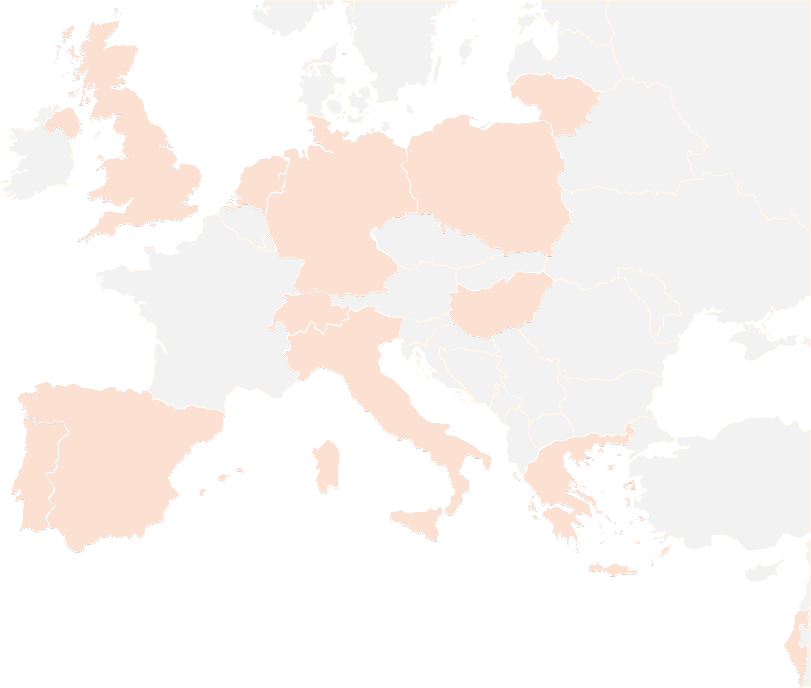
THANK YOU FOR YOUR ATTENTION!
mary@netmode.ntua.gr
dpantazatos@netmode.ntua.gr
#up2universe

Slide 30
Pilot Case Study
Italy
Andrea Corleto
GARR
5th Up2U General Assembly, Poznan, Poland

Slide 31





Timeline 2019
January-February
May-September
Dissemination
and communication
Students working with teachers / Pilot
Launch of the Contest
Teachers training / CPD
Contest award
March-May
October

Slide 32






Engaging schools
Dissemination through GARR
media channels
Direct mail
Face to face meetings and online webinar
Invitation to join the Contest
Dissemination through GARR
media channels
Mail to Regional Offices for Schools
Face to face meetings and online webinar
Invitation to join the Contest

Slide 33
Outcomes of the engagement
Training for teachers / CPD
100
from 79
Pilot (teachers + students)
79 students working with 6
from 6

Slide 34


Pilot activities
Training for teachers / CPD
1 online course + 9 webinar on technology, pedagogy and security
show to teachers how to work with students on the collaborative construction of a multimedia artifact, developing some of the Up2U core competencies

Slide 35







Pilot activities
Training for teachers / CPD
According to a 5 steps template
1 | Materials research and selection
2 | Design of the video
3 | Video editing
4 | Products improvement
5 | Contest

Slide 36
Pilot activities
Pilot (teachers + students)
79 students working with 6
from 6
According to a 5 steps template
1 | Materials research and selection
2 | Design of the video
3 | Video editing
4 | Products improvement
5 | Contest

Slide 37
Pilot activities
Pilot (teachers + students)
Critical thinking, Problem-Solving and Information, Media and Technology Literacy
Self-directed or self-regulated learning
Communication
Collaborative learning

Slide 38
Points of weakness
Low participation of teachers
Tools learning for teachers is too much time-spending
“Student role” privileges considered too restrictive by teachers
GDPR issues

Slide 39
Points of strength
Teachers can regulate their learning process autonomously
Pilot activity has a clear process made of well defined steps
Continuous support provided to the teachers, both technological and methodological
Use of webinars to reach users

Slide 40
Lesson learned
Involve teachers and schools is very hard and demanding
New tools and technology is not enough
Teachers are interested in using technology at school and want to be trained
When it comes using technology with students… it’s different

Slide 41
Image credits
Megaphone: kisspng.com
Launch: freeicons.io
Teacher: commons.wikimedia.org
Student: pngrepo.com
Award: cmdpdh.org
Mail: i-love-png.com
School: pngimage.net
Meeting: littlestarslearning.blogspot.com
Webinar: med-iq.com
Goal: pngrepo.com
Video: pixabay.com
Tools: freeiconspng.com
Moodle: icon-library.net
H5P: h5p.org
Filmora Go: filmorago.it.aptoide.com

Slide 42
THANK YOU FOR YOUR ATTENTION!
up2u@garr.it
#up2universe

Slide 43
Pilot Case Study
Lithuania
Gytis Cibulskis, Kaunas University of Technology

Slide 44
Preparations for Piloting
Setting up National Up2U infrastructure done 2018 May - September
CPD Module 1 in Lithuanian language is prepared and approved as official qualification development program
Dedicated VLE established at https://mokymai.vma.lm.lt
Face-to-face CPD Module 1 delivered in November-December 2018 with 15 selected teachers
Online CPD Module 1 is developed and delivered in 2 iterations this year:
  January - February - 166 enrolled teachers
  March– April - 352 enrolled teachers

Slide 45
Structure of CPD Module 1
30 hours, 5 weeks, program officially recognized for teachers’ qualification
Consists of:
  Learning material
  10 instructional webinars (twice per week)
  Online collaboration (forums, wiki, glossary, data base, messages, etc.)
  4 self-assessment tests
  3 assignments (SELFIE/DigComEdu, Workshop, Practice course)

Slide 46
mokymai.vma.lm.lt

Slide 47
Badges and certificate
1st badge is earned after self-introduction in the forum;
2nd – for active participation and filling in the survey;
3rd – for completion of all activities.
Certificate - after compulsory activities are completed and own practice course is created and peer reviewed

Slide 48
Numbers of participants in CPD Module 1
Successful graduates
Face-to-face – 14 out of 15
1st online iteration – 107 out of 166
2nd online iteration – 220 out of 352
Overall success rate – 64%

Slide 49
Number of schools participating
Teachers from 277 schools enrolled to CPD Module 1
Teachers from 185 schools has completed CPD Module 1
133 schools activated Up2U
VLE at vma.lm.lt
~60 schools are using Moodle
with their students
~15000 registered users on the platform
~100K visits
~2,7 Mln page views during the 2018-2019 academic year

Slide 50
Up2U Tools in CPD
Used actively:
  Most of Moodle native tools
  H5P
  KnockPlop
  EduOER
  Personal Recorder/Poddium
Introduced without practical use:
  Swan/Jupyter notebooks
  Dspace

Slide 51
Feedback from CPD Participants
Data from all 3 CPD iterations is available at http://bit.ly/2Z8C7tk

Slide 52
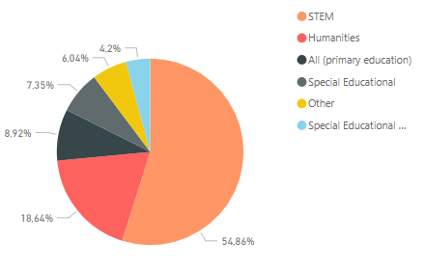
Teachers’ background
Female – 89%, Male – 11%
The average age of the group was 47 years (from 22 to 66 years old)
The average training experience of the group was 21.7 years
Regarding previous professional development, participating teachers reported that they attended a number of training courses with a pedagogical focus (about 9.2 in average) which doubles those on ICT (about 3.3 in average)

Slide 53
Would you recommend the course?

Slide 54
Learning Analytics and Monitoring
Internal Moodle statistics
Extended Moodle statistics for monitoring and analysis of teachers and students activities
Google Analytics
Matomo
Learning Locker LRS

Slide 55
Internal Moodle statistics

Slide 56
Extended Moodle statistics
Special Moodle plugin was developed that allows to monitor:
  Numbers of active users per course
  Number of resources and activities created by teacher per course
  Number of artefacts (forum posts, data base records, assignment files uploaded, etc.) created by students per course
Analysis and visualization can be done with Excel or can be implemented with other data analytics tool
In Lithuania we use MS PowerBI (http://bit.ly/2JAAZdg)

Slide 59
Use of a shared LRS
Records are provided to shared LRS from all instances of National Up2U Moodle
Only CPD instance is configured to provide records with e-mail instead of Moodle user ID, this could allow to correlate with data from other tools in the future

Slide 60
Strengths Weakness
Good political support from the Ministry
High interest from schools to use VLE
Good motivation of the teachers
Good feedback from CPD participants
Good learners support
Not clear sustainability perspective for other Up2U tools
Dependency on another project for national IdP service for schools that is delay with implementation
GDPR is quite big obstacle and it is not clear how to implement data collection and monitoring yet

Slide 61
Lessons learnt
Success factors of high completion rates:
right motivation for teachers
effective organization of the learning process
good learners support
completion tracking and conditional access is a good way to stimulate learners interest in finishing activities

Slide 62
Pilot Case Study
Poland
Michał Zimniewicz
PSNC
5th Up2U General Assembly, Poznan, Poland
11th September 2019

Slide 63
Agenda
Air pollution – Spring 2019
Artifical intelligence – May-September 2019
Lessons learned

Slide 64
Scenario on Air Pollution
March – May 2019
Face-to-face kick-off meetings with introductory lessons at PSNC
A learning scenario focused on smog and air pollution
3-4 hours
Assignments and tools
  CERNBox – sharing data
  SWAN – analyze data
  Knockplop, MM – connect with an expert to get next assignments

Slide 65
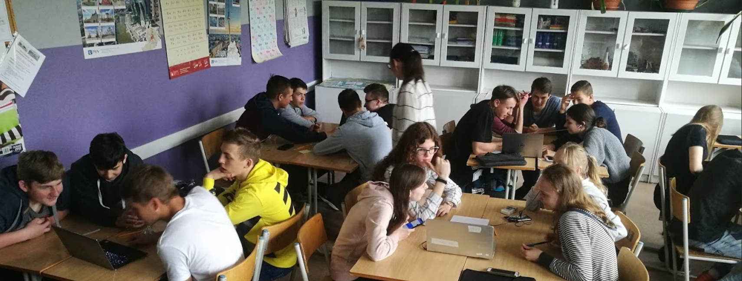

Slide 66
Scenario on Air Pollution
March – 5 classes from 5 different schools
April – 10 classes planned but all cancelled
May – 2 classes from 2 different schools
Follow-ups planned in classrooms but never happened. GDPR.

Slide 67
Artifical Intelligence
Artifical intelligence course from Intel for high schools
Curricular subjects
  NLP
  Image recognition
  Classification
They wanted to do it off-line…
But finally, it is run using Up2U tools

Slide 68
Artifical Intelligence
About 100 work hours for students
Ca. 30 Jupyter notebooks
May – September 2019
2 schools from Gdansk, 3 schools from Poznan
120 students

Slide 69
Artifical Intelligence
Introduction
  Poznan – introductory lessons at schools (teachers + students)
  Gdansk – two-day training for 13 teachers
Online support for teachers – Knockplop/MM… and Slack
Students working in classes and at home

Slide 70
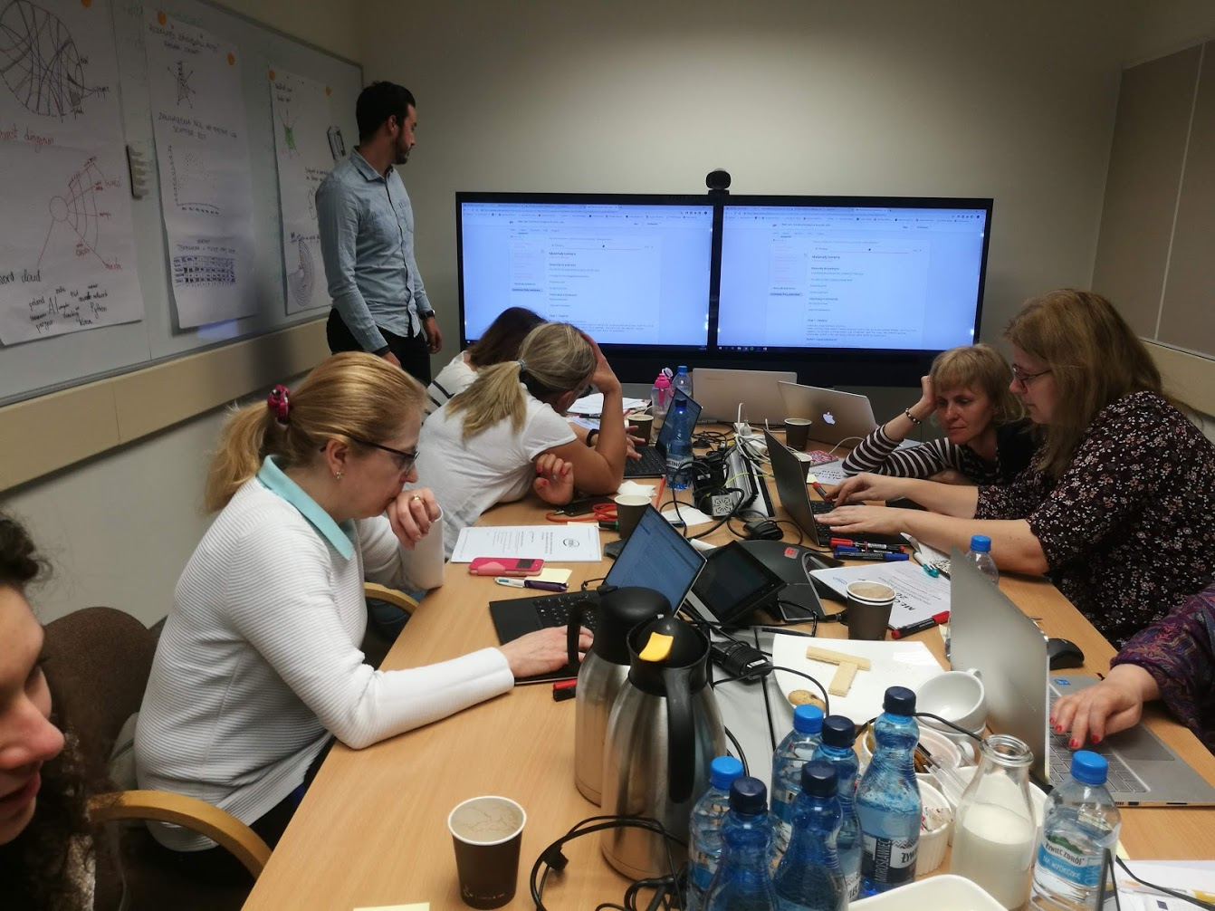

Slide 71
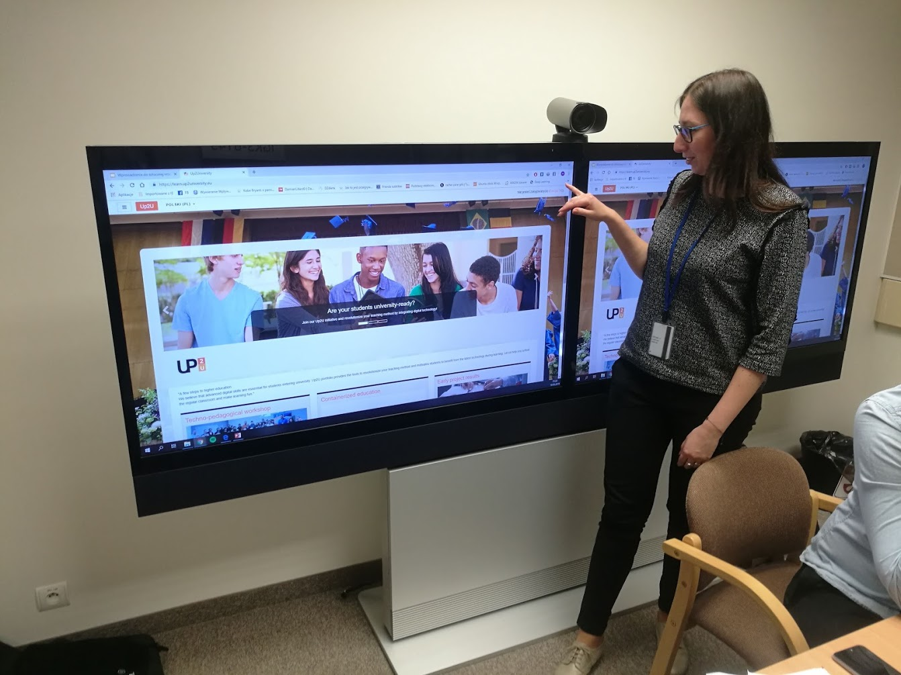

Slide 72
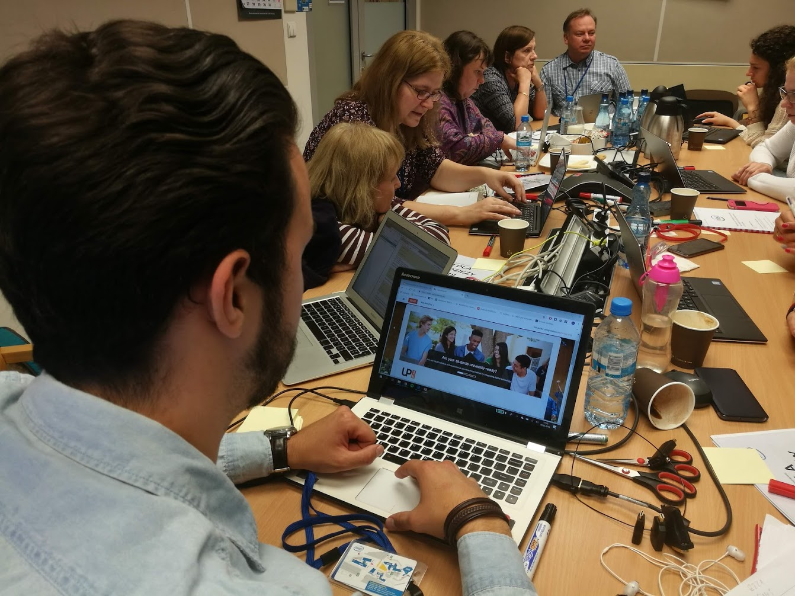

Slide 73
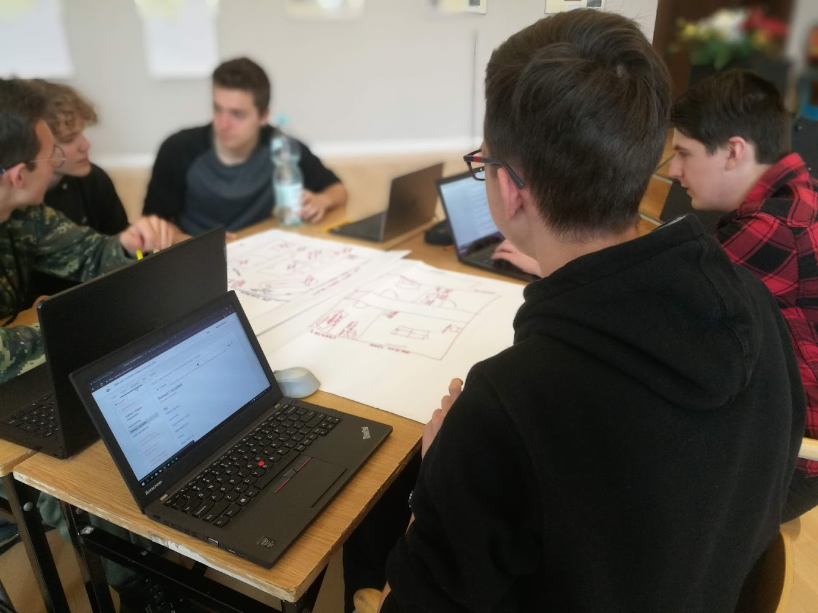

Slide 74
Points of Weakness
GDPR
Tools
  Weak user experience, too many options, not sure what to click
  Some schools already have Moodle
  Missing translations
  The integration of tools is not visible in UI
  Cannot clearly see our advantage against the competition
  No group management

Slide 75
Points of Weakness
Teachers
  No time and not willing to create new materials
  Not willing to be assessed
  Not easy to coordinate teachers’ schedules
  They like dedicated tools for specific tasks rather than LMS
Miscellaneous
  Weak internet connection at schools in some cases
  Not sure how to track progress in Jupyter notebooks
Notes:
Not motivated teachers don’t want make changes.
Motivated teachers see our deficiencies against other competitors

Slide 76
Points of Strength
In general, our selection of tools is good
  But see the suggestions about missing tools
When users learn how to do things with the tools,
the work gets smooth and easier
We can easier offer hosting tools and a limited support
for Polish teachers after the end of the project

Slide 77
Points of Strength
Good contents or interesting subject bring more users
Introductory lessons for teachers and students make teachers more confident about the tools

Slide 78
THANK YOU FOR YOUR ATTENTION!
contact@lists.up2university.eu
#up2universe

Slide 79
Pilot Future Steps
Greece
Mary Grammatikou & Dimitris Pantazatos
NTUA
5th Up2U General Assembly, Poznan, Poland

Slide 80
Participating schools
Season | Activities with teachers only |  | Activities with students
 | No. of schools | No. of teachers | No. of schools | No. of students
Sep ’18 – Jun ’19 | 10 | 80 | 8 | 50
Sep ’19 – Dec ’19 | 79 | 140 | 50 | 800
Jan ’20 – Mar ’20 | 30 | 90 | 15 | 240
Notes:
Next Iteration (second) has already started. First Webinar has already been conducted with success.

Slide 81
How to engage new schools?
Schools with students active so far: 8
Planned total number of schools with students engaged: 70
What actions are taken to engage new schools?
  A meeting with the Ministry of Education has been scheduled
  An online course (with the material of the second iteration of the CPD), will be freely accessed by guest users
  New invitation letter will be send. This invitation will be posted the websites of the Greek School Network, the Greek community of eTwinning, Scientix etc.

Slide 82
Greek soft CPD current status
The first webinar was implemented with success
Learning material is available on the Greek Up2U mini-site (https://up2u.netmode.ntua.gr/?page_id=34) and on the Up2U Learning platform (https://learn.test.up2university.eu/course/view.php?id=99)
The video of the first webinar (in Greek) is available at: https://up2u.netmode.ntua.gr/?page_id=34

Slide 83
Greek Soft CPD Structure
Five webinars based on these topics:
  Introduction to Up2U
    Introduction to pedagogical aspects of the Up2U platform
  Best Learning practices and techniques on Up2U Learning Platform
    Demonstration and Pedagogical aspects on: Authentication on the Up2U Learning Platform and Moodle best practices
  Using and Storing OER material
    Demonstration and Pedagogical aspects on : eduOER, Dspace, CERNBox
  Creating Interactive content based on Teachers’ Scenarios
    Demonstration and Pedagogical aspects on : H5P, KnockPlop
  Creating Multimedia Content based on Teachers’ Scenarios
    Demonstration and Pedagogical aspects on : SeLCont, PODDIUM
Teachers during the Module 1, will create at least a Learning Scenario based on the Up2U Learning Platform

Slide 84
Timeline
Dates | Actions / Status
September 2019-October 2019 | Second iteration of the CPD (Combined modules 1 and 2) 140 teachers will participate from 70 schools New courses with students will start from October
November 2019-December 2019 | First results from the second iteration of the CPD will be analysed Dissemination activities for contacting news schools and teachers Preparation of the third iteration of the CPD
January 2020- March 2020 | Third iteration of the CPD (Combined modules 1 and 2) 90 teachers will participate from 30 schools (estimation) New courses with students will start from February
Risks:
Low adaptation of the Up2U Learning Platform by the teachers. As a result, teachers will not use Up2U in their courses.
The estimations for the third iteration of the CPD may be optimistic.

Slide 85
THANK YOU FOR YOUR ATTENTION!
contact@lists.up2university.eu
#up2universe

Slide 86
Pilot Future Steps
Hungary
Csilla Gödri
KIFÜ
5th Up2U General Assembly, Poznan, Poland

Slide 87
Participating schools
Season | Activities with teachers only |  | Activities with students
 | No. of schools | No. of teachers | No. of schools | No. of students
Sep ’18 – Jun ’19 | 9 schools | 78 teachers | 3 schools | 42 students
Sep ’19 – Dec ’19 | 24 schools | Approx. 24 teachers | 20 schools | Approx. 280 students
Jan ’20 – Mar ’20 | 17 schools | Approx. 17 teachers | 27 schools | Approx. 378 students

Slide 88
How to engage new schools?
Schools with students active so far: 4
Planned total number of schools with students engaged: 50
What actions are taken to engage new schools?
  Invitations through school year greeting emails
  Invitations through Facebook posts
  Preparing CPD Modul 1 training for teachers in September 2019
  Creating a microsite https://up2u.kifu.hu/
  Preparing educational videos about application tools
  Participating on National Public Education Expert Conference 2019
  Organising f2f meetings with teachers and visiting potential new schools

Slide 89
Timeline
Dates | Actions / Status
September 2019 | Numbers of schools invited : 358 Schools start with the pilots: during September CPD iterations: CPD Modul 1 Invitation through Facebook posts Creating educational videos about application tools Visiting potential new schools
October 2019 | Numbers of schools invited : 70 New schools start with the pilots: during October Soft CPD: planning webinar Organising f2f meetings with teachers and visiting potential new schools
November 2019 | Numbers of schools invited : 50 New schools start with the pilots: during November Soft CPD: planning webinar Participating on National Public Education Expert Conference 5-7 November 2019 Organising f2f meetings with teachers and visiting potential new schools
December 2019 | Numbers of schools invited : 25 Coordination of school’s pilot activities Evaluation of our results in Q4 2019
Risks: Teachers are overloaded, it’s hard to convince them to join the program and using new applications, difficulties with implementation at school level, teachers are enthusiastic at the beginning, but starting the pilot activities with students is demanding

Slide 90
THANK YOU FOR YOUR ATTENTION!
contact@lists.up2university.eu
#up2universe

Slide 91
Pilot Future Steps
Italy
Andrea Corleto
GARR
5th Up2U General Assembly, Poznan, Poland

Slide 92
Participating schools
Season | Activities with teachers only |  | Activities with students
 | No. of schools | No. of teachers | No. of schools | No. of students
Feb ’19 – Oct ’19 | 79 | 100 | 6 | 79
Sep ’19 – Mar’20 | 100 | 100 | 50 | 500

Slide 93
How to engage new schools?
Schools with students active so far: 6
Planned total number of schools with students engaged: 50
Actions to engage new schools:
  Dissemination through GARR media channels
  Direct mail (not only to GARR schools) and mail to Regional Offices for Schools
  Online webinars
  Didacta: 9-11th October

Slide 94
Timeline
Dates | Actions / Status
Sep’ 2019 | Schools invitation (more than 1.000) and engagement
Oct’19 – Feb ‘20 | Teachers training (CPD 1) and 2nd Pilot
Feb’ – Apr ‘20 | Data analysis
  Risks:
    Low number of schools really engaged
    Pilots not completed

Slide 95
THANK YOU FOR YOUR ATTENTION!
up2u@garr.it
#up2universe

Slide 96
Pilot Future Steps
Lithuania
Gytis Cibulskis
Kaunas University of Technology
5th Up2U General Assembly, Poznan, Poland

Slide 97
Participating schools
Season | Activities with teachers only |  | Activities with students
 | No. of schools | No. of teachers | No. of schools | No. of students
Sep ’18 – Jun ’19 | 277 – joined CPD 185 – graduated CPD 130 – joined platform | 533 – joined CPD 341 – graduated CPD | ~60 | ~14000
Sep ’19 – Dec ’19 | 250 | 500 | 150 | 20000
Jan ’20 – Mar ’20 | 300 | 700 | 200 | 25000

Slide 98
How to engage new schools?
Schools with students active so far: ~60
Planned total number of schools with students engaged: 200
What actions are taken to engage new schools?
  Addressing teachers communities on social networks
  3 back to school webinars at the end of August (477 participants)
  Invitation to all participants of back to school webinars to join CPD
  Invitation to CDP new iteration for all schools through the ministry
  Invitation to join Up2U platform for schools whose teachers graduated CPD
  Invitation to join CPD and Up2U platform to schools that already using LITNET services

Slide 99
Timeline
Dates | Actions / Status
August 26-30, 2019 | Back to school webinars introducing Up2U platform. (477 teachers registered, ~200 joined live broadcast, recordings sent to all registered and published at https://mokymai.vma.lm.lt/mod/forum/discuss.php?d=1446 .
September 1 – 18, 2019 | Active campaign on social networks and through direct e-mails to schools via ministry, LITNET and other to invite teachers to new iteration of CPD Module 1
September 18 – October 18, 2019 | Running CPD Module 1 (500 teachers from 200 schools expected)
October – November | Running CPD Module 2 – Pilots with students (50 teachers from 30 schools expected)
January – March, 2020 | Running CPD Module 1 and 2 (100 teachers from 50 schools expected)
Risks: teachers might not be willing to commit for pilots with students. Trying to address this by formalizing pilots as CPD Module 2 and recognizing this via official certification.

Slide 100
THANK YOU FOR YOUR ATTENTION!
contact@lists.up2university.eu
#up2universe

Slide 101
Pilot Future Steps
Poland
Michał Zimniewicz
PSNC
5th Up2U General Assembly, Poznan, Poland
11th September 2019

Slide 102
Participating schools
Season | Activities with teachers only |  | Activities with students
 | No. of schools | No. of teachers | No. of schools | No. of students
Sep ’18 – Jun ’19 | 26 | 47 | 11 | 300
Sep ’19 – Dec ’19 | 130 | 130 | 90 | 1800
Jan ’20 – Mar ’20 | 40 | 40 | 80 | 1600

Slide 103
How to engage new schools?
Schools: 11 now, 180 planned
Focusing on 1 teacher + students per school
What actions are taken to engage new schools?
  Schools from 4 small regions that have signed MoU with PSNC
    Nowy Tomyśl, Września, Krotoszyn, Poznań (a part of the city)
  Invitations to 300 schools from Greater Poland by a local government body (i.e. „Kuratorium oświaty”) overseeing public schools
  Individual teachers contacted via social media communities
  Local conferences
  Reaching other vovideships via the local government body
One full-day training for ca. 20 teachers – repeated many times
Webinars and online support if needed

Slide 104
Timeline
Dates | Actions / Status
Sep `19 | Inviting teachers from 20-30 schools from the 4 regions that have signed MoU Meeting the local government body that oversees 300 high schools in Greater Poland
Oct `19 | One-day face-to-face trainings Invitations by the local government body to 40 schools; Engaging 20 schools Local conference in Zielona Góra
Nov `19 | One-day face-to-face trainings Invitations by the local government body to 120 schools; Engaging 60 schools Local conference in Radom

Slide 105
Timeline
Dates | Actions / Status
Dec `19 | One-day face-to-face trainings Invitations by the local government body to 80 schools; Engaging 40 schools
Jan `20 | One-day face-to-face trainings Invitations by the local government body to 40 schools; Engaging 20 schools
Feb `20 | One-day face-to-face trainings Invitations by the local government body to 40 schools; Engaging 20 schools Local conference in Września

Slide 106
Risks
Engagement of the local government body
Getting teachers interested in what we offer
Coordinating trainings and teachers’ schedules

Slide 107
THANK YOU FOR YOUR ATTENTION!
contact@lists.up2university.eu
#up2universe

Slide 108
Pilot Future Steps
Portugal
Antonio Vieira de Castro
ISEP
5th Up2U General Assembly, Poznan, Poland
11th September 2019

Slide 109
Pilot Future Steps
Spain
Iván Otero González
University of Vigo
5th Up2U General Assembly, Poznan, Poland

Slide 110
Participating schools
Season | Activities with teachers only |  | Activities with students
 | No. of schools | No. of teachers | No. of schools | No. of students
Sep ’18 – Jun ’19 | 1 | 7 | 1 | 40
Sep ’19 – Dec ’19 | 25 | 50 | 25 | 250
Jan ’20 – Mar ’20 | +25 | +50 | +25 | +250
Notes:
engage more schools on the pilot encourage /inkarige/

Slide 111
How to engage new schools?
Schools with students active so far: 1
Planned total number of schools with students engaged: 50
What actions are taken to engage new schools?
  Publicatión and dissemination of courses: OER, Edpuzzle, VR&AR, Robotics, Biology
  Building a educational community from the teachers’ group of social networks, facebook, telegram, linkedin.
  Propose concrete projects to be developed by the schools:
    e-car, depopulation, fire, water exploitation.
  Invitation to all activities related with the training and use of UP2U platform.

Slide 112
Timeline
Dates | Actions / Status
09-10 / 2019 | 200 teachers from 25 schools will be invited Webinars: H5P, owncloud, Moodle, video tutorials First results from the iteration of the CPD will be analysed Dissemination activities for contacting news schools and teachers
11-12 / 2019 | First results from the iteration of the CPD will be analysed. Dissemination activities for contacting news schools and teachers. VR & AR webinar
1-3 / 2020 | 200 teachers from 25 schools will be invited Webinars: H5P, owncloud, Moodle, video tutorials First results from the iteration of the CPD will be analysed Dissemination activities for contacting news schools and teachers Video Edition webinar
Risks:
Availability of teachers and students to attend the webinars and online course.
Few motivation of working in the proposal projects.
Not certification of participation that allow them to use as part of they work.

Slide 113
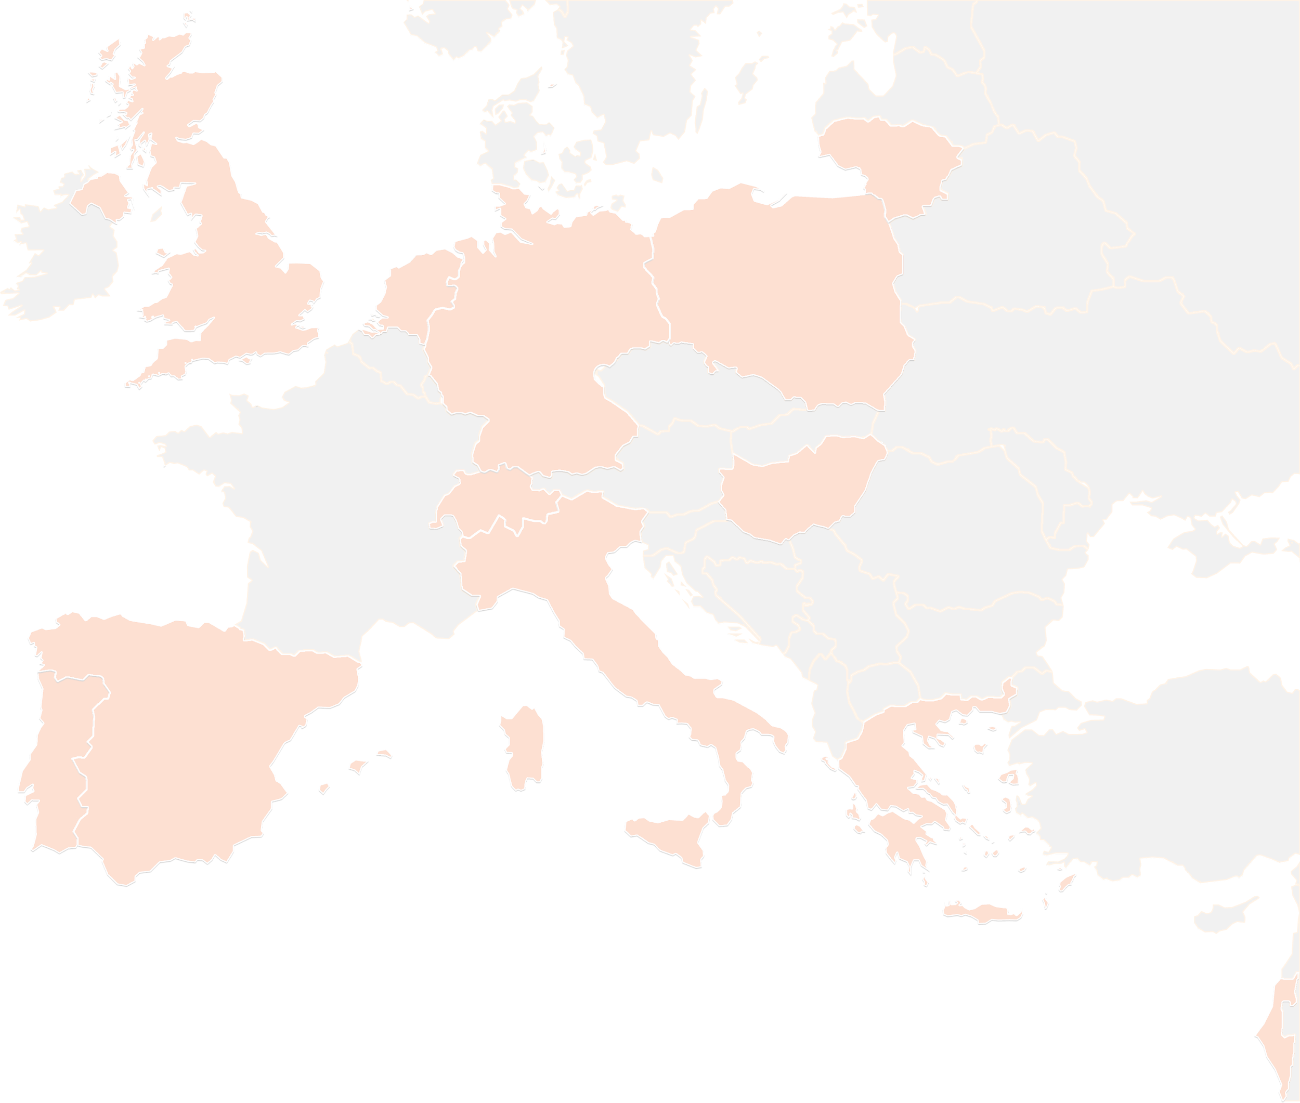
THANK YOU FOR YOUR ATTENTION!
contact@lists.up2university.eu
#up2universe

