Slide 1
Learning Community Management
WP5 Activity Update
Up2U General Assembly 11-09-2019

Slide 2
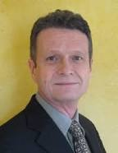
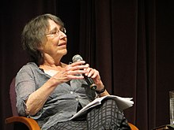
Learning Community Management
WP5 2019-2020
The Learning Community Concept, a basic definition
  Etienne Wenger and Jean Lave, a Computer Scientist (University of California, Irvine ) and a Social Anthropologist (University of California, Berkeley. ), in the early ‘90s proposed to go beyond the Piagetian constructivism based on the Individual as a basic unit of cognitive development
  According to Wenger and Lave, and to their situated cognition theory, knowledge building happens in a given social context
  Thus the researchers began to focus on analysing the "communities of practice", another concept on which they made deep analysis, since then attributed to them
Notes:
From Github issue tracker

Slide 3
Learning Community Management
WP5 2019-2020
According to Etienne Wenger,
"Communities of practice are groups of people who share a concern or a passion for something they do and learn how to do it better as they interact regularly." [from Wikipedia]
Wenger earned a Ph.D. in artificial intelligence, and worked with the Institute for Research on Learning applying his concept of communities of practice to education.
He was a pioneer of the now common research practice connecting learning to the technological and social aspects of communities.
Notes:
From Github issue tracker

Slide 4
Learning Community Management
WP5 2019-2020
Currently, Wenger is working on "Learning for a Small Planet." This research is focused on how students learn in the 21st century, and how the integration of technology is affecting education.
It is also emphasizing the various domains of learning: "education, business, and civic" and how it is not each one separately, but rather the synthesis of them that enables effective learning. [from Wikipedia]
Notes:
From Github issue tracker

Slide 5
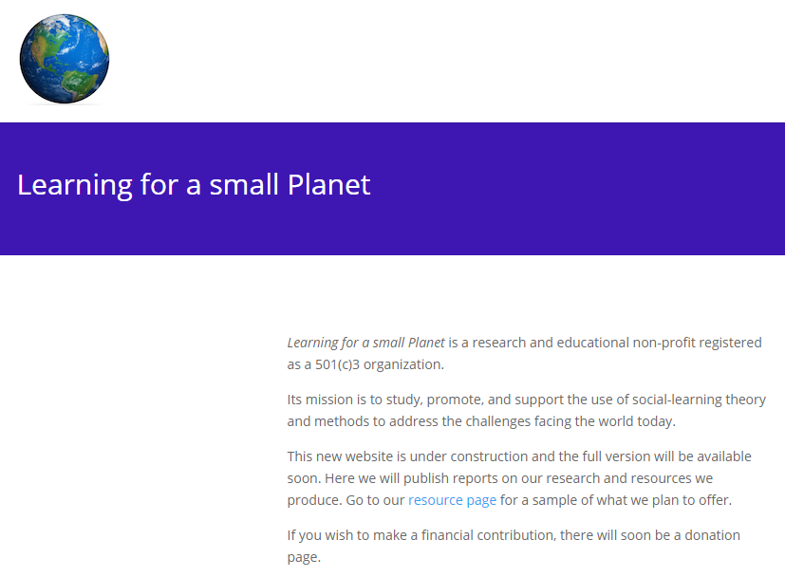
Learning Community Management
WP5 2019-2020
Currently, Wenger is working on "Learning for a Small Planet." This research is focused on how students learn in the 21st century, and how the integration of technology is affecting education.
It is also emphasizing the various domains of learning: "education, business, and civic" and how it is not each one separately, but rather the synthesis of them that enables effective learning.
[from Wikipedia]
Notes:
From Github issue tracker

Slide 6
Learning Community Management
WP5 2019-2020
Wenger’s selected publications
Wenger, Etienne (1987). Artificial Intelligence and Tutoring Systems: Computational and Cognitive Approaches to the Communication of Knowledge. Morgan Kaufmann Press. ISBN 978-0-934-61326-2.
Lave, Jean; Wenger, Etienne (1991). Situated Learning: Legitimate Peripheral Participation. Cambridge: Cambridge University Press. ISBN 0-521-42374-0.
Wenger, Etienne (1998). Communities of Practice: Learning, Meaning, and Identity. Cambridge: Cambridge University Press. ISBN 978-0-521-66363-2.
Wenger, Etienne; McDermott, Richard; Snyder, William M. (2002). Cultivating Communities of Practice (Hardcover). Harvard Business Press; 1 edition. ISBN 978-1-57851-330-7.
Wenger, Etienne (2009). Digital Habitats. Portland: CPsquare. ISBN 978-0-521-66363-2. [from Wikipedia]
Notes:
From Github issue tracker

Slide 7
Pilots, international communities status and LCM [1]
WP5 Pedagogical coordination in Up2U foreseen
  A substantial start-up of a [Multilingual] Learning Communities Management with basically the following objectives:
    Implementing the possible review of all Pilots from Pilot Coordinators January 2019-July 2019
    Supporting a “Trouble and success” collection
    Supporting exchanging best practices
    Establishing gradually a common Assessment Method to be implemented

Slide 8
Pilots, international communities status and LCM [2]
WP5 Pedagogical Team is working to set-up a framework of tools and methods to nurture an interactive and alive communication amongst different communities in the Up2U ecosystem:
  A gradually common mean of defining and reporting level of Competence Acquisition to be used by learners and teachers, Moodle Competences Framework (MCF)
  Up2U LEC Learning Experience Center: a Learning Locker instance, a central repository of xAPI statements to trace individual and groups learning behavior and achievements
  A set of harmonized courses in multiple languages (formal /informal) that make use of MCF and LEC and that support experiences exchange at the International Level
  Guidelines, Tutorial and Sample Courses to show how to use these facilities for deans and principals, teachers and for learners
  Basic features and a model design to implement an integrated social channel for the learning community

Slide 9
Pilots, international communities status and LCM [3]
To support and lead a piloting development towards LCM and the rise of a Life Learning Community in the Up2U ecosystem, WP5 Pedagogical coordination in Up2U plans to design some piloting example of informal learning events:
  Cultural Heritage Digital Storytelling: together with the DTC Lazio, the Innovation District of Regione Lazio, we are designing an informal course example of social construction of stories for the reception of tourists and visitors to be used through a mobile application of Audio Augmented Reality (Loquis); (to be adopted beside Schools of Tourism and other schools in Spring 2020)
  A Community of practice around Music Education as an informal practice, hosted by willing schools in Italy (to be adopted beside Music schools and other schools)
  A Master course in Georeferencing and Walk Path Mapping through the use of OpenStreetMap (to be adopted beside Schools of Tourism and other Schools)
  Critical Thinking and Language Analysis for a better Social Media usage and towards the foundation of a participatory science platform

Slide 10
Pilots, international communities status and Learning Communities Management
Finalise documentation of the Rome Meeting
  Proceedings with WP4-WP5 interaction to implement what is need to enhance Learning Analytics collection
Implement the actions planned in the Rome Agenda
Transfer to each Pilot Coordination team the results of the new agreements
  Implement Learning scenario (CFM in Moodle, and other)

Slide 11
Planned activity after GA in Poznan [1]
Program and design new Pilots and new CPD for informal Learning
  In Italy: we are implementing a 4 subjects agreement with 4 bodies to reach teachers and schools with informal educational contents
    DTC Lazio, Sapyent, Georadio (Loquis), Ammappalitalia
  In Greece:
  In Lithuania:
  In Germany
  In Portugal
  In Spain
  In Switzerland
  In Poland
  In Hungary

Slide 12
Planned activity after GA in Poznan [2]
Designing and programming next Pilots
  Pilots regarding 4 Subjects areas with an offer of Informal Courses
    Critical Thinking Education
    Civic rights and Social Responsibility Education
    Metacognition: Computational Thinking through Music Education,
    Metacognition: Computational Thinking through Language Analysis in the Secondary Schools (Natural Language Analysis and Social Media Mastering)
  Pilot Courses: offer of formal courses on these subjects in schools:
    Introduction to Up2U toolbox (all the pilot countries)
    Artificial Intelligence and Robotics (Intel, PL)
    Introduction to programming (PO)
    Writing a Scientific Essays (IT, IS)
    (check the full list provided by WP7-WP5)
    …..

Slide 13
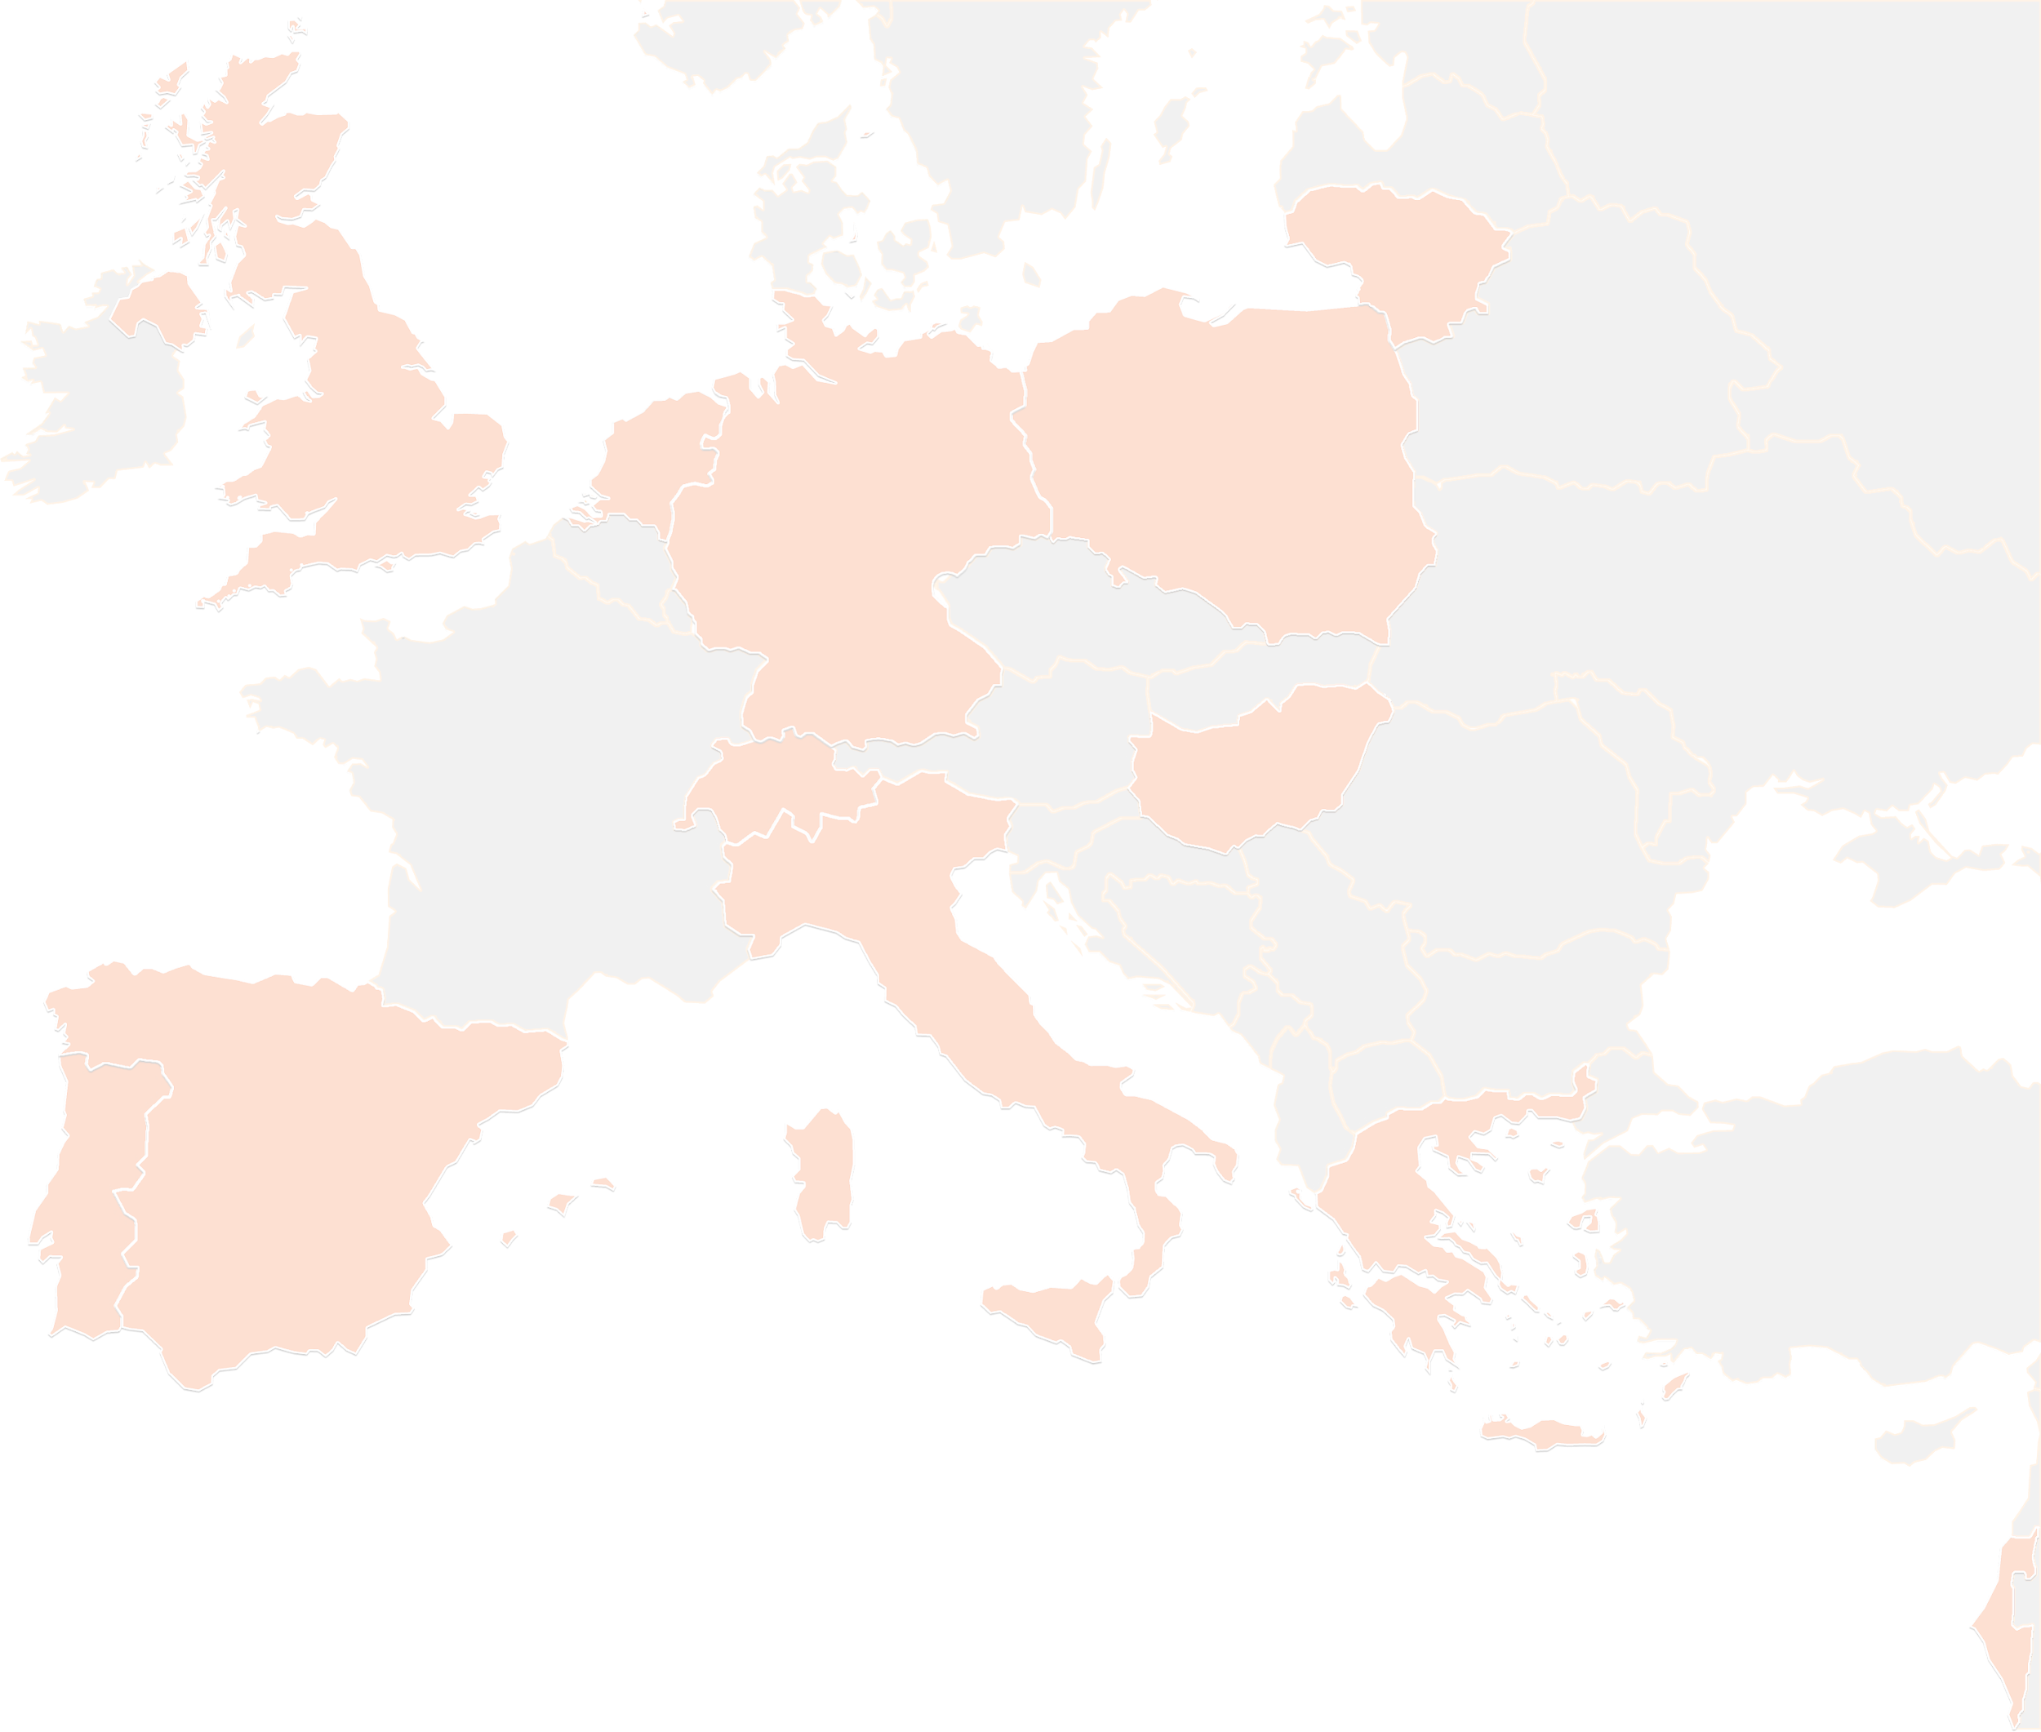
THANK YOU FOR YOUR ATTENTION!
wp5@lists.up2university.eu
#up2universe

