Slide 1
Introduction & project management overview
Erik Kikkenborg
NORDUnet
5th Up2U General Assembly, Poznan, Poland

Slide 2
Agenda
Wednesday 11 September | Topic | Presenter
09:00 - 10:00 10:00 - 10:30 | Project management overview & GDPR update Q&A | Erik Kikkenborg, Casper Dreef
10:30 - 11:00 | Coffee break
11:00 - 12:00 | Introduction new workplan per workpackages | WP leaders
12:00 - 13:00 | Lunch + group photo
13:00 - 14:00 | Task Force outcomes | TF leaders
14:00 - 14:30 | Stabilized SSO and other technical constraints discussion | Mary Grammatikou
14:30 - 15:40 | Pilots | Michal Zimniewicz
15:40 - 16:10 | Coffee Break
16:10 - 16:40 16:40 - 17:10 | Pilots part 2 Q&A session | Michal Zimniewicz
17:10 - 18:30 | WP8 - Sustainability and exploitation | Faraz Fatemi Moghaddam
 | Future School Lab visit & dinner

Slide 3
Agenda
Thursday 12 September | Topic | Presenter
08:30 - 09:00 | Welcome & coffee | Erik Kikkenborg
09:00 - 10:30 | Pedagogy roadmap - presentations | Stefano Lariccia
10:30 - 11:00 | Coffee break
11:00 - 12:00 | Pedagogy roadmap - discussions | Stefano Lariccia
12:00 - 13:00 | Lunch
13:00 - 14:10 | Break out sessions round 1 | Mary Grammatikou
14:10 - 14:30 | Coffee break
14:30 - 15:00 | Break out sessions round 2 | Mary Grammatikou
15:00 - 16:10 | Working on summarizing outcomes | Mary Grammatikou
16:10 - 16:40 | Present outcomes by WP5 | Mary Grammatikou
16:40 - 17:00 | Future plans and wrap up | Erik Kikkenborg

Slide 4
Workplan
Details provided by WP leaders
New deadlines:
Apr 19 | May 19 | Jun 19 | Jul 19 | Aug 19 | Sep 19 | Oct 19 | Nov 19 | Dec 19 | Jan 20 | Feb 20 | Mar 20 | Apr 20 | May 20
M28 | M29 | M30 | M31 | M32 | M33 | M34 | M35 | M36 | M37 | M38 | M39 | M40 | M41
Q10 |  |  | Q11 |  |  | Q12 |  |  | Q13 |  |  | Q14
 | M19 |  | M20 |  |  |  |  | M23 |  |  |  | M22
 |  |  | M21 |  |  |  | M24 | M26 |  |  |  | M25
 |  | D5.4 |  |  |  | D3.5 |  |  |  |  | D8.4 |  | D1.2
 |  |  |  |  |  |  |  |  |  |  |  | D5.5 | D2.3
 |  |  |  |  |  |  |  |  |  |  | D4.3
 |  |  |  |  |  |  |  |  |  |  | D6.3
 |  |  |  |  |  |  |  |  |  |  |  |  | D7.4

Slide 5
Workplan - Feedback from the reviewers
Explanation for the five months requested extension of the project Up2U (January – May 2020)
Evaluate the impact of the Up2U learning platform on current high school students who will start university in September 2019.
Complete and evaluate two iterations of pilot implementation.
Reach more new pilot schools

Slide 6
Workplan - Feedback from the reviewers
Extension welcomed and supported
  Will help to achieve the project’s goals
New KPIs
  1000 schools (originally 1500)
  New ways of reaching KPIs by:
    NREN community
    Webinars / open online courses for students, teachers and schools
    Local governments and ministries of education
    Extend scope: Asia, South-America and other regions
    Soft CPD

Slide 7
Workplan - Feedback from the reviewers
Evaluation of the pilots
  More time for and concrete plans for in-dept and qualitative evaluation of the impact
  Quantitative results
  Qualitative results
Business models
  Reduction of number of BMs
  Defined plans for sustainability
Risk assessment
  Addressed the main problems

Slide 8
Workplan - Feedback from the reviewers
Problematic:
Learning analytics support for evaluation
Clear strategy to engage more schools
Interaction with international learning communities
Notes:
LA will be discussed during the Break out sessions tomorrow

Slide 9
Workplan
Financial implications:
  Same budget
  Spread over 5 extra months
  Numbers as of Q9 (March 2019)
Notes:
Total budget will remain the same, but some budget shifts might be needed.

Slide 10
Partner | Original PM | Changes | New Totals
01: GÉANT | 27 | -6 | 21
02: OU | 50 | 0 | 50
03: UROMA | 44 | 0 | 44
04: GARR | 51 | 0 | 51
05: NTUA | 38 | 5 | 43
06: GRNET | 58 | 1 | 59
07: UVIGO | 28 | 0 | 28
08: TELTEK | 25 | 0 | 25
09: ISEP | 27 | 7 | 34
10: FCT | 18 | -3 | 15
11: TAU | 23 | -1 | 22
12: IUCC | 24 | 0 | 24
13: KTU | 58 | 0 | 58
14: KIFÜ | 57 | 5 | 62
15: PSNC | 54 | 7 | 61
16: ownCloud | 8 | 0 | 8
17: GWDG | 47 | -3.5 | 43.5
18: CERN | 36 | 0 | 36
19: NORDUnet | 0 | 2.5 | 2.5
TOTAL | 674 | 14 | 688
Notes:
New PM according to the workplan
These are included in the amendment

Slide 11
Partner | New Totals | Q9 | Variance
01: GÉANT | 21 | 27.35 | -6.35
02: OU | 50 | 39.99 | 10.01
03: UROMA | 44 | 40.91 | 3.09
04: GARR | 51 | 58.39 | -7.39
05: NTUA | 43 | 35.59 | 7.41
06: GRNET | 59 | 51.28 | 7.72
07: UVIGO | 28 | 32.15 | -4.15
08: TELTEK | 25 | 58.81 | -33.81
09: ISEP | 34 | 36.64 | -2.64
10: FCT | 15 | 13.43 | 1.57
11: TAU | 23 | 0.01 | 22.99
12: IUCC | 24 | 18.77 | 5.23
13: KTU | 58 | 51.94 | 6.06
14: KIFÜ | 62 | 68.21 | -6.21
15: PSNC | 61 | 55.35 | 5.65
16: ownCloud | 8 | 14.79 | -6.79
17: GWDG | 43.5 | 30.84 | 12.66
18: CERN | 36 | 29.71 | 6.29
Notes:
Second column: New totals according the workplan
The third colomn are the actual PM spent up to Q9.
NOTE: some partners are already over their allocated PMs
But: <next slide>

Slide 12
Partner | Total Direct Costs | Q9 | Variance
01: GÉANT | 249,499.80 | 178,619.58 | 70,880.22
02: OU | 375,200.28 | 166,827.81 | 208,372.47
03: UROMA | 286,999.92 | 188,267.51 | 98,732.41
04: GARR | 277,999.92 | 266,618.75 | 11,381.17
05: NTUA | 207,400.68 | 142,027.91 | 65,372.77
06: GRNET | 371,559.24 | 238,780.95 | 132,778.29
07: UVIGO | 130,400.28 | 143,964.24 | -13,563.96
08: TELTEK | 150,999.84 | 142,307.53 | 8,692.31
09: ISEP | 217,299.96 | 134,395.88 | 82,904.08
10: FCT | 117,799.92 | 31,318.35 | 86,481.57
11: TAU | 156,400.20 | 76,584.19 | 79,816.01
12: IUCC | 180,400.32 | 129,420.77 | 50,979.55
13: KTU | 143,600.76 | 110,458.86 | 33,141.90
14: KIFÜ | 268,900.20 | 148,849.62 | 120,050.58
15: PSNC | 329,800.32 | 267,511.17 | 62,289.15
16: ownCloud | 79,499.88 | 63,499.60 | 16,000.28
17: GWDG | 293,299.56 | 179,329.11 | 113,970.45
18: CERN | 299,640.24 | 246,163.87 | 53,476.37
Notes:
This is not a problem as long as the partners stay within their budget.
This slide shows Total budget that is left until the end of the project (M41)
Q9 column shows budget spent by partners in the reporting period up until Q9
Flagged with green are the partners that have over E100.000 left until the end of the project.
Flagged with orange are the partners that have less than E40.000 left until the end of the project.
Flagged with red are the partners are already overspending.
Partners will be contacted directly to discuss their budgets.

Slide 13
GDPR update
Casper Dreef
GÉANT
5th Up2U General Assembly, Poznan, Poland

Slide 14
Work done
Privacy notice
Consent collection for minors
  KWS
    Implementation planning
  Difficulties:
    New iterations from Sept / Oct
    Seamless implementation

Slide 15
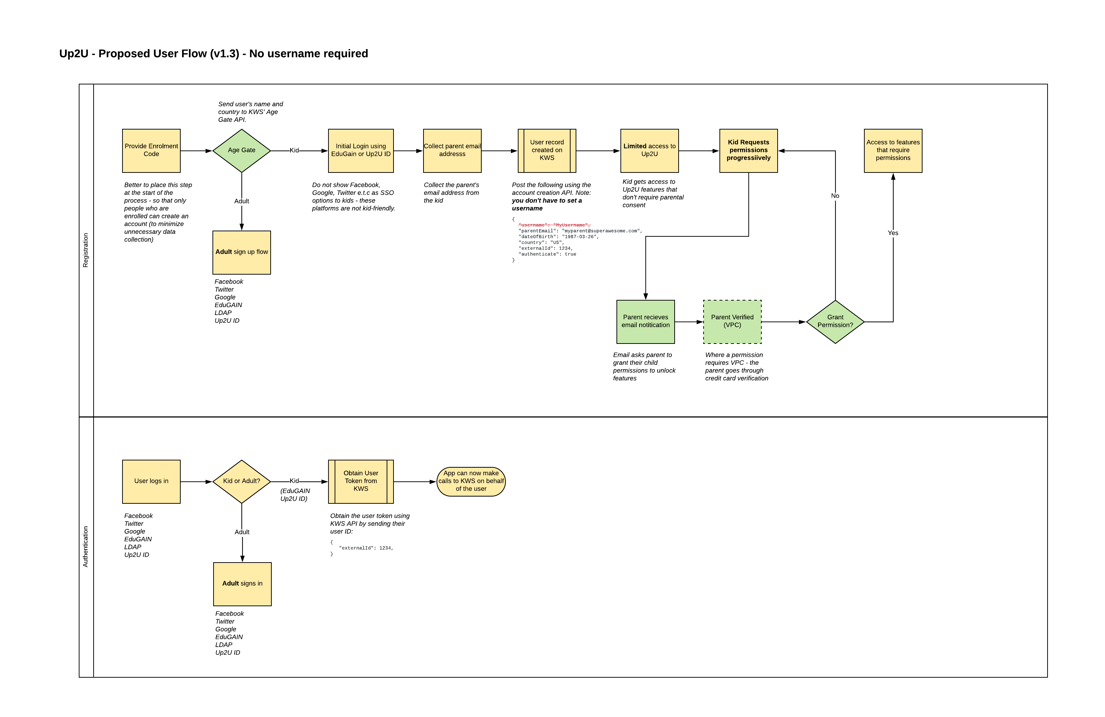
KWS integration (proposal 1)

Slide 16
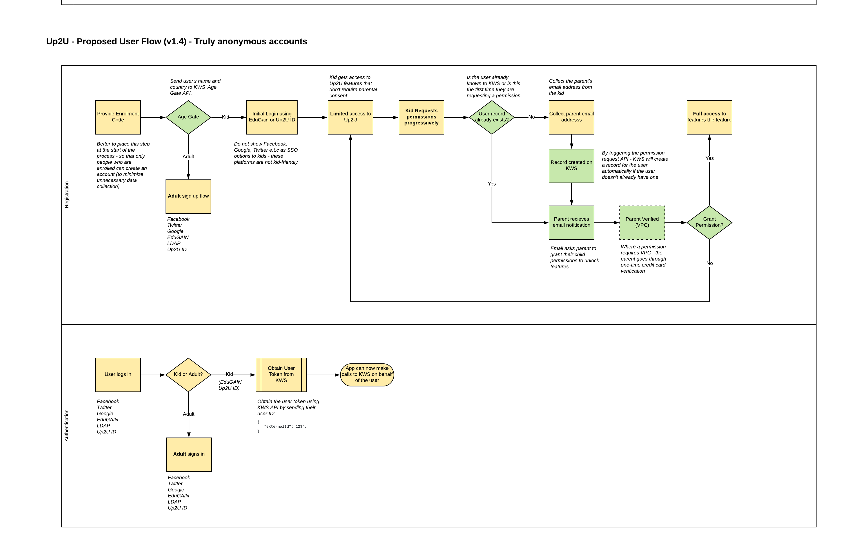
KWS integration (proposal 2)

Slide 17
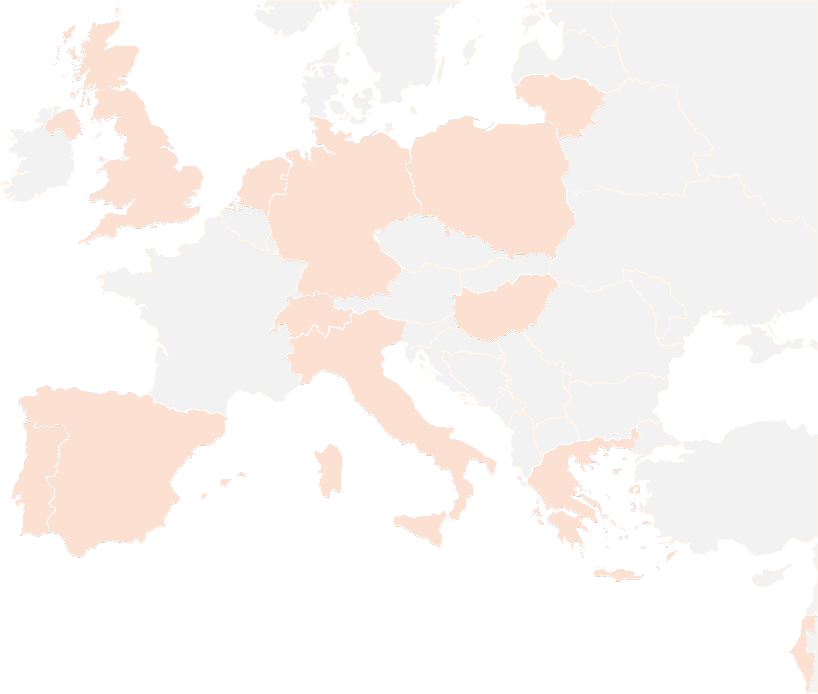
THANK YOU FOR YOUR ATTENTION!
contact@lists.up2university.eu
#up2universe

