Slide 1
WP2 workplan
Barbara Tóth
KIFÜ
5th Up2U General Assembly, Poznan, Poland

Slide 2
WP2 objectives
Project communications
  Includes coordinating dissemination activiy, social media, web presence (content), keeping project documentation up to date.
Web presence and design
  Project website and motion graphics video
Events and training
  Creating webinars, local trainings
  Participating in national and international conferences

Slide 3
Work done after March review
Website revamp
    Still ongoing, focusing on better UX
    Please contribute:
    UP2U Website - Short Usability Test
    UP2U Website - Bug Report
IT security flyer
    Production and publication on the website
    Multiple languages: ITA, GR (LIT, HUN)
Motion graphics video
INTED, SLERD, Scuola Democratica, TNC, EDULEARN

Slide 4
Timeline
Months September- December 2019
  Focusing on engaging more schools
Months January-March 2019
  Focusing on collecting use cases
Months 2019 March-May
  Preparing the final deliverable (final report)

Slide 5
How do we achieve our goal?
Information is key! Keep WP2 in the loop!
  Articles for the website
  Posts for social media
  Pictures, gifs, info graphics
  Events
    Provide input!!!

Slide 6
How do we achieve our goal?
    Challenges
      University as a Hub
      Learning community
      Badges
      Moodle design
      What did we miss? Let us know!

Slide 7
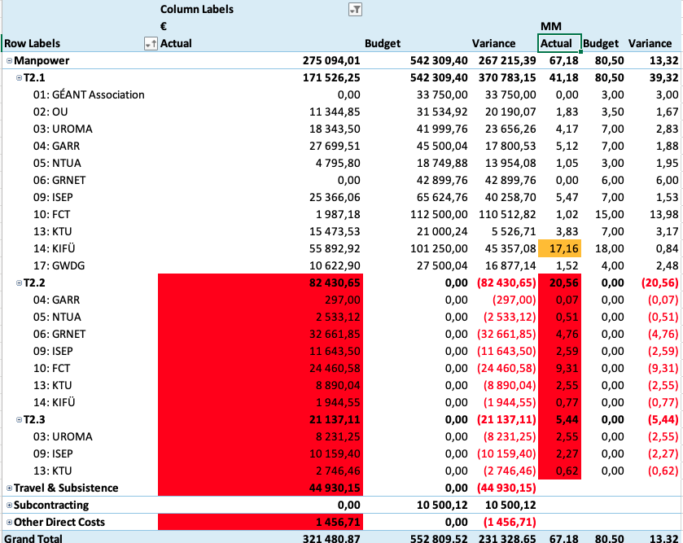
Efforts overview

Slide 8
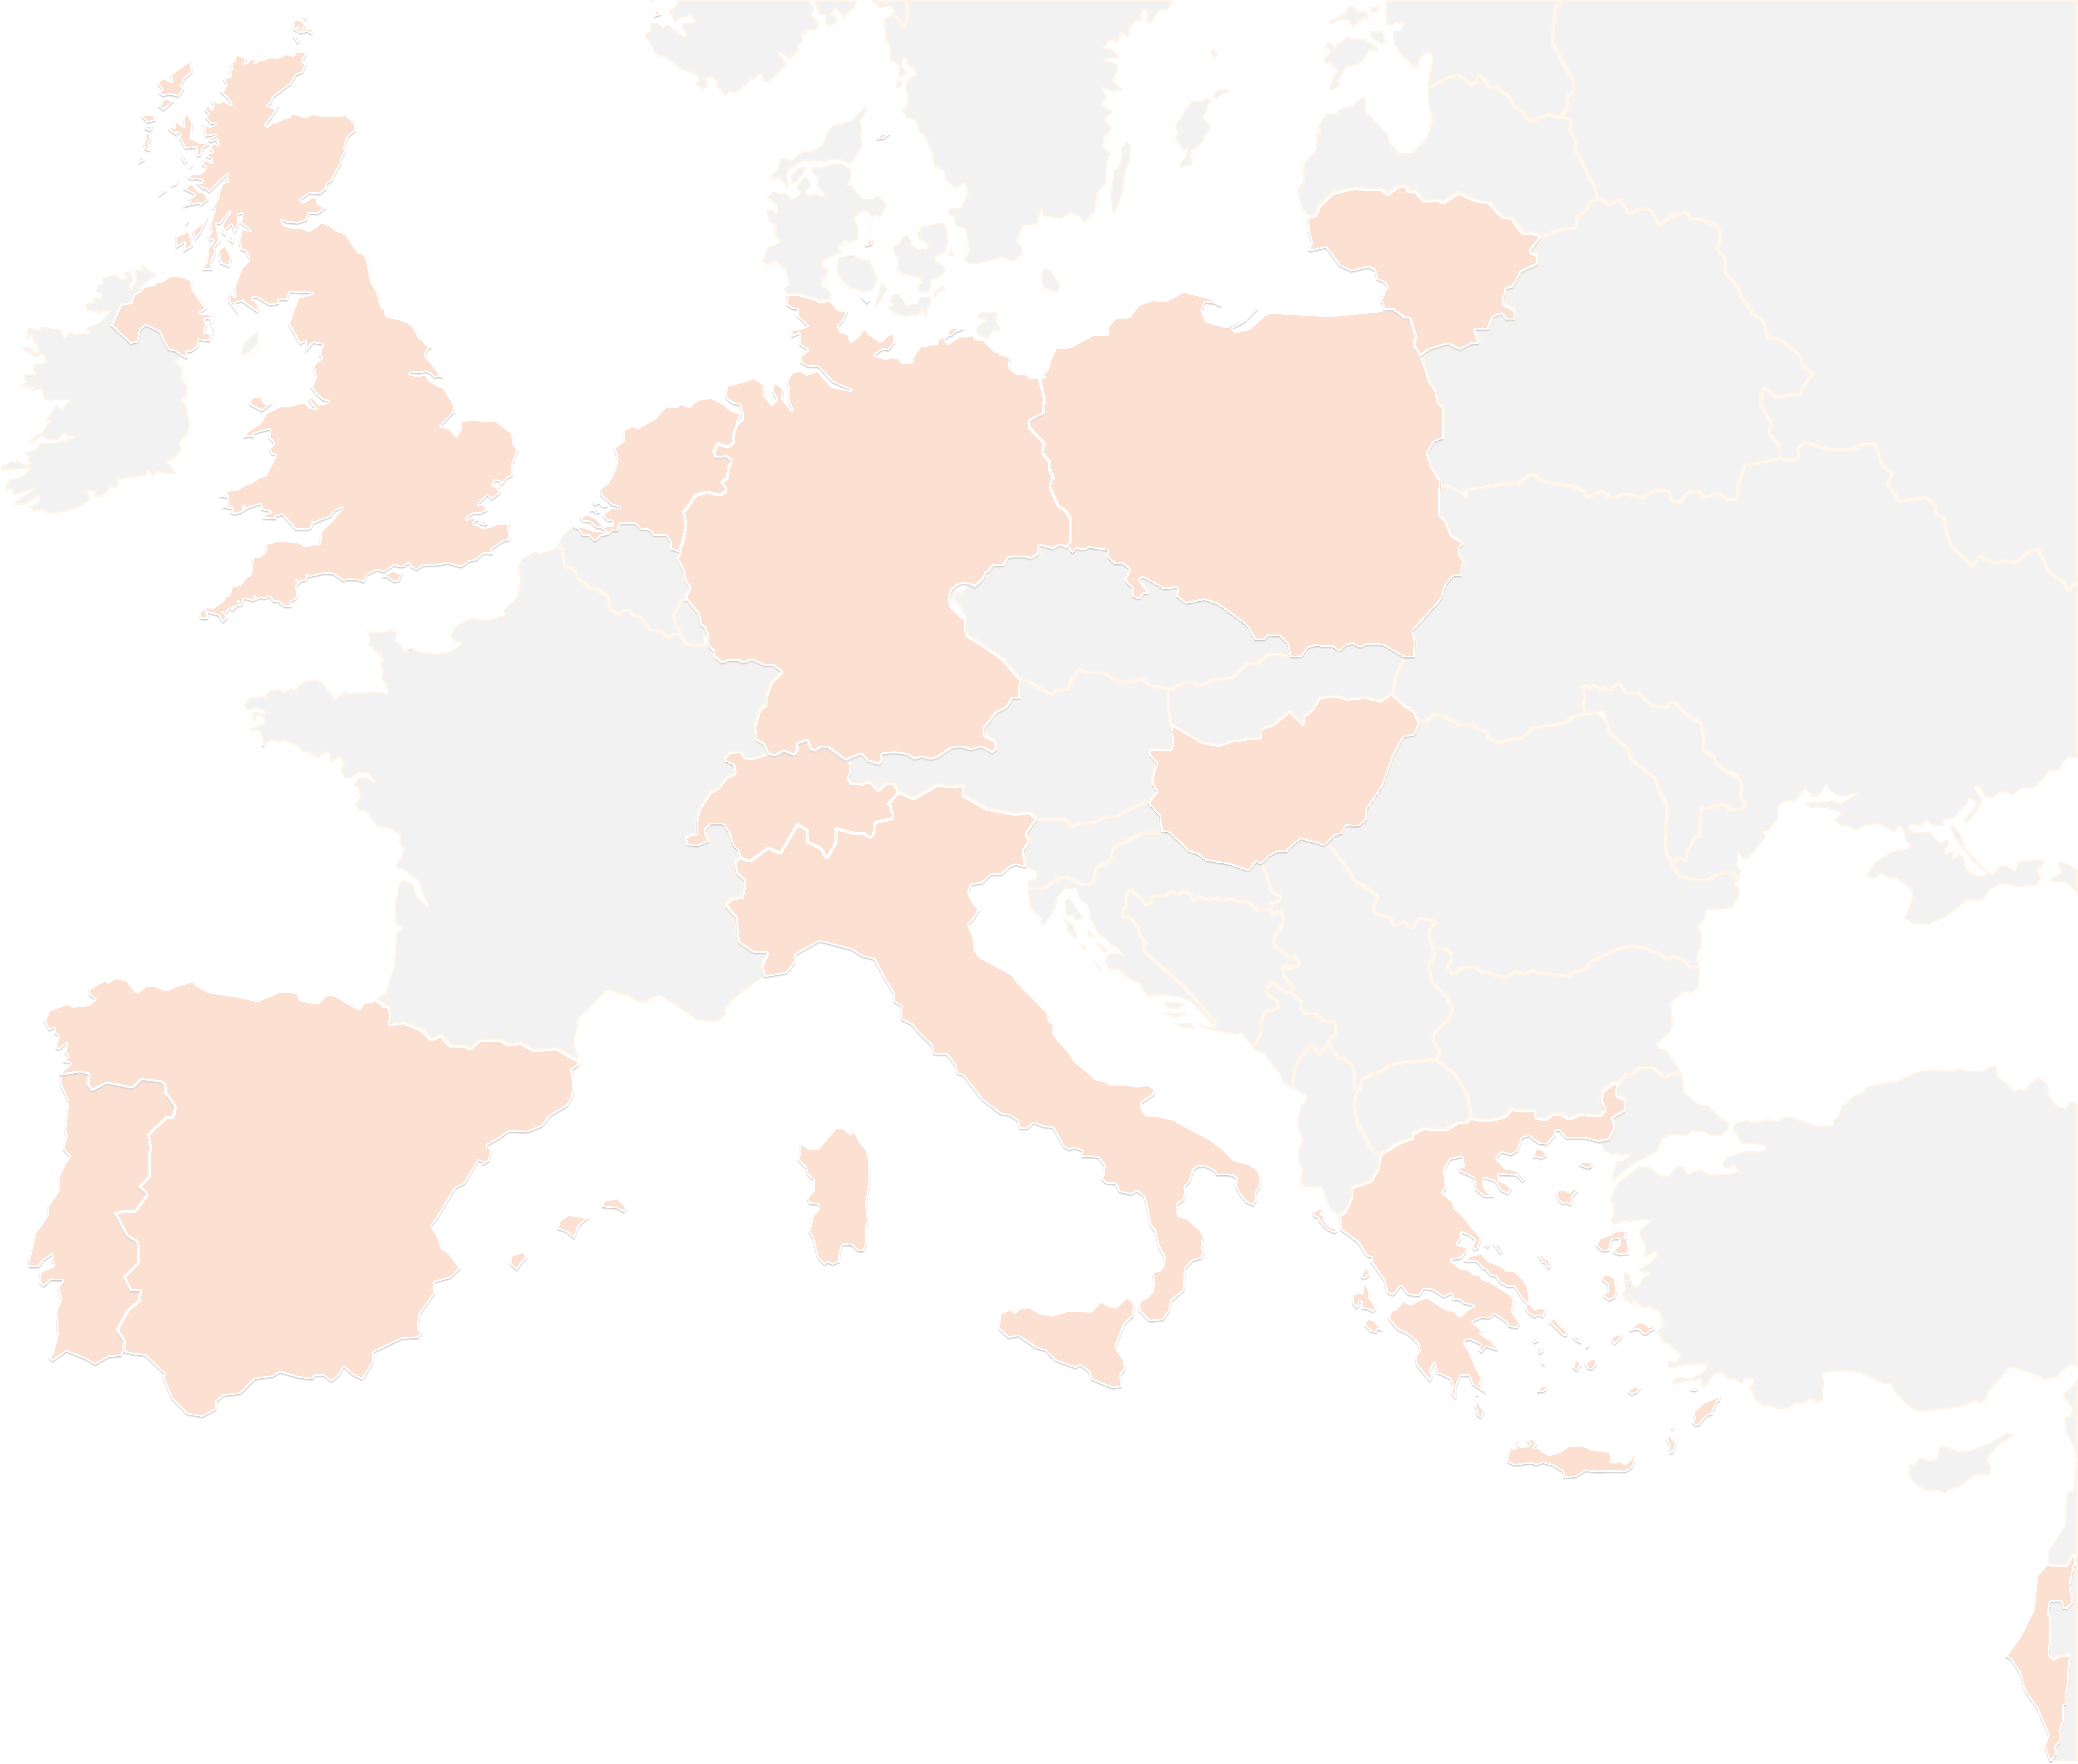
THANK YOU FOR YOUR ATTENTION!
contact@lists.up2university.eu
#up2universe

