Slide 1
WP3 workplan
Ilias Hatzakis
GRNET
5th Up2U General Assembly, Poznan, Poland

Slide 2
WP3 objectives
Objective A
  Address the networking needs through the appropriate network services from the GEANT service portfolio
Objective B
  Build a federated cloud storage and sharing infrastructure
Objective C
  Ensure an open learning content platform integration to the project

Slide 3
Work done after March review
  Finalization of the tests between NextCloud, Owncloud, CERNBox and PowerFolder/
  Integration of a large number of repositories (now 54 repositories – 24HE and 30 K12)
  Finalization of Deliverable 3.5

Slide 4
Timeline
Months 34-40
  Deployment of the new OCM protocol endpoints across the entire Up2U service infrastructure
Months 34-40
  Improvement of CERNBox and SWAN based on the feedback from pilots
Months 34-40
  Continuous enrichment of the open learning platform

Slide 5
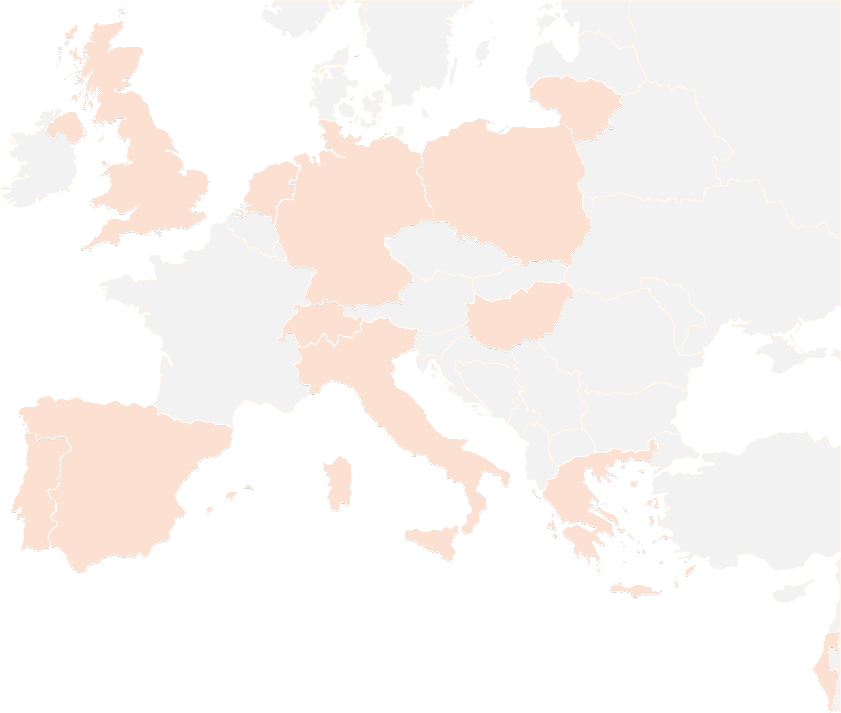
THANK YOU FOR YOUR ATTENTION!
contact@lists.up2university.eu
#up2universe

