Slide 1
WP4 workplan
Allan Third
OU
5th Up2U General Assembly, Poznan, Poland

Slide 2
WP4 objectives
Objective A
  Integrated Application Toolbox intermediating between cloud-based infrastructure and the Up2U tools
Objective B
  Support learning activity data collection for Learning Analytics
Objective C
  Integrate tools for formal and informal learning into workflows for dynamic creation and reuse of learning pathways

Slide 3
Work done after March review
  Milestone M3.4 Application toolbox developer specification
  Major Moodle upgrade (3.6.2)
  Moodle ‘capabilities’ support
  Integration of
    SCORM resources
    VPL plugin
    Multiparty Meeting
    Statistics module
  GDPR updates
  ”Editing student” role

Slide 4
Timeline
Months 34-40
  Implementation of new learning scenarios
  Expansion of learning analytics data collection
Months 34-40
  Document learning scenarios from WP5/pilots
Months 34-40
  Continuous enrichment of the integrated application toolbox

Slide 5
Key Performance Indicators
Completeness of application toolbox specifications: Year 1: 70%, Year 2: 90%, Year 3: 100%
‘Learning scenarios implemented in the platform and documented for reuse’: 80-85% of WP5/pilot-described scenarios
  Replaces both ‘number of (in)formal tools integrated’ KPIs

Slide 6
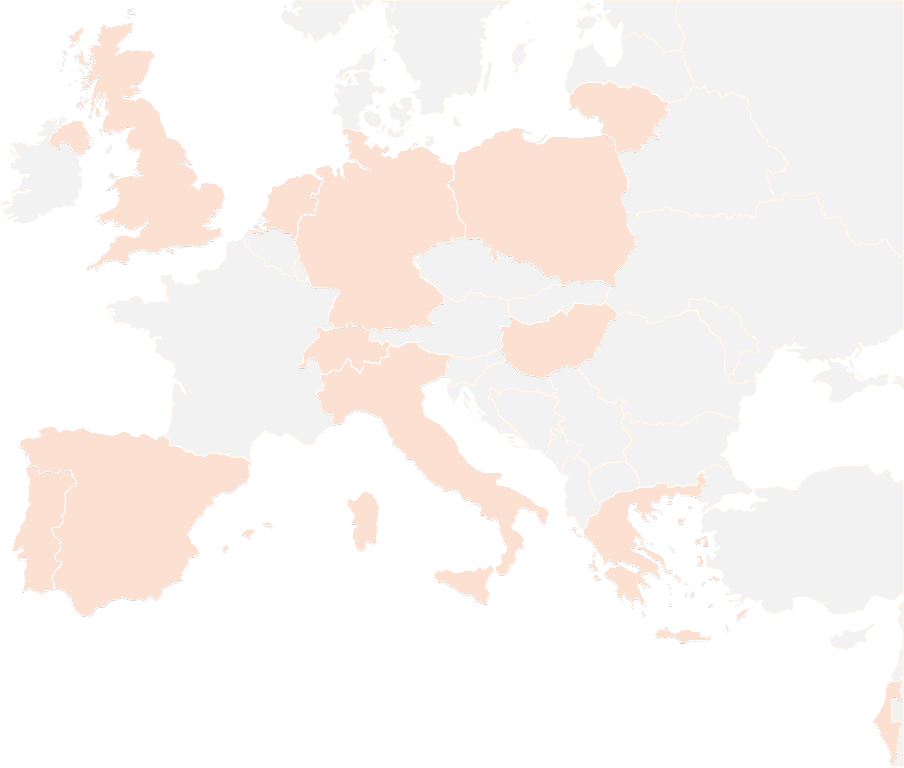
THANK YOU FOR YOUR ATTENTION!
contact@lists.up2university.eu
#up2universe

