Slide 1
WP5 Pedagogy Roadmap
Up2U Update

Slide 2
WP5 Pedagogy Roadmap [1]
How to align the pedagogy roadmap with the WPs?
Up2U Pedagogical Roadmap envisages these main milestones:
Implement a technological ecosystem ready for Secondary Education to bridge the gap between HighEd learning methods and secondary school methods and tools
Testing the Up2U ecosystem towards a simulated learning activity (communities of willing excellent teachers)
Testing the Up2U ecosystem and harmonizing it towards a Next Generation Digital Learning Environment
Notes:
From Github issue tracker

Slide 3
WP5 Pedagogy Roadmap [2]
How to align the pedagogy roadmap with the WPs?
Up2U Pedagogical Roadmap envisages these milestones: [cont]
Testing Up2U as a full featured NGDLE into CPD for teachers
Testing Up2U as a full featured NGDLE inside the classroom for teachers and learners (formal learning)
Testing Up2U as a full featured NGDLE besides the classroom for teachers and learners (informal learning integration into formal educational institutions)
Notes:
From Github issue tracker

Slide 4
WP5 Pedagogy Roadmap [3]
How to align the pedagogy roadmap with the WPs?
Up2U Pedagogical Roadmap envisages these milestones: [cont]
Providing Up2U NGDLE as an interactive playground where teachers and learners are supported in learning design, learning management and learning assessment
Providing Up2U NGDLE with Pilot activities and Course Samples to be used as models by teachers / learners
Providing Up2U NGDLE with all the needed documentation, guidelines, tutorials and remote guidance and assistance
Notes:
From Github issue tracker

Slide 5
WP5 Pedagogy Roadmap [4]
How to align the pedagogy roadmap with the WPs?
Up2U Pedagogical Roadmap envisages these milestones: [cont]
Collecting and Processing data produced as “Learning Experiences Statements” teachers and learners are supported in learning design and learning assessment
Analysing Learning Analytics data to provide a means to evaluate the relative effectiveness of tools, methodologies and learning design models in order to ensure a better, more active, assessable, learning experience
Notes:
From Github issue tracker

Slide 6
WP5 Pedagogy Roadmap [5]
How to align the pedagogy roadmap with the WPs?
Up2U Pedagogical Roadmap envisages these milestones: [cont]
Provide a sustainable framework for the Up2U infrastructure that will:
  Last 5 years with an increasing level of service
  Continue to evolve and grow providing possibly a common Competence Framework
  Keep on producing Learning Data to provide sensible feedback for both the owners of the system(s) and for the stakeholders (policy makers, deans and principals, teachers, learners)
Would pave the way for a worldwide dissemination of the service (thanks to Géant) and will produce a new product's / service's concept inspired by "widely spread cloud services" amongst the european education facilities providers (private and public)
Notes:
From Github issue tracker

Slide 7
WP5 Pedagogy Roadmap [7]
How to align the pedagogy roadmap with the WPs?
What are the main open issues and risks
Reaching a critical mass
  Reaching a critical mass in contents
  Reaching a critical mass in community users
  Reaching a critical mass of researchers interested in Learning Data Analysis
Resist for a minimum lapse of time
Nurturing and Managing a really interactive and international community of communities
Notes:
From Github issue tracker

Slide 8
WP5 Pedagogy Roadmap [8]
How to align the pedagogy roadmap with the WPs?
What are the main open issues and risks
Overcoming the multilingualism issue
  Lasts 5 years with an increasing level of service
  Continues to evolve and grow providing possibly a common Competence Framework
  Keep on producing Learning Data to provide sensible feedback for both the owners of the system(s) and for the stakeholders (policy makers, deans and principals, teachers, learners)
Resist and override the complexity of the educational systems structures
Find a way to be sustainable and maintain autonomous governance
Notes:
From Github issue tracker

Slide 9
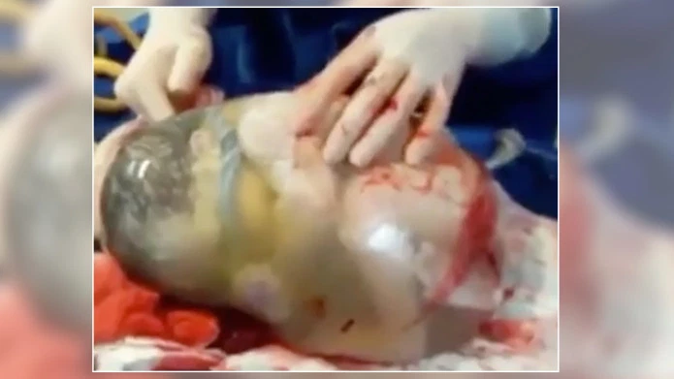
Planned activity in the next 9 months
Hey,
9 months are not so insignificant slot of time!

Slide 10
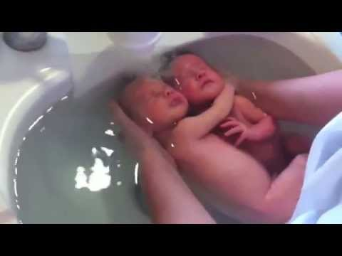
Planned activity in the next 9 months
Hey,
9 months are not so insignificant slot of time!

Slide 11

Planned activity in the next 9 months
Finally the baby’s got her feet!

Slide 12
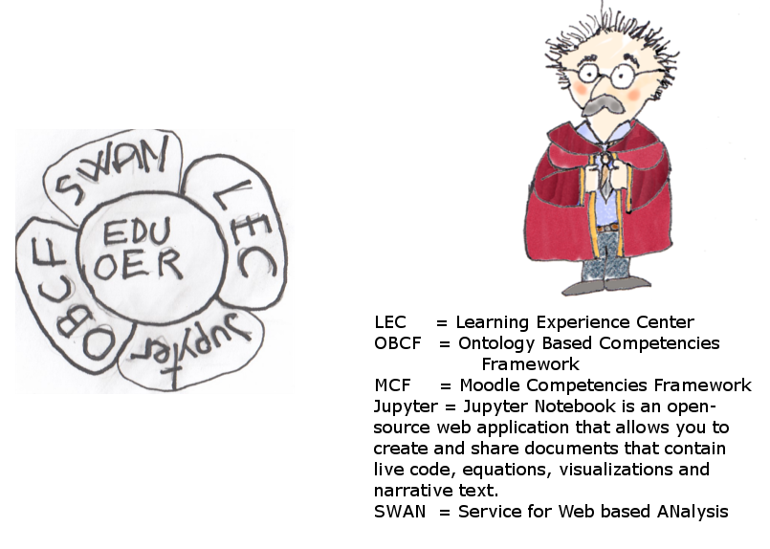
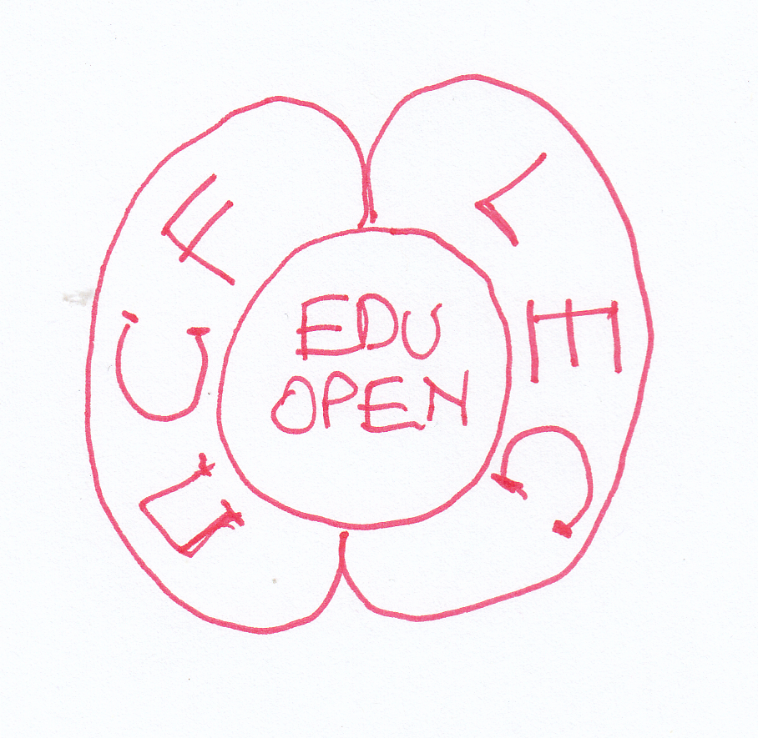
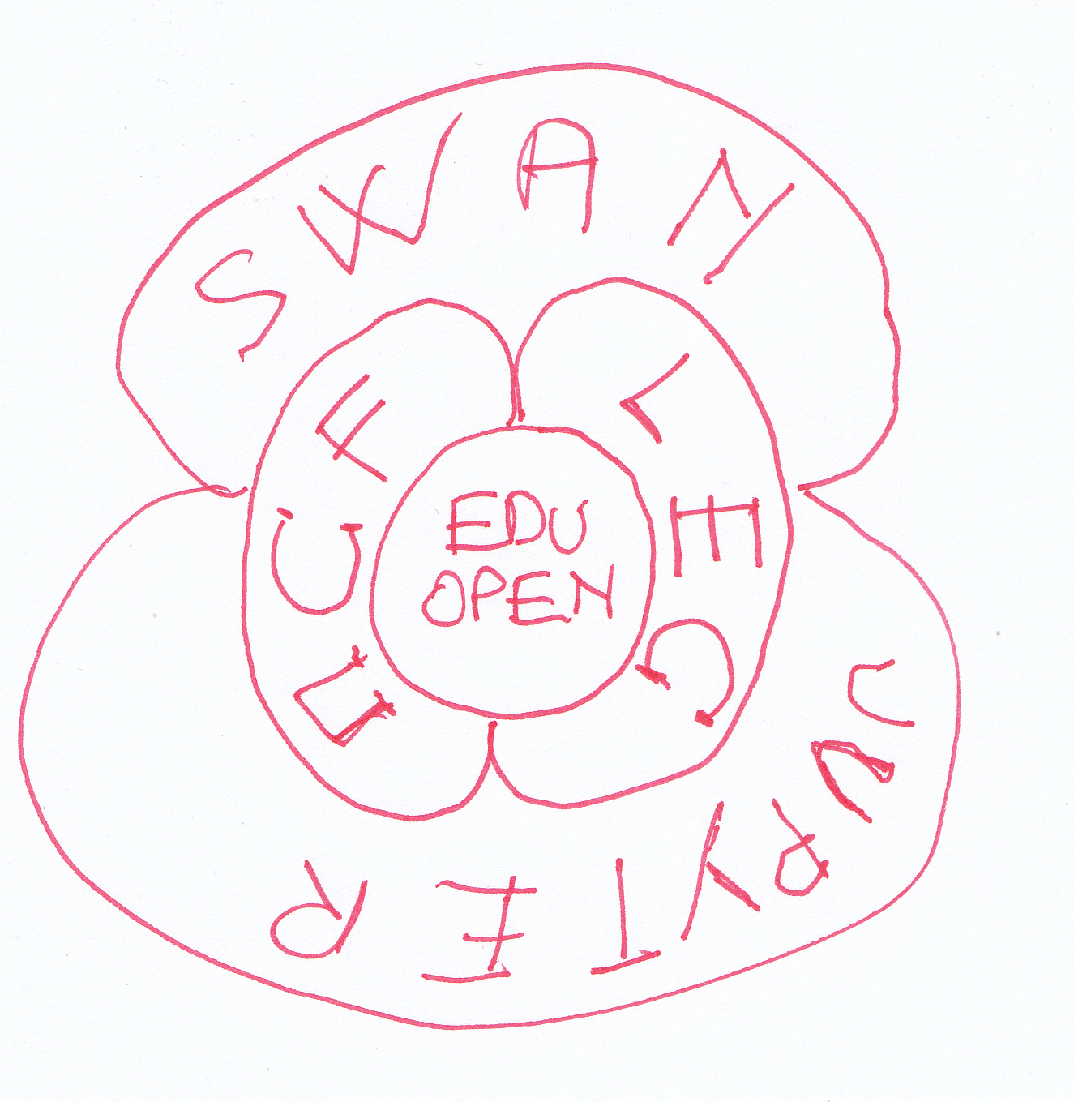
Functional sketch of the Up2U ecosystem
(pedagogical functionality view)
Full view of the core of the system: Present and Future
Today we are building a Central Competencies Tools in Moodle: MCF = Moodle Competencies Framework;
in a mid term future (a next project!) we should extract MCF into an INTEROPERATIVE Ontology Based Competencies Framework where the experiences made within Up2U will be transferred
Present Core Functionalities

Slide 13
Functional sketch of the Up2U ecosystem
(pedagogical functionality view)
Full view of the core of the system: Present and Future
Today we are building a Central Competencies Tools in Moodle: MCF = Moodle Competencies Framework;
in a mid term future (a next project!) we should extract MCF into an INTEROPERATIVE Ontology Based Competencies Framework where the experiences made within Up2U will be transferred
Future Core Functionalities

Slide 14
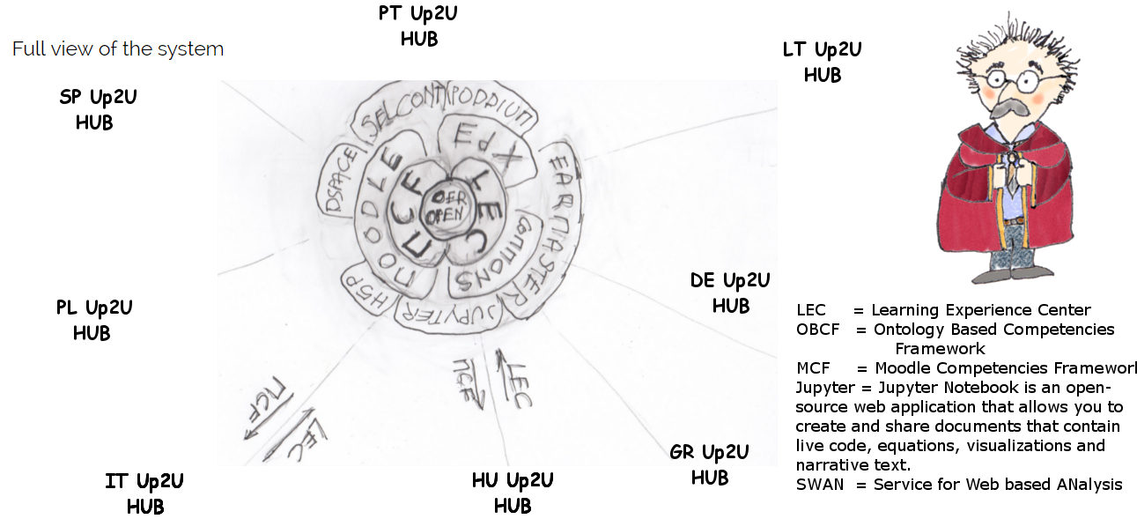
Functional sketch of the Up2U ecosystem
(pedagogical functionality view)
Full view of the system

Slide 15
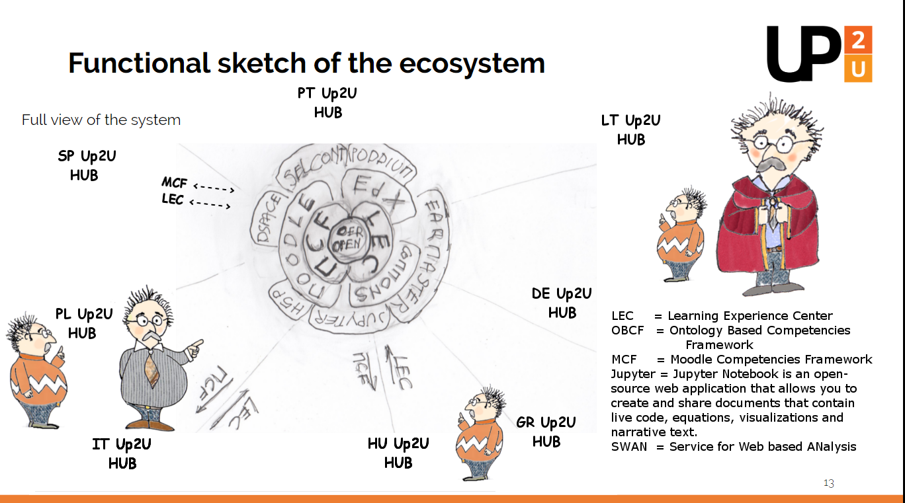
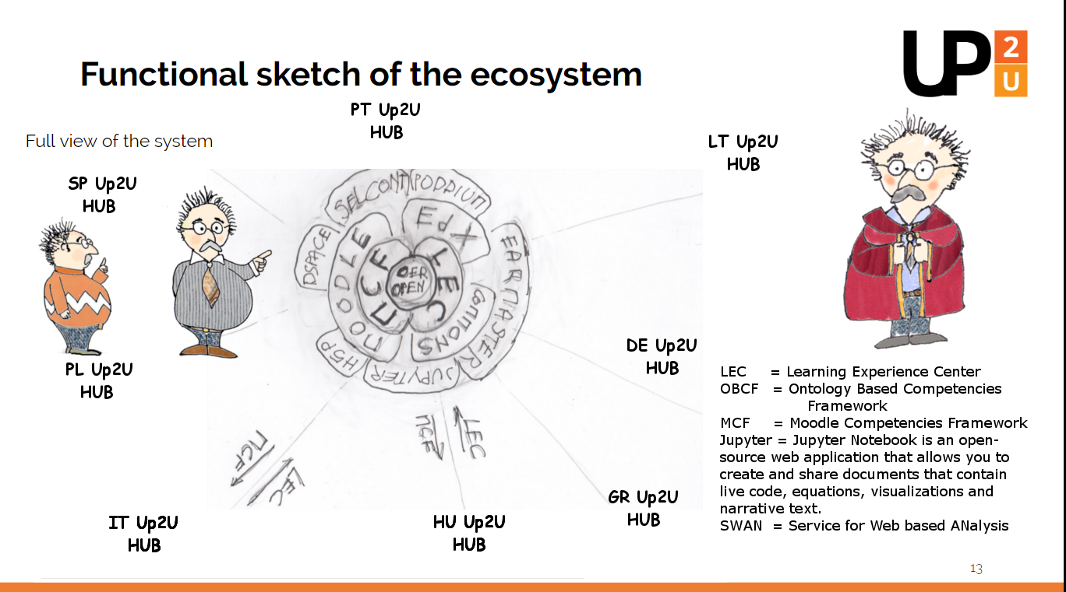
Functional sketch of the Up2U ecosystem
(pedagogical functionality view)
Full view of the system

Slide 16
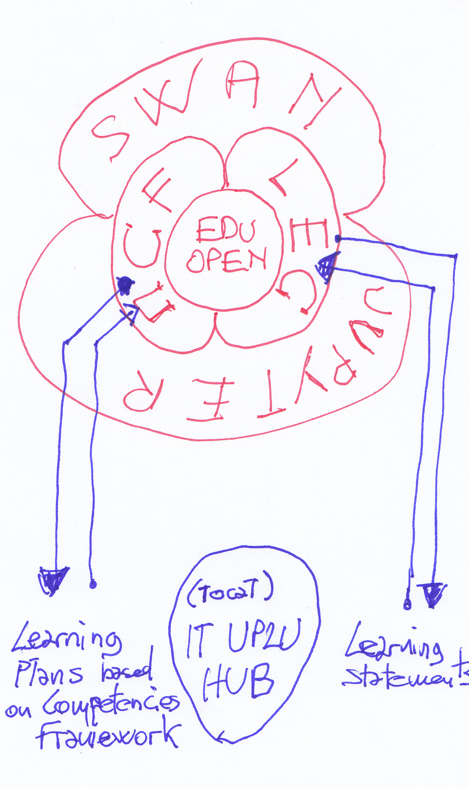
Functional sketch of the Up2U ecosystem
(pedagogical functionality view)
Focus on the role of the peripheral HUB
Learning Experience Center: Learning Analytics xAPI Centre, or, “Learning Experiences Central Repository” where all statements are collected and processed to be analysed by a central pedagogical centre and/or by peripheral pedagogical teams
MCF (later in a future development OBCF) : a Competencies Framework where Learning experiences are distilled by analysts and processed to build a central laboratory of Prescriptive Competencies Directions ; today, in Up2U, we are going to use pre-built Competencies Schemata derived from other teams and other projects experiences.(see details later)

Slide 17
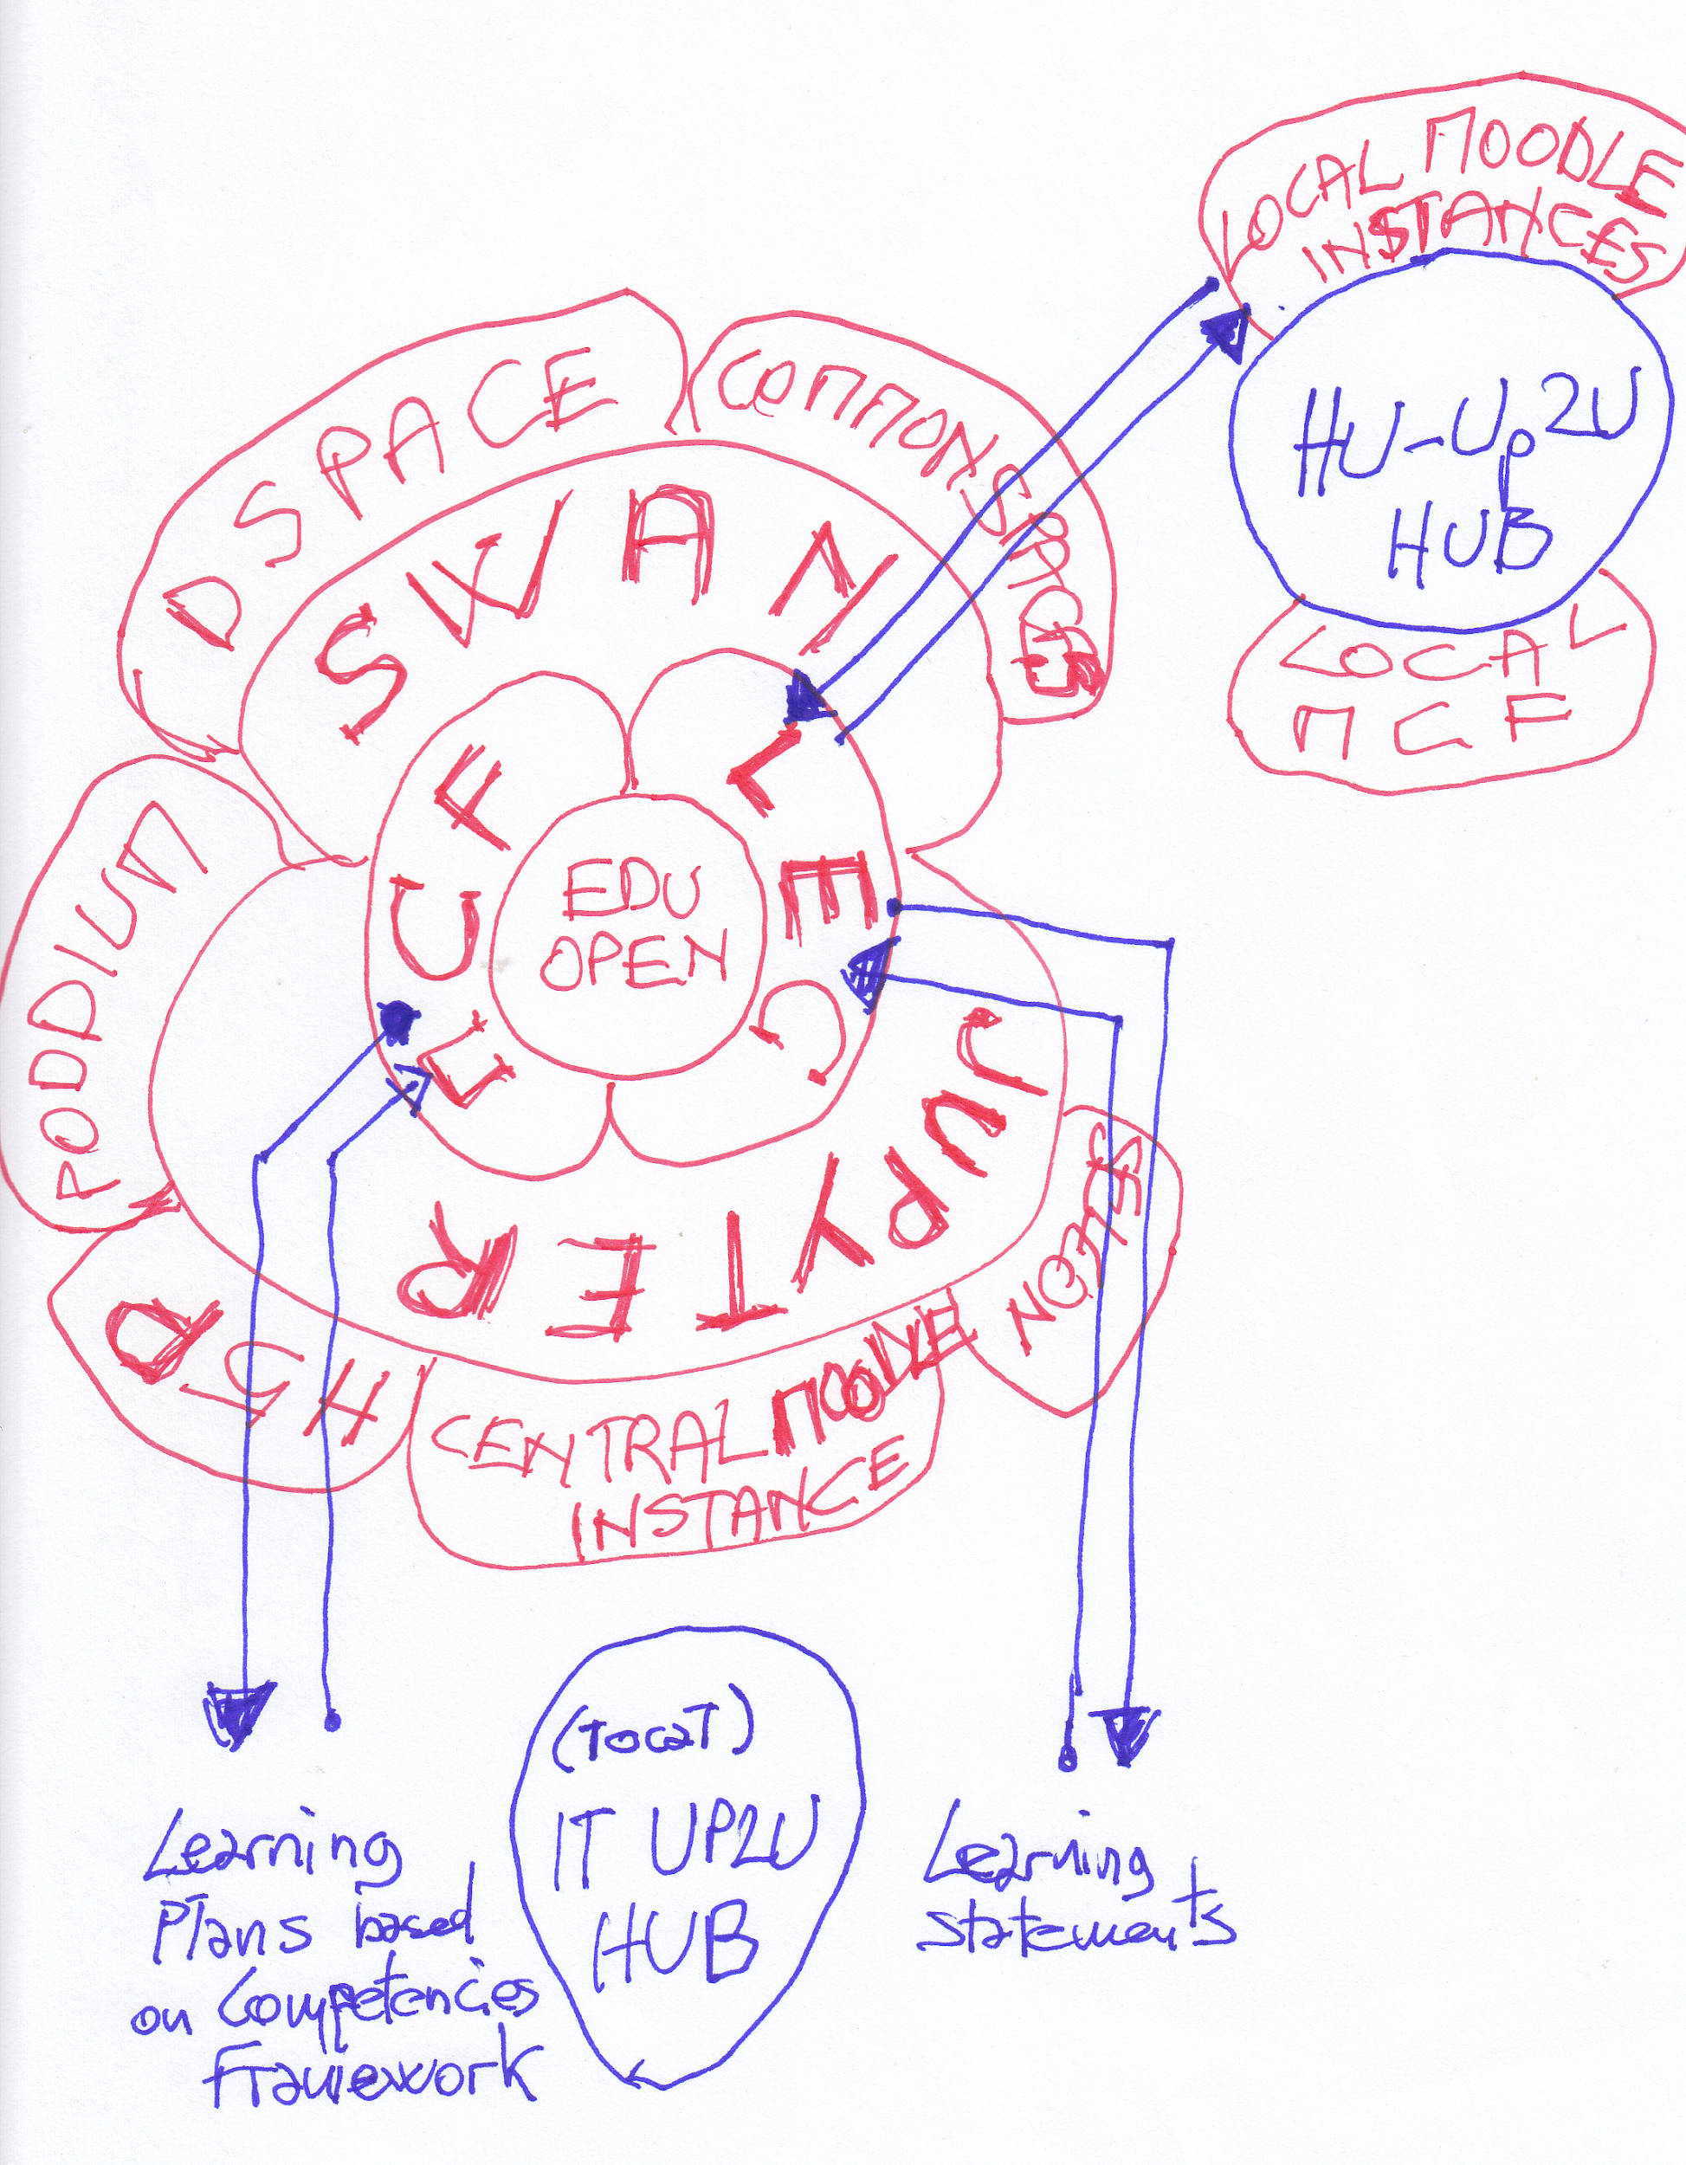
Functional sketch of the Up2U ecosystem
(pedagogical functionality view)
Focus on the role of the peripheral HUB
Learning Experience Center: Learning Analytics xAPI Centre, or, “Learning Experiences Central Repository” where all statements are collected and processed to be analysed by a central pedagogical centre and/or by peripheral pedagogical teams
MCF (later in a future development OBCF) : a Competencies Framework where Learning experiences are distilled by analysts and processed to build a central laboratory of Prescriptive Competencies Directions ; today, in Up2U, we are going to use pre-built Competencies Schemata derived from other teams and other projects experiences.(see details later)
Specific Peripheral HUBs can have a different architecture: today HU-Up2U HUB manage local Moodle Instances;; what is mandatory is that all the hubs rely on a central and unique MCF and LEC

Slide 18
Functional sketch of the Up2U ecosystem
(pedagogical functionality view)
Bibliography:
«Competencies and Learning Plans: Monitoring performance via Moodle - Titus Learning», s.d. https://www.tituslearning.com/competencies-and-learning-plans-monitoring-performance-via-moodle/.
Gilbert Paquette, «A Competency-Based Ontology for Learning Design Repositories», s.d. https://core.ac.uk/download/pdf/35146319.pdf.
«COUNCIL RECOMMENDATION of 22 May 2018 on key competences for lifelong learning (Text with EEA relevance)», Official Journal of the European Union, 2018. https://eur-lex.europa.eu/legal-content/EN/TXT/PDF/?uri=CELEX:32018H0604(01)&from=EN.
Avram, Carmen, Pierre Larrivée, Training foreign and second language teachers : European challenges, successes and perspectives, 2016. https://www.worldcat.org/title/training-foreign-and-second-language-teachers-european-challenges-successes-and-perspectives/oclc/1090471120.
Thomas Nagunwa, Edda Lwoga, «Developing eLearning technologies to implement competency based medical education: Experiences from Muhimbili University of Health and Allied Sciences», s.d. http://dspace.muhas.ac.tz:8080/xmlui/bitstream/handle/123456789/1364/EDICT-with nagunwa.pdf?sequence=1&isAllowed=y.
Pumilia-Gnarini, Paolo M., Elena Favaron, Elena Pacetti, Jonathan Bishop, Luigi Guerra (a cura di), Handbook of Research on Didactic Strategies and Technologies for Education, IGI Global, 2013. http://services.igi-global.com/resolvedoi/resolve.aspx?doi=10.4018/978-1-4666-2122-0.

Slide 19
Planned activity in the next 9 months [M-9]
Here we want to summarize main activities and deadlines assumed during the meeting in Rome of 30/31 of July 2019-
For a full list of activities and tasks please check the online documents:
Updated Activity List https://docs.google.com/spreadsheets/d/1zteDGXKDX0OIFqTxKl_OQ8wkLhWzHpKwH81JQIG3Nos/edit?usp=sharing
Updated Course Catalogue: https://docs.google.com/spreadsheets/d/1_1O9NORwESV7sR2WIxQWO8j5GTIuGD4H6QkgxS8uLjM/edit?usp=sharing

Slide 20
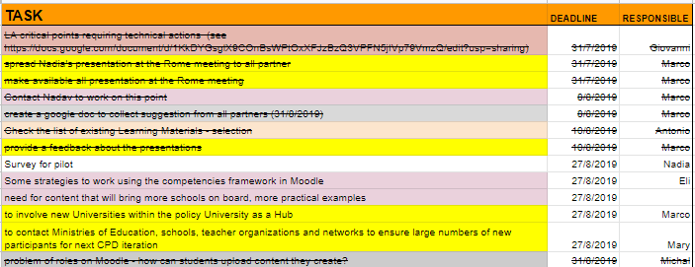
Planned activity [M 32]

Slide 21
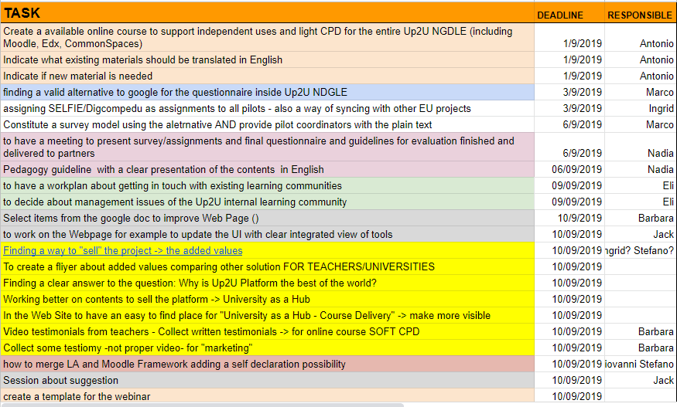
Planned activity in the next 9 months [M 32]

Slide 22
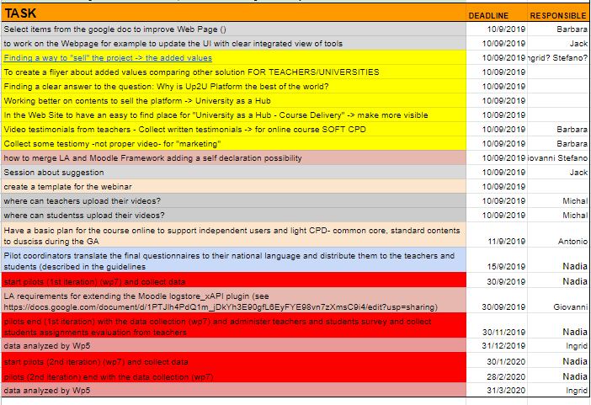
Planned activity in the next 9 months [M 32]

Slide 23
Planned activity in the next 9 months (by month) [M-9]
When | What | Who
September 2019 | Finalise documentation of the Rome Meeting Proceed with WP4-WP5 interaction to implement what is needed to enhance Learning Analytics data collection Implement the actions planned in the Rome Agenda Transfer to each Pilot Coordination team the results of the new agreements Implement Learning scenario (MCF in Moodle, and other tools; LEC in Learning Locker) Finding a common Agreement over a Common Calendar

Slide 24
Planned activity in the next 9 months (by month) [M-8]
When | What | Who
October 2019 | Implement the actions planned into the Rome Agenda Transfer to each Pilot Coordination team the results of the new agreements Implement Learning scenario (MCF in Moodle, and other LEC in Learning Locker ) Start Formal Courses in Schools 2. Cycle | Italy Greece Hungary Portugal Poland

Slide 25
Planned activity in the next 9 months (by month) [M-7]
When | What | Who
November 2019 | Completing Formal Classroom Activity [2. Cycle] Starting Formal Classroom activity [3. cycle] Starting Informal Learning activity with a willing teacher agreement and beside specific classrooms in specific schools (Music Education, Heritage StoryTelling, Mapping Walk paths) (Task 5.4) Starting Programming Language training with VPL (Task 5.4) | All pilots Italy Portugal

Slide 26
Planned activity in the next 9 months (by month) [M-6]
When | What | Who
December 2019 | Completing Formal Classroom activity [3. cycle]

Slide 27
Planned activity in the next 9 months (by month) [M-5]
When | What | Who
January 2020 | Starting Formal Classroom activity [4. cycle] | Specific Pilot Counties:

Slide 28
Planned activity in the next 9 months (by month) [M-4]
When | What | Who
February 2020 | Closing Formal Classroom activity [4. cycle] | Specific Pilot Counties:

Slide 29
Planned activity in the next 9 months (by month) [M-3]
When | What | Who
March 2020 | Closing Informal activities [2.. cycle]

Slide 30
Planned activity in the next 9 months (by month) [M-2]
When | What | Who
April 2020 | Data Processing Start Writing Final Deliverable Completing Deliverables

Slide 31
Planned activity in the next 9 months (by month) [M-1]
When | What | Who
May 2020 | Finalise Data Processing Finalise Last Deliverable Submit Deliverables Submit Administrative Documentation

Slide 32
Up2U Open Issues and feasible solutions.
Learning Communities and Multilingualism. [1]
“The European Union is founded on ‘unity in diversity’: diversity of cultures, customs and beliefs - and of languages. Besides the 20 official languages of the Union, there are 60 or so other indigenous languages and scores of non-indigenous languages spoken by migrant communities.
It is this diversity that makes the European Union what it is: not a ‘melting pot’ in which differences are rendered down, but a common home in which diversity is celebrated, and where our many mother tongues are a source of wealth and a bridge to greater solidarity and mutual understanding. “

Slide 33
Up2U Open Issues and feasible solutions.
Learning Communities and Multilingualism. [2]
“Language is the most direct expression of culture; it is what makes us human and what gives each of us a sense of identity. Article 22 of the Charter of Fundamental Rights of the European Union states that the Union shall respect cultural, religious and linguistic diversity.”
Brussels, 22.11.2005 “A New Framework Strategy for Multilingualism”
COMMUNICATION FROM THE COMMISSION TO THE COUNCIL, THE EUROPEAN PARLIAMENT, THE EUROPEAN ECONOMIC AND SOCIAL COMMITTEE AND THE COMMITTEE OF THE REGIONS

Slide 34
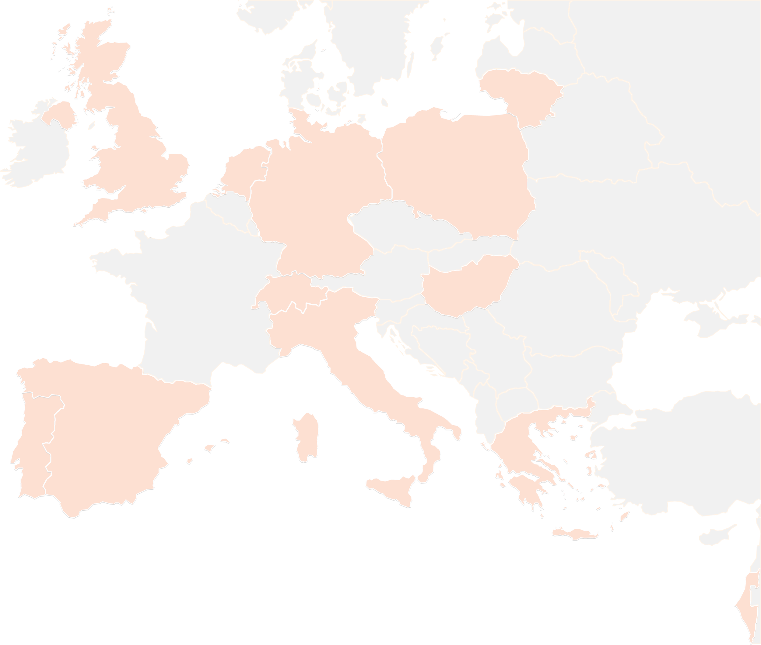
THANK YOU FOR YOUR ATTENTION!
See you in Poznan
wp5@lists.up2university.eu
#up2universe

