Slide 1
WP6 workplan
Andrea Corleto
GARR
5th Up2U General Assembly, Poznan, Poland

Slide 2
WP6 objectives
Security roadmap for schools
  Task 6.1: strengthening knowledge through training and defining a common approach
Common framework for schools IAM
  Task 6.2: enabling trust and identity solutions out of the box
OERs curation
  Task 6.3: defining the use of clear licensing and supporting use and reuse of OERs within schools
Notes:
Questa è una nota che nessuno può vedere

Slide 3
Work done after March review
Security
  Guidelines dissemination and translation in national language (ongoing)
  Video pills editing (completed)
  Online course “Schools: how to deal with security and digital identities” (completed)
  GDPR compliance (ongoing)
Identity and Access Management
  Reuse of AARC project training material (completed):
    Acceptable Use Policy Template
    Privacy Policy Template
OER curation
  Online course on the use of OERs and licensing (ongoing)

Slide 4
Timeline
September – October 2019
  ICT Security and OER Courses: users enrollment
  Dissemination and training on ICT security, identity and OERs in new schools
  Focus groups for final assessment: identification of Pilot countries and groups of teachers to be involved
November 2019 – January 2020
  Dissemination and training on ICT security, identity and OERs in new schools
  Focus groups activities for the final assessment
  Milestone 3.6 (M36) - Security, privacy, trust and IPR issues
January – May 2020
  Dissemination and training on ICT security, identity and OERs in new schools
  Deliverable 6.3 (M39) – Assessment of the roadmap adoption in the project

Slide 5
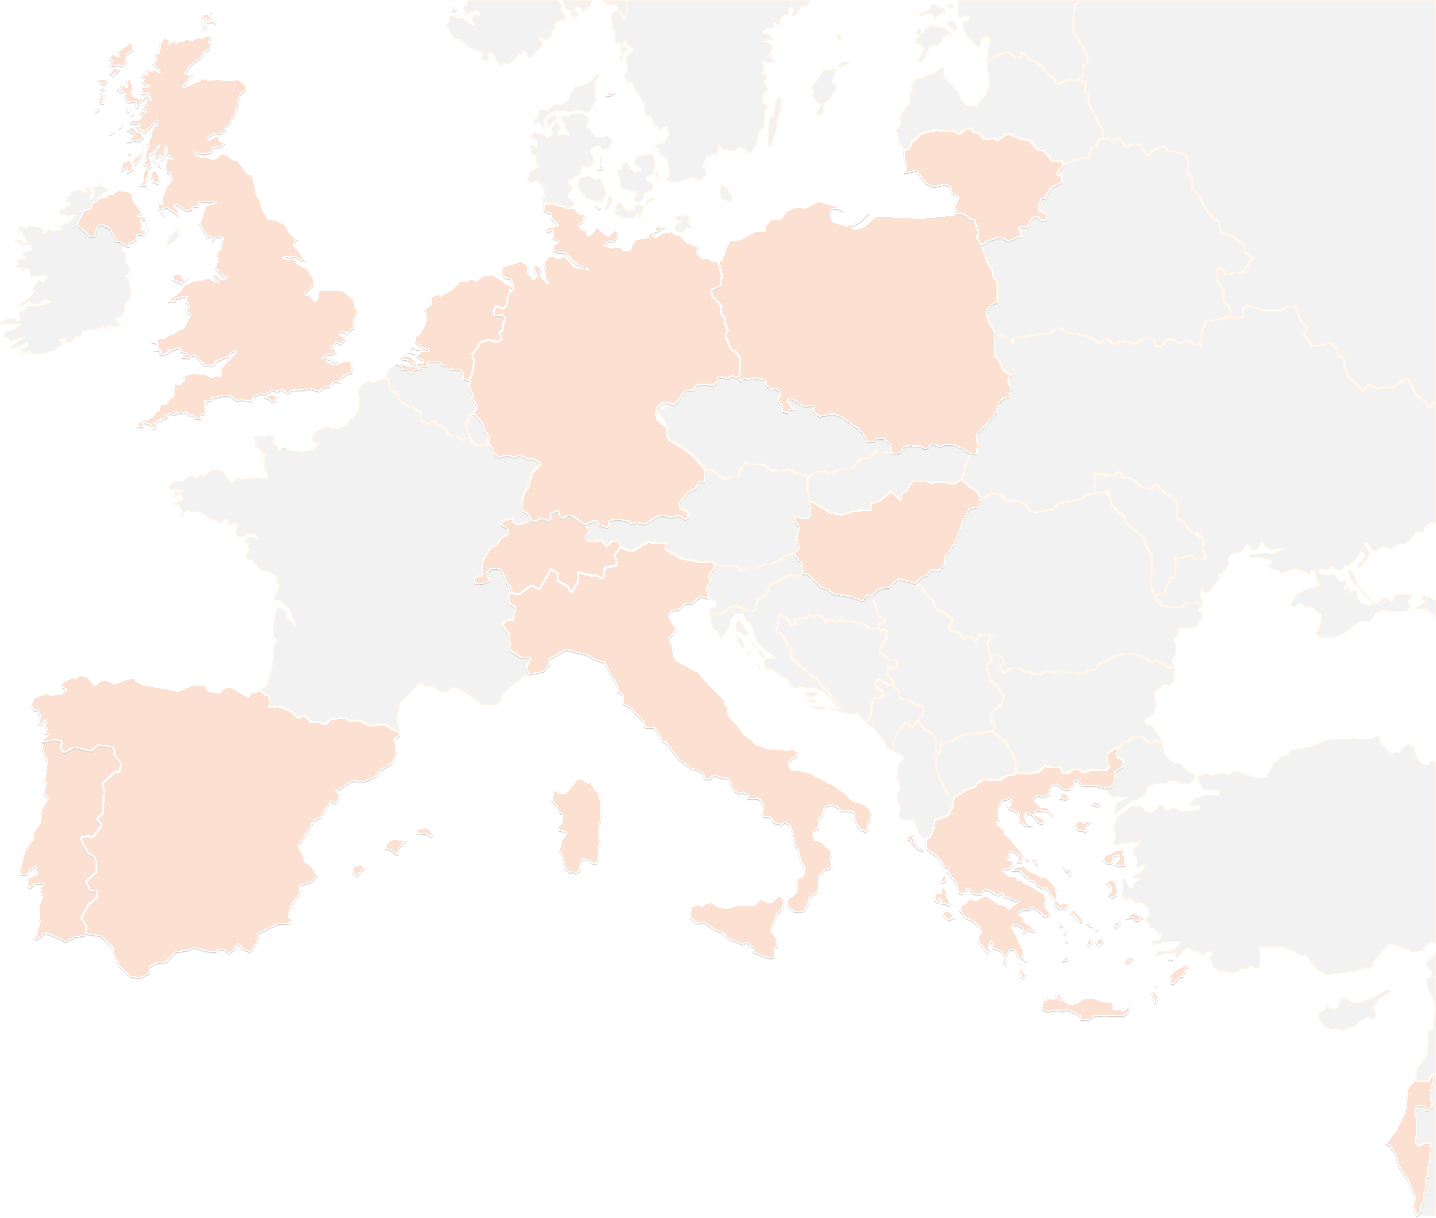
THANK YOU FOR YOUR ATTENTION!
up2u@garr.it
#up2universe

