Slide 1
WP8
NREN Services and Up2U Tools for Schools Business Models
Faraz Fatemi Moghaddam
GWDG
5th Up2U General Assembly, Poznan, Poland

Slide 2
Overview
Business Entity
  Centralized Model
  Decentralized Model
Pricing/Cost Model
Added Value
Timeline

Slide 3
Decentralized Model
Lithuania Case
  Cost Plan: By Funding
  Funding via LITNET, Other Plans
  Option: Fund by Schools
Poland Case
  Cost Plan: By Funding, No Pricing Model
  Plan: National Funding
Hungary Case
  Cost Plan: By Funding, No Pricing Model
  Plan: National Funding
  Current Plan: Project Life-time + 5 Years

Slide 4
Centralized Model
Hosted by GEANT
GEANT needs the figures from the costs of hosting / operating a central platform. That would be presented to GEANT's GA for decision.

Slide 5
Centralized Model
Hosted by GEANT
GEANT needs the figures from the costs of hosting / operating a central platform. That would be presented to GEANT's GA for decision.

Slide 6
Pricing/Costing Model
Market Analysis
  National and International Analysis
Experienced by PSNC
  Lithuania and Hungary

Slide 7
Added Value
Up2U for students
Up2U for universities
Up2U for school teachers
Reuse Up2U for NRENs
Up2U for collaborators(companies, content providers)

Slide 8
Timeline
11.09.2019 - 12.09.2019 | Presentation and final discussion about the plan in GA
13.09.2019 - 30.09.2019 | Finalizing the plan
30.09.2019 | Distributing the guideline to all partners
30.09.2019 - 30.10.2019 | Sustainability meetings (Every 2 weeks)
30.10.2019 | Each partner will send the first round of reports about the results
30.10.2019 - 20.12.2019 | Sustainability meetings (Every 2 weeks)
20.12.2019 | Each partner will send the second round of reports about the results
20.12.2019 - 31.01.2020 | Sustainability meetings (Every 2 weeks)
31.01.2020 | Each partner will send the final round of reports about the results
31.01.2020 - 28.02.2020 | Sustainability meetings (Every week) / Preparation of D8.4
01.03.2020 - 10.03.2020 | Finalizing D8.4
10.03.2020 | Sending D8.4 for Peer-Review
31.03.2020 | Submission of D8.4.
01.04.2020 - 30.05.2020 | [If any] Receiving more results from each partner and sending to EC.

Slide 9
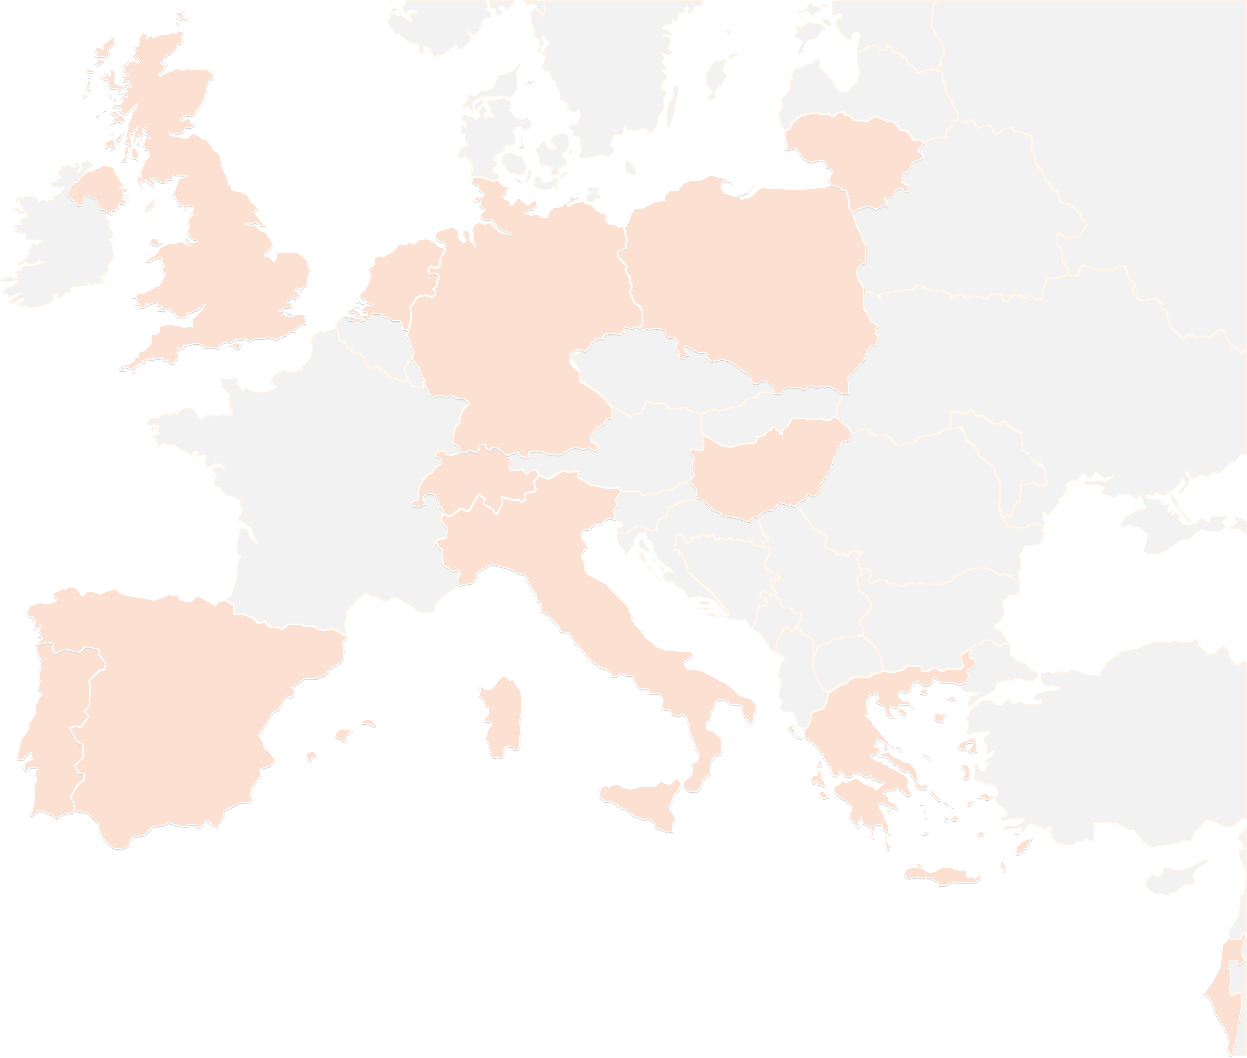
THANK YOU FOR YOUR ATTENTION!
contact@lists.up2university.eu
#up2universe

