Slide 1
New workplan
Work package leaders
5th Up2U General Assembly, Poznan, Poland

Slide 2
Introduction new workplan per work packages:
WP2 - Dissemination and outreach (5 min)
Q&A (5 min)
WP3 - Cloud based infrastructure services (5 min)
Q&A (5 min)
WP4 - Integration application toolbox (5 min)
Q&A (5 min)
WP5 - Learning community management (5 min)
Q&A (5 min)
WP6 - Roadmap for security and trust (5 min)
Q&A (5 min)
Notes:
WPs 7 and 8 will present later today during designated sessions

Slide 3
WP2 workplan
Barbara Tóth
KIFÜ
5th Up2U General Assembly, Poznan, Poland

Slide 4
WP2 objectives
Project communications
  Includes coordinating dissemination activity, social media, web presence (content), keeping project documentation up to date.
Web presence and design
  Project website and motion graphics video
Events and training
  Creating webinars, local trainings
  Participating in national and international conferences

Slide 5
Work done after March review
Website revamp
    Still ongoing, focusing on better UX
    Please contribute:
    UP2U Website - Short Usability Test
    UP2U Website - Bug Report
IT security flyer
    Production and publication on the website
    Multiple languages: ITA, GR (LIT, HUN)
Motion graphics video
INTED, SLERD, Scuola Democratica, TNC, EDULEARN

Slide 6
Timeline
Months September- December 2019
  Focusing on engaging more schools
Months January-March 2019
  Focusing on collecting use cases
Months 2019 March-May
  Preparing the final deliverable (final report)

Slide 7
How do we achieve our goal?
Information is key! Keep WP2 in the loop!
  Articles for the website
  Posts for social media
  Pictures, gifs, info graphics
  Events
    Provide input!!!

Slide 8
How do we achieve our goal?
    Challenges
      University as a Hub
      Learning community
      Badges
      Moodle design
      What did we miss? Let us know!

Slide 9
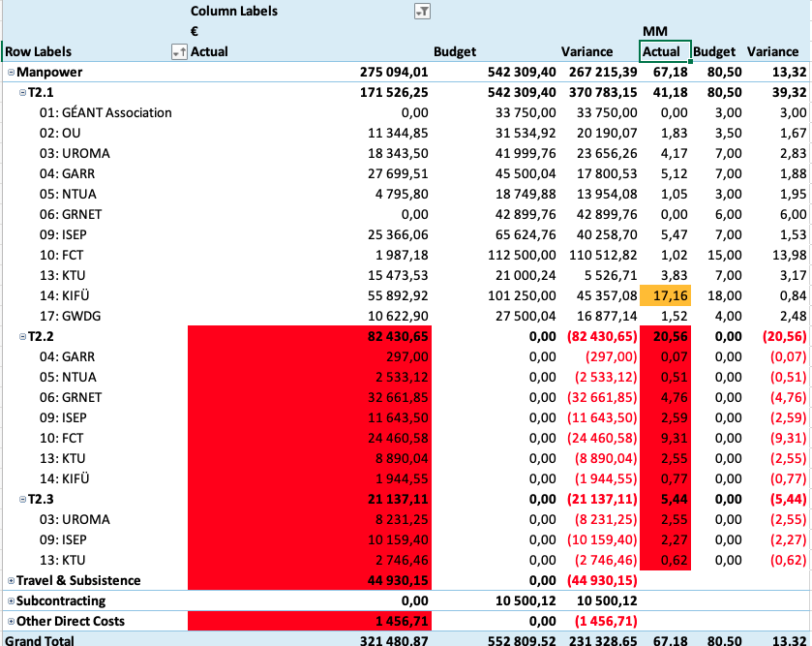
Efforts overview

Slide 10
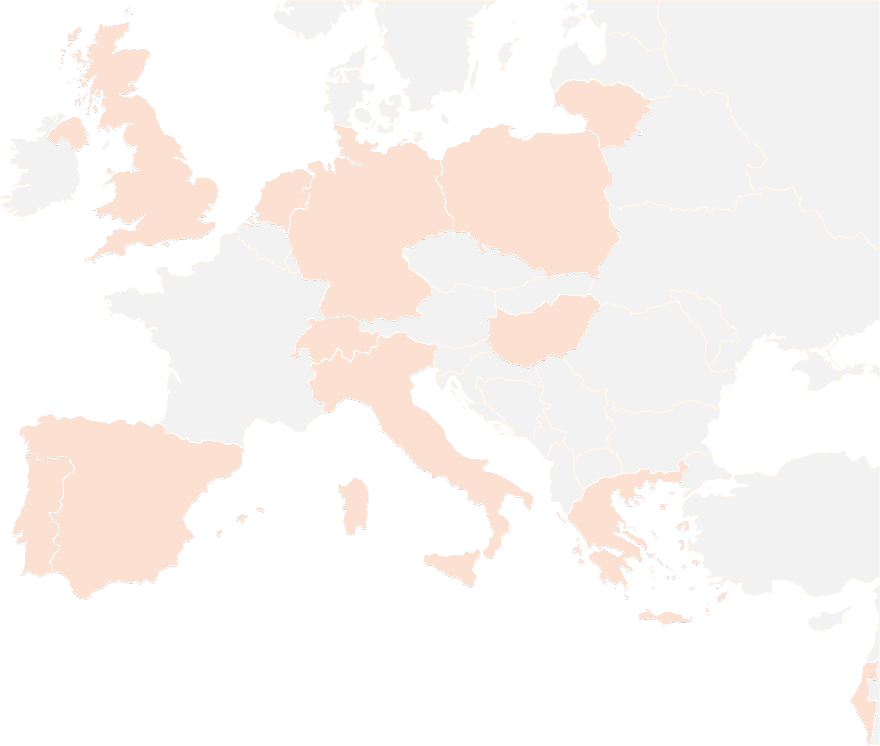
THANK YOU FOR YOUR ATTENTION!
contact@lists.up2university.eu
#up2universe

Slide 11
WP3 workplan
Ilias Hatzakis
GRNET
5th Up2U General Assembly, Poznan, Poland

Slide 12
WP3 objectives
Objective A
  Address the networking needs through the appropriate network services from the GEANT service portfolio
Objective B
  Build a federated cloud storage and sharing infrastructure
Objective C
  Ensure an open learning content platform integration to the project

Slide 13
Work done after March review
  Finalization of the tests between NextCloud, Owncloud, CERNBox and PowerFolder/
  Integration of a large number of repositories (now 54 repositories – 24HE and 30 K12)
  Finalization of Deliverable 3.5

Slide 14
Timeline
Months 34-40
  Deployment of the new OCM protocol endpoints across the entire Up2U service infrastructure
Months 34-40
  Improvement of CERNBox and SWAN based on the feedback from pilots
Months 34-40
  Continuous enrichment of the open learning platform

Slide 15
THANK YOU FOR YOUR ATTENTION!
contact@lists.up2university.eu
#up2universe

Slide 16
WP4 workplan
Allan Third
OU
5th Up2U General Assembly, Poznan, Poland

Slide 17
WP4 objectives
Objective A
  Integrated Application Toolbox intermediating between cloud-based infrastructure and the Up2U tools
Objective B
  Support learning activity data collection for Learning Analytics
Objective C
  Integrate tools for formal and informal learning into workflows for dynamic creation and reuse of learning pathways

Slide 18
Work done after March review
  Milestone M3.4 Application toolbox developer specification
  Major Moodle upgrade (3.6.2)
  Moodle ‘capabilities’ support
  Integration of
    SCORM resources
    VPL plugin
    Multiparty Meeting
    Statistics module
  GDPR updates
  ”Editing student” role

Slide 19
Timeline
Months 34-40
  Implementation of new learning scenarios
  Expansion of learning analytics data collection
Months 34-40
  Document learning scenarios from WP5/pilots
Months 34-40
  Continuous enrichment of the integrated application toolbox

Slide 20
Key Performance Indicators
Completeness of application toolbox specifications: Year 1: 70%, Year 2: 90%, Year 3: 100%
‘Learning scenarios implemented in the platform and documented for reuse’: 80-85% of WP5/pilot-described scenarios
  Replaces both ‘number of (in)formal tools integrated’ KPIs

Slide 21
THANK YOU FOR YOUR ATTENTION!
contact@lists.up2university.eu
#up2universe

Slide 22
Learning Community Management
WP5 Activity Update
Up2U General Assembly 11-09-2019

Slide 23
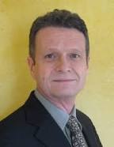
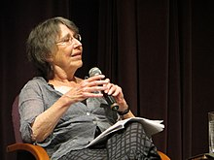
Learning Community Management
WP5 2019-2020
The Learning Community Concept, a basic definition
  Etienne Wenger and Jean Lave, a Computer Scientist (University of California, Irvine ) and a Social Anthropologist (University of California, Berkeley. ), in the early ‘90s proposed to go beyond the Piagetian constructivism based on the Individual as a basic unit of cognitive development
  According to Wenger and Lave, and to their situated cognition theory, knowledge building happens in a given social context
  Thus the researchers began to focus on analysing the "communities of practice", another concept on which they made deep analysis, since then attributed to them
Notes:
From Github issue tracker

Slide 24
Learning Community Management
WP5 2019-2020
According to Etienne Wenger,
"Communities of practice are groups of people who share a concern or a passion for something they do and learn how to do it better as they interact regularly." [from Wikipedia]
Wenger earned a Ph.D. in artificial intelligence, and worked with the Institute for Research on Learning applying his concept of communities of practice to education.
He was a pioneer of the now common research practice connecting learning to the technological and social aspects of communities.
Notes:
From Github issue tracker

Slide 25
Learning Community Management
WP5 2019-2020
Currently, Wenger is working on "Learning for a Small Planet." This research is focused on how students learn in the 21st century, and how the integration of technology is affecting education.
It is also emphasizing the various domains of learning: "education, business, and civic" and how it is not each one separately, but rather the synthesis of them that enables effective learning. [from Wikipedia]
Notes:
From Github issue tracker

Slide 26
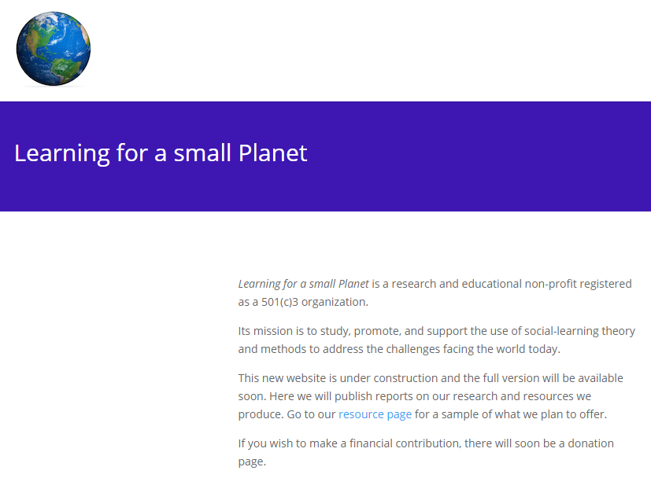
Learning Community Management
WP5 2019-2020
Currently, Wenger is working on "Learning for a Small Planet." This research is focused on how students learn in the 21st century, and how the integration of technology is affecting education.
It is also emphasizing the various domains of learning: "education, business, and civic" and how it is not each one separately, but rather the synthesis of them that enables effective learning.
[from Wikipedia]
Notes:
From Github issue tracker

Slide 27
Learning Community Management
WP5 2019-2020
Wenger’s selected publications
Wenger, Etienne (1987). Artificial Intelligence and Tutoring Systems: Computational and Cognitive Approaches to the Communication of Knowledge. Morgan Kaufmann Press. ISBN 978-0-934-61326-2.
Lave, Jean; Wenger, Etienne (1991). Situated Learning: Legitimate Peripheral Participation. Cambridge: Cambridge University Press. ISBN 0-521-42374-0.
Wenger, Etienne (1998). Communities of Practice: Learning, Meaning, and Identity. Cambridge: Cambridge University Press. ISBN 978-0-521-66363-2.
Wenger, Etienne; McDermott, Richard; Snyder, William M. (2002). Cultivating Communities of Practice (Hardcover). Harvard Business Press; 1 edition. ISBN 978-1-57851-330-7.
Wenger, Etienne (2009). Digital Habitats. Portland: CPsquare. ISBN 978-0-521-66363-2. [from Wikipedia]
Notes:
From Github issue tracker

Slide 28
Pilots, international communities status and LCM [1]
WP5 Pedagogical coordination in Up2U foreseen
  A substantial start-up of a [Multilingual] Learning Communities Management with basically the following objectives:
    Implementing the possible review of all Pilots from Pilot Coordinators January 2019-July 2019
    Supporting a “Trouble and success” collection
    Supporting exchanging best practices
    Establishing gradually a common Assessment Method to be implemented

Slide 29
Pilots, international communities status and LCM [2]
WP5 Pedagogical Team is working to set-up a framework of tools and methods to nurture an interactive and alive communication amongst different communities in the Up2U ecosystem:
  A gradually common mean of defining and reporting level of Competence Acquisition to be used by learners and teachers, Moodle Competences Framework (MCF)
  Up2U LEC Learning Experience Center: a Learning Locker instance, a central repository of xAPI statements to trace individual and groups learning behavior and achievements
  A set of harmonized courses in multiple languages (formal /informal) that make use of MCF and LEC and that support experiences exchange at the International Level
  Guidelines, Tutorial and Sample Courses to show how to use these facilities for deans and principals, teachers and for learners
  Basic features and a model design to implement an integrated social channel for the learning community

Slide 30
Pilots, international communities status and LCM [3]
To support and lead a piloting development towards LCM and the rise of a Life Learning Community in the Up2U ecosystem, WP5 Pedagogical coordination in Up2U plans to design some piloting example of informal learning events:
  Cultural Heritage Digital Storytelling: together with the DTC Lazio, the Innovation District of Regione Lazio, we are designing an informal course example of social construction of stories for the reception of tourists and visitors to be used through a mobile application of Audio Augmented Reality (Loquis); (to be adopted beside Schools of Tourism and other schools in Spring 2020)
  A Community of practice around Music Education as an informal practice, hosted by willing schools in Italy (to be adopted beside Music schools and other schools)
  A Master course in Georeferencing and Walk Path Mapping through the use of OpenStreetMap (to be adopted beside Schools of Tourism and other Schools)
  Critical Thinking and Language Analysis for a better Social Media usage and towards the foundation of a participatory science platform

Slide 31
Pilots, international communities status and Learning Communities Management
Finalise documentation of the Rome Meeting
  Proceedings with WP4-WP5 interaction to implement what is need to enhance Learning Analytics collection
Implement the actions planned in the Rome Agenda
Transfer to each Pilot Coordination team the results of the new agreements
  Implement Learning scenario (CFM in Moodle, and other)

Slide 32
Planned activity after GA in Poznan [1]
Program and design new Pilots and new CPD for informal Learning
  In Italy: we are implementing a 4 subjects agreement with 4 bodies to reach teachers and schools with informal educational contents
    DTC Lazio, Sapyent, Georadio (Loquis), Ammappalitalia
  In Greece:
  In Lithuania:
  In Germany
  In Portugal
  In Spain
  In Switzerland
  In Poland
  In Hungary

Slide 33
Planned activity after GA in Poznan [2]
Designing and programming next Pilots
  Pilots regarding 4 Subjects areas with an offer of Informal Courses
    Critical Thinking Education
    Civic rights and Social Responsibility Education
    Metacognition: Computational Thinking through Music Education,
    Metacognition: Computational Thinking through Language Analysis in the Secondary Schools (Natural Language Analysis and Social Media Mastering)
  Pilot Courses: offer of formal courses on these subjects in schools:
    Introduction to Up2U toolbox (all the pilot countries)
    Artificial Intelligence and Robotics (Intel, PL)
    Introduction to programming (PO)
    Writing a Scientific Essays (IT, IS)
    (check the full list provided by WP7-WP5)
    …..

Slide 34
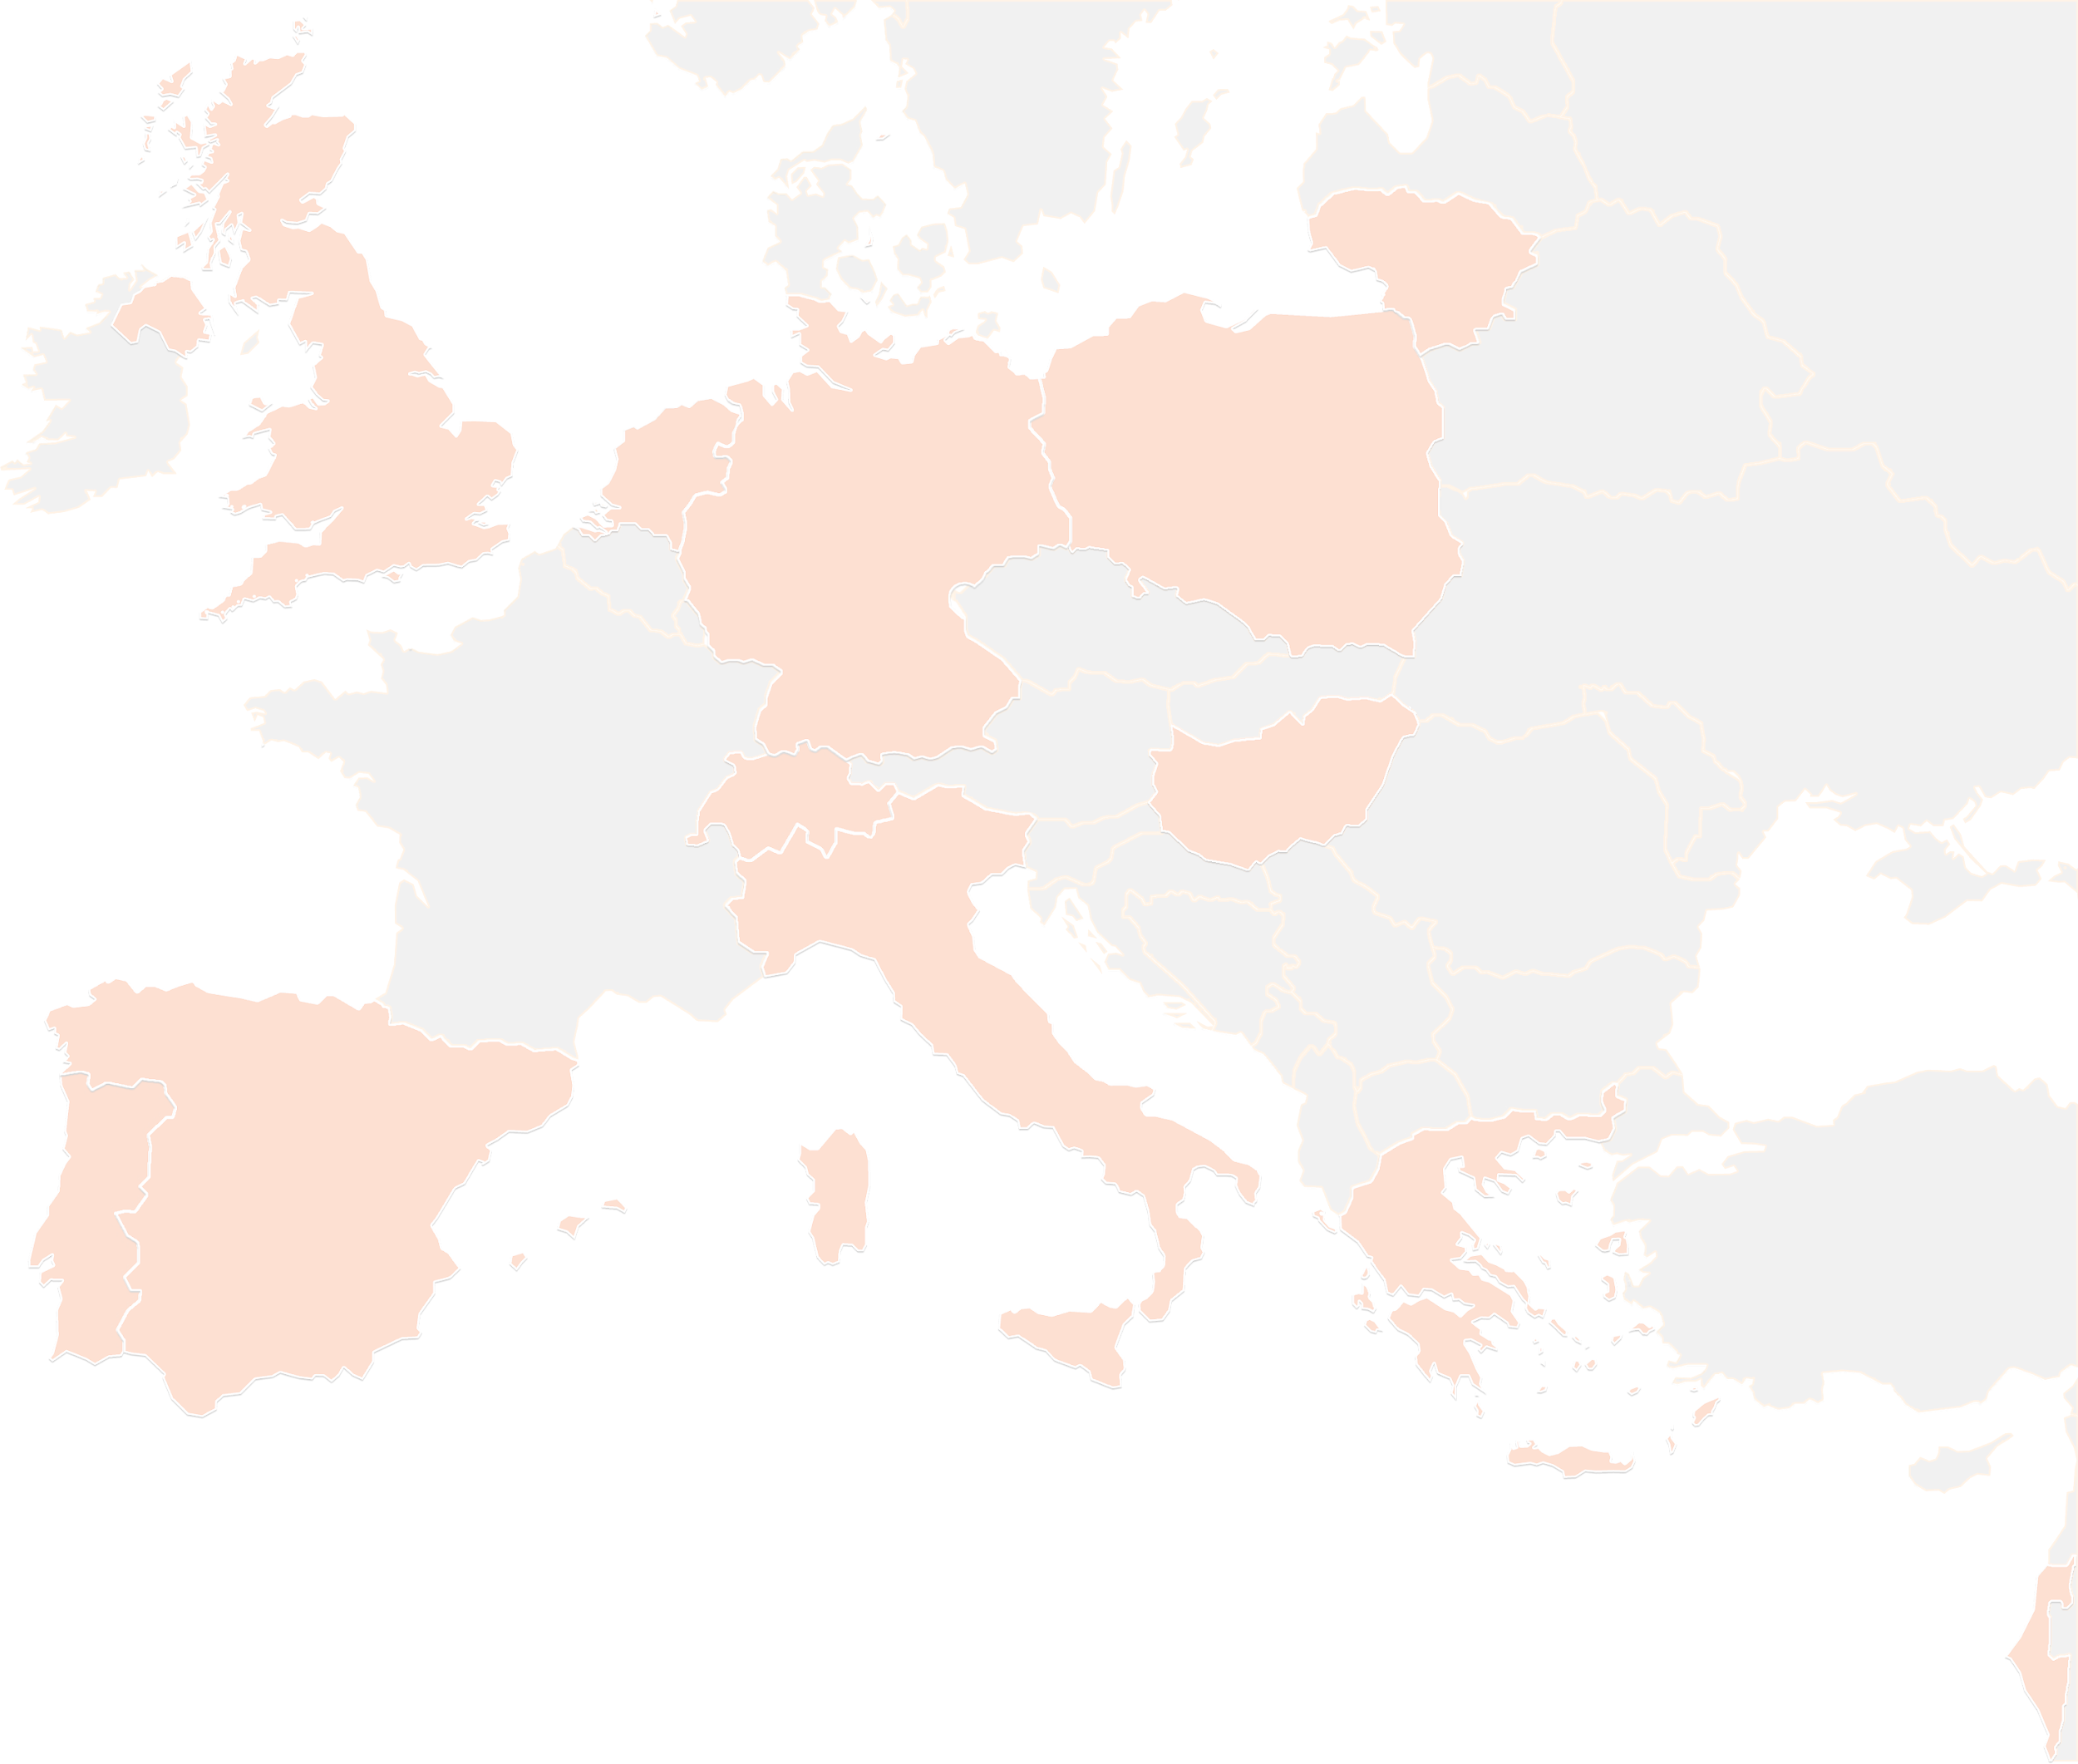
THANK YOU FOR YOUR ATTENTION!
wp5@lists.up2university.eu
#up2universe

Slide 35
WP6 workplan
Andrea Corleto
GARR
5th Up2U General Assembly, Poznan, Poland

Slide 36
WP6 objectives
Security roadmap for schools
  Task 6.1: strengthening knowledge through training and defining a common approach
Common framework for schools IAM
  Task 6.2: enabling trust and identity solutions out of the box
OERs curation
  Task 6.3: defining the use of clear licensing and supporting use and reuse of OERs within schools
Notes:
Questa è una nota che nessuno può vedere

Slide 37
Work done after March review
Security
  Guidelines dissemination and translation in national language (ongoing)
  Video pills editing (completed)
  Online course “Schools: how to deal with security and digital identities” (completed)
  GDPR compliance (ongoing)
Identity and Access Management
  Reuse of AARC project training material (completed):
    Acceptable Use Policy Template
    Privacy Policy Template
OER curation
  Online course on the use of OERs and licensing (ongoing)

Slide 38
Timeline
September – October 2019
  ICT Security and OER Courses: users enrollment
  Dissemination and training on ICT security, identity and OERs in new schools
  Focus groups for final assessment: identification of Pilot countries and groups of teachers to be involved
November 2019 – January 2020
  Dissemination and training on ICT security, identity and OERs in new schools
  Focus groups activities for the final assessment
  Milestone 3.6 (M36) - Security, privacy, trust and IPR issues
January – May 2020
  Dissemination and training on ICT security, identity and OERs in new schools
  Deliverable 6.3 (M39) – Assessment of the roadmap adoption in the project

Slide 39
THANK YOU FOR YOUR ATTENTION!
up2u@garr.it
#up2universe

