Slide 1
Firewall on Demand
Introduction
GEANT Security Team
March 2018

Slide 2

INDEX
What Firewall on Demand is
FoD Tutorial
  What FoD is and what it can be achieved by using it
  How to subscribe
  How to use FoD
  REST API
    Token creation
    Reading, editing and deleting rules
  Port Range
  History Graph
How to Contact us

Slide 3
What Firewall on Demand is
Firewall on Demand, abbreviated as FoD, is an application with a WEB front which allows subscribed users to disseminate firewall filters easily without any hassle.
The traits that make it unique are multifold:
  Time to disseminate/withdraw firewall filters is less than 10 seconds
  No interaction* (e-mail, phone call) with GEANT NOC is required. NREN user can add/remove filters at its own discretion.
  No special knowledge of router-language is required. The WEB based app offers a very friendly scheme for applying the filter.
The magic of FoD is powered on by the cutting edge flowspec technology as described by the RFC 5575.
*NOC/CERT users can still contact GEANT CERT using the traditional methods to request blocking

Slide 4
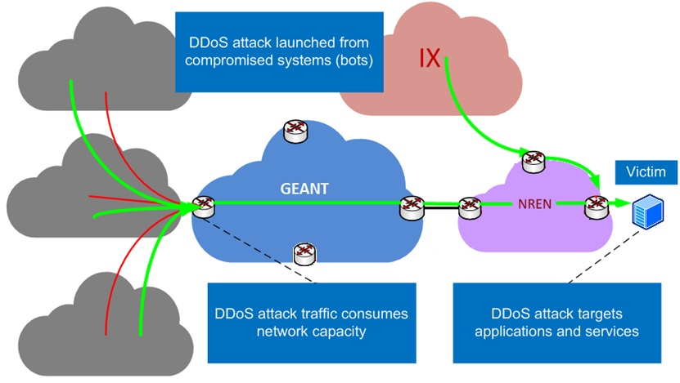

What you CAN do with FoD
Propagate flowspec filters across GEANT network
Filters CAN have DST address from YOUR administrative IP space
Submit as many filters as you want
Have an e-mail sent to yourself or ticketing system for tracking after rule submission/edit/withdrawn
See all rules submitted by you or your colleagues by state (active/deactivated) from past to the most current
Flowspec
Flowspec
Flowspec
Flowspec
FoD

Slide 5
What you CANNOT do with FoD
Propagate IPv6 filters (to be supported in the future)
Stop attacks NOT using GEANT as a transit (..or originating from)
Propagate a filter with a DST subnet longer than /29
Access FoD platform from an IP space other than your NREN’s/NOC’s
Attack that originates from the direct IX peering still passes through
Flowspec
Flowspec
Flowspec
Flowspec
FoD

Slide 6
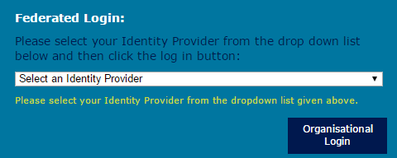
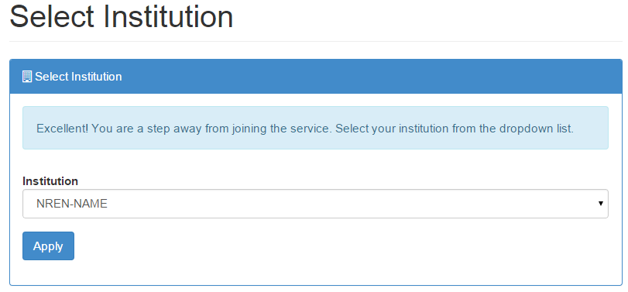
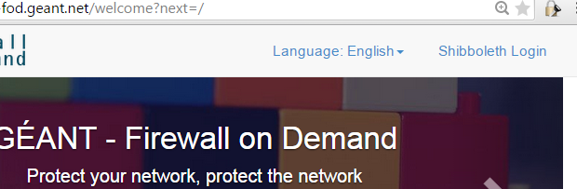
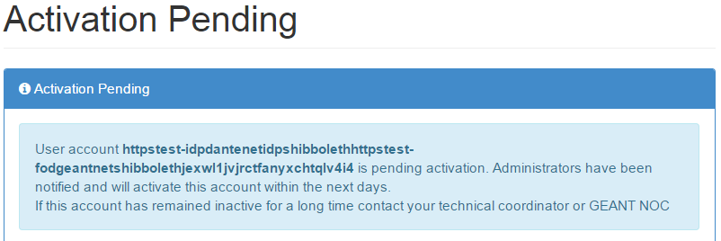
How to Subscribe
The first step needed in order to use FoD is to subscribe yourself to the service. For that you’ll need to:
Populate and send back the excel form found on the body of the e-mail.
Upon reception of the excel form, we’ll whitelist your NOC range so you would be able to reach FoD. Visit https://prod-fod.geant.net and click at the “Shibboleth Login” button on the top right
Select your Identity Provider from the list and provide your eduGAIN username and password
When redirected back to the https://prod-fod.geant.net/ page choose your Institution from the drop down menu and click apply
Your account will be activated within the next 24 hours (after verification of details)

Slide 7
Shibboleth Attributes
In order to interact with FoD Shibboleth module you’ll need to release the following attributes:
givenName
mail
persistent-id
principalName
surname
uniqueID

Slide 8
How to Use FoD
After your account is activated for which you’ll be notified by e-mail, you are ready to start Firewall-ing on Demand. The process of submission is as simple as follows:
Re-visit the https://prod-fod.geant.net page and click on the “Shibboleth Login” button
After supplying with your credentials you’ll have access to 4 tabs:
  Dashboard
  Rules
  Add Rule
  My Profile
Subsequent 4 slides detail the usage of the aforementioned tabs

Slide 9
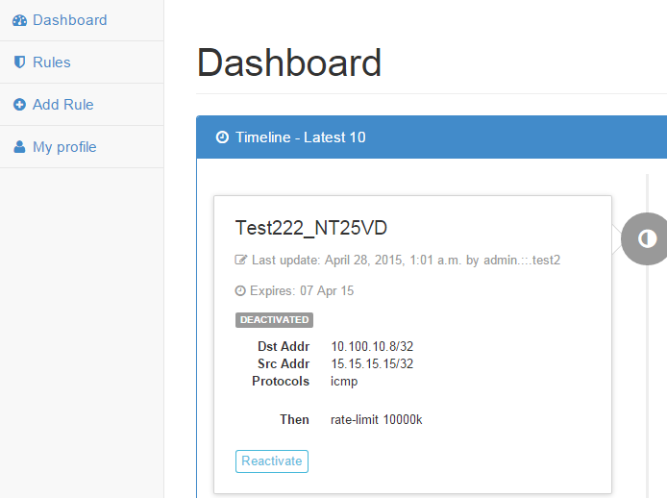
How to Use FoD - Dashboard
Dashboard page displays the latest 10 rules that have been submitted for your Institution along with their current status. Deactivated ones can be re-activated and vice versa.

Slide 10
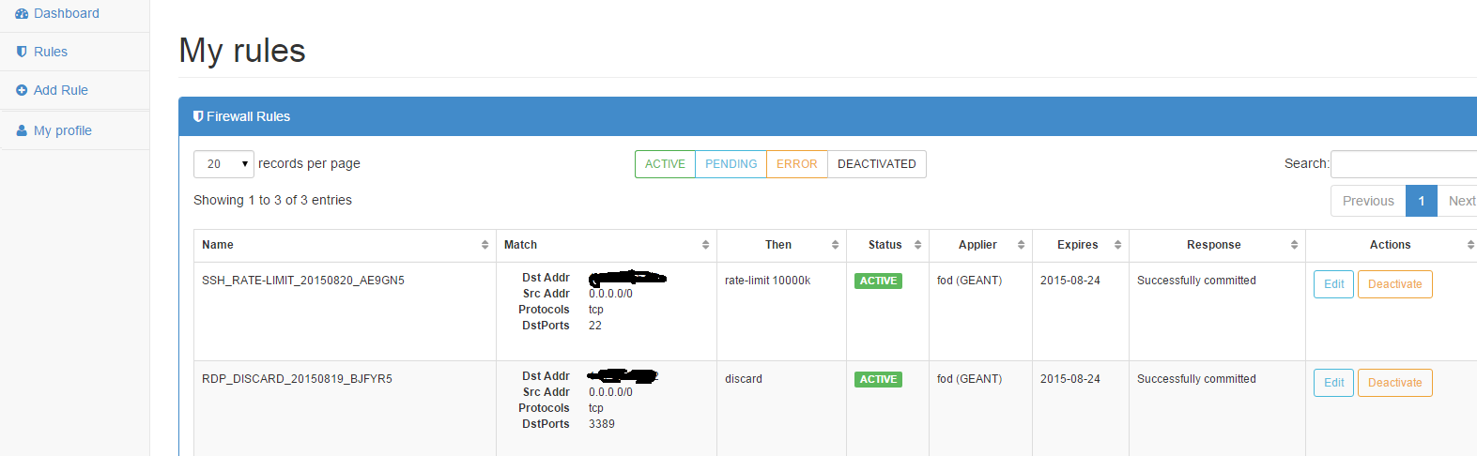
How to Use FoD - Rules
Rules page displays ALL (not just the latest 10) the rules that have been submitted for your Institution, sorted by status. From here, you can reactivate or deactivate rules, or even edit them.
What is more, one can use the search box to look for particular rules and process them further.

Slide 11
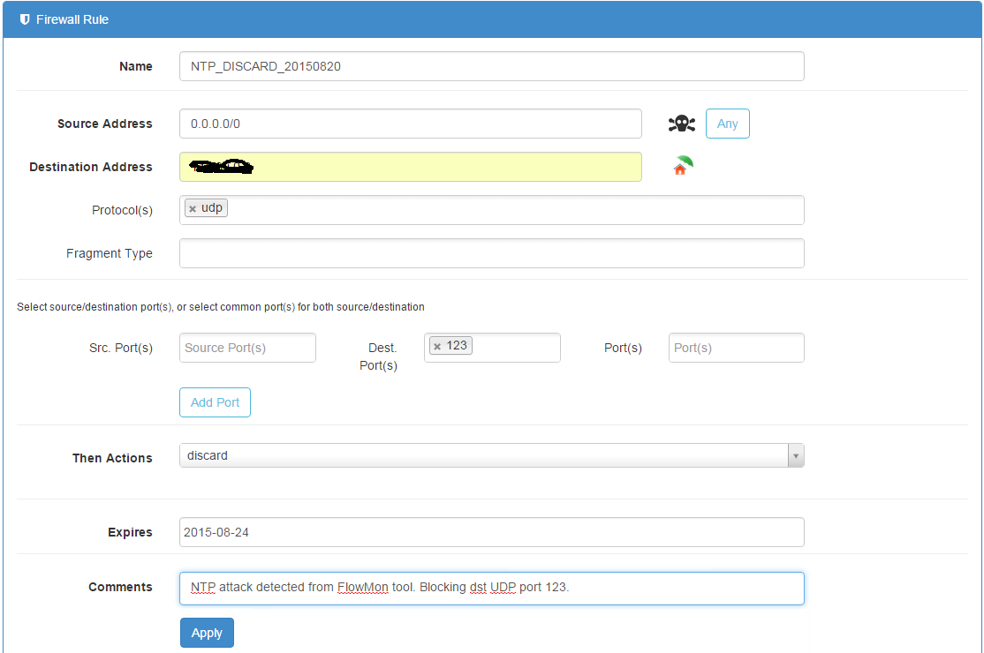
How to Use FoD – Add Rule
Add rule page is the place where you navigate when you first see an attack. To add a rule requires to populate all the necessary fields which are the following:
Name
Source Address
Destination Address - Make sure it’s yours ;)
Then Actions
Note: It is recommended that the rule’s name is of the following format:
<TYPE_OF_ATTACK>_<ACTION>_<DATE>
This will aid you and any GEANT OC engineer for troubleshooting if in need
in the future.

Slide 12
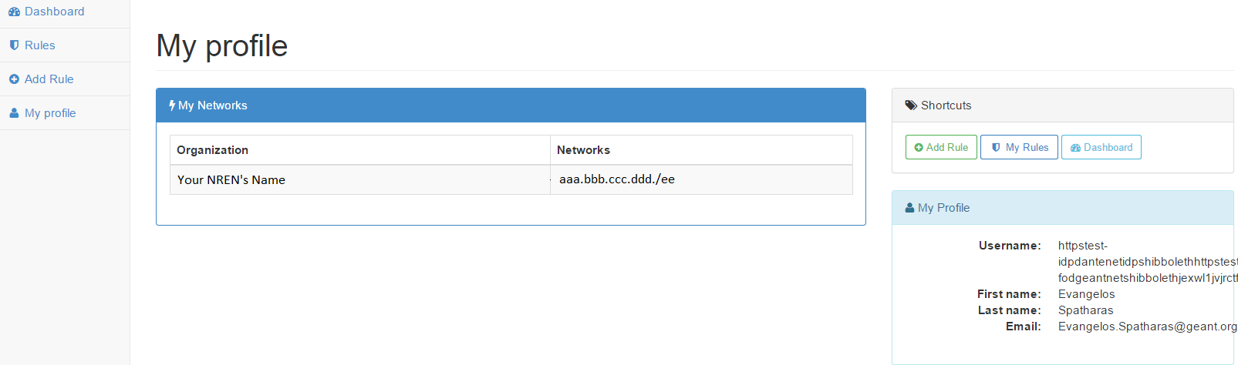
How to Use FoD – My Profile
My profile page displays information that has to do with your subscription such as your administrative network and name, your username and e-mail.

Slide 13
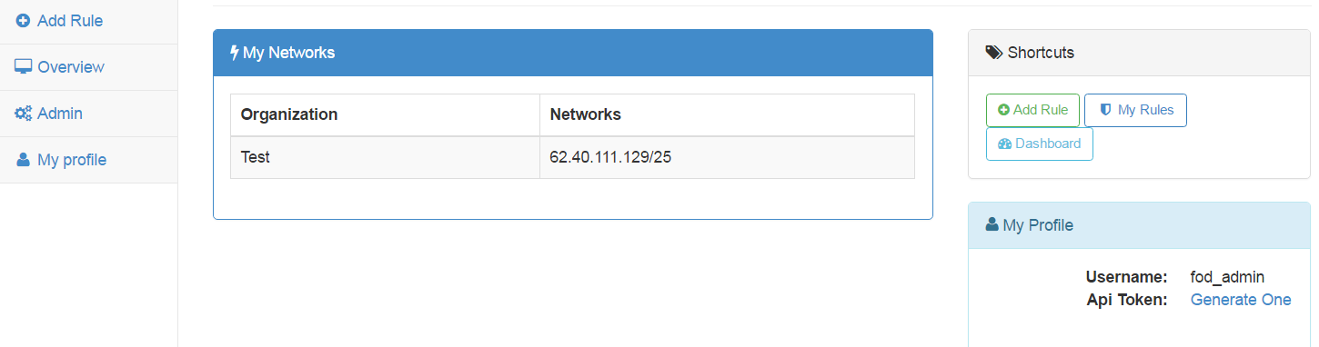
REST API – Token creation
API Token Creation Process
  Click on the “My Profile” tab and then from the right side click “Generate one” next to Api Token.
  You will use that token in order to make calls to the REST API
  Don’t worry about losing that token once generated. It will always be there.
    However, keep it safe from “shoulder surfers”

Slide 14
REST API – Reading rule examples with curl
  Reading all rules
    curl -X GET https://prod-fod.geant.net/api/routes/ -H 'Authorization: Token <your token>’ | python –mjson.tool
  Reading specific rule with ID of 1 (ID can be retrieved from above query)
    curl -X GET https://prod-fod.geant.net/api/routes/1/ -H ‘Authorization: Token <your token>’ | python –mjson.tool

Slide 15
REST API – Deleting a rule example with curl
  Deleting a specific rule with ID of 18
    curl -X DELETE 'https://prod-fod.geant.net/api/routes/18/' -H 'Authorization: Token <your token>‘| python –mjson.tool
    Again, the ID of a rule can be retrieved by reading all rules with “curl –X GET.. From the example previously”
    As always, the rule above now will enter the “deactivated” state, and not deleted. I.e. it will still be visible on your dashboard for later use if needed.

Slide 16
REST API – Submitting new rule requirements
Submitting a new rule requires that first we have defined protocols, and “then actions” at minimum
  Some ports, protocols and “then actions” are already defined. Let’s see which protocols are defined:
    curl -X GET https://prod-fod.geant.net/api/matchprotocol/ -H 'Authorization: Token xxxxxxxxxxxxxx' | python -mjson.tool
    [{
    "id": 1,
    "protocol": "icmp"
    },
    {
    "id": 2,
    "protocol": "tcp"
    },
    {
    "id": 3,
    "protocol": "udp"
    }]
  As you can see, ICMP, TCP and UDP protocols are defined. Those are enough for most of the attacks we know.

Slide 17
REST API – Submitting new rule requirements
Finally let us see what are the defined “then actions” already in place:
  curl -X GET https://prod-fod.geant.net/api/thenactions/ -H 'Authorization: Token xxxxxxxxx' | python -mjson.tool
  [ {
  "action": "discard",
  "action_value": "",
  "id": 3
  },
  {
  "action": "rate-limit",
  "action_value": "10000k",
  "id": 27
  }]
If we want to add new action of rate-limit 1k:
  curl -X POST https://uat-fod.geant.net/api/thenactions/ -F "action=rate-limit" -F "action_value=1k" -H 'Authorization: Token xxxxx' | python -mjson.tool
  {
  "action": "rate-limit",
  "action_value": "1k",
  "id": 28
  }

Slide 18
REST API – Wrapping it up all together
We submit new rules using the POST method. Additionally, we must add more control to our flows by using foreign keys with the –F parameter. The required keys are the following:
  Name
  Source
  Destination
  Status (which have to be active when submitting new rule)
  Then
  Some optional keys are:
    Comments
    Protocol
    Port
    Destinationport
    Sourceport
Submitting a new rule:
  Notice that “then” and “protocol” keys below take the whole path of the ID of the action and protocol. This is mandatory.
  curl -X POST https://uat-fod.geant.net/api/routes/ -F "comments=My first rule from REST" -F "source=10.100.10.4/32" -F "destination=192.168.1.5/32" -F "name=Test1" -F "then=https://uat-fod.geant.net/api/thenactions/27/" -F “destinationport=89" -F "protocol=https://prod-fod.geant.net/api/matchprotocol/2/" -F "status=ACTIVE" -H 'Authorization: Token xxxx' | python -mjson.tool

Slide 19
REST API – Having issues with REST API?
Don’t forget that:
  Field “name” does not accept spaces
  The trailing slash ‘/’ in the end of each field. E.g. https://prod-fod.geant.net/api/routes/
  To put the CIDR notation on the source/destination fields
  Field “status” has to take ACTIVE in capital

Slide 20
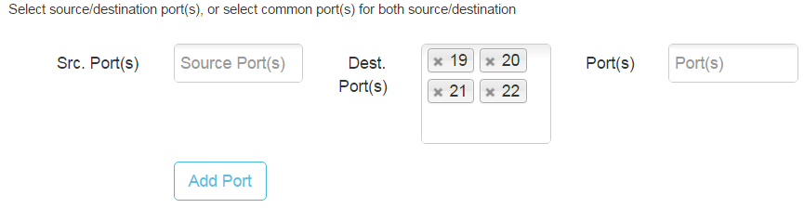
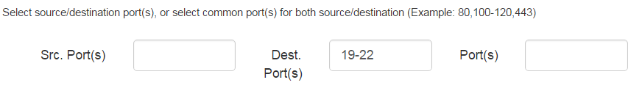
Multi-port Range Support
Historically, FoD users have to insert ports one by one to form a range on the FoD GUI
Now, it is possible that one can insert ranges

Slide 21
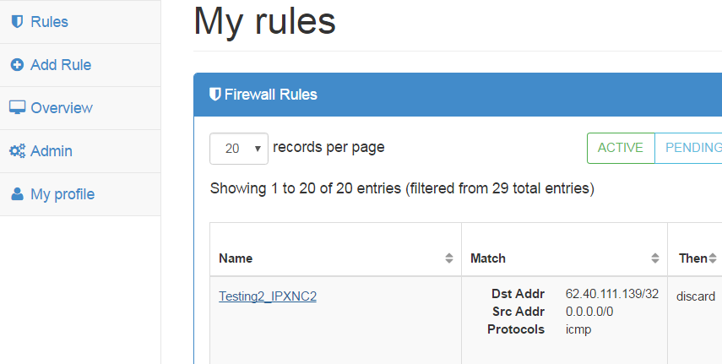
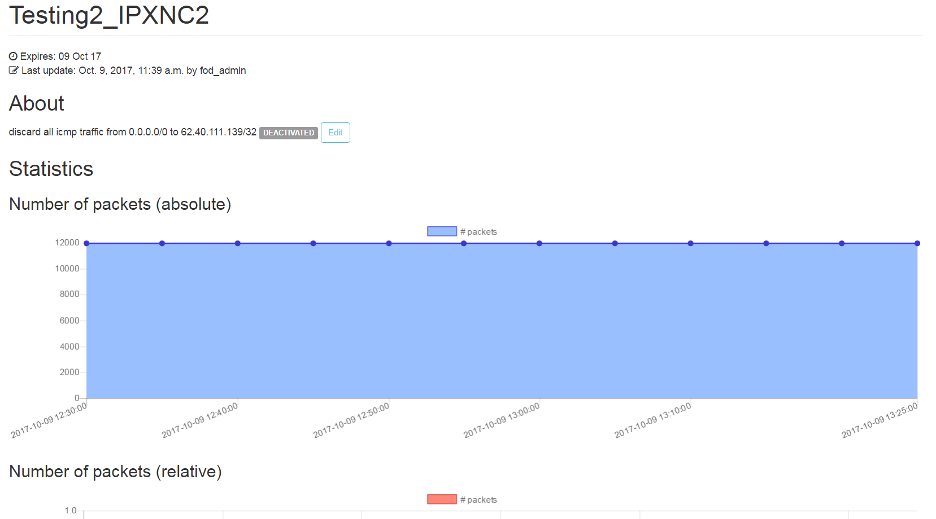
Attack History Graph
Now, it is also possible that one can see number of packets and bytes for a specific rule he applied.
There are two views, absolute and relative depicting traffic for the last 30 days
In order to see history graph, one would need to click on the “rule name” from within “Rules” tab

Slide 22
How to Contact us
In case you have any issues or queries in relation to FoD, please contact GÉANT Infrastructure & Security team at security@geant.org

Slide 23
GEANT OPS Security Team
security@geant.net

