Slide 1


8/JRA2:
Network Services Development
Jerry Sobieski, NORDUnet
Ivana Golub, PSNC
GN4-2 Period 1 EC Review
7-9 November 2017
Brussels

Slide 2
Agenda
JRA2: Network Service Development
Challenges
Overview & Structure
  Role of JRA2 (Tasks)
  Organisation (Team)
  Resources (Budget)
Accomplishments T1, T2, T3, T4, T5, T6
Mitigation of Challenges
Conclusions
  Activity Summary
  Looking Ahead

Slide 3

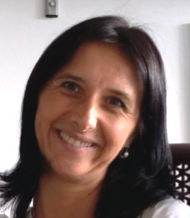




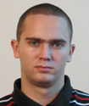
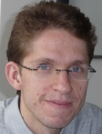














Joint Research Activity 2 (JRA2) Network Services Development
Activity Leader
Co-Activity Leader
  Jerry Sobieski
  NORDUnet
  Ivana Golub
  PSNC
T1: Consolidated Connection Services
T2: Service Provider Architecture
T3: GÉANT Testbeds Service
T4: Net Monitoring & Performance Analysis
T5: Network Management Services
T6: Network Security Services
Michal Hazlinsky
CESNET
  Sonja Filaposka
  MARnet
  Susanne Naegele-Jackson DFN -ERL
  Pavle Vuletic
  AMRES
  Jakub Gutkowski
  PSNC
  David Schmitz
  DFN -LRZ
Partners

Slide 4

Resources (Period 1: 1 May 2016 to 31 August 2017)
Manpower and partners
Voiceover?
JS: Hmmm... I think the budget is important – particualrly to T3... This is special for JRA2... We are way low on capital budget spend...
What do you suggest?
Pls focus on Period 1 – don’t upsell at the moment – the reviewers are looking back at impact at this stage
AL
T1
T2
T3
T4
T5
T6
Jerry Sobieski
NORDUnet
Ivana Golub
PSNC
(28.93 MM)
Consolidated Connection Services
Michal Hazlinsky
CESNET (35 MM)
Service Provider Architecture
Sonja Filaposka
MARnet
(41.02 MM)
GÉANT Testbeds Service
Susanne Naegele-Jackson DFN–ERL (63.39 MM)
Net Monitoring & Performance
Analysis
Pavle Vuletic
AMRES (28.46 MM)
Network Management Services
Jakub Gutkowski
PSNC (37.56 MM)
Network Security Services
David Schmitz
DFN–LRZ
(43.08 MM)
GN4-2 Period 1 budget (used / forecast) | €1.65 M / €1.7 M (97%)
Total manpower | 277.44 MM / 272.03 MM (102%)
Hardware budget (GN4-2 total) | 1490 k
Participants | 45 persons, 19 partners/third parties
✓
✓
6/6 milestones and 2/3 deliverables completed successfully

Slide 5
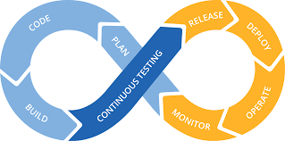
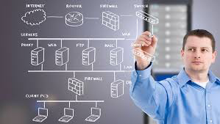
8/JRA2 Mission: To develop and evolve advanced networking services for the GÉANT community and project
Transform TRL5/6/7 concepts into viable TRL 8+ services
Focus on functional development:
  Delivering user capabilities (fuelling uptake)
  Incorporating ‘levers’ for the operators (control and manage the facilities)
Define service architecture, long-term feature roadmap(s), development timelines, and evolution strategy
Develop these services with the entire NREN community in mind (scalability, interoperation, security, and autonomy)

Slide 6

JRA2 Timeline: Milestones and Deliverables delivered in Period 1
✓
M8.* Milestones – Feature set roadmaps
  T1 – Consolidated Connection Services
  T2 – Service Provider Architecture
  T3 – GÉANT Testbeds Service
  T4 – Performance Monitoring and Verification
  T5 – Network Management as a Service
  T6 – Network Security
D8.1 Integrated Services Framework document – In progress but requires further review/refinement
D8.2 FoD Progress Report
D8.3 DDoS Mitigation 1.0 Pilot
✓
✓
✓
✓
✓
✓
X
✓
✓

Slide 7
Overall Challenges and Observations
Staffing
  Coordination:
    The topics assigned to JRA2 represent a broad range of new and advanced service concepts
    This strains the Activity Leader to guide and coordinate tasks while also handling management issues
  Software Developers:
    There is shortage of knowledgeable and qualified software developers
    Skilled staff replacement is difficult/takes time
It is easy to underestimate scope of effort (complexity, time, hardware, and personnel)
of advanced services concepts
The deployment, operations, and management process for new services needs attention

Slide 8
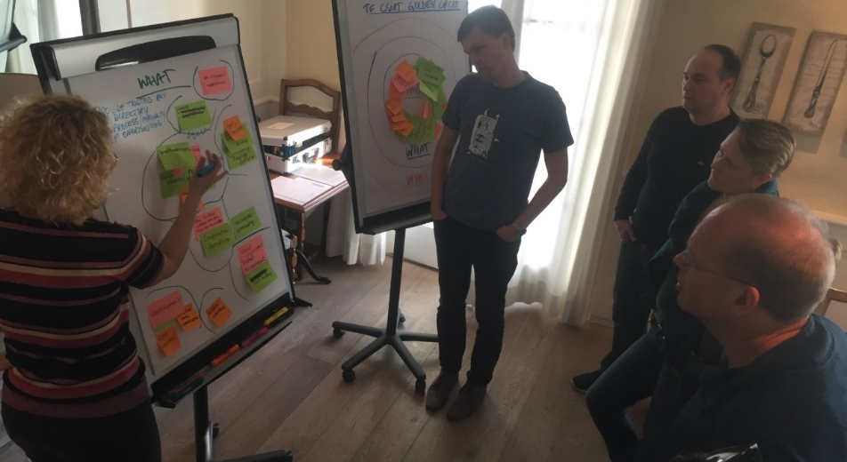
Notable JRA2 accomplishments in Period 1
Providing important groundwork for upcoming progress in Period 2
T1 CCS – OpenNSA now in service on the GÉANT MPLS core
T2 SPA - ELINE pathfinder project in progress
T3 GTS – GTS Version 4.0 is ‘on the air’ and open to users
T4 PMV - Architecture defined and prototype under construction
T5 NMaaS - Platform, portal, service provisioning, and first tools available
T6 Net Security - Development of FoD 1.5, FoD 1.6, RepShield and Certificate Transparency log service completed
All tasks are now ‘PLM-ified’

Slide 9
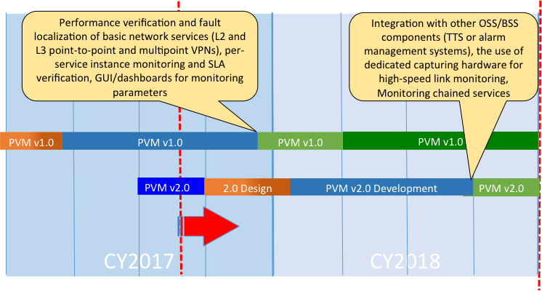
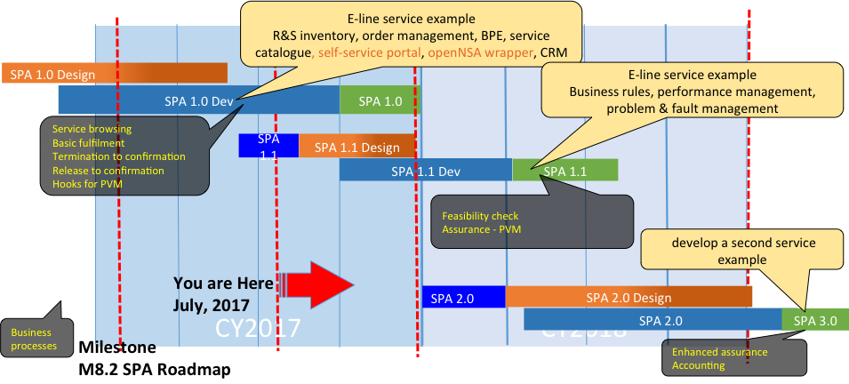
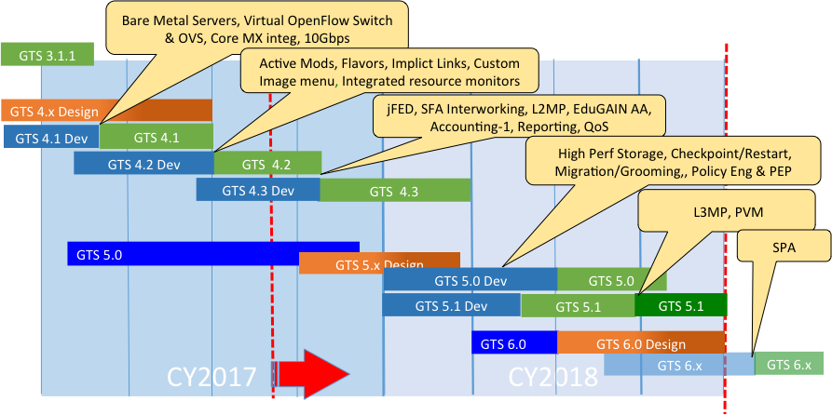
Product Lifecycle Management (PLM)
All 7 JRA2 development efforts are now in PLM:
  Each Task/effort has a feature development roadmap conforming to PLM
  Each product major release goes through the PLM Strategy review, where feature sets, product planning, documentation is coordinated and approved
  Strategy Review followed by Design+Development+Testing phase, then Pilot, and on to Production

Slide 10

Task 1: Consolidated Connection Services (CCS)
Period 1 achievements
Task Leader: Michal Hazlinsky (CESNET)
91 PM (2.84 FTE) –> 3.6 FTE P1-Q4
  7 people from 6 partner organisations
Period 1 output:
  Milestone M8.1: Consolidated
  Connection Services Roadmap
  Deliverable D8.1: Integrated Services
  Framework and Development Roadmap
you can voiceover re: D8.1

Slide 11
Task 1: Consolidated Connection Services Objective
Harmonise and unify multiple, GÉANT connection-oriented services into a single, strategic product development tranche:
  Present a simplified (abstracted, technology-agnostic), user-facing connection service
  Leverage appropriate underlying infrastructure via intelligent automated provisioning processes
  Assimilate BoD, GÉANTPlus, GTS VCs, GÉANT Open, MD-VPN, etc. into one coordinated and strategic, product management effort
GTS RCA-VC
BoD
GÉANT Plus
T1 CCS
GÉANT Open
MD VPN
...

Slide 12

Consolidated Connection Services Achievements
Deployment of OpenNSA on GÉANT core completed:
  Path provisioning of RFC 4448 EoMPLS LSPs over 100G BB
  Abstract NSI Connection Services model & API
    Open Grid Forum Standards
  JunosSpace implementation
  Staff vacancy filled (after key departure)
Initial primary use case: GTS virtual circuits
  ~3000 virtual circuits in 2016

Slide 13

Task 1: Looking forward
Incorporation of other connection services: BoD, GÉANTplus, multi-point services, time-division multiplexing (TDM) services
Implement performance guarantees (QoS) with intelligent path selection
Multi-domain – interconnections among NRENs; common policy specification/coordination; robust, reliable MD provisioning
Simplify CCS adoption – make it easy and inexpensive to deploy CCS in other network (simplify and lower cost of entry, encourage deployment among the NRENs)
CCS over Service Provider Architecture –> ELINE Project

Slide 14

Task 2: Service Provider Architecture
Period 1 achievements
Task Leader: Sonja Filiposka (MARnet)
84 PM (2.6 FTEs) –> 4.12 FTE in P1-Q4
  7 people from 4 partners
Period 1 output:
  Milestone M8.2: Service Provider Architecture Roadmap

Slide 15


Task 2: Service Provider Architecture
Goal: Develop an integrated information architecture and associated API that can support all GÉANT services and internal business processes
Based upon TMF “Zoom” Architecture:
  Operational Support Systems and Business Support Systems (OSS/BSS) models from TMF
  Schemas, databases, APIs, business process specifications ...
  Provide a single portal to browse services,
  order services, track usage and performance,
  raise issues, and receive billing information
Demonstrator, with an example GÉANT service,
planned for December 2017

Slide 16
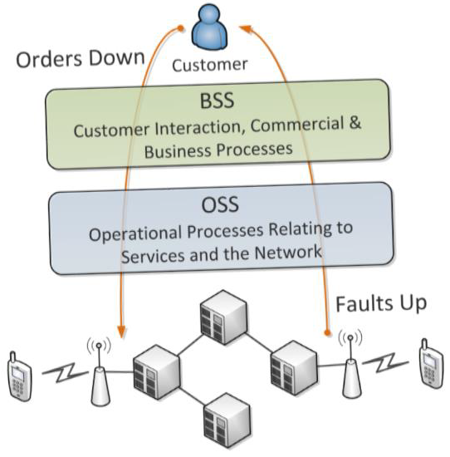
Service Provider Architecture Goals
End-to-end view of service delivery process
User-centric:
  Dynamic service catalogue and portfolio
  Unified view of service offerings, service
  monitoring and management
Service integration approach:
  Break down the duplicated service silos (improve product strategy)
  Simplify introduction of new services (agility and responsiveness)
  Reuse common IA blocks (reduced costs,
  improved interop)
Next generation OSS/BSS architecture

Slide 17
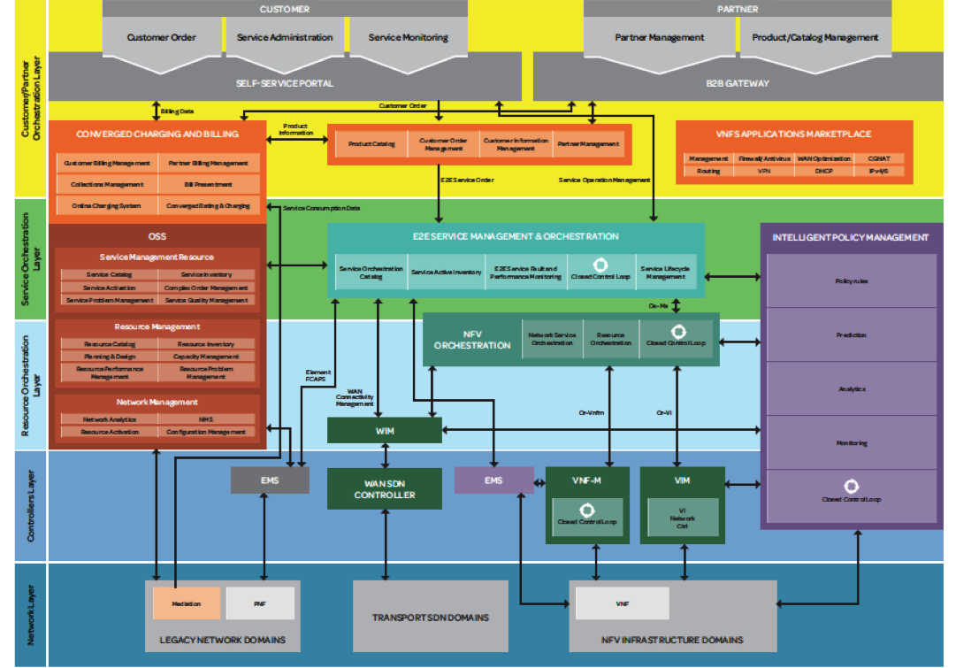
SPA: TMF Zoom Architecture
Customer/
Partner
Layer
Customer/Partner
JRA2-T2 SPA Focus Customer, Service, Resource layers
Service
Orchestration
Layer
Resource
Orchestration
Layer
Telecommunication Management Forum (TMF) Zoom Architecture Poster

Slide 18
Service Provider Architecture Benefits
SPA offers immediate, direct and tangible benefits to the GÉANT Project by providing a common information architecture underlying the GÉANT services portfolio:
  Single authoritative information base
  Formalised business process specifications
  Increased ability to automate these processes
  Reduced time to develop and deliver new services
  Improved interoperability with other service providers
svc
svc
svc
svc
svc
svc
BSS3
BSS
BSS2
BSS
OSS
OSS
OSS
OSS

Slide 19

ELINE 1.0 Pathfinder Project
How do we verify and validate the SPA implementation? We need a dry run...
Enter the ELINE Project:
  T2 SPA provides the underlying common information architecture and APIs
  T1 CCS provides an initial GÉANT service to be ported to SPA conformance
  T4 PVM provides for common service monitoring and fault analysis agents
  Incorporate MEF Ethernet Private Line (“ELINE”) service specification
What problems do we encounter? How do we resolve them?
  Authoritative database synchronisation with other component state information
  What is the service migration effort?
  What extensions are needed to support GÉANT [advanced] services?

Slide 20

Task 2: Looking ahead
Service Provider Architecture
The ELINE Project results will provide important validation:
  ‘First Look’ SPA/ELINE on track for CY18Q1
Evaluate the results:
  Cost, effectiveness ...
Iterate
  Plan migration of other services to the service provider architecture

