Slide 1

Task 3: GÉANT Testbeds Service
Period 1 achievements
Task Leader: Susanne Naegele-Jackson (DFN-ERL)
123 PM (3.84 FTE) –> 4.5 FTE P1 Q4
  10 People from 7 Partner Organisations
Period 1 output:
  Milestone M8.3: GÉANT Testbeds Service Roadmap

Slide 2

Task 3: The GÉANT Testbeds Service (GTS)
GTS dynamically creates user defined, user controlled, geographically distributed network environments:
  For the user, experimental services can be quickly and inexpensively deployed and studied “at scale” in the WAN, i.e. Testbeds
  For the service provider, network innovations can be safely introduced, with minimal risk to other network services
These GTS environments can support the full evolution of new services – from early TRL5/6 experiments up through to mature TRL9 services
GTS is a running service, with a growing user base

Slide 3
Task 3: GTS Accomplishments
GTS v4 is now deployed and in service
  Major hardware deployment supporting important new features:
    Bare metal servers, 10Gbps links, VSIs, VM flavors
  Recognise SA1 engineering/operations team: ~50 boxes engineered/deployed/redeployed in 9 locations, 100x10G ports, new software requirements, operational integration
New virtual SDN switching elements now available in GTS v4 (VSIs):
  Allows efficient and secure sharing of SDN switching elements among many [global] users
  Defined by GTS, jointly developed with Corsa – now a shipping feature in Corsa products
GTS Tech+Futures Workshop III (Utrecht, Feb 2017):
  30+ researchers, network operators, developers, vendors. Tech+Futures drives the GTS features roadmap
GTS Secure Code Audit
  Thorough review of the entire GTS software suite by SA2 Task 1
  Only two critical issues found – corrected

Slide 4

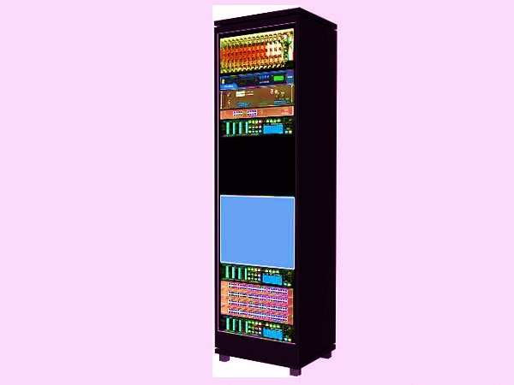

Status of GTS at end-Period 1
GTS v4.1.3 is now in service
Footprint: 8 GÉANT PoPs:
  Amsterdam, Bratislava, Hamburg, London,
  Madrid, Milan, Paris and Prague
Kit: 67 servers, 8 SDN switches, 95 10G router ports
Connected by CCS dynamic virtual circuits
Several NREN Deployments:
  NORDUnet (GVA, CPH, WDC, MIA)
  HEAnet (DUB)
  CESNET (PRG, BNO)
  DFN [CY17-Q4?] (NUR, ?)
  Ciena Research (OTW, CHI, HAN)
  INITIATE (UK) Project
  Expressed Interest: RENAM, MARNET, PSNC, REANZ, AMPATH, CENIC, Internet2
AMS
HAM
LON
PRG
CCS
Connections
PAR
MAD
MIL
BRA

Slide 5
GTS Registered Users and Projects
Notable projects and/or relationships:
  ICN2020 (Info. Centric Networking w Cisco)
  PlanetLab Europe
  Fed4FIRE Plus (EC funded future internet research and experimentation coordination)
  EuWireless (GTS/GVM applied to wireless and cellular metro research facilities)
  Ciena Testbeds Service (GTS deployed on Ciena North America GENI/OTN core)
  INITIATE (GTS open source use)
  Computer and Network Engineering Curriculum (GTS replacing campus networking labs)
Either show May to Aug or state why not?

Slide 6
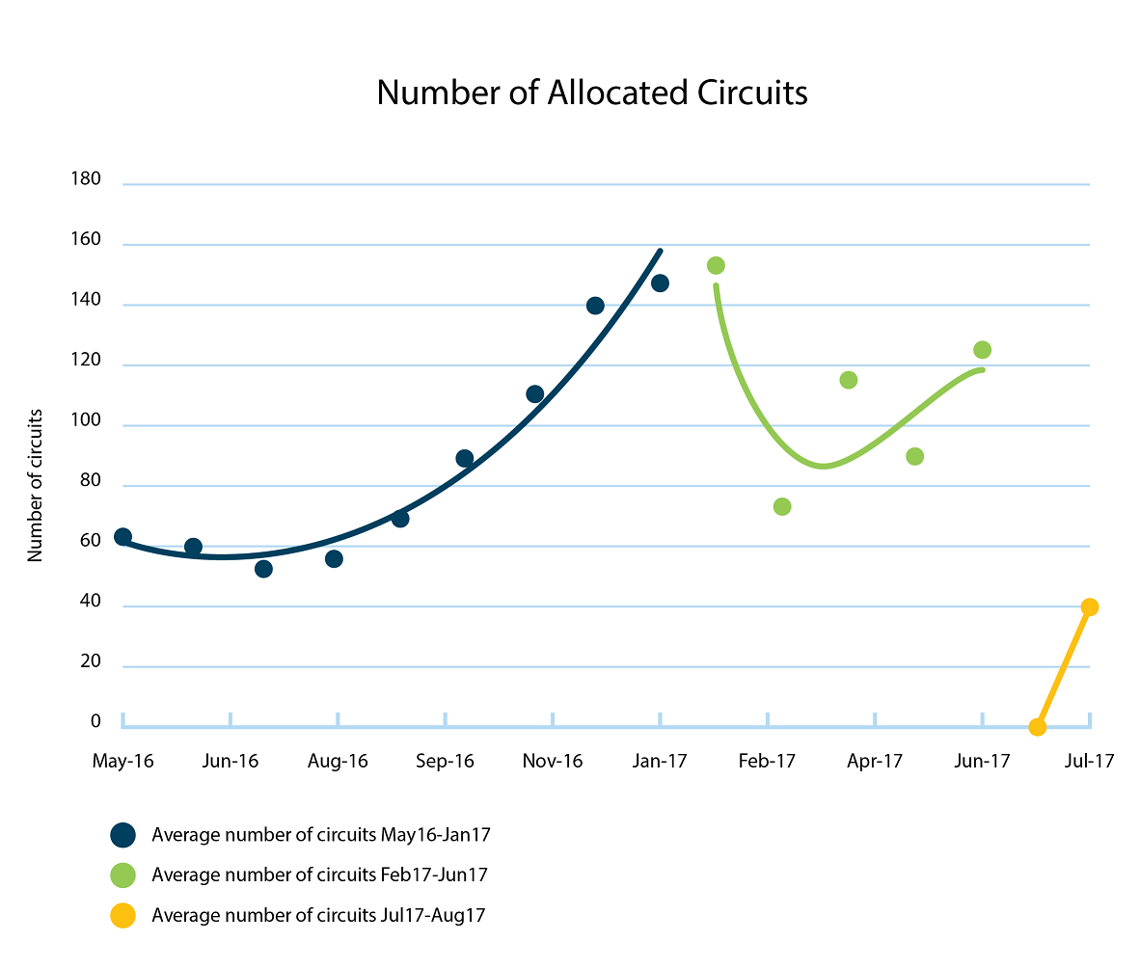
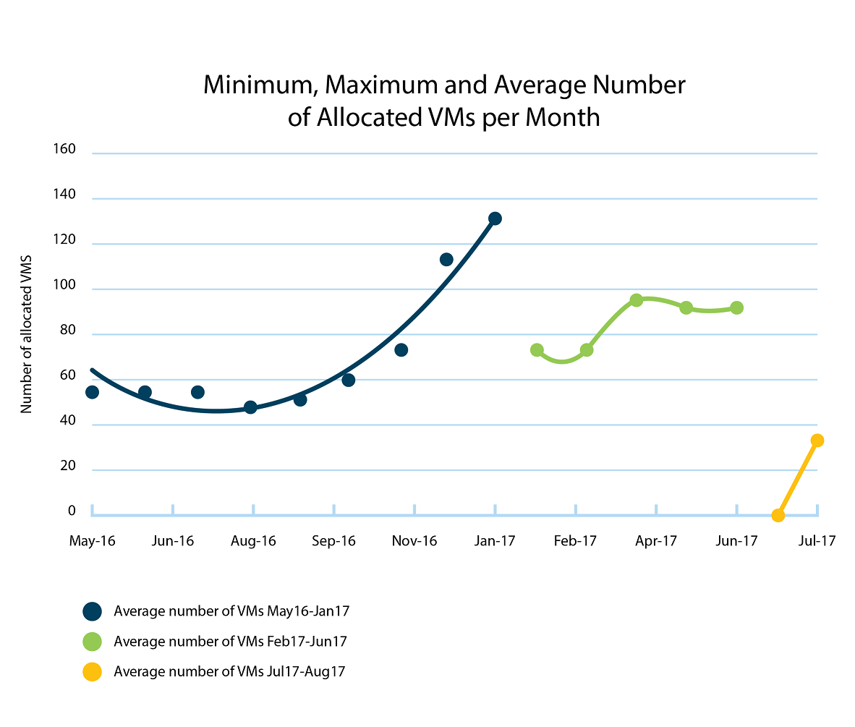
GTS Utilisation
Number of Allocated VMs
Number of Allocated Circuits
GTSv3
after partition
GTSv3
after partition
GTSv3
GTSv3
GTSv3
GTSv3
GTSv4
Service begins
GTSv4
Service begins
Note: Discontinuities are due to maintenance windows where the GTS infrastructure was partitioned for GTSv4 upgrade

Slide 7
Task 3: GTS Challenges
Performance guarantees
Challenge: QoS capabilities:
  Performance provisioning is essential to GTS testbed isolation and performance analysis
  Per-circuit QoS is needed, but current MPLS hardware does not support it
Mitigation:
  Option 1: Buy the appropriate (Juniper) MPLS router blades (capex intensive, quickest viable solution)
  Option 2: Utilise the existing switched OTN layer (Infinera) for QoS services (best technical QoS solution, OTN engineering cost unclear, GÉANT’s long-term plans for OTN layer is under discussion. )
  Option 3: SDN (too early TRL, introduces substantial re-engineering, long-term plans not clear yet)
Status: TBD
  Option 1 looking most pragmatic approach
  JRA2 is working with SA1 to set up an OTN pilot on Infinera kit
  GTS holding off planned footprint expansion until the QoS is worked out

Slide 8
Task 3: GTS Challenges
Perception
Challenge: The GÉANT ‘Testbeds’ Service is perceived as a service useful only to a small network research community, or even as a testbed itself:
  Why should NRENs deploy a testbed?
  This is an incorrect perception – but it persists
Mitigation: Re-focus the outreach for GTS: Address to the value to service providers, not just researchers:
  GTS is a means for Service Providers (NRENs) to introduce innovation easily and safely within their production environment
  Reframe/rebrand(?) GTS – It’s not just about ‘testbeds’ anymore ...Its about virtualised service environments
  Promote the Generic Virtualisation Model (GVM) underlying GTS – provides greater control over service environments, resource management, evolution planning, support for SDN, etc.
Status: In discussion phase – we want the next step to be a well-considered, comprehensive, long-term strategy:
  We need to demonstrate to the NREN service provider that:
    GTS represents an important (even critical) long-term capability for GÉANT networks
    The GÉANT Project is committed to the long-term evolution and support of GTS

Slide 9

Task 3: Looking forward
GTS version 5.0 (second half of 2018) shifts focus from user features to provider features:
  Resource migration/grooming, checkpoint/restart, federated interoperability, policy engine/resource quotas, accounting and reporting, testbed management
Reduce the cost of entry:
  Minimise the initial investment (soft resources on commodity servers to kick the tires )
  Simplify the installation, configuration, and management of the service
Sustainability planning:
  Ensuring the service is financially sustainable over the long term
  The GTS team and GÉANT Project Management are already
  vetting possible business models and operational budgets
  Focus GTS capabilities as a strategy for integrated
  network evolution

Slide 10
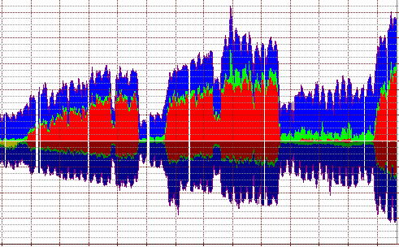
Task 4: Performance Verification and Monitoring
Period 1 achievements
Task Leader: Pavle Vuletić (AMRES)
59 PM (1.84 FTE) -> 2.6 FTE P1 Q4
  6 people from 5 partner organisations
Period 1 output:
  Milestone M8.4: Network Monitoring/
  Performance Verification Architecture
  Roadmap

Slide 11
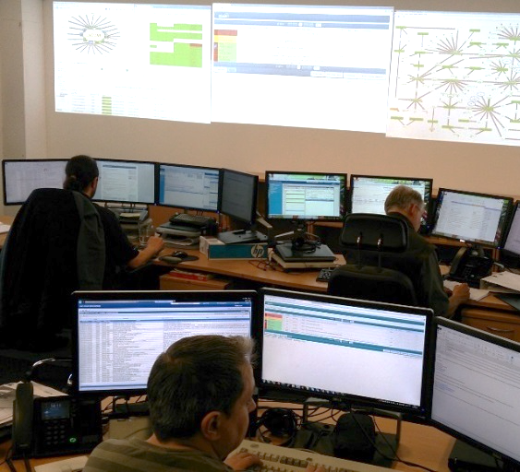
Task 4: Network and Service Monitoring (NetMon)
Performance Verification and Monitoring
The Network and Service Monitoring (NetMon) Task
is developing a generalised comprehensive network monitoring capability that will measure the performance of GÉANT network services
Goal:
  Create a framework for end-to-end monitoring of each service instance for all GÉANT network services – current and future (e.g. VNFs and service chains)
  Automated Fault-analysis Utility (AFU) to localise errors
  Extensible: Able to incorporate future service models/components (e.g. virtual switching elements, VMs, etc.)
To verify, you need to measure

Slide 12
Task 4: Network and Service Monitoring (NetMon)
Performance Verification Monitoring Accomplishments in Period 1
Defined the Advanced Service Monitor/Performance Verification Architecture (ASM/PVA)
  Full automation of service monitoring
  Performance verification
  Fault localisation processes in a multi-domain context
Initial Monitoring Demonstrator
  Currently being configured and tested in the development lab (Prague)
  Uses Virtual MX (VMX) software to act as routers and networks.
Performance Verification at 100G
  Hardware for development and validation testing of 100G PVA analysis processes has been ordered for the dev lab
Integration of the Performance Monitoring Verification (PMV) system with the Service Provider Architecture (SPA) components – ELINE Project
  Automated service verification during activation process and fault analysis, as invoked

Slide 13
Task 4: Looking forward
An automated fault analysis utility (AFU) promises to be both challenging and a critical capability for
future networks
  Adopts a “delegated” approach to decomposition testing
    Decomposition testing asserts a recursive ‘domain of responsibility’ concept – i.e. identifies which service domain is failing, notifies that domain, and expects that domain to correct the problem
    T4 is developing an inter-domain protocol specification (NSI extension) to coordinate the agents performing end-to-end decomposition testing
In the development lab:
  100Gbps – sourcing and sinking application-specific traffic profiles at 100G
  Multi-domain correlation processing
  Port-based and virtual Measurement Points
Explore how to integrate with perfSONAR:
  PVM complements existing pS capabilities
  Integration with perfSONAR package could leverage 2000+ pS installations

