Slide 1





Task 5: Network Management as a Service
Period 1 achievements
Task Leader – Jakub Gutkowski (PSNC)
Service Manager – Frederic Loui (RENATER)
1.9 FTE: 6 persons from 3 NRENs
Period 1 output:
No deliverables scheduled
Milestone M8.5 Network Management
as a Service Roadmap

Slide 2
Network Management as a Service Objectives
Objectives achieved in GN4-2 Period 1
Develop a service to simplify and automate domain network management
Usage of tools and technologies for simplifying and automating network configuration
Objectives
from
Technical
Annex
Milestone M8.5 Network Management as a Service Roadmap
Development based on third-party software
GN4-2
Period 1
Results
Network management tools available via NMaaS platform
NMaaS is using automatic configuration and container tools and technologies
Available solutions used for Portal, Services Cluster, Network Automation, Management and Monitoring
Roadmap for NMaaS Service defined in a Milestone document M8.5
✓
✓
✓
✓

Slide 3

Challenges: Managing an infrastructure is not easy
NMaaS helps with the platform and the offered tools
Challenges of contemporary network management:
  Managing networks require:
    Appropriate number of highly skilled and knowledgeable experts
    Reliable (and expensive) infrastructure
      Redundancy, resiliency, availability ...
Mitigation:
  Network Management as a Service
Result:
  Platform and tools for network management
  Easy to configure, use, manage, outsource

Slide 4

Challenges: Requirement analysis as a starting point
Challenge:
Placing NMaaS with existing NRENs' NM solutions
Tools selection
Mitigation:
Discussions with the NREN community
Expert user groups: SIG-NOC, APM/STF
Result:
Model defined for multiple use-cases
Tools selected based on SIG-NOC Survey results
New NRENs on-boarding

Slide 5

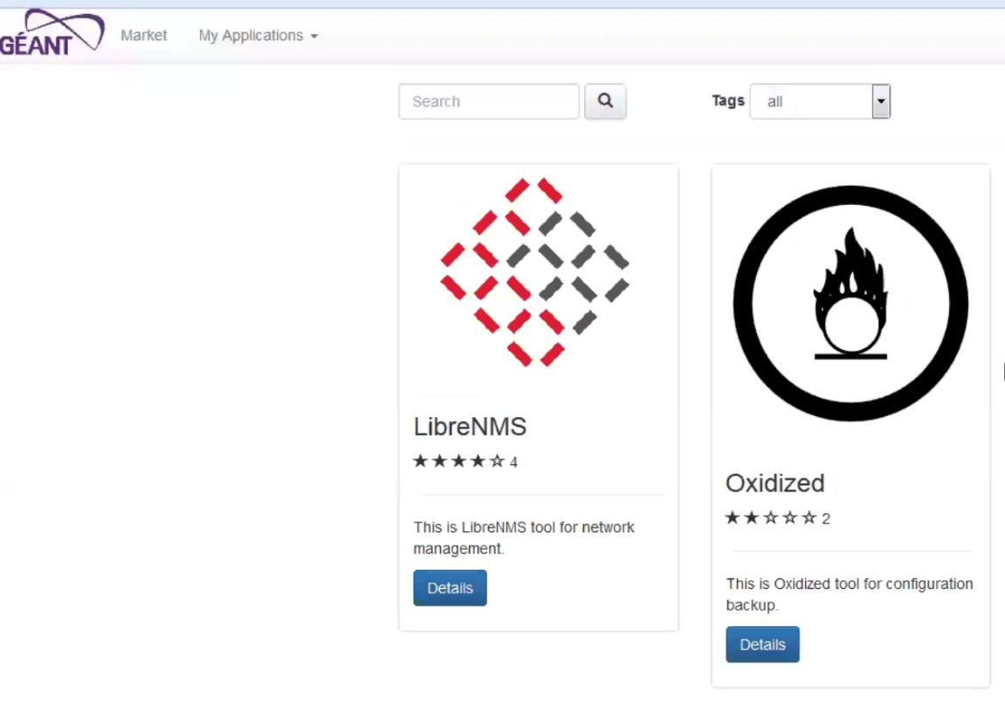

NMaaS is ...
What is NMaaS and who are its users?
NMaaS is:
A platform for network management
An application marketplace suitable for any tool
A service, providing user support and managing the infrastructure:
  Portal, virtualised infrastructure, tools, NMS cloud instances...
NMaaS users are:
Organisations that:
  Do not want to own NMS infrastructure themselves
  Want to outsource network management
Organisations and/or individuals:
  Searching for quality network management software
  Who want to share their software with the community

Slide 6
NMaaS benefits
NMaaS simplifies and automates domain network management
NMaaS platform:
Provide cloud-based, multi-tenant and secure network management platform
Enables deployment of network management tools in a cloud
Simplifies domain network management by providing the infrastructure and tools
Enables management and monitoring of client networks
NMaaS application market place:
Tools easy to install and use with minimum configuration required from users
Tools can be downloaded and installed locally or in NMaaS cloud
Tools offer can be extended with the contributions from NRENs
No limits on tools selection – beyond network management
NMaaS service:
Users do not have the ownership of specific costs and risks for NM infrastructure maintenance and management
Simplifies domain network management by providing the infrastructure and tools
Assist network engineers and/or operators in managing complex infrastructures
Network management can easily be delegated using NMaaS
... and many more ...

Slide 7


NMaaS Achievements
NMaaS simplifies and automates domain network management
Established platform for multi-tenant, secure, cloud-based network management
  Network management services provided in the Research & Education (R&E) Cloud Infrastructure
  Tools fast and easy to configure and use locally or in NMaaS cloud
  eduGAIN integration in progress
  Demonstrated and presented to the community
Leveraged third-party software
  2 initial network management tools demonstrated in the application store, more in preparations (NAV, OpenNTI)
First users on-board
  UNINET in pilot for NAV tool offering and platform sharing
NMaaS service preparation started
  Support ensured for NMaaS contributors
  Service design through the PLM process
Portal
Network automation
Services cluster
Network management:
Oxidized

Slide 8

Task 5: Conclusions
NMaaS as a Swiss-knife for network management
NMaaS is:
Developed as a platform, an app marketplace and a service
Designed for:
    Users that do not want to have the ownership of
    network management (infrastructure) costs and risks
    Organisations and users that need help in
    network management
    Organisations and/or individuals that want to
    share their software
Provides and uses a portfolio of third-party software
Offers numerous benefits and opportunities

Slide 9

Task 5: Looking ahead
NMaaS Development continues
NMaaS v1.0 pilot planned for November 2017
NMaaS will be further developed:
  To include more tools
  To become open towards users' contribution
  Towards version 2.0
NMaaS Future – guided by listening to the community:
  Platform for tools outside of Network Management?
  Collaborations with other GÉANT project efforts?
  Collaborations with NRENs and other user groups?
  ...

