Slide 1








Task 6: Network Security
Period 1 achievements
Task Leader: David Schmitz (DFN/LRZ)
2.75 FTE / 7 persons from 5 NRENs
Period 1 output:
Milestone M8.6: Network Security
Services Roadmap
Deliverables:
  D8.2: Firewall on Demand Progress Report
  D8.3: Distributed Denial of Service
  Mitigation v1.0 Pilot

Slide 2
Network Security Objectives
Objectives achieved in GN4-2 Period 1
Objectives
from
Technical
Annex
Development of Firewall on Demand
Reputation scoring of network entitites
Certificate Transparency
Deliverables and Milestones
GN4-2
Period 1
Results
Continued development of Firewall on Demand
RepShield in DDoS detection and mitigation solution
RFC6962-based design and development of Certificate Transparency log service
2 Deliverables and 1 Milestone document completed
✓
✓
✓
✓

Slide 3
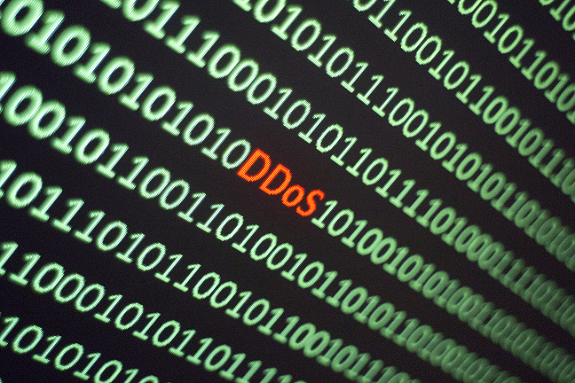
Task 6 Challenges
Exploring NREN DDoS defence systems
Challenges for the development of a multi-domain DDoS defence solutions:
Tailoring multi-domain DDoS detection and mitigation solution requires information about the DDoS mitigation efforts in NRENs
Mitigation:
DDoS mitigation Working Group
  Gathers NREN representatives on regular VC calls
Result:
Information sharing and discussion of individual
NREN solutions
Analysis of the existing open source and
commercial solutions

Slide 4
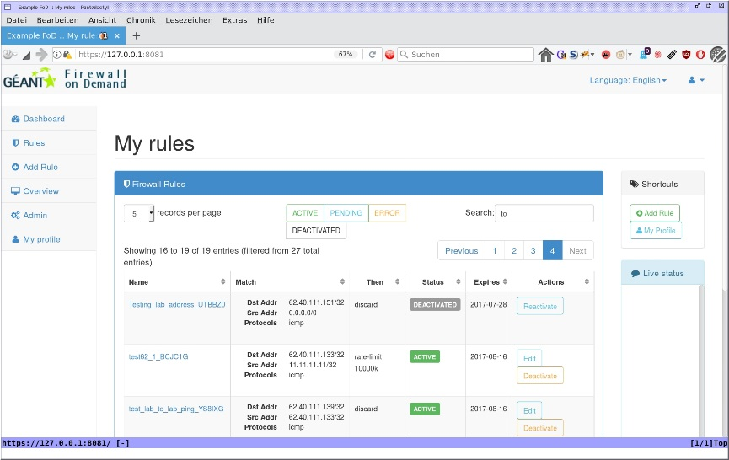

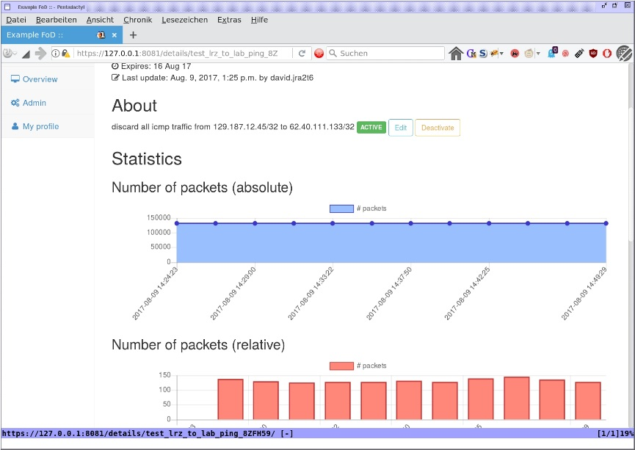
Achievements: Firewall on Demand
Continued development of FoD
Firewall on Demand:
  BGP FlowSpec-based WebGUI for DDoS mitigation by NOC admins
  Single- and multi-domain solution
FoD users:
  GÉANT community organisations (with their own AS) and their NOC operators
FoD benefit:
  NRENs can monitor and act upon any DDoS attack to protect their network using FoD
Current status:
  FoD version 1.1 in production
  FoD version 1.5 in pilot (July – September 2017)
  FoD version 1.6 in planning and development

Slide 5
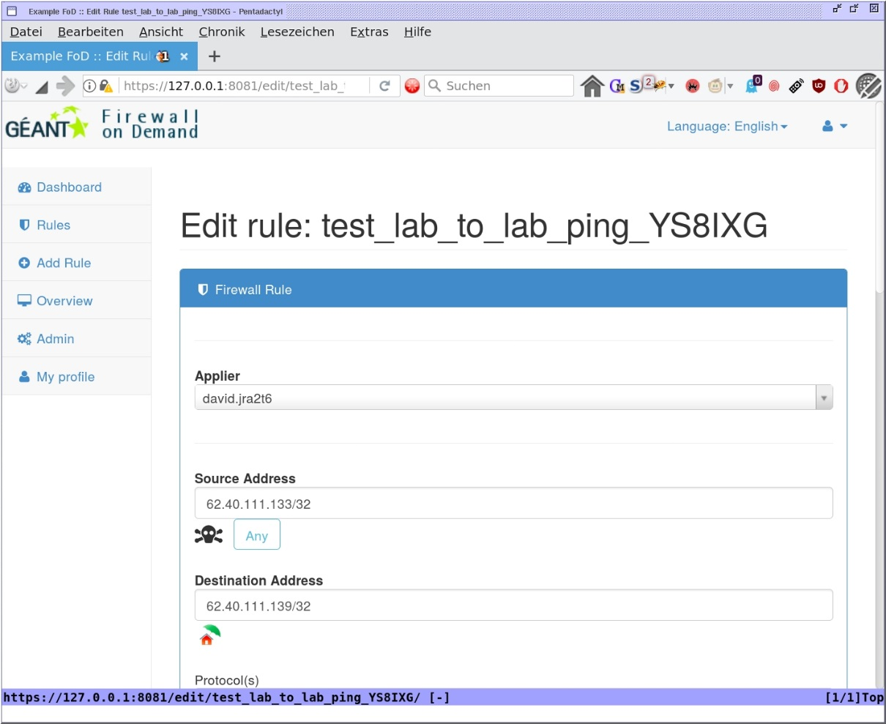
FoD versions 1.5 and 1.6
New features and systems integration
FoD development presented in Deliverable:
D8.2 Firewall on Demand Progress report
FoD version 1.5
  Easier rule specification: Port ranges
  Rule mitigation statistics
  Multi-tenant rule REST API
  Pilot preparation in progress
FoD version 1.6
  Provides automated rule proposal
  A part of DDoS detection and mitigation system
  Internally using RepShield via Firewall Rule Updater
  Currently in planning phase
  Pilot proposed in Deliverable
  D8.3 Distributed Denial of Service Mitigation v1.0 Pilot

Slide 6
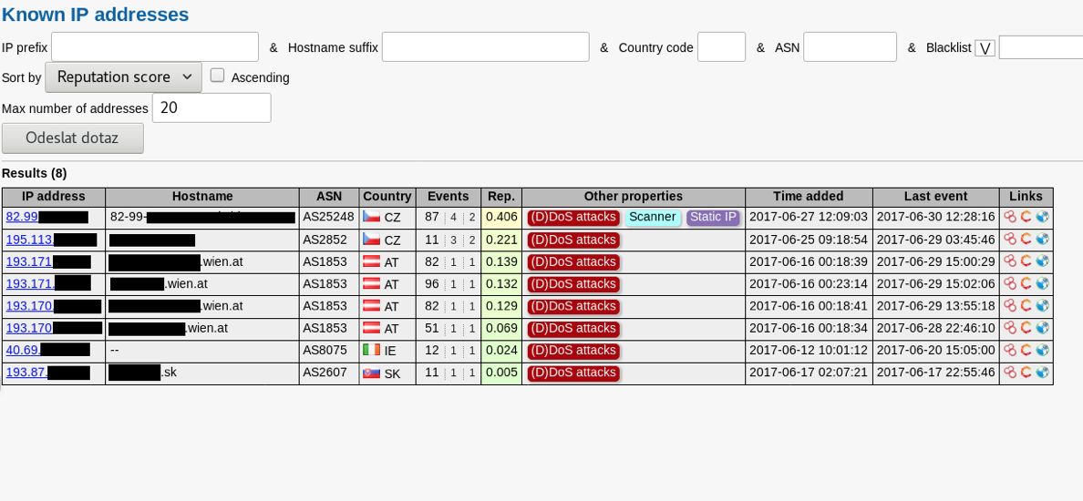
Achievements: RepShield
A part of DDoS detection and mitigation system
Reputation Shield - RepShield:
  Access correlated security events from
  alert-sharing system WARDEN
  Derived reputation score of network objects:
    IP addresses/prefixes, AS numbers,
    domain name
  Provides search function:
    by object, event type, manually
    (WebUI) or automated (REST API)
RepShield users:
  GÉANT, NRENs, research institutions, or
  other organisations
  NOC / security engineers, CERTs, system administrators, researchers

Slide 7
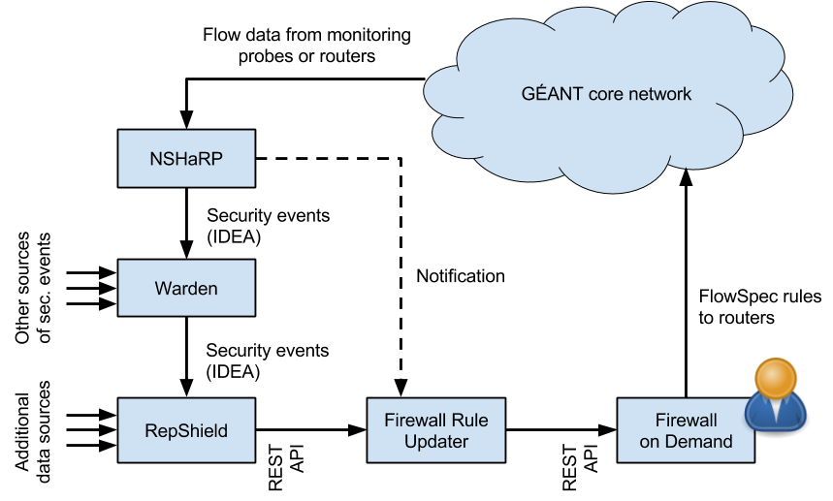
RepShield development – current status
Part of a DDoS detection and mitigation system
RepShield benefits:
  For DDoS mitigation and blocking lists:
  block all IPs with bad reputations
  Helps investigation and incident handling
  Provides events statistics
  Can be used in and for research
Current status:
  In development
  Continued work from CESNET
  Reputation score calculated based on inputs
  from WARDEN
  Pilot presented in Deliverable 8.3
GÉANT DDoS Detection and Mitigation Architecture

Slide 8

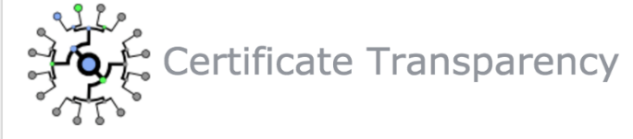
Task 6 Achievements: Certificate Transparency
Provides stronger control over domain certificates to domain-owners
Certificate Transparency (CT) is:
  A system for storing X.509 certificates in public, append-only logs
  Based on IETF RFC 6962 (CTv1) and DRAFT RFC6962 (CTv2)
  Specifies a means for verifying certificates issued for a domain
  Aimed for CAs, domain owners, browser vendors and web users
  Used and supported by Google
CT benefits:
  Allows domain owners to discover certificates issued and used
  for their domains
  Helps detect certificates from untrusted CAs without their knowledge, order, approval
  Helps strengthen the general level of trust and security in the Internet

Slide 9
Certificate transparency development - current status
A part of DDoS detection and mitigation system
Continued work from NORDUnet/SUNET
Focus on:
Design, development and testing of catlfish – CT server implementation
Contributing theory and first-hand implementation experience to the IETF TRANS working group
  "Gossiping in CT" – draft-ietf-trans-gossip-04
Current status:
Version 0.10.2 released and tested between SUNET and DFN
Preparations for production
Deliverable D8.4 Certificate Transparency Log v2.0 Production Service in progress

Slide 10

Task 6: Conclusions
Network Security focuses on FoD, RepShield and CT
Focus on DDoS detection and mitigation:
  FoD, RepShield, DDoS mitigation Working Group
Continued development of FoD:
  Added port-ranges based filtering and new statistics in v. 1.5
  FoD ver. 1.5 pilot in progress, v.1.6 in development
Development of RepShield
  Reputation score calculation for better traffic filtering/analysis
  A part of DDoS detection and mitigation system with FoD 1.6
Certificate Transparency:
  Development towards the production service
  Deliverable 8.4 in preparation
2 Deliverables and 1 Milestone document published

Slide 11

Task 6: Looking ahead
Towards the production services
Roadmaps for all three work areas defined:
  FoD v1.5 and 1.6
  RepShield integration with FoD into DDoS detection and mitigation system
  CT v1.0 production
Strong collaboration with GÉANT security team to continue
Further work will consider:
  Security testbeds
  Feedback from DDoS mitigation Working Group
  Test and Pilot results
Final goal
  Useful, stable production services in use

Slide 12
In conclusion: Resolution of challenges and observations
Mitigation of coordination and staffing issues
Mitigation:
  Appointment of a Co-Activity Leader (Ivana Golub) for T5 NMaaS and T6 NetSec
  Additional software development staff requested:
    Partially filled to date from NRENs
Result:
  Tasks are making better progress due to increased staff
  Hiring software developers remains an issue

Slide 13

In conclusion
8/JRA2 is developing a broad range of very ambitious new services
T1 CCS – Simplified, user-facing connection services with intelligent resource planning/provisioning
T2 SPA – ELINE pathfinder project leveraging the common information architecture
T3 GTS – Advanced, virtualised service environments for innovation
T4 PMV – Advanced, automated, multi-domain performance verification and fault analysis
T5 NMaaS – Cloud-based processes for simplified and scalable, automated network management
T6 Net Sec – Coordinated and automated DDoS mitigation and advanced internet security capabilities
  The team is aggressively taming complexity that is critically important to GÉANT’s future:
    Delivering well-designed foundations for their continuing evolution and long-term support
    Deploying and supporting early TRL services

Slide 14

Thank you
Any questions?

Slide 15
What Does GTS do?... Really..
Existing GTS Service
User Agent(s)
Common Open API
CCS
VM
VFC
BMS
Composite
SBI
OpenNSA
SBI
OpenStack
SBI
CorsaOS
SBI
iDRAC
Common
API
Shared
Information Base
GÉANT Infrastructure

Slide 16
What Does SPA do?... Really..
User Agent(s)
Common Open API
CCS
VM
VFC
BMS
Other svc
...
BSS
OSS
PM
PM
PM
PM
PM
PM
SBI
OpenNSA
SBI
OpenStack
SBI
(corsa)
SBI
IPMI
Prov
System
Prov
System
Shared Integrated
Information Base
GÉANT Infrastructure

