Slide 1
WP7. Pilot coordination and continuous risk assessment
Michał Zimniewicz
Poznan Supercomputing and Networking Center
Up2U Update Webinar
13th June 2019
Notes:
These slides present the status up to the second half of May

Slide 2
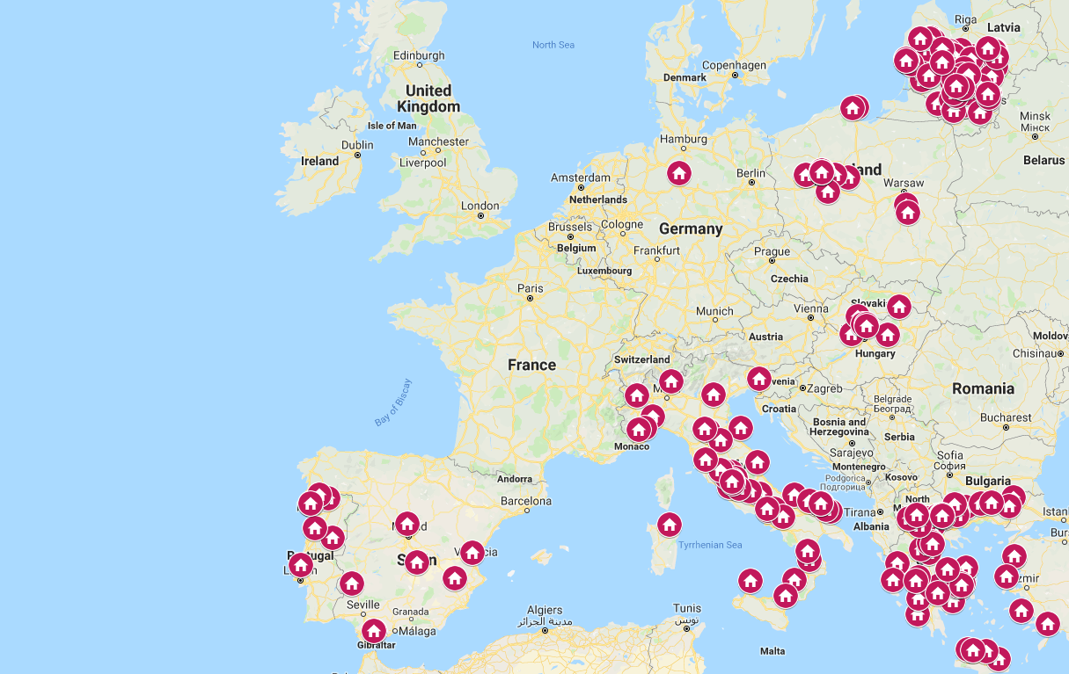

Slide 3
Pilots
Greece
  4 schools active
  Meetings with CPD and teachers who use the tools in classrooms
  Creating additional materials to attract schools
Hungary
  3-4 schools active
  Work on new invitations
  F2f meetings for students

Slide 4
Pilots
Italy
  More than 100 teachers in CPD
  13 courses, 5 active with students (ca. 70 students in total)
  New dissemination activities to reach teachers
  Trying to understand why teacher are not joining
Lithuania
  More than 120 schools registered; ca. a half of them is active
  219 teachers finished 2nd iteration of CPD M1, and 76 of them have registered to continue in M2

Slide 5
Pilots
Poland
  11 schools started activities between March and May
  F2f meetings for all the schools
  New f2f training for 10 teachers for two full days
  Engagement through collaboration with other projects
Portugal
  8 schools in joint CPD 1&2 since January
  First class of students joined in February
Notes:
Poland: In April, the activities were cancelled and suspended because of the national teacher strike.

Slide 6
Pilots
Spain
  1 school active (around 40 students) between February and April
  New invitation ongoing via social media communities
Germany
  Launching the pilot in September

Slide 7
Tools in Use per Countries
Greece – Moodle, eduOER, H5P, CERNBox, DSpace, SeLCont, Knockplop, PODDIUM, SWAN
Hungary – Moodle, Knockplop, NextCloud, Mahara, Videotorium and Etherpad
Italy – Moodle, H5P, eduOER, CERNbox
Lithuania – Moodle, eduOER, H5P, Knockplop
Poland – CERNBox, SWAN, Knockplop, MultipartyMeeting, OpenEdX
Portugal – Moodle, Knockplop, Poddium, eduOER, H5P
Spain – Moodle, H5P, Poddium, Knockplop, eduOER, DSpace, Owncloud

Slide 8
KPI in the New Workplan
The number of pilot schools
  Request to the EC for changing 1500 to 1000
University enrolment rate – To be considered as irrelevant
  Success rate of student enrolments to university across the pilot schools in Europe: Year 1: baseline, Year 2: +15%, Year 3: +20%
  Weak correlation with the project’s impact
  Debatable feasibility to collect meaningful data

Slide 9
Minimum Viable Product
Finalising 2nd phase of MVP
Collecting suggestions in http://bit.ly/2WCg9gj
Main suggestions are:
  New tools
  Improving user experience
  Add features available in competitive solutions
Analysing the collected feedback
Notes:
Collected via questionnaires and other ways chosen by national pilot coordinators

Slide 10
Quality Control and Risk Assessment
Full review of the risk register
Functional testing
  New people joining
  Recently very active because of the upgrades of Moodle
  The upgrades of CERNBox and SWAN
  Report issues: https://wiki.geant.org/display/UP2U/Issue+tracking
Performance testing initiated

