Slide 1
Subject Matter Committee
Mary Grammatikou
National Technical University of Athens
Up2U webinar, June 2019

Slide 2
SMC Meetings
Six meetings in the last period
  The first one on 31st of January 2019
  The second one on 4th of March 2019
  The third on 15th of March 2019
  The fourth on 5th of April 2019
  The fifth on 23rd of April 2019
  The sixth on 24th of May 2019

Slide 3
SMC new members
Four new experts are added to the SMC:
Prof. Bruno Losito (UROMA- Italy)
Dr. Berita Simonaitiene (KTU – Lithuania)
Dr. Lisa Amdur (TAU – Israel)
Dr. Despo Ktoridou (University of Nicosia - Cyprus)

Slide 4
Discussions in the last SMC meetings
Introducing the new members in the SMC
Discussion on the Module 2
  Discussion on the existing evaluation methodologies
  Discussion on the methodology that fits to Up2U needs
  Comment on the questionnaires and new proposals
Discussion in depth on the methodology that Up2U will adopt
Questionnaires (teachers and students)
Focus groups
Notes:
What discussed in the two last meetings

Slide 5
SMC Next Steps
SMC will:
Support the new methodology of evaluation the pilots’ results
support the online education for the learning community
support the method of learning the learners
investigate the final results of pilots regarding both students and teachers
Advice on the review and evaluation of the pilots’ feedback

Slide 6
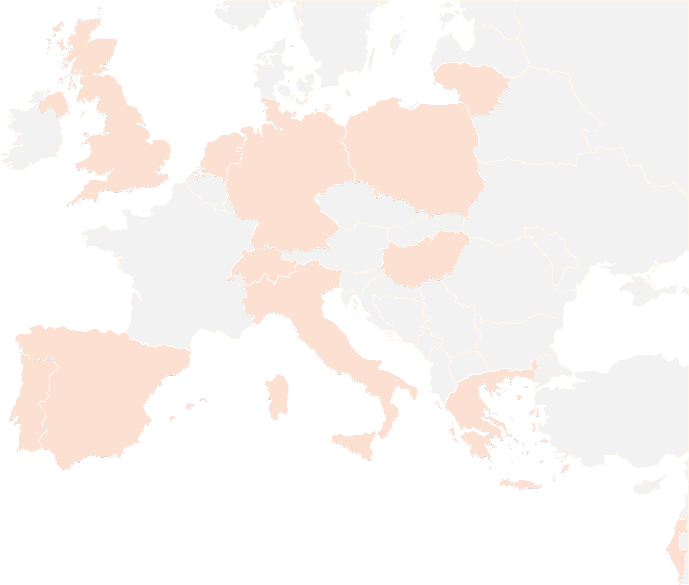
THANK YOU FOR YOUR ATTENTION!
contact@lists.up2university.eu
#up2universe

