Slide 1
WP4 Webinar Update
Up2U Update

Slide 2
Platform status & WP4 activity
Pedagogy and development testing platforms
  Updated to Moodle 3.6.2
    Fixes multiple issues
    Capability configuration
    GDPR improvements
Testing for update to production platform
Developer documentation/specification for M30 milestone
Notes:
From Github issue tracker

Slide 3
Next steps
Finalise documentation
Initiate fortnightly WP4/WP5/pilot calls
  Learning scenario elicitation
Schedule production update

Slide 4
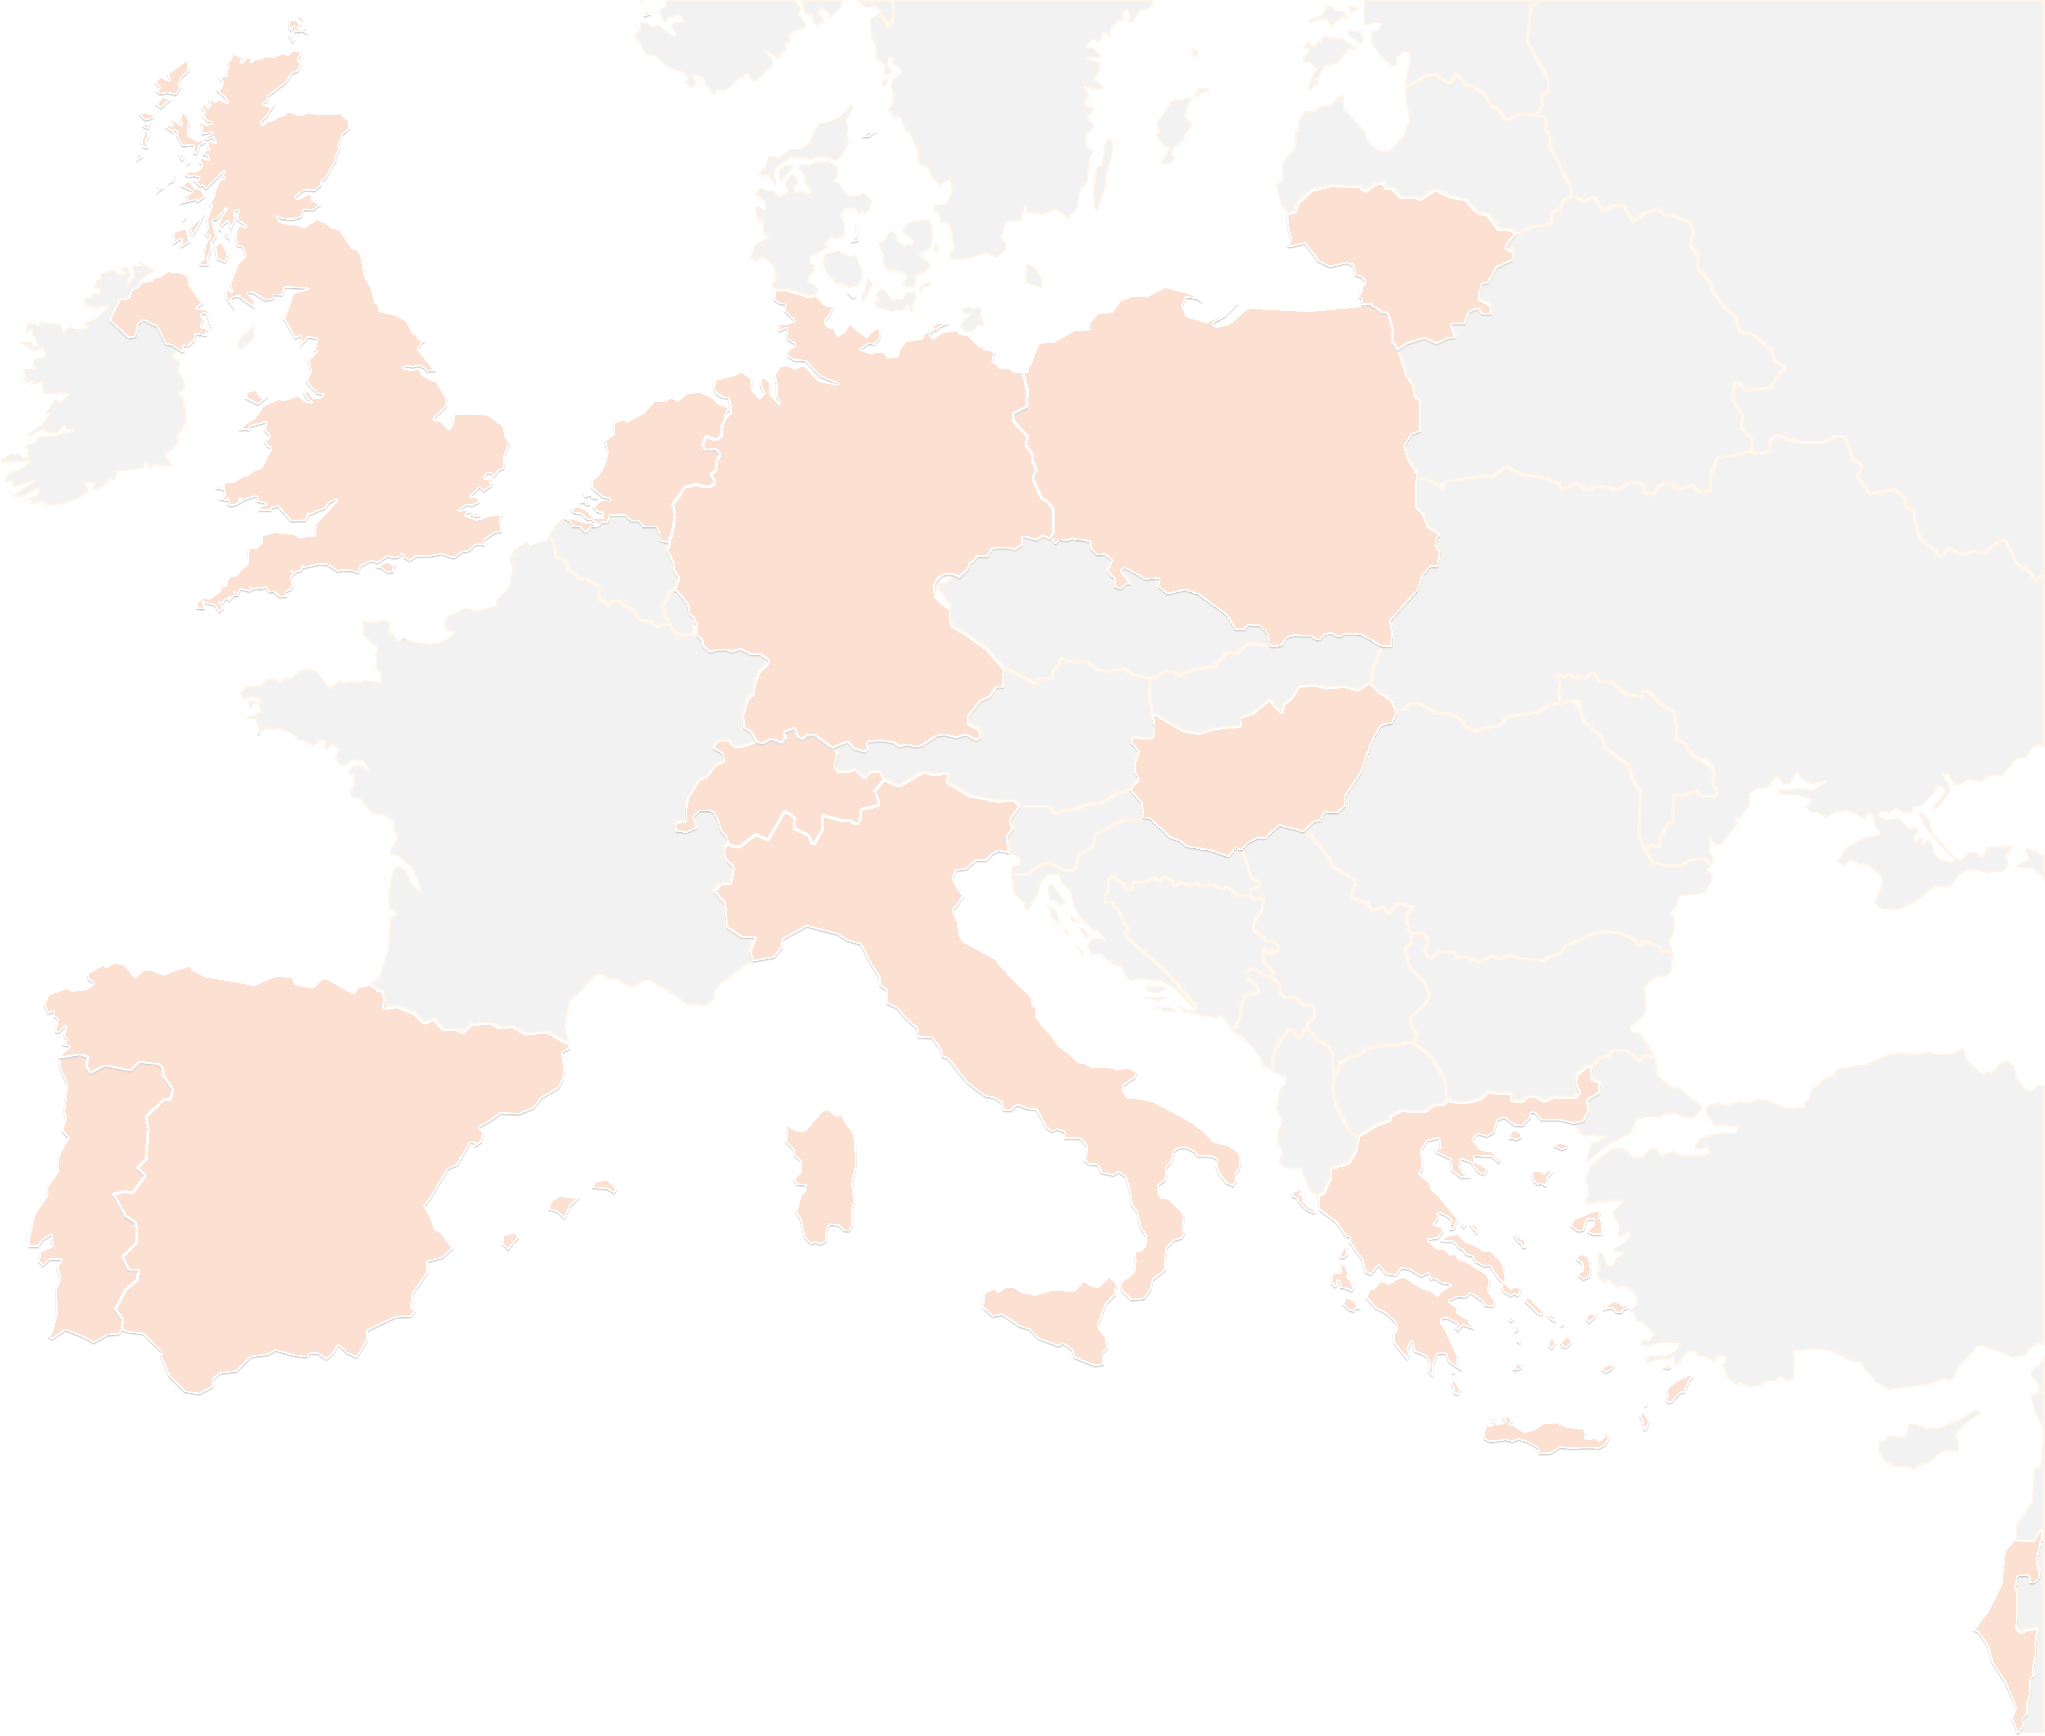
THANK YOU FOR YOUR ATTENTION!
wp4@lists.up2university.eu
#up2universe

