Slide 1
WP5 Webinar Update
Up2U Update

Slide 2
Learning Communities & WP5 activity
Collaborative writing of revised Deliverable 5.4 on Pedagogical Foundations for Assessment and Methodology -
  Methodology plan under the coordination of TAU- with supervision of an IEA expert
    Course and groups Naming Prescriptions
    Learning Locker Aggregation API to produce easy to read graph based on Learning Analytics
    Monitoring in progress Pilots
    Production of Templates for Pilot Self-Assessment Interactive Documents
User Community organization
  Groups & projects creation on CommonSpaces for Teachers, students, self-directed learners
Notes:
From Github issue tracker

Slide 3
Learning Communities & WP5 activity
User Community organization
  Groups & projects creation on CommonSpaces for Teachers, students, self-directed learners
ISEP production of VPL interactive activities for the next year
Learning Analytics in Up2U - Why and How to
  Jupyter Notebooks integration of Learning Locker queries
  Documentation and Learning Path for teachers
Documentation/specification for the teachers / for the independent learners to be embedded into final D5.5
Notes:
From Github issue tracker

Slide 4
Next steps
Competence functionality implementation in the Moodle platform (TAU, IUCC)
Translation of 3 Learning Units from italian to english
  Sharing the process of translation into other national languages
  Supporting spanish translation ...
Production of 3 more Learning Units in english
  Collection of national content production
  Selection of the best Learning Units
Production of Documentation on How to use LA in 2019/2020 Pilots - Operating instructions
Template production to support collection of Pilots’ final assessment

Slide 5
Next steps (2)
University as a Hub - planning the University outreach programs
  Project of H-Hub at Sapienza
    Experimental usage of Up2U regional schools to enhance awareness of secondary students in choosing their University Degree
    Monitoring activity coordinated by Sapienza in some regional secondary schools
    Harmonization of Outreach activities with other partner countries (TAU, IUCC, ISEP)
Experimental usage of NLP libraries to support semi-automatic essays evaluation
  NLP team at Sapienza will experiment with some NLP OS libraries
  Connection between TAU and other Universities to collect homogeneous, comparable results

Slide 6
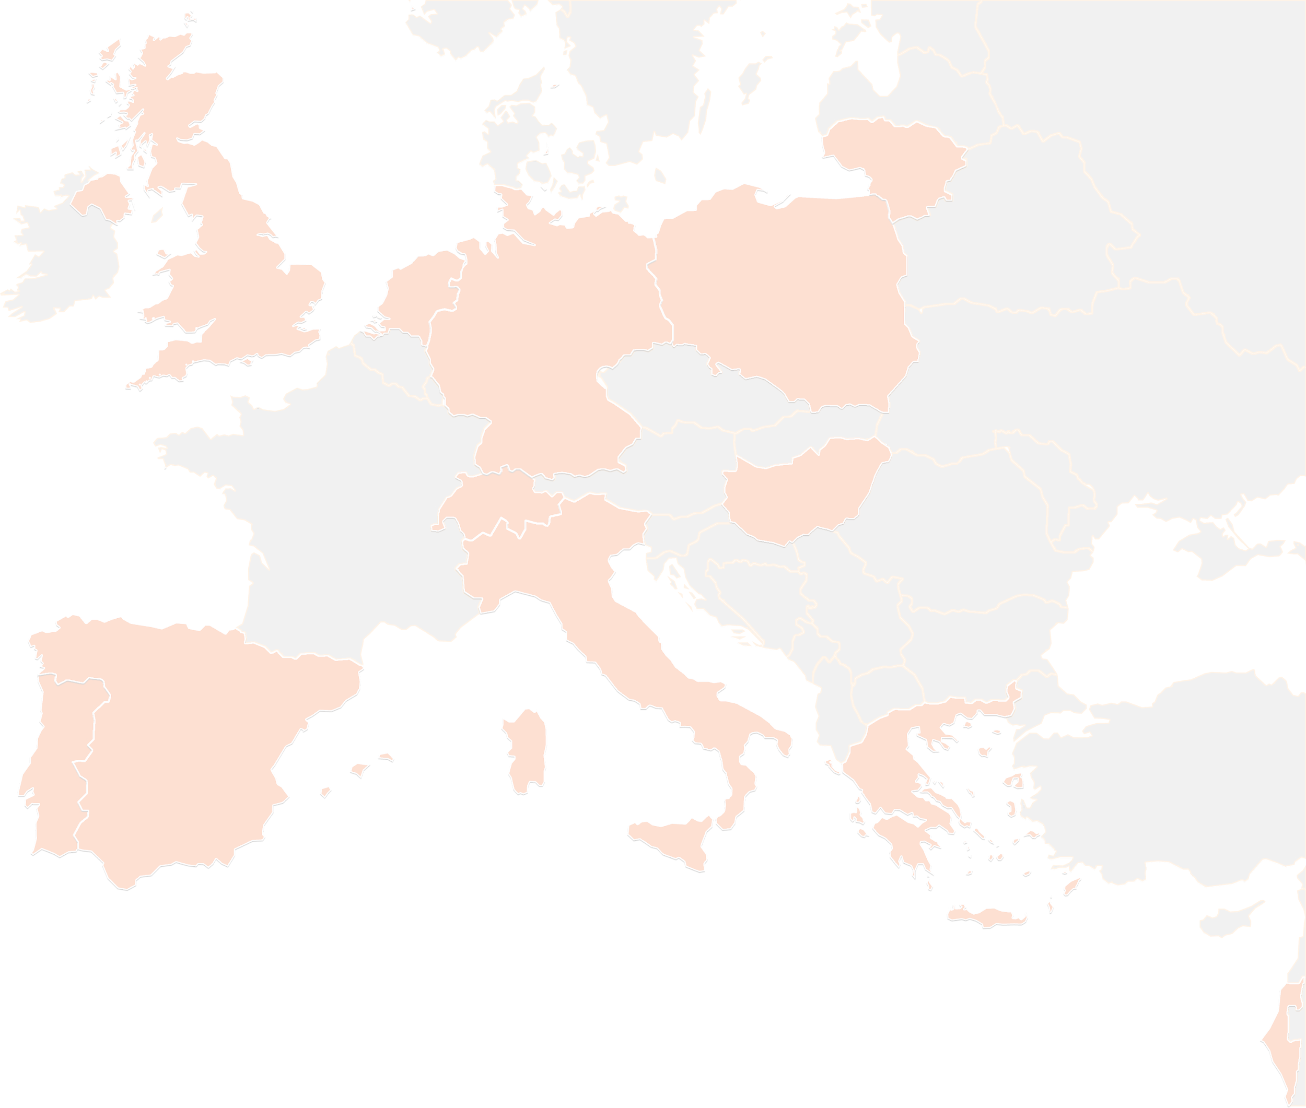
THANK YOU FOR YOUR ATTENTION!
wp5@lists.up2university.eu
#up2universe

