Slide 1
WP6
_{UPDATE - June}
Gabriella Paolini
GARR

Slide 2
Security Guidelines translation
Done: Italian
On going: Greek, Hungarian
GARR website page for the project with Guidelines
    https://www.garr.it/it/comunita/scuola/progetti/up2u

Slide 3
#SecurityTuesday,

Slide 4
GDPR on Moodle 3.6.2
New version installed in testing mode
  No issues reported!
To do:
  upload the Policy notice
  configure privacy and policy settings,
  test collecting of consents
  -> upgrade the production instance.

Slide 5
New workplan
New deadline for Deliverable 6.3
  M39 – March 2020

Slide 6
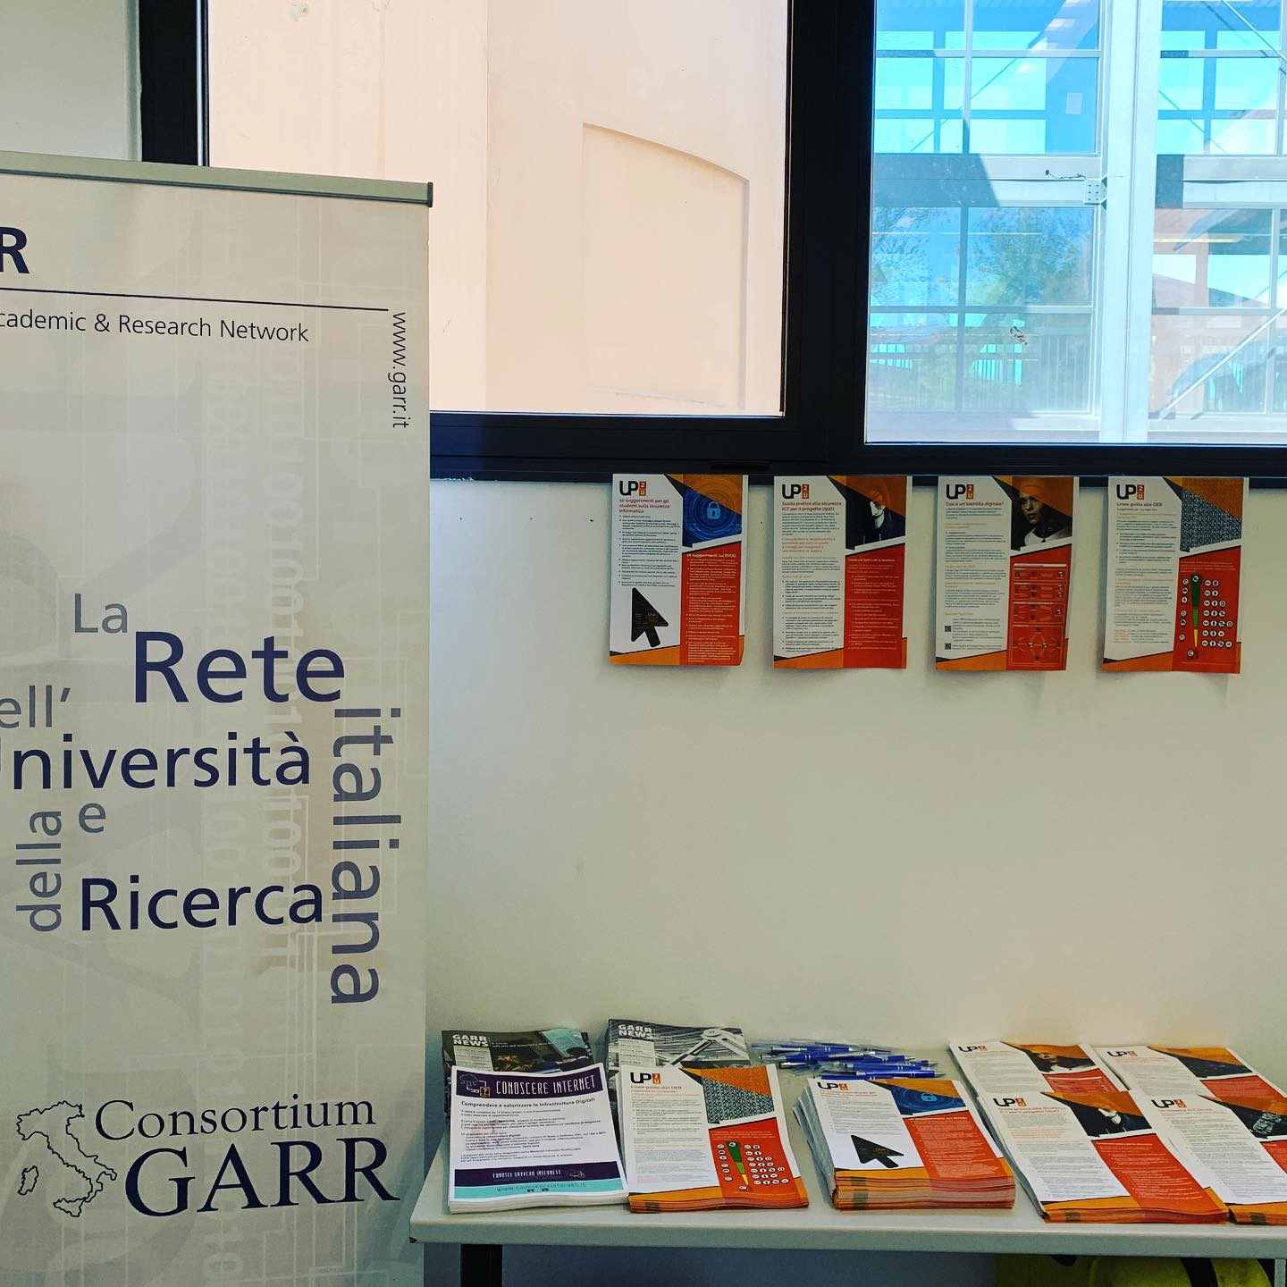
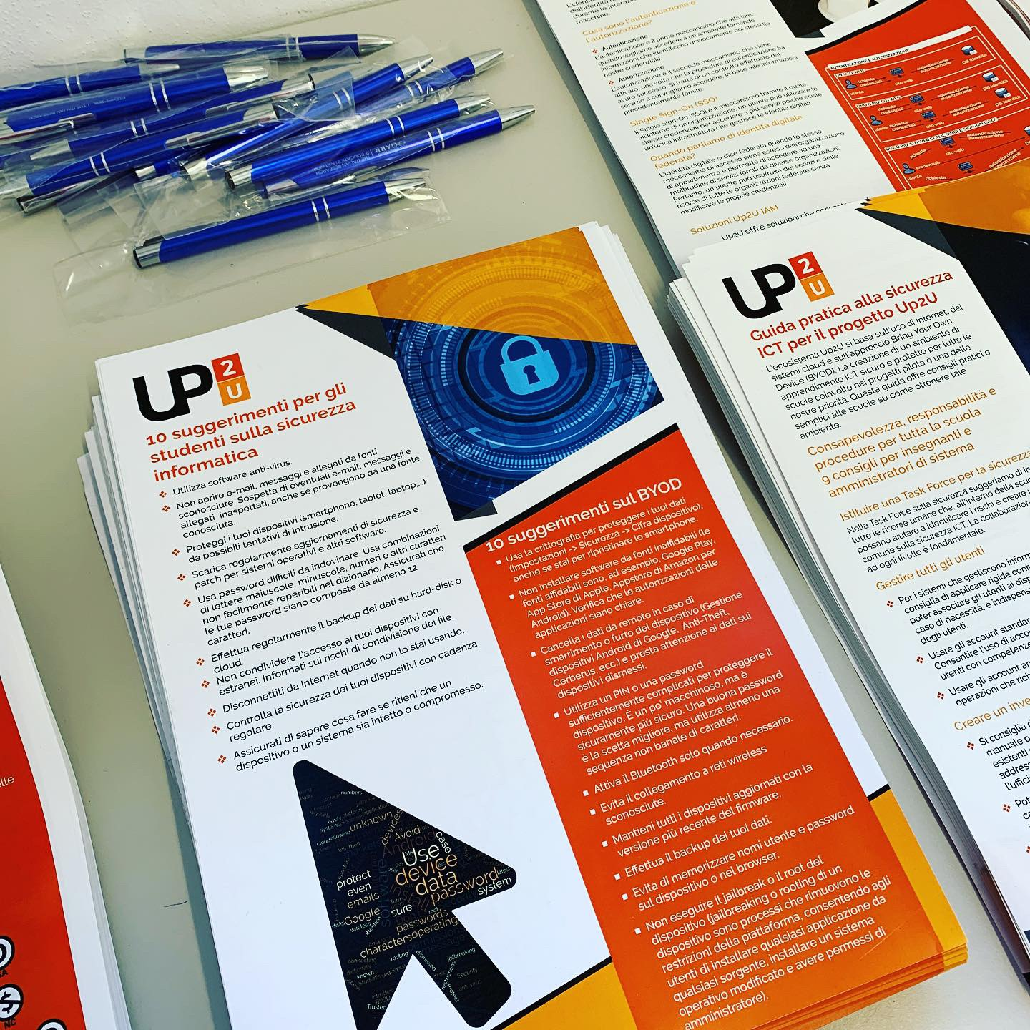
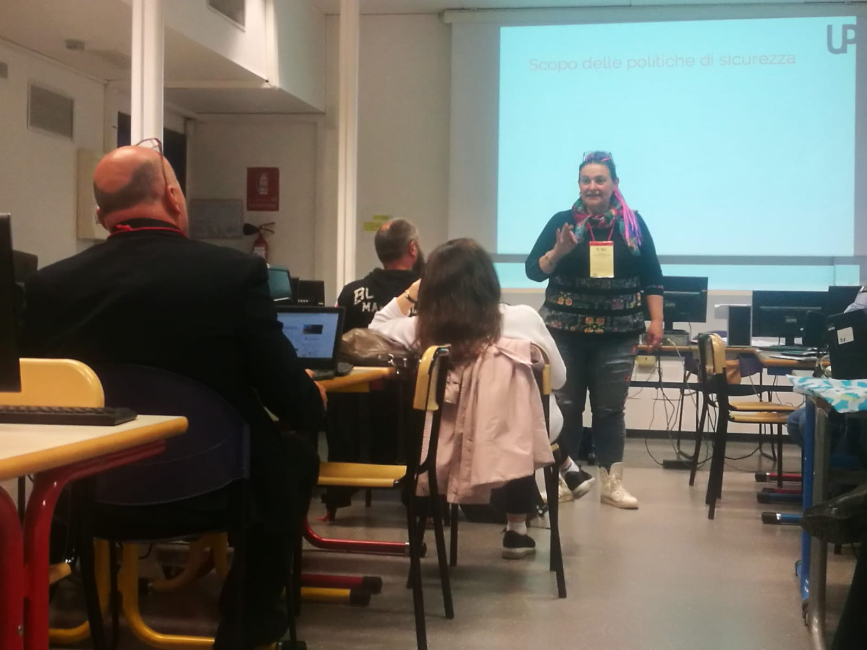
UP2U Security training
Meeting Insegnanti 2.0 - Bologna
Conferenza GARR - Torino

