Slide 1
WP1 Update
Gyöngyi Horváth
Webinar #4 13/06/2019

Slide 2
Past - Work done
Up2U Workplan revision
General Assembly
Financial report
  Q8 done
  Q9 – urgently needed to be finalised
Notes:
Up2U workplan revision from all WP leaders and the PCT took most the effort which has been made during the last two months as the planning involved agreeing on requesting extension of the project for the purpose of reaching the key KPIs and the key objectives of the project. The extension is planned for 4 months with the 5th month as the reporting time indicated. In the meantime the key focus will be on getting more pilots to the project.
General Assembly is planned for 10-11 September in Poznan, Poland. Logistics arrangements has started and agenda preparations have been made.
Financial report – Past period:
Q8 is finalized
Q9 reporting:
Submitted by:
Missing from: GRNET
ISEP
IUCC
OwnCloud
GWDG

Slide 3
Future - Ongoing/Planned work
Submit request to the EC for extension
Revising deadlines
Finance
Monthly reporting:
  Overall project
  Pilots
  Communication
  Finance
Notes:
If the Up2U revised workplan is approved by the reviewers we need to submit an official request to the EC for the extension proposed. This also requires all deadlines to be amended and all relevant team members to be informed (GEANT Technical Authors…etc).
Once again, once the workplan approved, the finance / person effort needs to be amended based on the proposal. Relevant team members will need to submit change requests, person months needs to be amended from all WPs and also from the finance team.
Monthly project reporting should now be back to normal: monthly webinar to be the base for the reports.

Slide 4
Up2U monthly webinar
WP2
Barbara Tóth
KIFÜ

Slide 5
Ongoing tasks, updates
  Help us get feedback about the website! Usability test and bug report https://trello.com/c/iVcqKvQ8/89-up2u-website-development-usability-test-and-bug-report
  Upcoming events with Up2U presence:
  TNC, EDULEARN, ECEL
  Motion graphics video will be launched during TNC with professional voiceover. Subtitles are welcome!
  IT security flyers available on the website-translations are welcome!
  #SecurityTuesday-new activity each Tuesday social media content on IT security
Notes:
Website improvement efforts:
In order to improve the website we introduced two tools. Please use them: bug report (for internal use) and usability test (external use). Please ask teachers, students, people who are not familiar with the project to conduct this test so we can improve the website based on their feedback.
We will have a dedicated Up2U special session in the following upcoming events: TNC(16-20 June 2019), EDULEARN (01-03 July 2019), ECEL (07-08 November 2019).
The motion graphics video was finalized. We managed to purchase professional voice-over so the quality of the video is even more superb. Feel free to share and use the video!
The IT security flyers are ready for sharing available on the website. Italian and Greek version are ready, Lithuanian and Hungarian versions are expected to be ready in the upcoming weeks.
We launched a new social media activity that is focused on a theme-IT Securtiy. Each Tuesday we share content in this topic: flyer, video, etc.

Slide 6
Reminders, requests
  We are collecting how much merch should we order to promote the project. Fill out this form please!
  Don’t forget to share information about your local and international events:
  https://docs.google.com/spreadsheets/d/1sbdofqggjqn2uyM_1a1ZmchNXCLjW3rAq3UNK3mW0XE/edit?usp=sharing
  Let us know if you have social media post or new item ideas! Share and promote our content please!
  Next WP2 mtg: 14 June 2019 12:00 CEST
    Zoom: https://videoconf-colibri.zoom.us/j/693659865
Notes:
We are collecting how much stickers, bookmarks, IT security flyers should be produced. You can also handle printing if you prefer, you need to claim the costs of this (with proper invoicing) under ODC.
Please let WP2 know if you are planning to submit a proposal to a conference/event. In the above mentioned link you can find sheets dedicated to local and to international events. Please make sure you provide input regarding your local session with teacher, as this table will be used by Michal for his WP7 reports.
Based on this we have no progress this year! We have to be more transparent!
We are trying to improve our social media presence by creating more content. Please provide input so we can make our feed more colourful. React on our feed! That is why we tag the partners! Only a couple of them share our content! This should be a joint effort!

Slide 7
Up2U monthly webinar
WP3
Ilias Hatzakis
GRNET

Slide 8
TASK 3.3: OER
  NEW REPOS:
    Oxford University (534 lectures on science, math, chemistry, astronomy, biology, coding etc.)
    Sheffield University (189 lectures on kinds of disciplines including math, IT, literature etc.)
    Asian Art Museum (498 lectures on Asian art and architecture)
    BBC Radio (48 animations mainly on Philosophy).
  We now have 46 repositories (16 HE and 30 K12 ).
  Deliverable 3.5 Final-Cloud-Platform-Overview-Including-Access-To-Network-Storage-And-Content. Delivery deadline extended to October 2019.
Notes:
A continuous work is in constantly in progress with the investigation, selection and finally harvesting and integration of new repositories. Specifically the results of this task during the last months were the integration of 4 additional educational repositories, namely:
The Oxford University repository with 534 lectures, mainly on science, math, chemistry, astronomy, biology, coding etc.
The Sheffield University repository with 189 lectures on all kinds of disciplines including math, IT, literature etc.
The Asian Art Museum repository with 498 lectures on Asian art and architecture
The BBC Radio repository with 48 animations mainly on Philosophy
With these new entries, we now have on board 46 repositories, 16 addressed to Higher Education and 30 addressed to the secondary education.

Slide 9
TASK 3.2
  OCM tests have been performed between OC and NC and they seem to work fine
  Still some bugs to be fixed before releasing the final version of the OCM protocol
Notes:
OCM tests have been performed between OC and NC. There are still bugs that prevent a fully cross platform OCM interoperability. CERN is trying to fix them in the following weeks
At the same time, continuous improvement of CERNBOX and SWAN based on the feedback from pilots is taking place

Slide 10
TASK 3.1
  Continuous improvement of the WebSSO.
  Continuous bug fixing
Notes:
In the framework of Task 3.1, the work is in continuous progress with improvements of the WebSSO and general bug fixing, according to remarks generated during the pilots

Slide 11
WP4 Webinar Update
Up2U Update

Slide 12
Platform status & WP4 activity
Pedagogy and development testing platforms
  Updated to Moodle 3.6.2
    Fixes multiple issues
    Capability configuration
    GDPR improvements
Testing for update to production platform
Developer documentation/specification for M30 milestone
Notes:
Current version of Moodle is 3.3. Moodle 3.6.2 contains fixes for multiple issues affecting or reported for the platform (e.g., compatibility with certain uploaded H5P activity types), and GDPR-related privacy support. The official Moodle GDPR measures do not fully address the stricter GDPR approach of Up2U; we have also added the ability automatically to configure Moodle “role capabilities”, which increases our flexibility in managing what different types of user are able to do. This enables us to limit the visibility of user data further than the defaults.
As a major update, moving the production platform to Moodle 3.6.2 requires further testing, which is ongoing.
The M3.4 milestone due in M30 requires the platform specification to be released to app designers and developers – we have been working on an aggregated document describing the integration processes for various types of infrastructure and tool with the Up2U platform.

Slide 13
Next steps
Finalise documentation
Initiate fortnightly WP4/WP5/pilot calls
  Learning scenario elicitation
Schedule production update
Notes:
The specification documentation will be completed and published for M30.
A regular call will be set up between WP4 and everyone involved in the pedagogy to ensure new learning scenarios developed by pilot teachers can be documented and related to their realisation on the Up2U platform, with any required tools or functionalities integrated.
A date and time will be scheduled to update the production platform to the latest version of Moodle

Slide 14
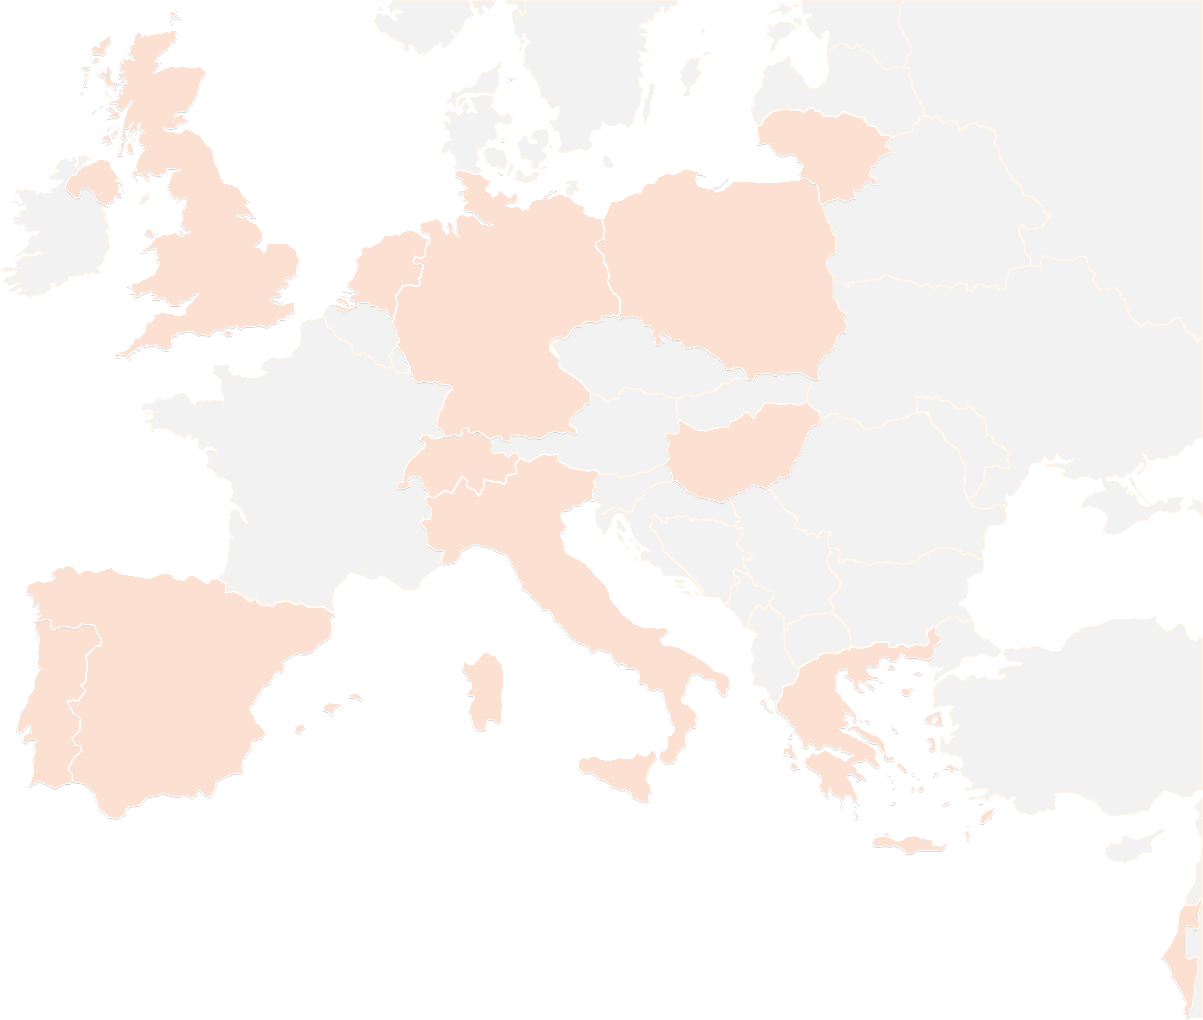
THANK YOU FOR YOUR ATTENTION!
wp4@lists.up2university.eu
#up2universe

Slide 15
WP5 Webinar Update
Up2U Update

Slide 16
Learning Communities & WP5 activity
Collaborative writing of revised Deliverable 5.4 on Pedagogical Foundations for Assessment and Methodology -
  Methodology plan under the coordination of TAU- with supervision of an IEA expert
    Course and groups Naming Prescriptions
    Learning Locker Aggregation API to produce easy to read graph based on Learning Analytics
    Monitoring in progress Pilots
    Production of Templates for Pilot Self-Assessment Interactive Documents
User Community organization
  Groups & projects creation on CommonSpaces for Teachers, students, self-directed learners
Notes:
From Github issue tracker

Slide 17
Learning Communities & WP5 activity
User Community organization
  Groups & projects creation on CommonSpaces for Teachers, students, self-directed learners
ISEP production of VPL interactive activities for the next year
Learning Analytics in Up2U - Why and How to
  Jupyter Notebooks integration of Learning Locker queries
  Documentation and Learning Path for teachers
Documentation/specification for the teachers / for the independent learners to be embedded into final D5.5
Notes:
From Github issue tracker

Slide 18
Next steps
Competence functionality implementation in the Moodle platform (TAU, IUCC)
Translation of 3 Learning Units from italian to english
  Sharing the process of translation into other national languages
  Supporting spanish translation ...
Production of 3 more Learning Units in english
  Collection of national content production
  Selection of the best Learning Units
Production of Documentation on How to use LA in 2019/2020 Pilots - Operating instructions
Template production to support collection of Pilots’ final assessment

Slide 19
Next steps (2)
University as a Hub - planning the University outreach programs
  Project of H-Hub at Sapienza
    Experimental usage of Up2U regional schools to enhance awareness of secondary students in choosing their University Degree
    Monitoring activity coordinated by Sapienza in some regional secondary schools
    Harmonization of Outreach activities with other partner countries (TAU, IUCC, ISEP)
Experimental usage of NLP libraries to support semi-automatic essays evaluation
  NLP team at Sapienza will experiment with some NLP OS libraries
  Connection between TAU and other Universities to collect homogeneous, comparable results

Slide 20
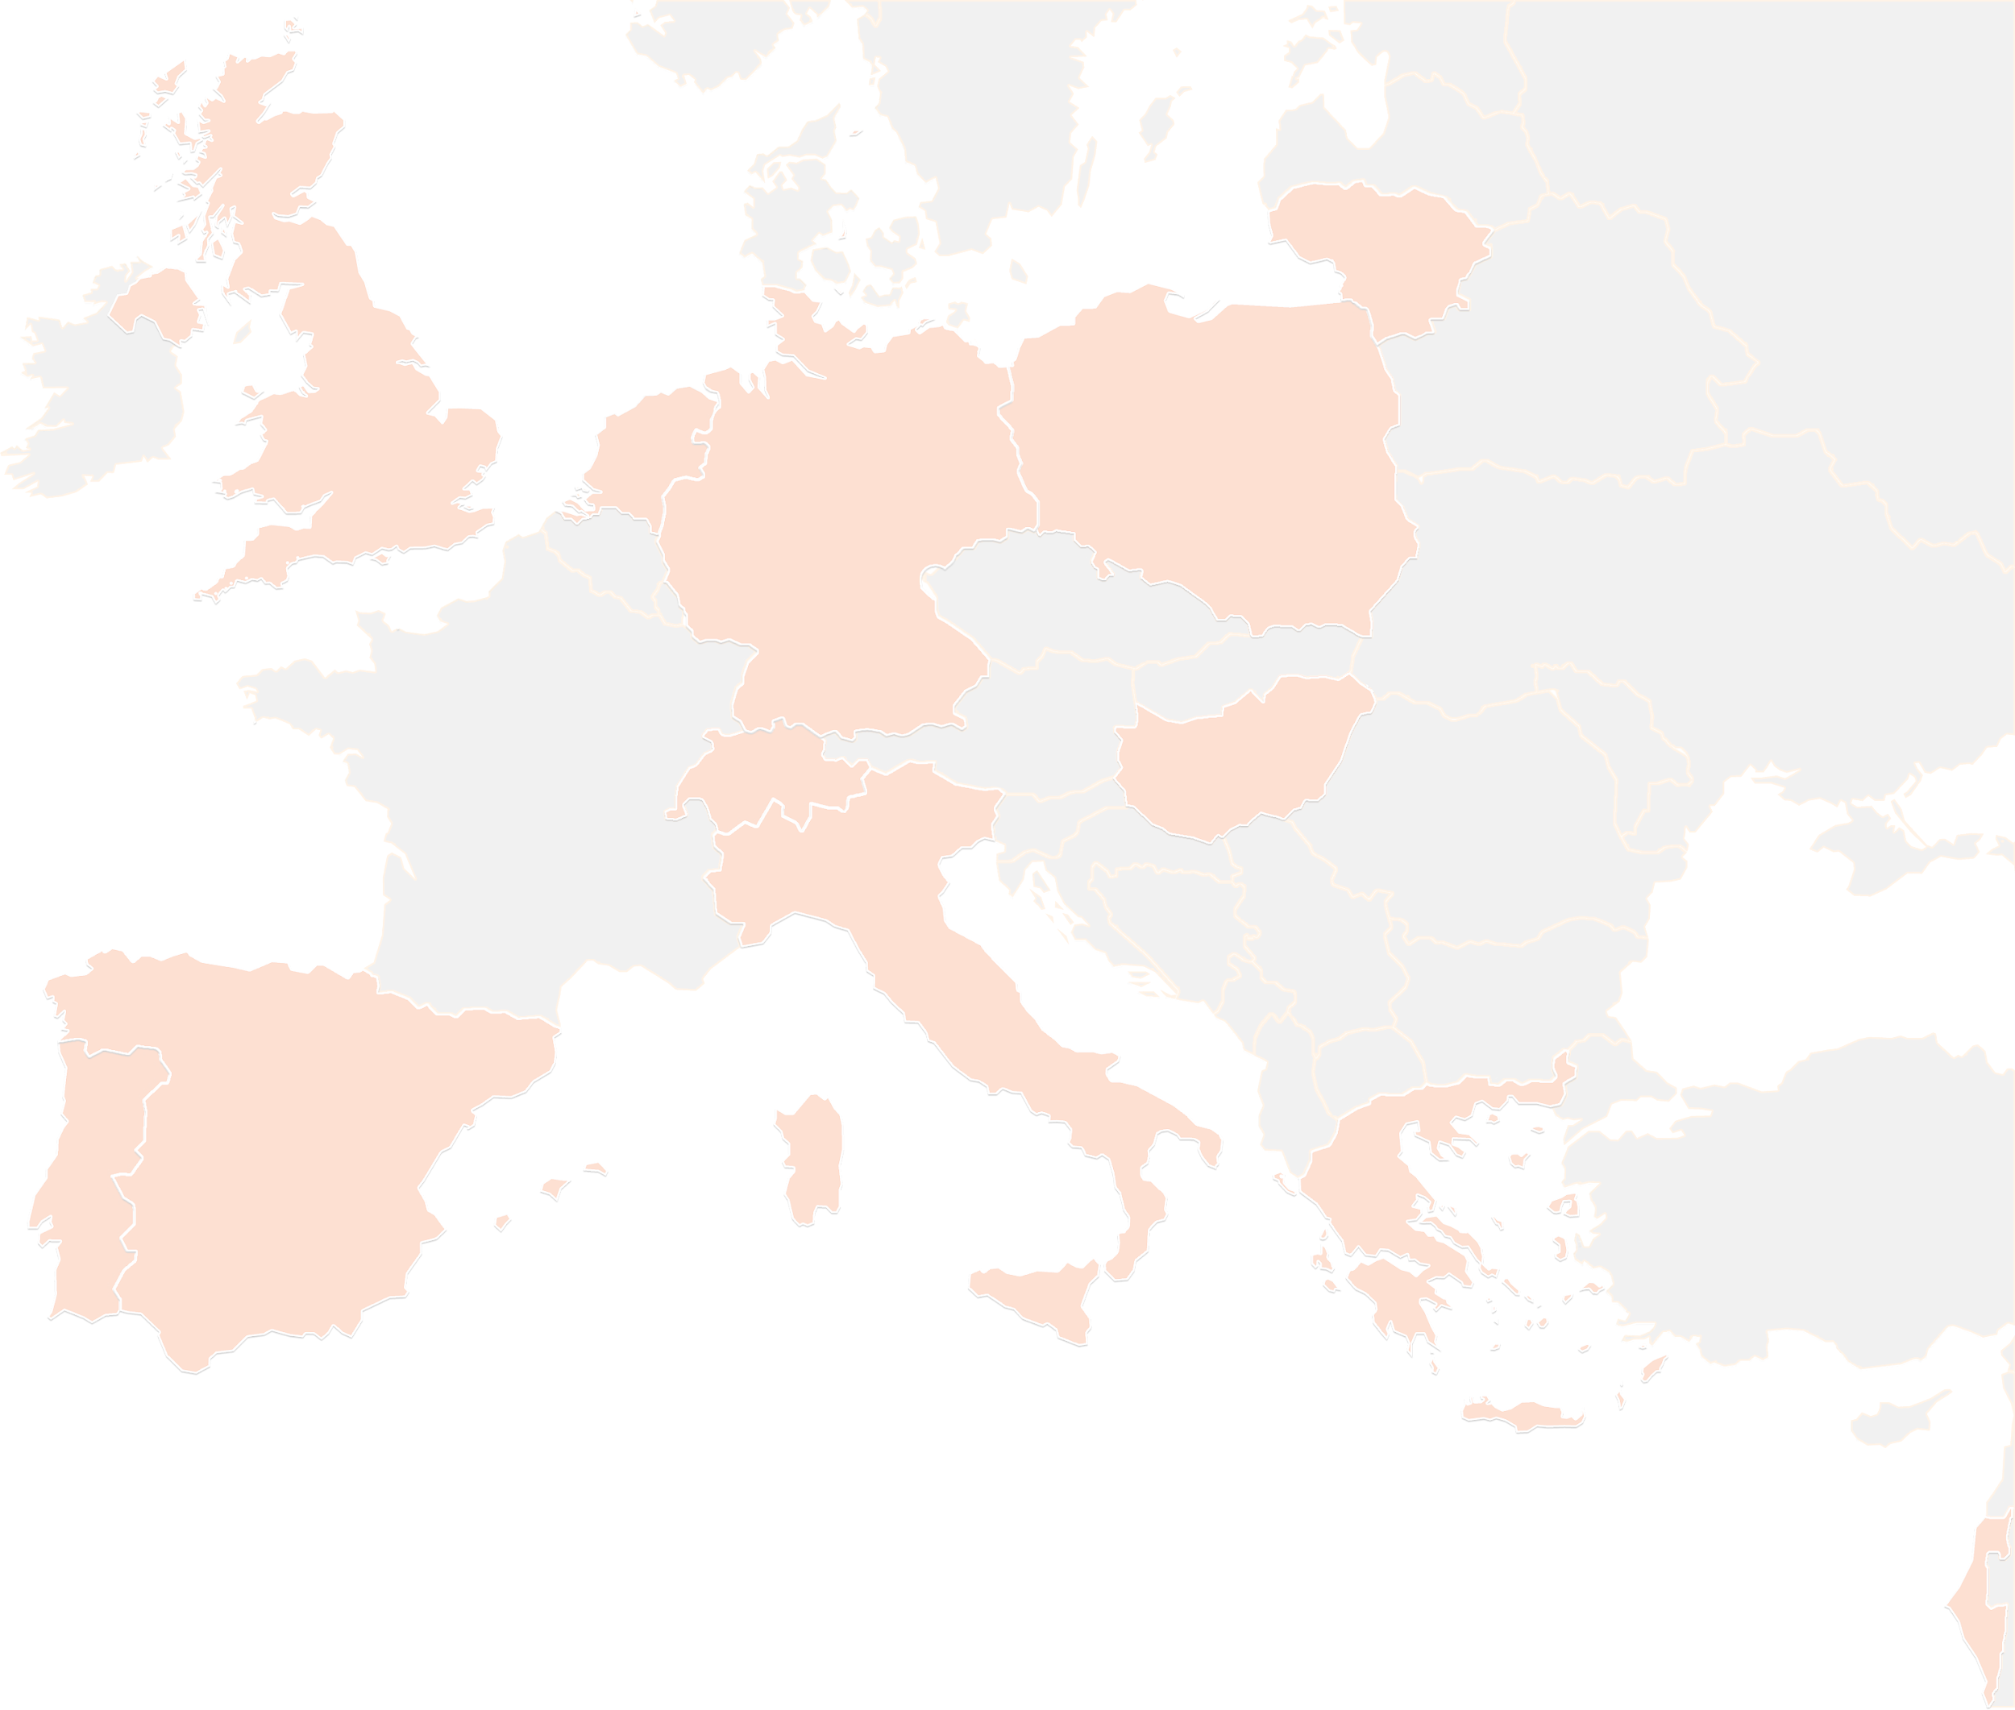
THANK YOU FOR YOUR ATTENTION!
wp5@lists.up2university.eu
#up2universe

Slide 21
Subject Matter Committee
Mary Grammatikou
National Technical University of Athens
Up2U webinar, June 2019

Slide 22
SMC Meetings
Six meetings in the last period
  The first one on 31st of January 2019
  The second one on 4th of March 2019
  The third on 15th of March 2019
  The fourth on 5th of April 2019
  The fifth on 23rd of April 2019
  The sixth on 24th of May 2019

Slide 23
SMC new members
Four new experts are added to the SMC:
Prof. Bruno Losito (UROMA- Italy)
Dr. Berita Simonaitiene (KTU – Lithuania)
Dr. Lisa Amdur (TAU – Israel)
Dr. Despo Ktoridou (University of Nicosia - Cyprus)

Slide 24
Discussions in the last SMC meetings
Introducing the new members in the SMC
Discussion on the Module 2
  Discussion on the existing evaluation methodologies
  Discussion on the methodology that fits to Up2U needs
  Comment on the questionnaires and new proposals
Discussion in depth on the methodology that Up2U will adopt
Questionnaires (teachers and students)
Focus groups
Notes:
What discussed in the two last meetings

Slide 25
SMC Next Steps
SMC will:
Support the new methodology of evaluation the pilots’ results
support the online education for the learning community
support the method of learning the learners
investigate the final results of pilots regarding both students and teachers
Advice on the review and evaluation of the pilots’ feedback

Slide 26
THANK YOU FOR YOUR ATTENTION!
contact@lists.up2university.eu
#up2universe

Slide 27
WP6
_{UPDATE - June}
Gabriella Paolini
GARR

Slide 28
Security Guidelines translation
Done: Italian
On going: Greek, Hungarian
GARR website page for the project with Guidelines
    https://www.garr.it/it/comunita/scuola/progetti/up2u

Slide 29
#SecurityTuesday,

Slide 30
GDPR on Moodle 3.6.2
New version installed in testing mode
  No issues reported!
To do:
  upload the Policy notice
  configure privacy and policy settings,
  test collecting of consents
  -> upgrade the production instance.

Slide 31
New workplan
New deadline for Deliverable 6.3
  M39 – March 2020

Slide 32
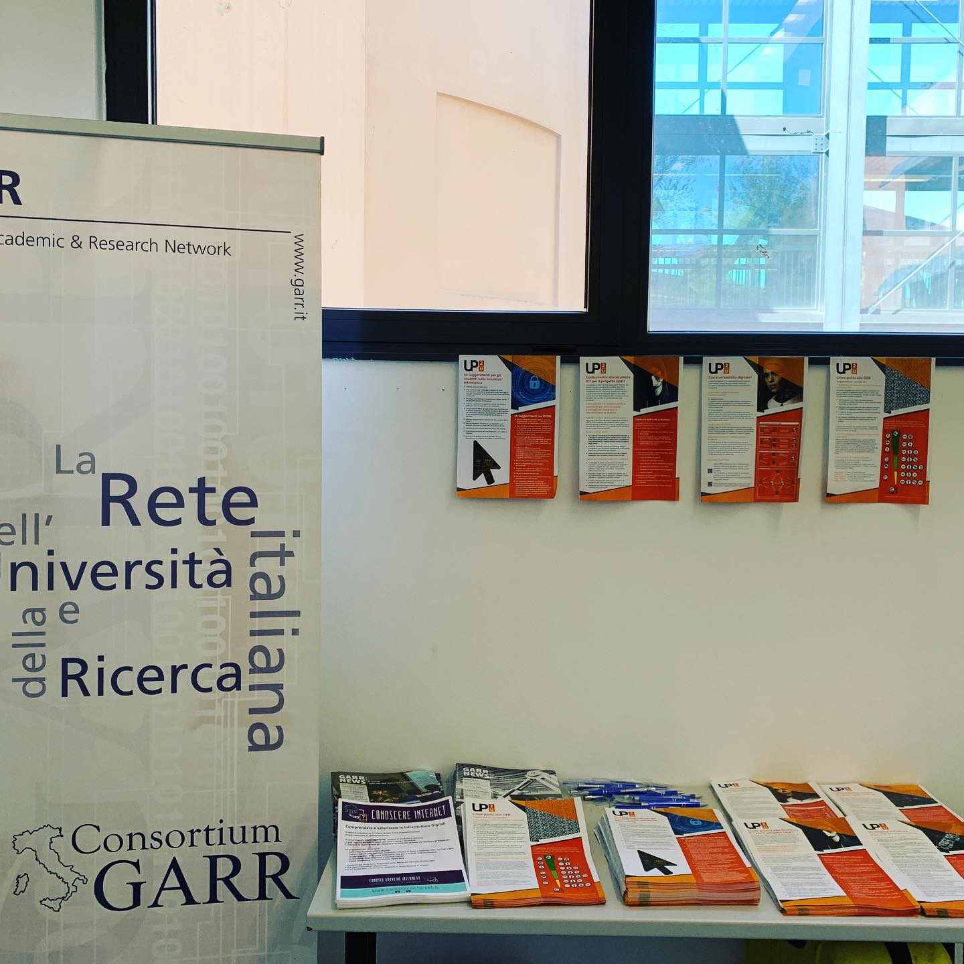
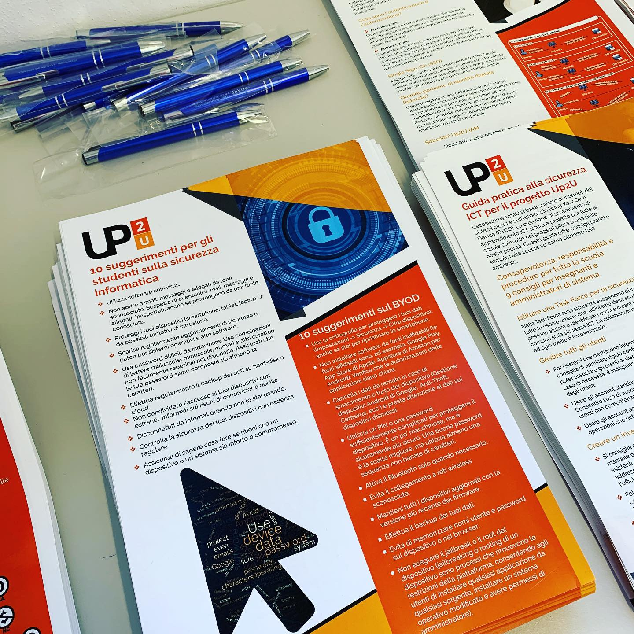
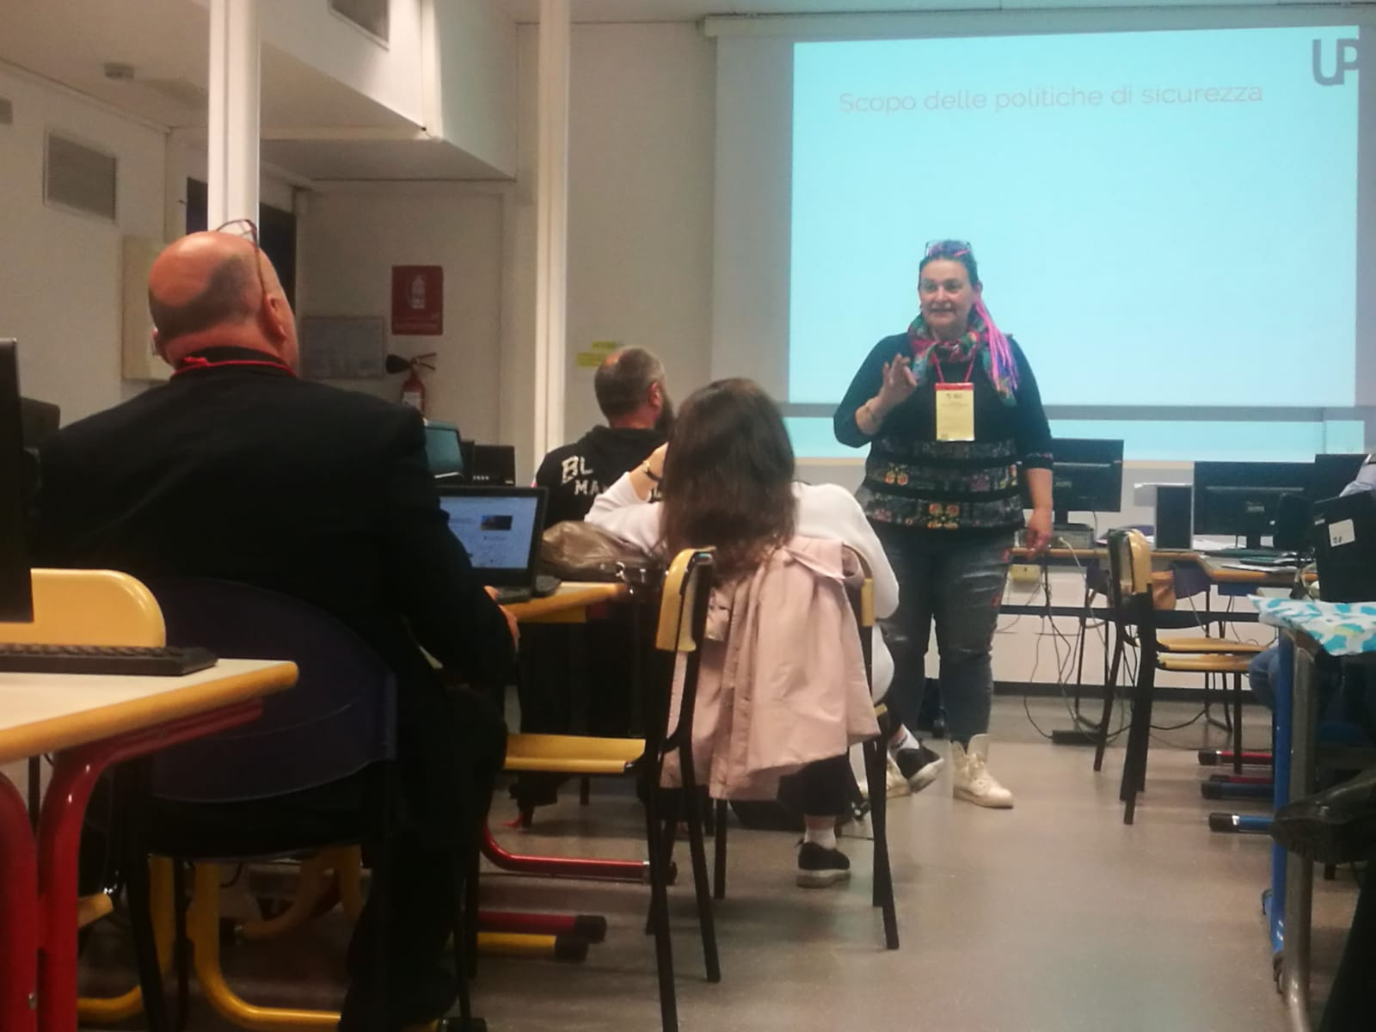
UP2U Security training
Meeting Insegnanti 2.0 - Bologna
Conferenza GARR - Torino

Slide 33
WP7. Pilot coordination and continuous risk assessment
Michał Zimniewicz
Poznan Supercomputing and Networking Center
Up2U Update Webinar
13th June 2019
Notes:
These slides present the status up to the second half of May

Slide 34
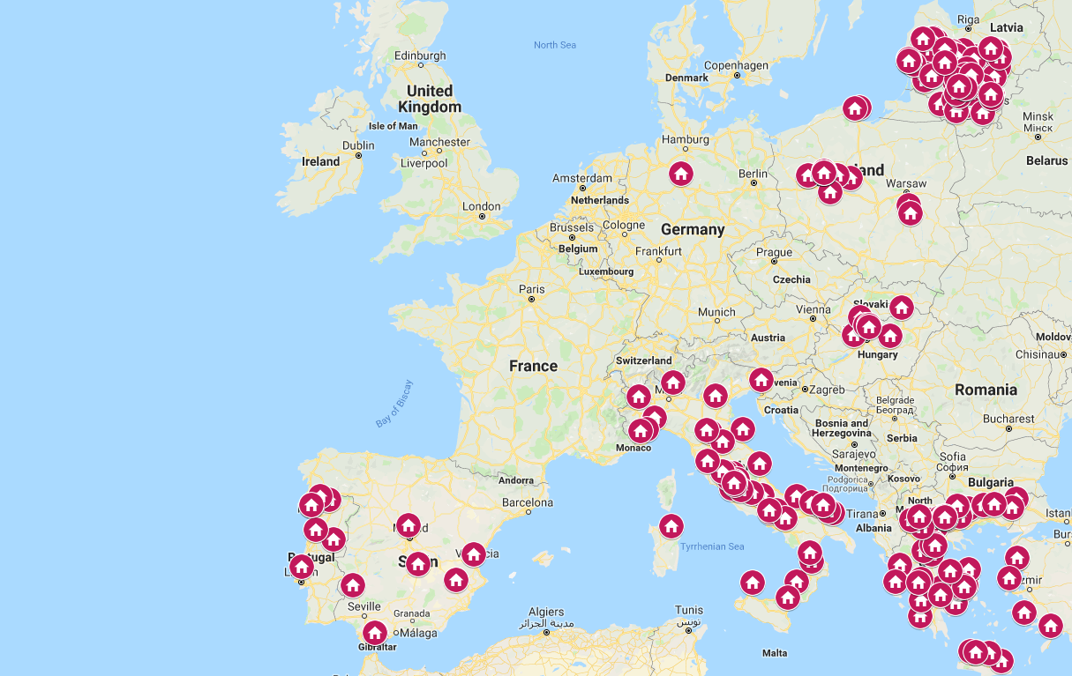

Slide 35
Pilots
Greece
  4 schools active
  Meetings with CPD and teachers who use the tools in classrooms
  Creating additional materials to attract schools
Hungary
  3-4 schools active
  Work on new invitations
  F2f meetings for students

Slide 36
Pilots
Italy
  More than 100 teachers in CPD
  13 courses, 5 active with students (ca. 70 students in total)
  New dissemination activities to reach teachers
  Trying to understand why teacher are not joining
Lithuania
  More than 120 schools registered; ca. a half of them is active
  219 teachers finished 2nd iteration of CPD M1, and 76 of them have registered to continue in M2

Slide 37
Pilots
Poland
  11 schools started activities between March and May
  F2f meetings for all the schools
  New f2f training for 10 teachers for two full days
  Engagement through collaboration with other projects
Portugal
  8 schools in joint CPD 1&2 since January
  First class of students joined in February
Notes:
Poland: In April, the activities were cancelled and suspended because of the national teacher strike.

Slide 38
Pilots
Spain
  1 school active (around 40 students) between February and April
  New invitation ongoing via social media communities
Germany
  Launching the pilot in September

Slide 39
Tools in Use per Countries
Greece – Moodle, eduOER, H5P, CERNBox, DSpace, SeLCont, Knockplop, PODDIUM, SWAN
Hungary – Moodle, Knockplop, NextCloud, Mahara, Videotorium and Etherpad
Italy – Moodle, H5P, eduOER, CERNbox
Lithuania – Moodle, eduOER, H5P, Knockplop
Poland – CERNBox, SWAN, Knockplop, MultipartyMeeting, OpenEdX
Portugal – Moodle, Knockplop, Poddium, eduOER, H5P
Spain – Moodle, H5P, Poddium, Knockplop, eduOER, DSpace, Owncloud

Slide 40
KPI in the New Workplan
The number of pilot schools
  Request to the EC for changing 1500 to 1000
University enrolment rate – To be considered as irrelevant
  Success rate of student enrolments to university across the pilot schools in Europe: Year 1: baseline, Year 2: +15%, Year 3: +20%
  Weak correlation with the project’s impact
  Debatable feasibility to collect meaningful data

Slide 41
Minimum Viable Product
Finalising 2nd phase of MVP
Collecting suggestions in http://bit.ly/2WCg9gj
Main suggestions are:
  New tools
  Improving user experience
  Add features available in competitive solutions
Analysing the collected feedback
Notes:
Collected via questionnaires and other ways chosen by national pilot coordinators

Slide 42
Quality Control and Risk Assessment
Full review of the risk register
Functional testing
  New people joining
  Recently very active because of the upgrades of Moodle
  The upgrades of CERNBox and SWAN
  Report issues: https://wiki.geant.org/display/UP2U/Issue+tracking
Performance testing initiated

Slide 43
UP2U WP8
Sustainability and Exploitation of Results

Slide 44
Status of Deliverables
Deliverables | Topic | Status
D8.1 | Analysis of Up2U Ecosystem and Existing Business Models | Accepted
D8.2 | Draft Plan for Sustainability and Exploitation | Accepted
D8.3 | Up2U Business Models | Approved
D8.4 | Final Report on Up2U Sustainability and Exploitation | M39 (March 2020)

Slide 45
Tasks Update
Task 8.1 – Sustainability and business models (PSNC)
Efforts will focus on implementing these business models in an effective, efficient and consistent manner, as well as on providing effective competitive analyses for achieving a sustainable strategy after the project’s lifetime.
Task 8.2 – Ecosystem Analysis (GWDG)
The task will continue to focus on competitive solutions and the advantages of Up2U’s solution by comparison as part of the ecosystem analysis.

Slide 46
Tasks Update
Task 8.3 – Industry Engagement (TELTEK)
Companies that may be willing to provide Infrastructure as a Service (IaaS) and that can also offer cloud services to the project, with a focus especially on extender ownCloud compatible storage.
Contact publishers of digital textbooks that can provide commercial educational content to the platform.
Contact Microsoft (Spain branch) or a Microsoft partner to engage as an Office 365 provider for the Up2U platform.
Furthermore, the task will focus on implementing NREN and Up2U tools for school business models and engage local NRENs or commercial providers (for countries where the local NREN is not interested in engaging with the project).
Task 8.4 – New Schools (GARR)
Activities addressed to new schools to fully exploit the benefits of the project will be continued in the last year of the project. Schools are the main target for the proposed business models the project will focus on (NREN services for schools, Up2U Tools for Schools and Third-Party Tool Integration).

Slide 47
New KPI
Two KPIs were defined in the DoW:
1. Number of Business Models identified and evaluated – 10 required.
5 have already been evaluated and 2 others identified, reported in D8.3.
2. Business actors willing to engage on commercial basis – 5 required.
4 business actors are willing to engage, reported in D8.3.
- Sustainability strategy - Task. 8.1
- Analysis of competitive solutions and our unique selling points - Task 8.2
- Extending the community of schools interested in the Up2U platform - Task 8.4

