Slide 1

Cloud Activities in the Eastern Partnership Region – Armenian Experience
Hrachya Astsatryan,
ASNET-AM (Academic Scientific Research Network of Armenia)
Institute for Informatics and Automation Problems of NAS RA

Slide 2
Outline
Eastern Partnership Region
EaP Cloud
Policy
Actors
Armenian NREN ASNET-AM
ASNET-AM use cases
Connectivity
IaaS
History & future activities
Mission, vision
Scientific & societal challenges
Digital services

Slide 3

EaP region - policy
Launched in 2009 as a joint policy initiative, the Eastern Partnership (EaP) aims to deepen and strengthen relations between the European Union, its Member States and its six Eastern neighbours: Armenia, Azerbaijan, Belarus, Georgia, the Republic of Moldova and Ukraine (73 million population).
Within this framework, all partners have committed to demonstrate and deliver tangible benefits to the daily lives of citizens across the region.

Slide 4







EaP region - actors

Slide 5
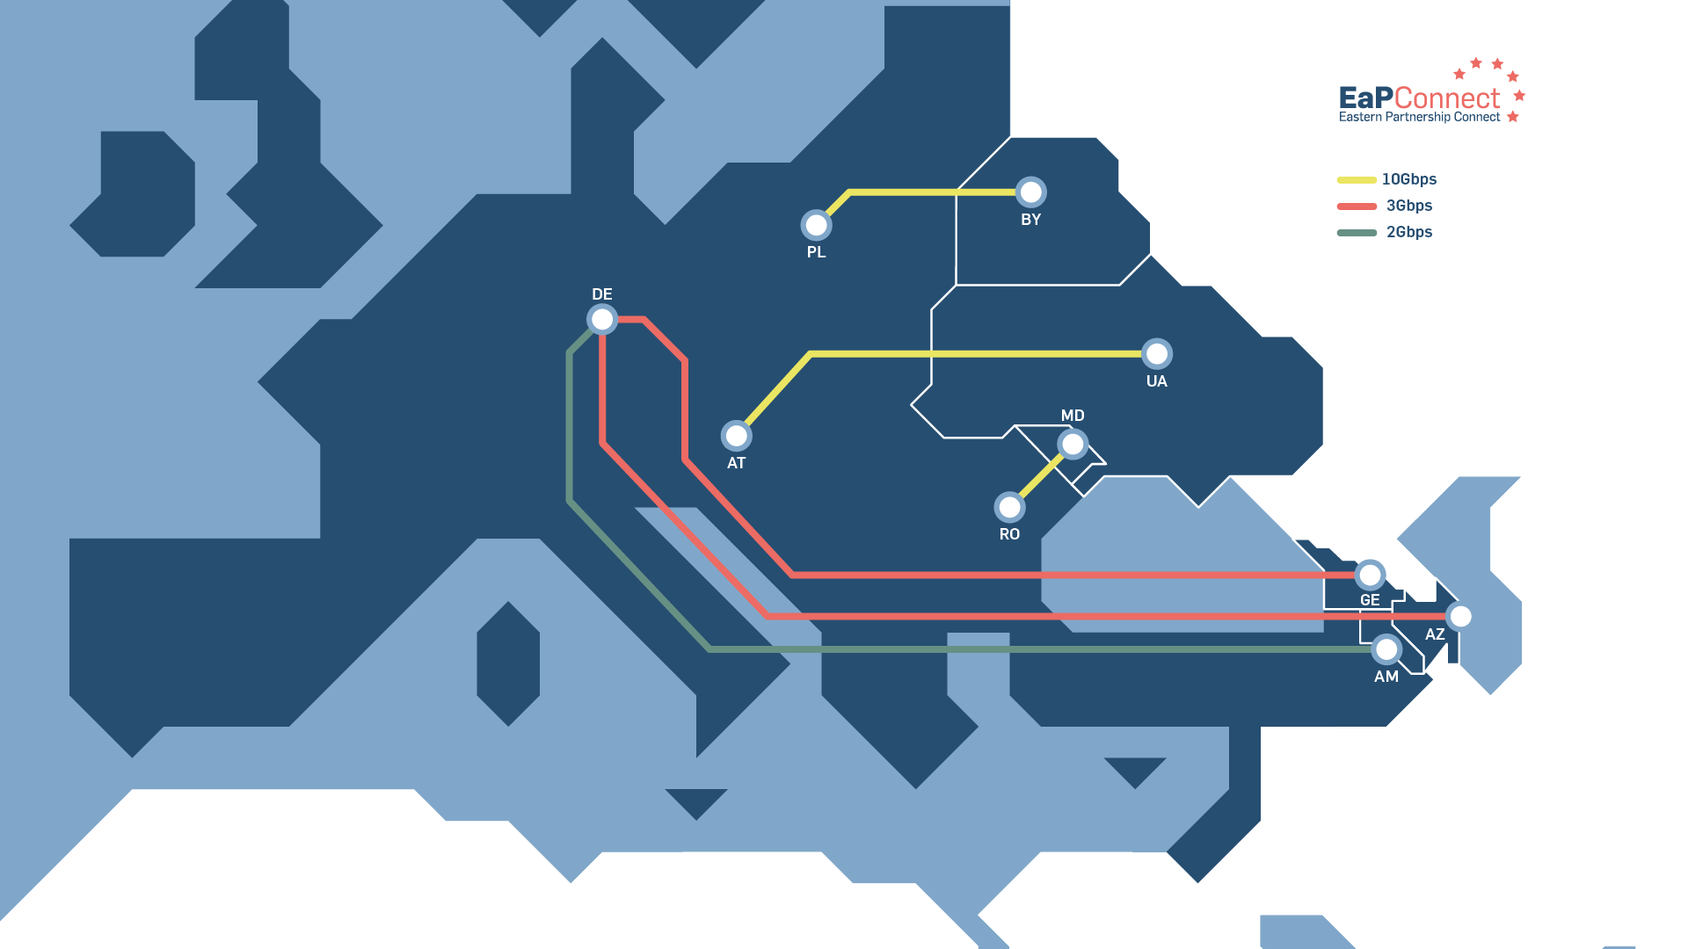
EaP Cloud – connectivity

Slide 6




EaP Cloud – cloud usage
Global
Local

Slide 7
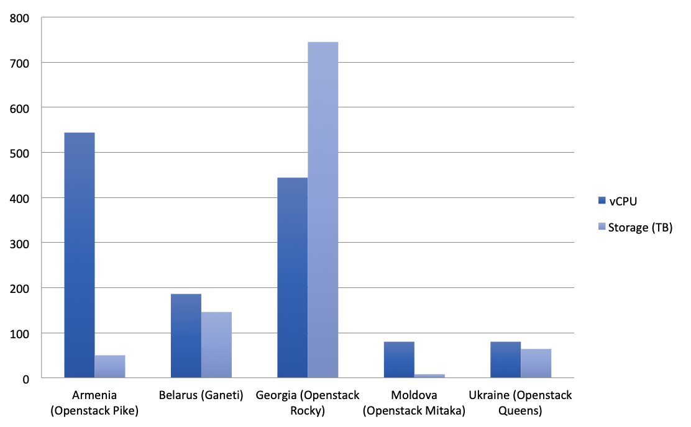
EaP Cloud – IaaS resources

Slide 8
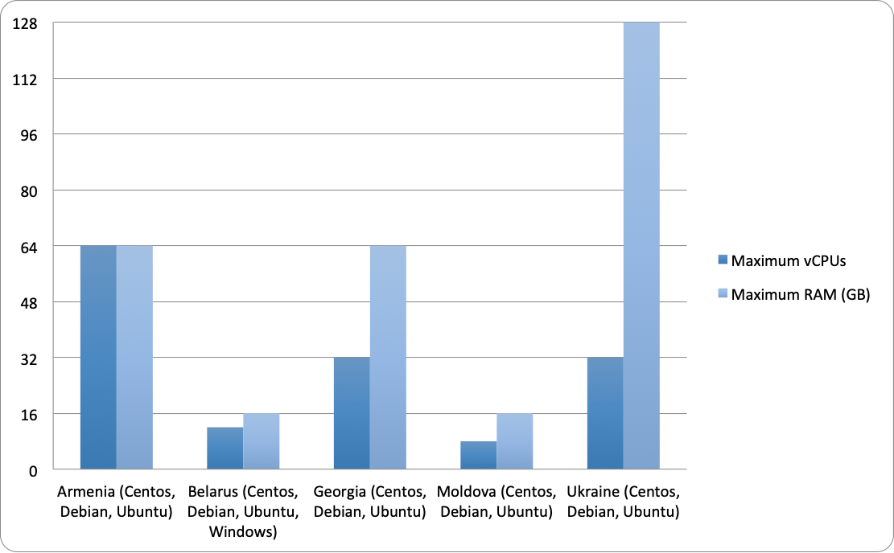
EaP Cloud – IaaS VMs

Slide 9
ASNET-AM – mission
Digital economy
Digital science
R&D focused on ICT and their application
Creating ICT inspired innovations
To provide an advanced eInfrastructures to academia
R&D Environments

Slide 10








ASNET-AM – vision
01
02
03
04
E-infrastructures
HPC, networking & data facilities
Applications
Scientific challenges
Societal challenges
Industry
Technologies
HPC and cloud
Data
Networking
Education
AI/ML
Data science
Scientific computing and computational science
Connecting Armenia
Fostering communities
Advancing technologies
Empowering knowledge

Slide 11
ASNET-AM – at a glance
National Data Center
Digital libraries
Digital museum
Astrophysics
Meteorology
1
3
National HPC Center
Iass Cloud providing CPU cores,
GPU cloud (ongoing): Tesla V100 devices
National Research and Educational Network
2
ASNET-AM: >65 organizations
Eduroam, videoconference, etc.
Direct connectivity with GEANT

Slide 12
ASNET-AM - connectivity
Direct Con. 1Gb/s
EaPConnect Project
2015
Optical network to Geant
Black Sea Interconnection
2008
Satellite conn. to Geant
Nato Virtual Silk Project
2002
Operator
Connectivity to the universities
1998
1st international link –DESY (Germany)
Founded
1994

Slide 13











ASNET-AM - computing
External collaboration
Funding
Supercomputing
French Supercomputer
2019
Cloud/HPC
Openstack – 620vCPUs and GPUs
>2016
Grid/HPC
ArmGrid – 512CPUs
>2009
Cluster
Armcluster – 128 CPUs
>2004
Distributed Systems
Networking servers - 10
1998

Slide 14
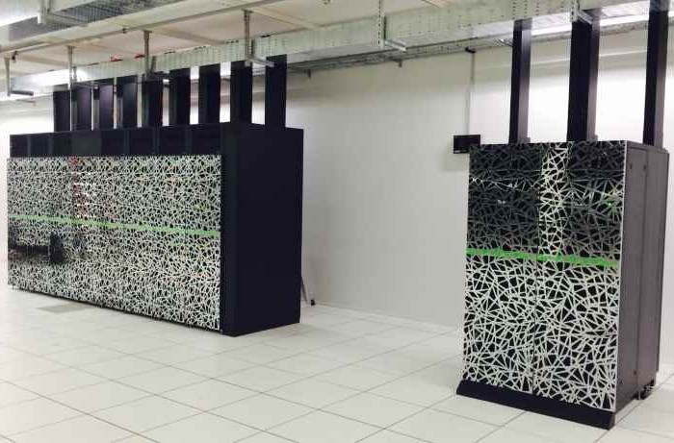


ASNET-AM - future
Data Science
Artificial Intelligence
HPC
Cybersecurity
122400 CPU cores
274GFlop/s
performance
HPC resources
Industry
Academia
State

Slide 15
Use cases - societal challenges
Off site monitoring
Atmospheric modeling
Hydrological modelling
Water resources management
Societal challenges
Air pollution
Env. protection
Weather prediction
Severe weather
Drought, desertification
Climate modelling
Seismology and geology
hazardous geological and
seismological phenomena

Slide 16
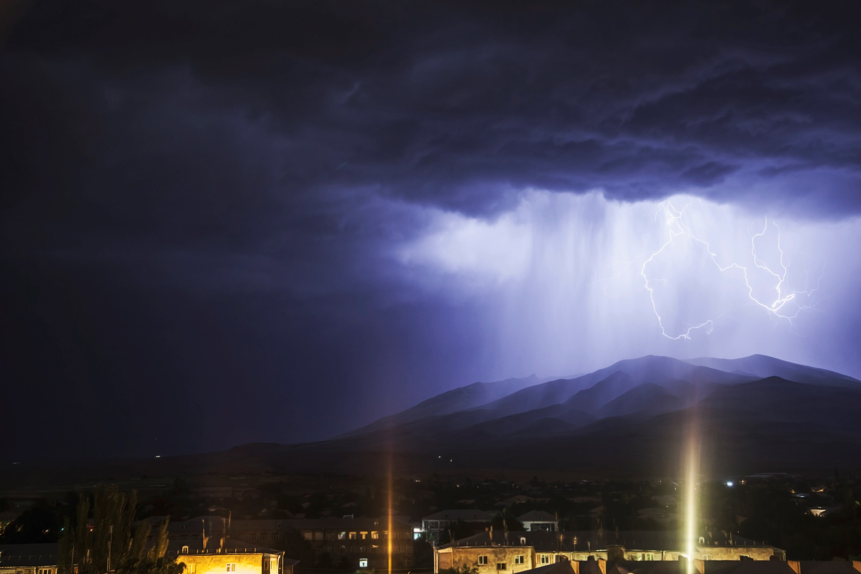
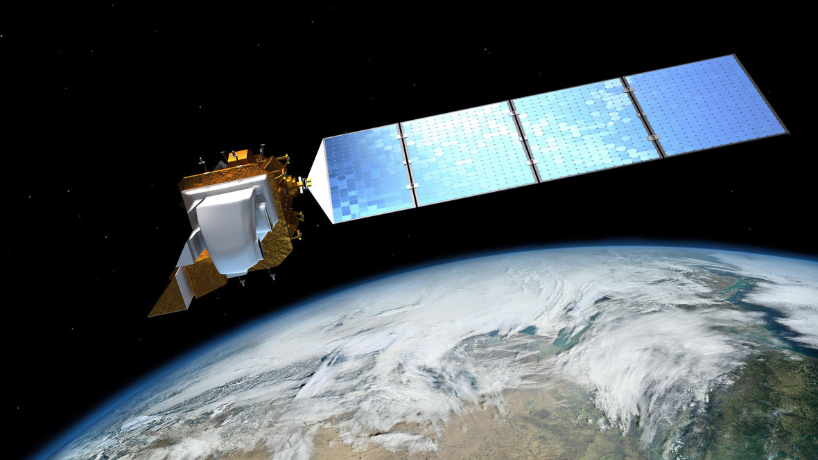
Use cases - societal challenges
Supporting weather ‘nowcasting’ to prevent damage in Armenia
Monitoring the environment with Earth observation in Armenia
Armenian State Hydrometeorological and Monitoring Service
http://datacube.sci.am

Slide 17
Use cases - scientific challenges
Genomics, molecular dynamics
Materials, chemistry
Life science & medicine
Quantum chemical simulations
Astrophysics and high energy physics
Scientific challenges
LHC CERN, IVOA
Engineering
Scientific computing & modelling
GIS, GPS
Archeology and social sciences
3D modelling
Earth science

Slide 18

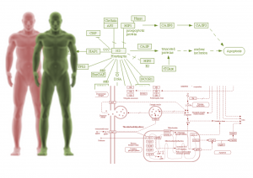
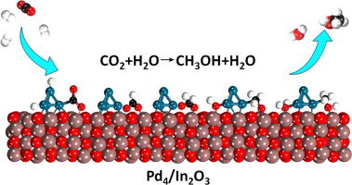
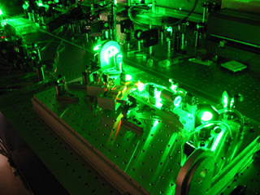
Use cases - scientific challenges
Supporting the multiwavelength monitoring of the bright Blazars
Empowering the Armenian Genome Project with HPC resources
International Centre for Relativistic Astrophysics
http://armeniangenome.am
Enabling computational materials discovery and atomic scale simulations
Enabling laser physics and quantum computing simulations
http://datacube.sci.am
Faculty of Radiophysics, Yerevan State University
Institute for Physical Research of NAS RA

Slide 19
Use cases – digital services
Lola technology
Streaming
Repositories
Mirroring
Digital services
Visualization
Digital museums
Digital libraries
Metadata management
FileSender
Data transfer
E-Learning
Moodle

Slide 20
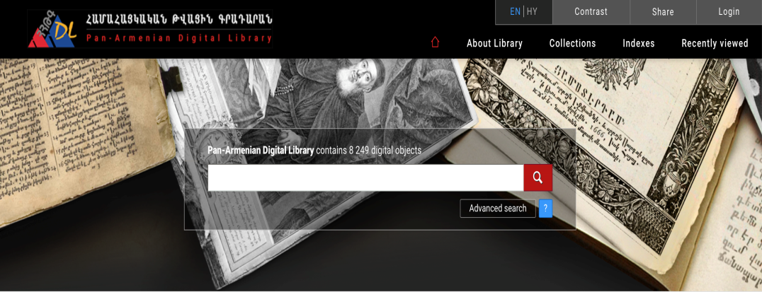
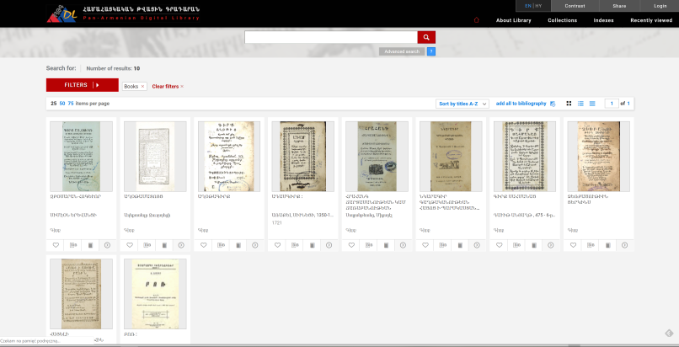
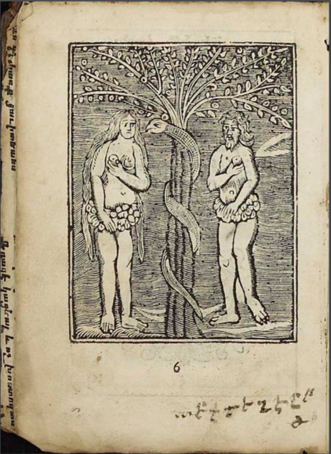
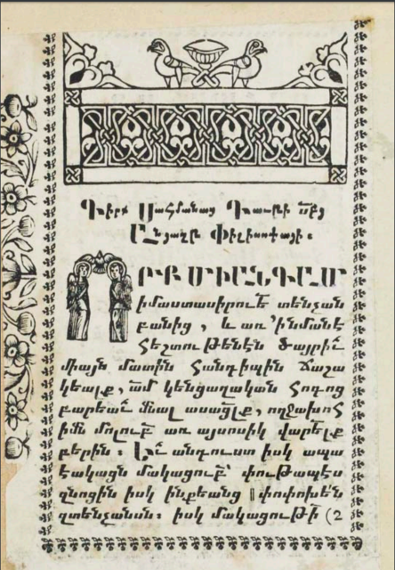

Digital services – digital libraries online
We are moving to the new platform based on dLibra system.
The new portal offers the users many powerful possibilities such as searching the content of the collected resources, searching bibliographic descriptions using synonyms dictionary, grouping digital publications and navigating their structure.
dLibra enables creating professional repositories of digital documents and sharing them with other people and systems on the Internet.

Slide 21
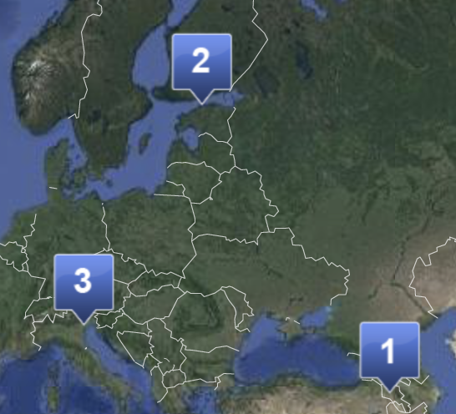

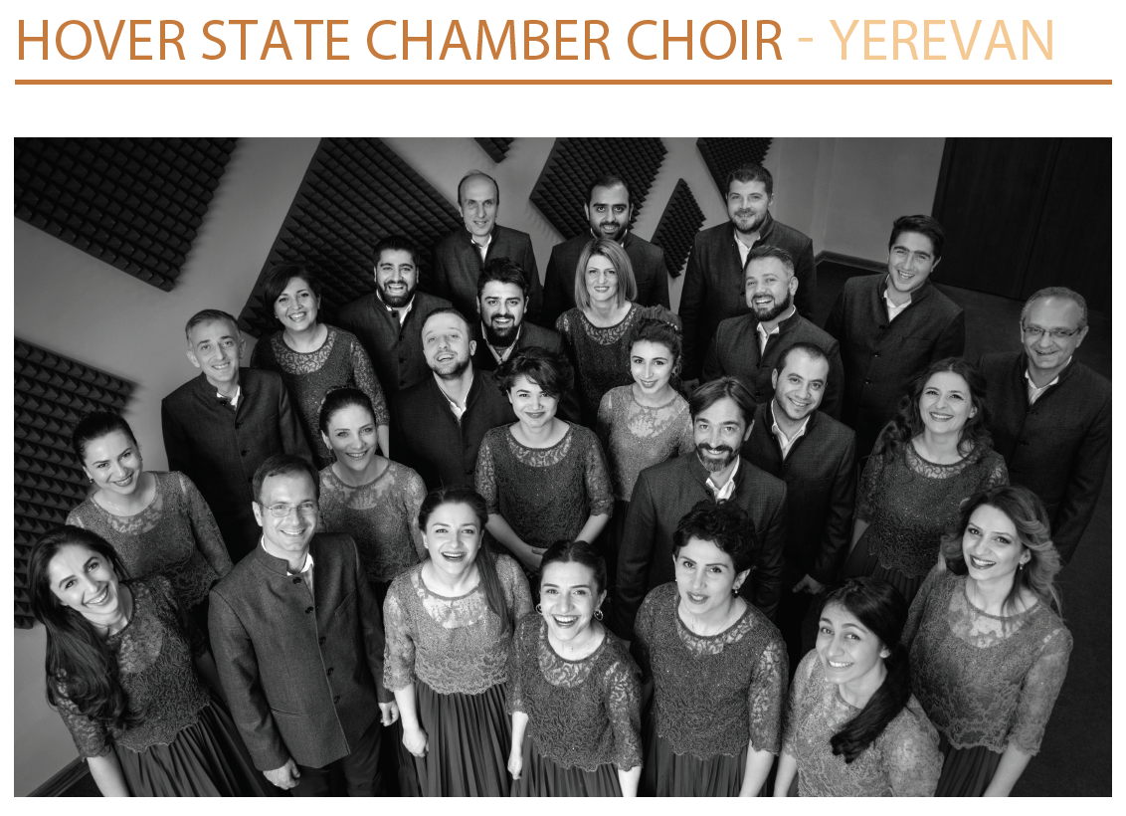
Digital services – streaming
A Low Latency, High Quality Audio/Video Transmission System (Lola)
for Network Musical Performances and Interaction
Estonian Academy of Music and Theatre
Fondazione Università Ca' Foscari. Cà Dolfin
National Academy of Sciences of Armenia

Slide 22
hank ou!

