Slide 1


EOSC State of Play
SIG-CISS
29 November 2019
Hendrik Ike
www.geant.org

Slide 2
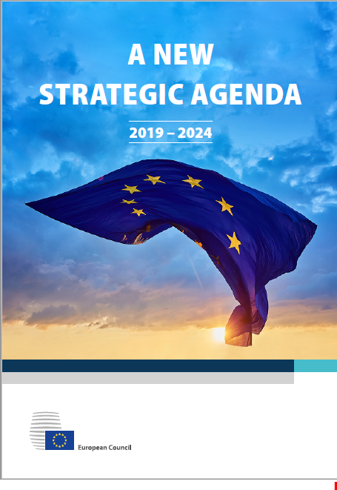
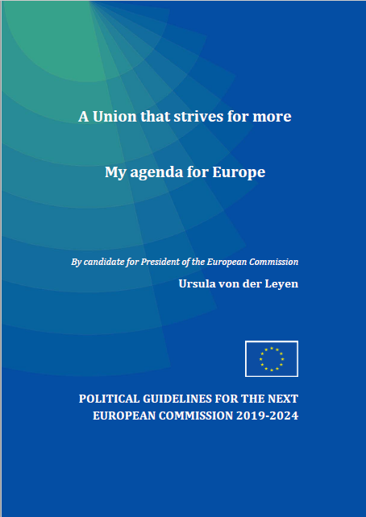
An EU Leadership Transition and New EU Priorities
20-21 June 20019
European Council, nomination of Ursula von der Leyen (UvdL)
Council also publishes ‘New Strategy for the EU’
October 2019
Commissioners’ Hearings
16/17th October
European Council final Strategy for EU
16th of July
EP approved UvdL and started the procedure of the new EC commissioner
First week of September
UvdL priorities published
23rd of October
Final vote on Commissioners
?
A European Green Deal
An Economy that works for people
A Europe fit for the digital age
Protecting our European way of life
A stronger Europe in the world
A new push for European democracy
Commissioner for Innovation and Youth (Research and Education) is Ms Mariya Gabriel; good news for the ERA and the EEA.
Commissioner for Internal Market including Digital: Thierry Breton former CEO of ATOS
EU Commission final approval by 1st of December or postponed to thus far an unknown date.
Notes:
The Process will be delayed, , BREXIT is additional uncertainity. Plus the MFF
GÉANT will aling its priorities with the EU priorities agreed by the EU member States

Slide 3
European Open Science is a strategic choice to respond to future challenges:
The reality inside the sector – data has to be made ‘FAIR’
    Less than 20% of data measured by researchers is recorded
    Less than 20% of the recorded data is reused at least once
    80% of researchers’ time is used to gather the data they need
The digitisation of the research sector
    Sensor-enabled nature and society will turn the Earth into a ‘laboratory’, with real time data generated continuously
    Laboratories with super-equipment generate immense data
    The computer ecosystem and integrated AI will utilise high quality data
Research is capital, energy, and talent intensive, while resources are limited
    A marked change in effectiveness and efficiency is crucial
    Sustainability is the name of the game
EU prosperity should be research and science data driven
    Economic, industrial and social policies require better research

Slide 4
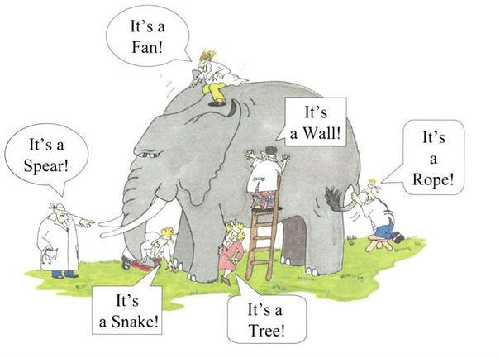
What is EOSC?
  Is it clear?...Too many things to too many people?
  Open science/data and the FAIR ( Findable , Accessible, Interoperable and resusable) principles are the over arching goals
  Implementation often being seen from individual stakeholder viewpoints
  EOSC is not just an e-infra consolidation issue (if that)

Slide 5
EOSC as both an Environment and a Delivery Mechanism
EOSC: an ecosystem of open but secure data accessible for research, realised through a set of basic rules of participation and supported by long term commitments to necessary support infrastructures

Slide 6
Connecting Science Data to Researchers & Researchers to Resources
SSHOC Cluster
ESCAPE Cluster
EOSC-Life Cluster
Energy
SPACE DATA
DIAS
Environment
HEALTH
FENIX
Smart Industry
IoT
Transport
Mobility
Public Services
ENVRI Cluster
PANOSC Cluster
European Research Data lake
Storage
HTC
EuroHPC
HPC
IaaS/PaaS etc
Researchers

Slide 7
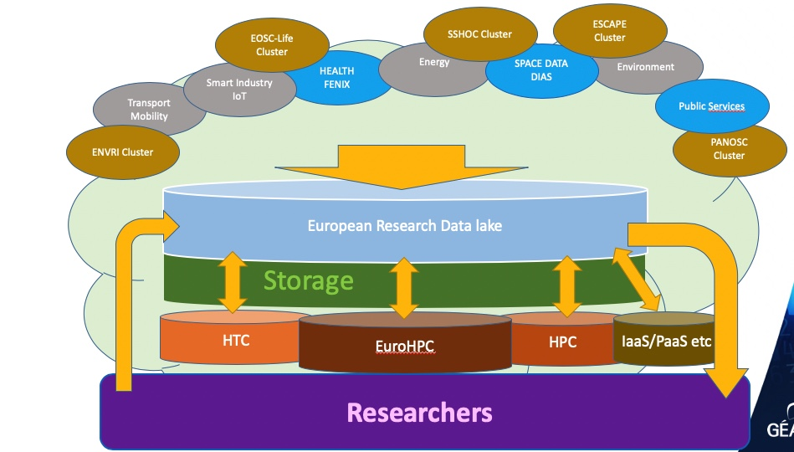
GÉANT and NRENs role for EOSC in the EDI
GÉANT and NRENs infrastructure services in all countries
AAI
Network
Security
Procurement
=

Slide 8
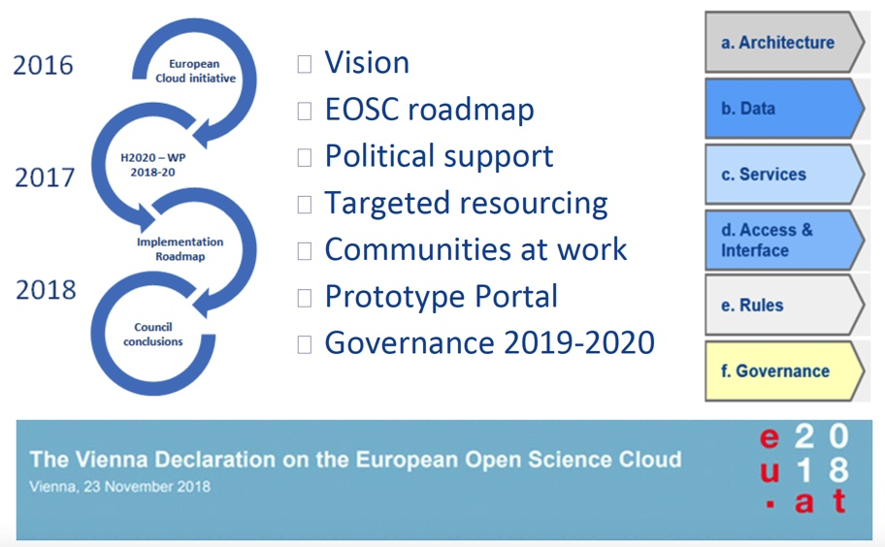
EOSC thus-far

Slide 9
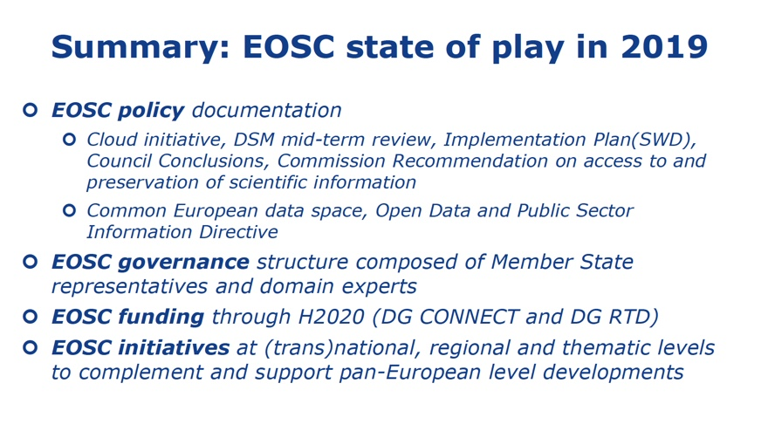
EOSC in 2019

Slide 10
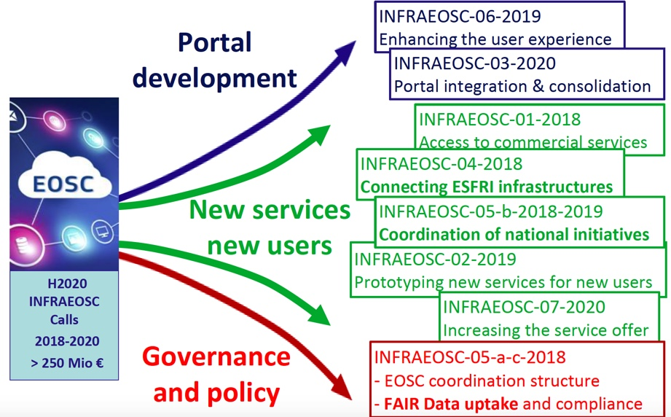
Current Projects

Slide 11
Overall EOSC/EDI environment: Interdependent, but with different objectives
EOSC:
  Moving from extensive fragmented data management towards intensive cross-domain sustainable collaboration
  Objective criteria besides excellence to select the best projects
  FAIR Data management and a secure data infrastructure
EDI:
  Will generate the European Data Lake that would be compatible with technologies such as AI and Quantum
    A ‘Public European Infrastructure’ (EuroHPC, GÉANT, PRACE..)
    European Common Data Space (This will achieve the ‘data lake’ without frontiers under research criteria rather than internal market criteria)
    Will provide a secure legislative framework based on GDPR and high ethical standards

Slide 12
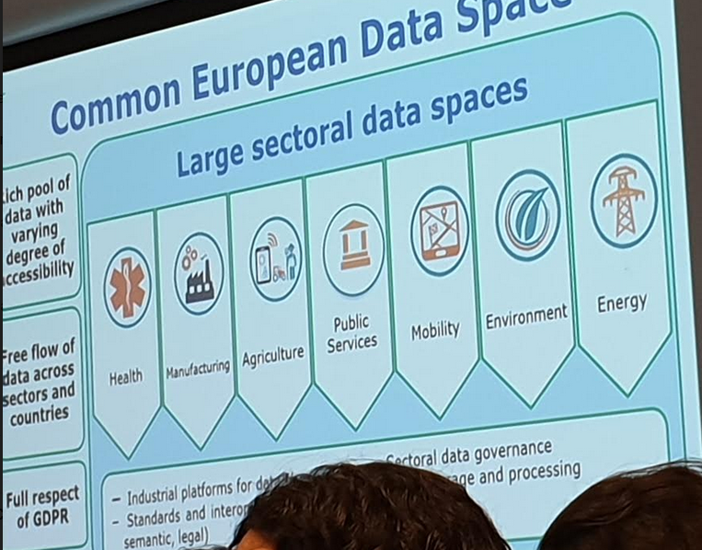
Common European Data Space – snapshot!

Slide 13

Thank you
Any questions?
www.geant.org
© GÉANT Association on behalf of the GN4 Phase 2 project (GN4-2).
The research leading to these results has received funding from
the European Union’s Horizon 2020 research and innovation programme under Grant Agreement No. 731122 (GN4-2).

