Slide 1
MetaCentrum Cloud
“Cloud as a code”
Radek Hrabovský, Andrei Kirushchanka, Jiří Brázdil, Sven Relovský, Tomáš Sapák, David Vasicek

Slide 2
MetaCentrum Cloud
https://cloud.muni.cz
https://cloud2.metacentrum.cz
https://cloud.cerit-sc.cz

Slide 3







MetaCentrum Cloud

Slide 4

Contents
Introduction
History: From OpenNebula to OpenStack
Fully automated deployment
Infrastructure
Bottlenecks
Plans

Slide 5

From OpenNebula to OpenStack

Slide 6
Automated deployment

Slide 7




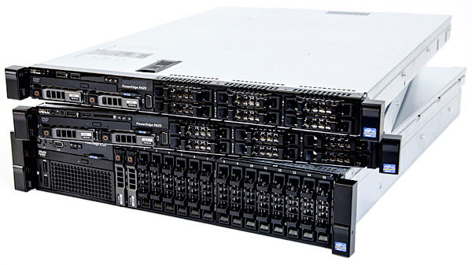

Automated deployment
Razor

Slide 8
Infrastructure

Slide 9
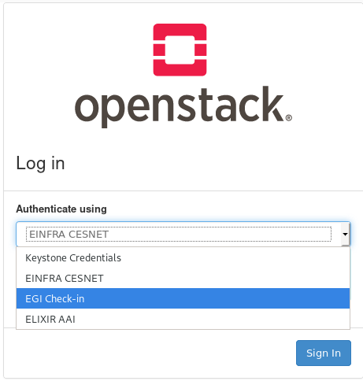
Current state
In Production from the first of April
Actual state
  163 Hypervisors; 4132 VCPU; 87TB RAM
  250 Personal projects; 110 Group projects
  GPU via PCI PathThrough GF RTX 2080
  3 oidc domains
4.5 FTE

Slide 10

Current state
Central storage→Ceph
Cooperation with DataCare CESNET (THANKS!)
Cluster 26 nodes
1.4 PB storage
Swift trough RADOS Gateway
Nvme disks

Slide 11

Open Virtual Network
ML2/ovs
ML2/networking-ovn
287 networks
Issues:
  Controller performance issue with
  neutron-server-ovn

Slide 12
Bottlenecks

Slide 13


Hardware & networking

Slide 14

User support

Slide 15
Plans

Slide 16




Plans
Upgrade from Rocky to Stein (next two weeks)
Cloud for sensitive data
Kubernetes as a service (Magnum + Octavia)
Metrics monitoring (Monasca)
+
=

Slide 17

Thanks for paying attention!
cloud@metacentrum.cz

