Slide 1
Up2University Bridging the gap...
Casper Dreef
GÉANT
SIG-MM 9-10 Oct, KIFÜ

Slide 2
Objective
The “Up to University” (Up2U) Project aims to bridge the gap between secondary schools and universities by providing European schools with a Next Generation Digital Learning Environment (NGDLE) that helps high school teachers equip their students with the knowledge, skills and attitudes they will need to succeed at university and beyond.
www.up2university.eu
2

Slide 3
7
Up2U Consortium
18 partners
Universities
NRENs
Infrastructure providers
Commercials
12 countries
EU
Switzerland
Israel

Slide 4






































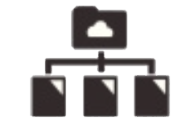







U p 2 U E C O S Y S T E M
FORMAL LEARNING SPACE INFORMAL LEARNING SPACE
LOR
Attend
Search
LMS
Create
SIS
Assessment
Share
INFRASTRUCTURE
eduOER aggregation
WiFi eduroam
TO UNIVERSITY
Sync&Share ownCloud
’Always-on’ education
at school
in library
in museum
at home
on the go

Slide 5
Skills for Academic Learners Up2U approach
Critical Thinking & Problem Solving Communication & Collaboration Information, Media & Technology Literacy Self-Direction
Learning to learn
www.up2university.eu

Slide 6
Up2U teaching models, methodologies and tools
Project Based Learning (Trello, wikis)
Place-Based Learning Education (Treasure hunt) Experiential Learning (CernBox)
Flipped Classroom (WebRTC, SeLCont, eduOER) Scenario-based learning (H5P)
www.up2university.eu

Slide 7
What users can do with Up2U
An authenticated course creation in Up2U platform Multi-disciplinary courses
Recording a lecture
Uploading a lecture & making assignments Interactive video creation and exercises
Creation, storage and usage of open educational content in Up2U repository
Virtual room communication
www.up2university.eu

Slide 8
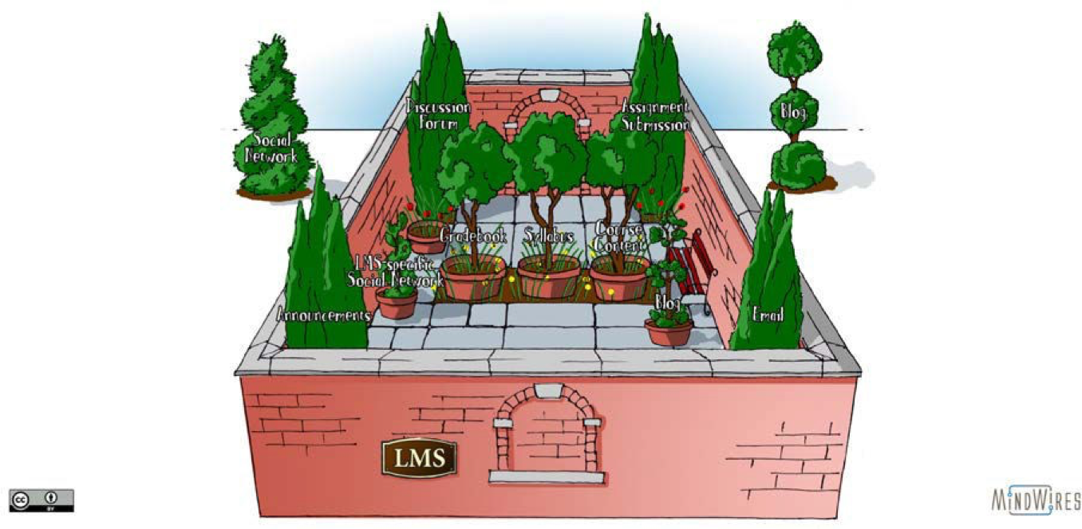
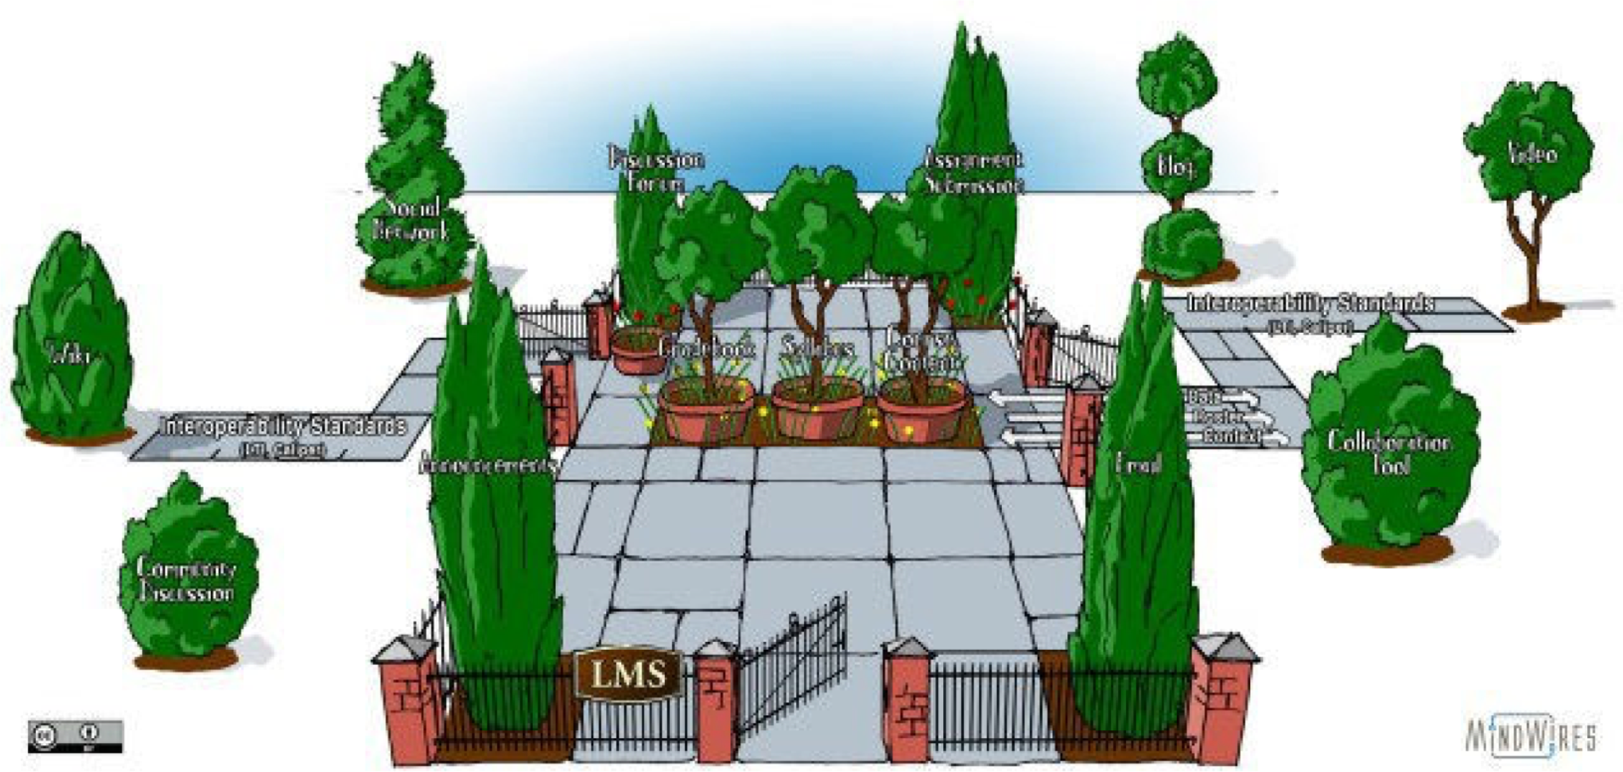



...to an Open Garden
From a Walled Garden...
Tool A
Tool A
Tool A
Tool LMS
Tool B
Tool B
Tool E
Tool E
Tool E
LMS
LMS
Tool B
Learning Analytic
Learning Analytic s
Tool C
Tool D
Tool C
Tool D
Tool D
Tool C
Learning Analytic s
LMS-based architecture
Transitional architecture
NGDLE architecture
www.up2university.eu

Slide 9
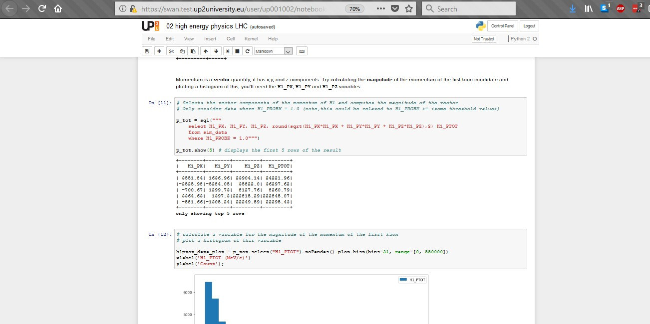



SWAN – Jupyter Notebooks
34

Slide 10
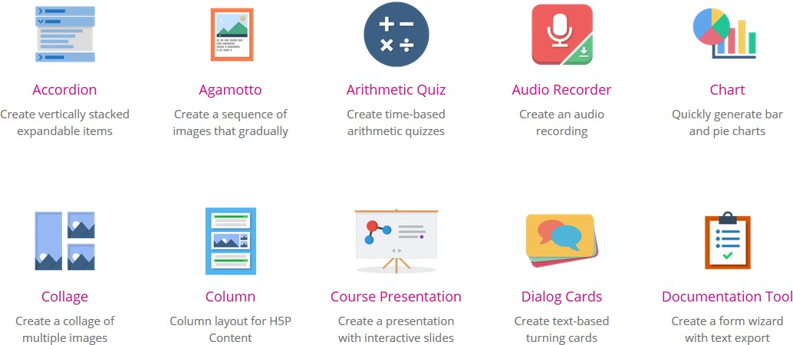
H5P – Interactive quizzes and assignments
30/09/19 PCSS, 04.02.2019 35

Slide 11
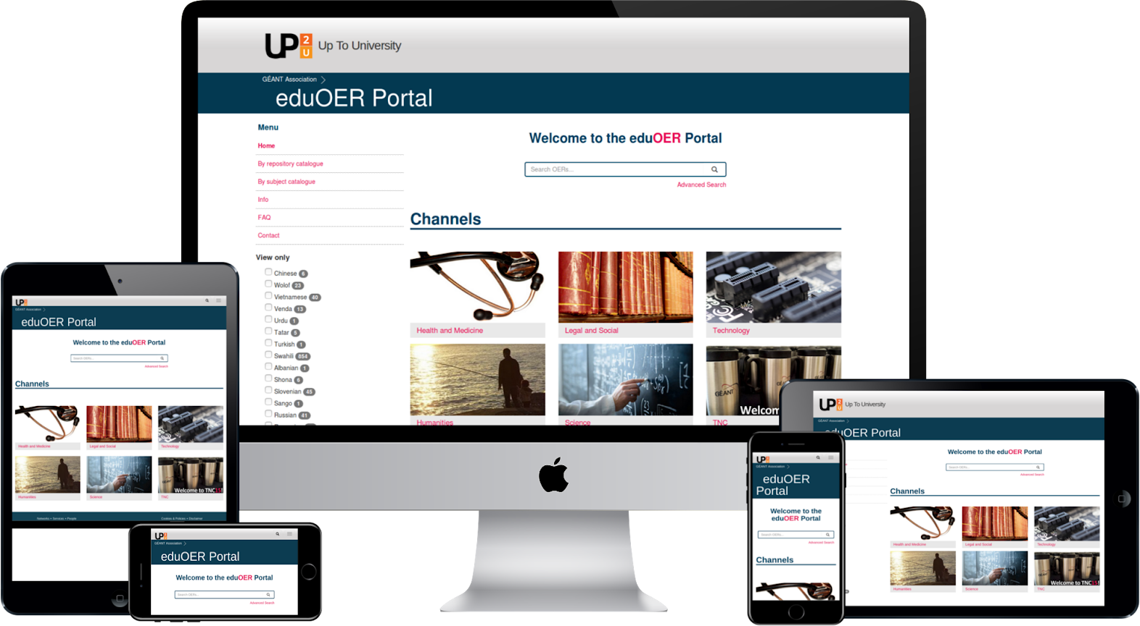



EduOER – Content across multiple repositories
11

Slide 12
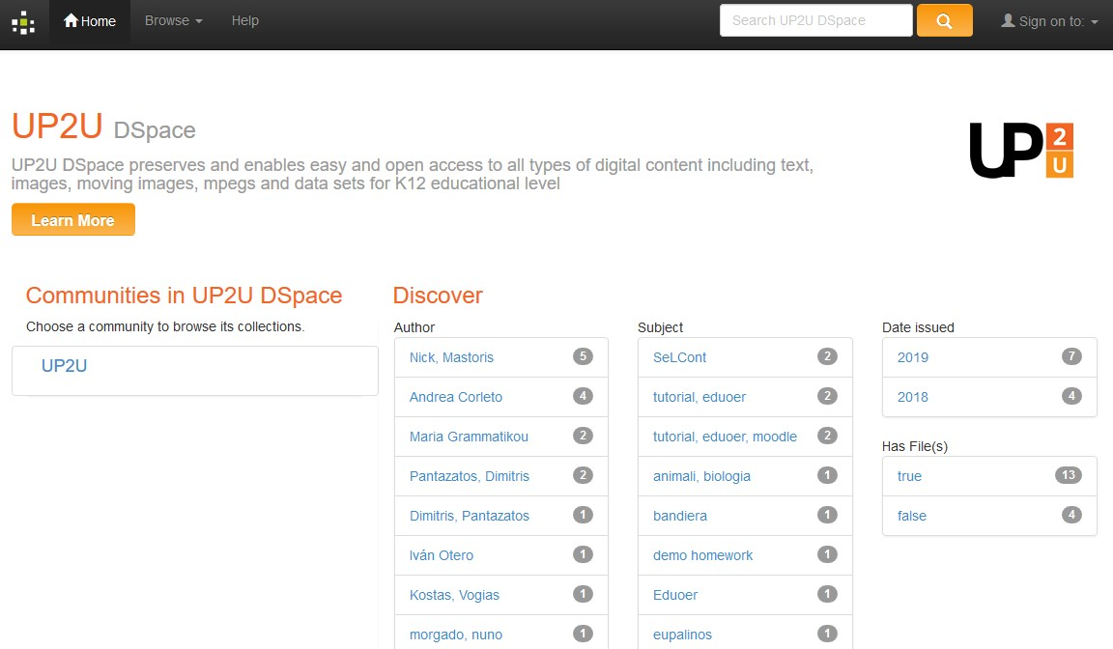
DSpace – Share and reuse OER
www.up2university.eu
12

Slide 13
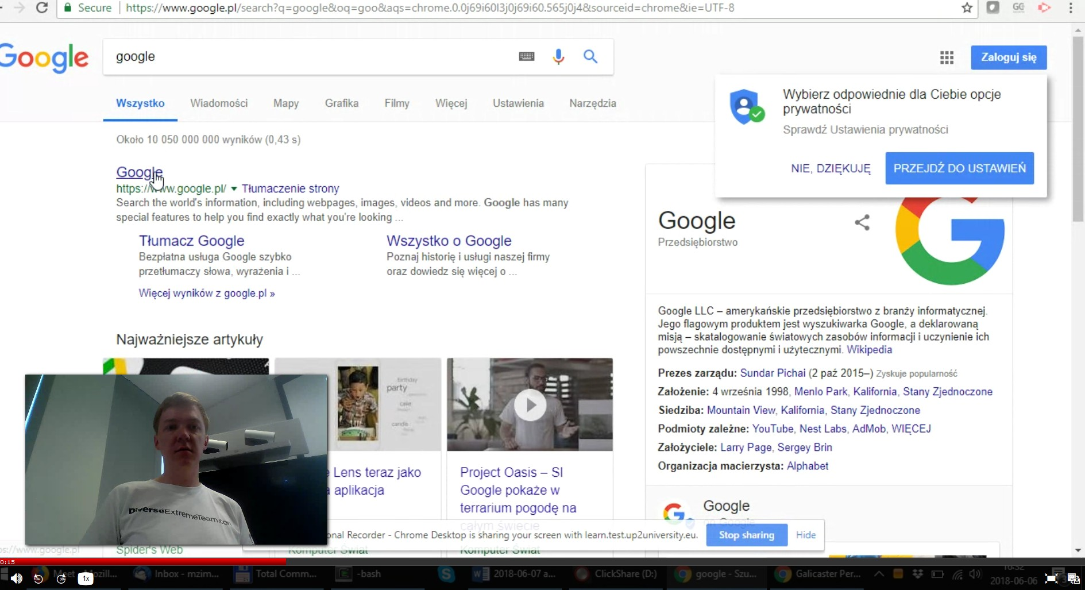
Poddium – Personal Video Recorder
PCSS, 04.02.2019
13

Slide 14
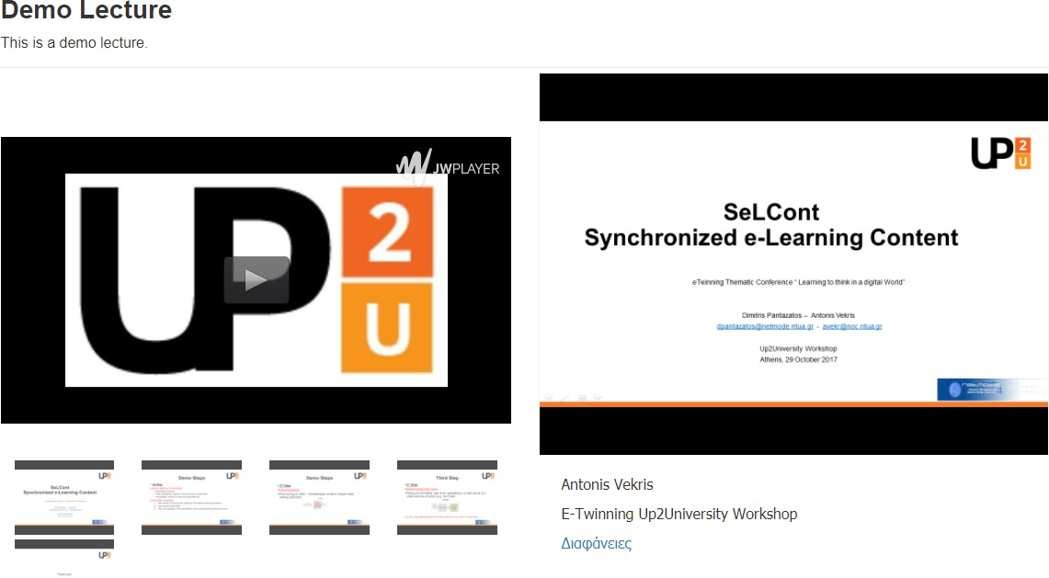
SeLCont – Online Synchronised Lectures
www.up2university.eu
14

Slide 15
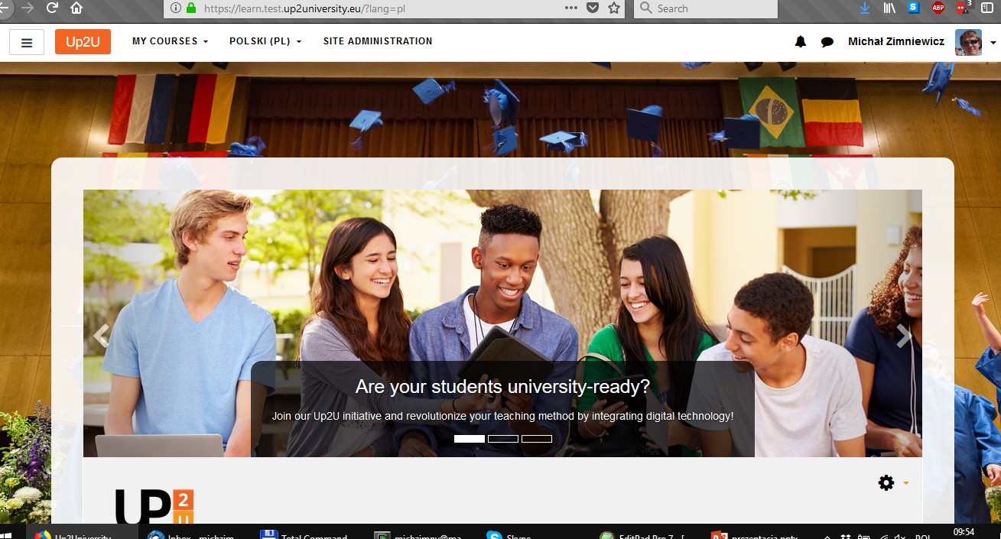


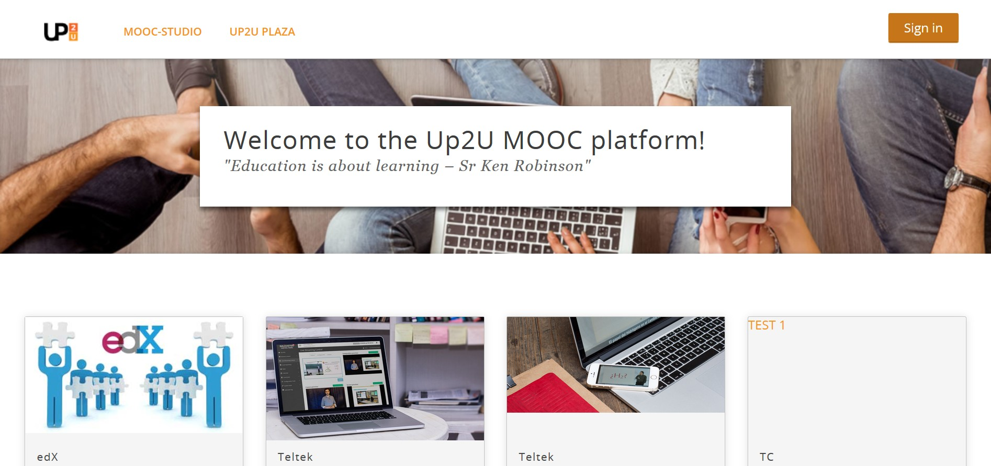
Learning Management Systems
15

Slide 16
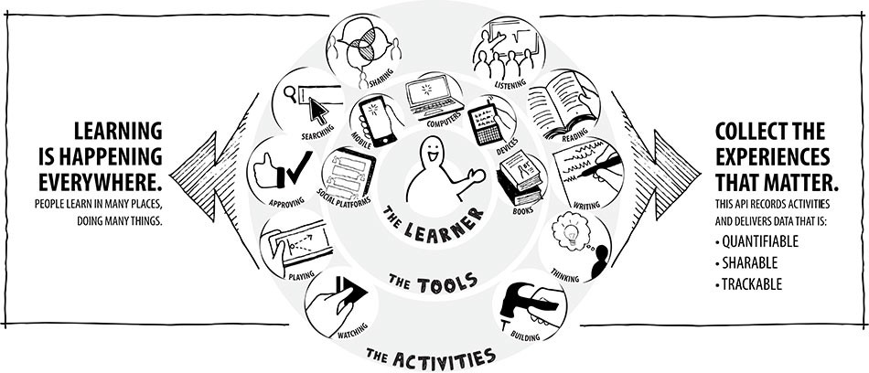
Learning Analytics
www.up2university.eu

Slide 17








Learning Analytics
Learning records
www.up2university.eu

Slide 18
Added value of Up2U
Up2U for universities
Up2U drives up your enrolments with students ready for higher education.
Up2U reduces the dropout rate due to unexpected skills and technical requirements.
Up2U for collaborators (companies, content providers) Up2U gives you access to schools and provide a trusted and secure delivery vehicle for your content.
Up2U gives you community feedback on your content and services via advanced learning analytics.
Up2U provides an international network of users.
www.up2university.eu

Slide 19
Educational services
Online, blended and remote
Digital Learning Environment
Logistical Support for education
delivery of education in home NREN country
Providing e- Content
Learning Analytics
Open badges, digital credentialling
Inhouse built tools by your NREN for digital learning
Digital assessment and testing
Educational staff training
Transnational education
21

Slide 20
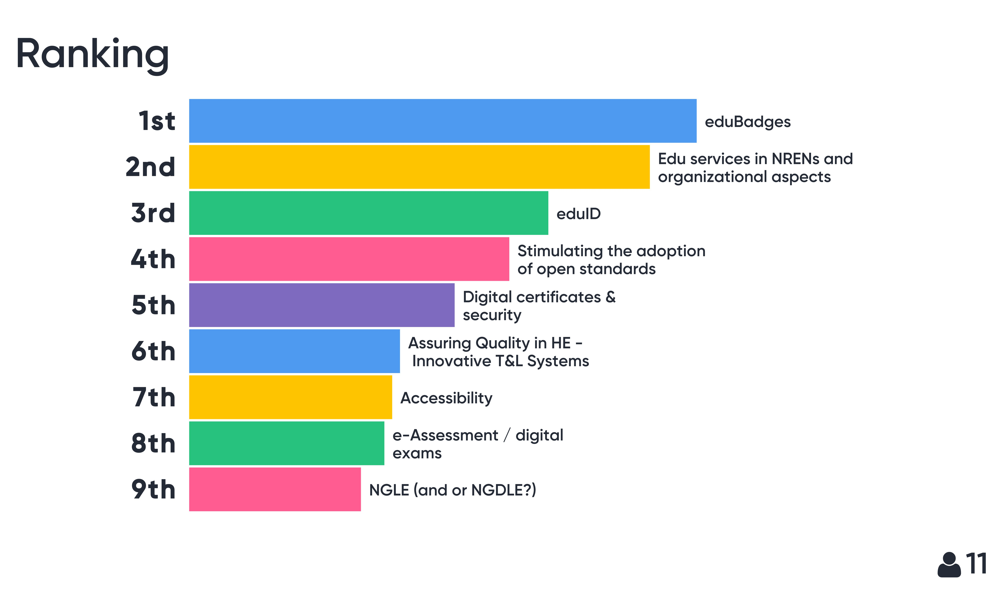
So… what does the NREN community want?
www.up2university.eu

Slide 21

THANK YOU FOR YOUR ATTENTION!
QUESTIONS?
contact@lists.up2university.eu
#up2universe
www.up2university.eu
21

