Slide 1
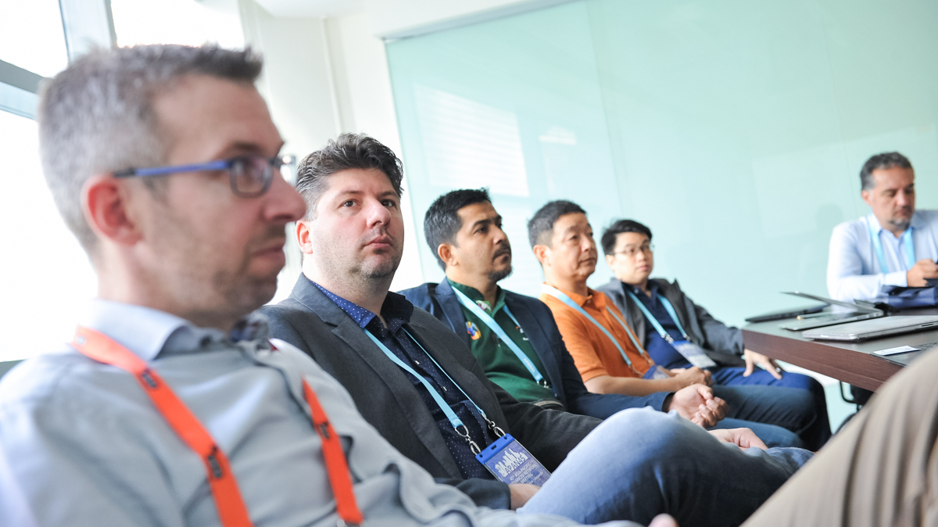
SIG-TNE Meeting
TNC19 – Tallinn, Estonia
Notes:
Welcome – introduction
In this session I want to introduce or reintroduce the GÉANT SIG-TNE, it’s objectives and workstreams, before moving on to define TNE to those who may not be so familiar with this area of international education. I then want to discuss a key issue with TNE – that is collection of global data on before finally working through a product of workstream 4 which is the NREN resource pack
The resource pack is in draft form currently and we will need some information from those in the room to help finish it off

Slide 2
Message from Esther Wilkinson, SIG-TNE Chair
“Welcome to the eighth meeting of the Special Interest Group for Transnational Education. Unfortunately I can’t be at the meeting (bad planning on my part). The Steering Committee members have a good session planned, but I would like to highlight a few things for you to think about.
We have been a little quiet this year in the SIG due to a number of reasons, changing staff and Steering Committee membership, and discussions relating to the remit of this group and the new GÉANT Task Force on Education. That being said, I’d like to ramp up our work in the next year to cover the four areas of work that we have previously defined, but also with a new area of work thinking about TNE 4.0 and how we can work with our communities delivering TNE on this area.
We’ll be broadening the membership of the Steering Committee but also we’d really like more active engagement from members in deciding on future priorities and developing this area to support our NRENs and respective communities. So I’ll leave you in very capable hands, enjoy TNC19, and we’ll catch up soon.”
Notes:
A message from Esther Wilkinson, Head of International at Jisc and the TNE special interest group chair who unfortunately cannot be with us today
Gyongyi – explain TF-EDU here
To expand a little on Esther’s mention of TNE 4.0 – we at Jisc have recently been discussing how emergent technologies such as virtual, augmented and mixed realities, AI and robotics can be used to support TNE – imagine a virtual seminar room where learners can connect into, interacting and collaborating with their peers despite geographical distances. We are calling this TNE 4.0 to fit in with the concept of Industry 4.0 or the fourth industrial revolution, Jisc recently presented a masterclass on the subject at the British Council’s Going Global conference in Berlin to get people thinking about the types of technology which will be available in the very near future, how this will impact the delivery of education and supplement teaching and learning and how institutions can start getting ahead now.

Slide 3
Introduction
Notes:
Just to introduce the GÉANT SIG-TNE – this is the special interest group for transnational education which has been put together to address the technological challenges in the delivery of international education and is a forum for interchanging knowledge and experience on the subject – it hopes to promote collaboration between research and education networking organisations around the world in support of the provision of education that is developed in one country and delivered to another
It was started in 2017 and has four areas of interest; basic connectivity approaches for campuses in other countries, establishing relationships with local partners (ISPs and NRENs), developing open connectivity policies and ensuring end to end network performance and finally providing monitoring and international support
It includes representatives from Jisc, the NREN for the UK, CERNET, the Chinese NREN, Internet2 USA, SURFnet in the Netherlands and GARR in Italy – we are open to new members

Slide 4
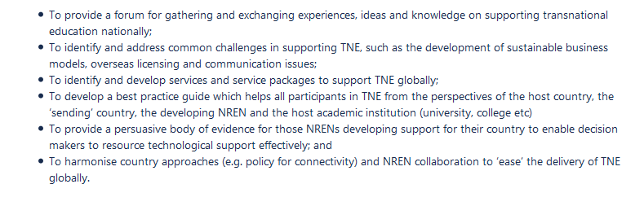
Overall Aims
Notes:
Overall the mains aims as stated on this slide;
1.as a way to identify and address common challenges in supporting TNE
2.to identify and develop services and service packages to support TNE globally
3.develop best practise guides,
4.provide a persuasive body of evidence for those NRENs developing support in their country
5.harmonise country approaches and collaboration to ease TNE delivery.

Slide 5
Four Workstreams of the SIG-TNE
Workstream 1: TNE data – regional, national and global
Workstream 2: Global TNE Policies
Workstream 3: Technology Barriers and TNE Service Development
Workstream 4: Tools, toolkits and resources
Notes:
Four work streams
1 – regarding TNE data at all levels – this is the fundamental workstream underpinning all other areas and looks to establish the scale and scope of TNE activities identifying key data sources and best practises and putting together guidelines for RENs to establish this information themselves. Data will be brought together through desk research, surveying NRENs and NRENs posing questionnaires to their own communities. This workstream also looks to develop partnerships with global international education organisations and also attend conferences outside of the IT/REN sphere
The second workstream focuses on global TNE policies looking to develop consistent policies across NRENs to support TNE such as openness to connecting education institutions to networks, develop strategic alliances and Memorandums of understanding, outline case studies on TNE programmes which have elements of bi-directional flow, reciprocal relationships and partnerships and also raise the profile of the infrastructure required to support TNE to governments
Workstream 3 relates to the operational challenges for TNE such as connectivity, promoting inter-NREN connectivity and provide information to TNE providers on technological issues they may encounter when providing TNE in certain countries and known solutions and workarounds
The final workstream looks to develop resources for NRENs and the institutions we support and also build on the value proposition of NRENs to TNE providers

Slide 6
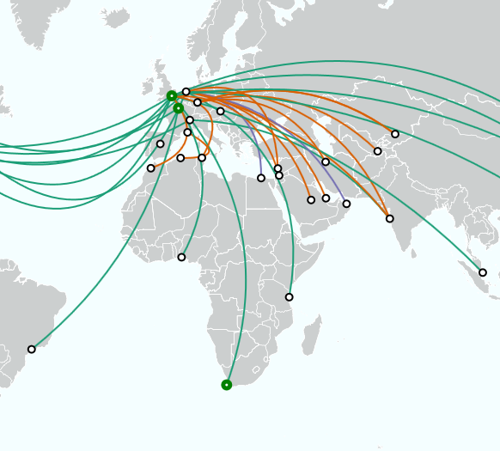
Aims of the NREN Resource Pack
Three Broad Aims
Gives advice on developing a TNE support programme
Provides country specific information on main markets
Provides information on how to support your education institutions and education community
Notes:
One of the products of workstream four is the NREN resource pack which has been developed in partnership with GÉANT, other NRENs and institutions delivering higher education transnationally – it provides information on the technological aspects and considerations of TNE delivery
It provides a resource for NRENs to assist education institutions working at all levels of TNE maturity – from those with well-established international branch campuses (IBCs) to those initiating a partnership with an overseas institution or developing an online course.
3 aims:
1. Advises NRENs how to develop and run a TNE support programme, highlighting some of the common challenges and pitfalls, best practices and case studies;
2. Provides country-specific information on the main markets of interest, including regulatory, legal and data regimes; performance of popular technology solutions and services, and information on network connectivity;
3. Provides information to NRENs interested in TNE on how to support their communities

Slide 7
TNE Definitions
Notes:
Just a quick note on definitions…

Slide 8
Transnational Education (TNE)
Defined as:
“Transnational education (TNE) is education delivered in a country other than the country in which the awarding institution is based, e.g. students based in country Y studying for a degree from a university in country Z..”
Notes:
It always helps to define a concept like Transnational education so we can make sure we are on the same page!
TNE is known around the world by a variety of different terms – international programme and provider mobility (IPPM), borderless, cross-border, transnational or offshore education
We use the definition of Universities UK International, an organisation which aims to represent the UK Higher Education sector as a whole who define TNE as
“education delivered in a country other than the country in which the awarding institution is based, for example students based in country Y studying for a degree from a university in country z
Fundamentally we are speaking about students gaining qualifications from foreign institutions without moving from their country of residence

Slide 9
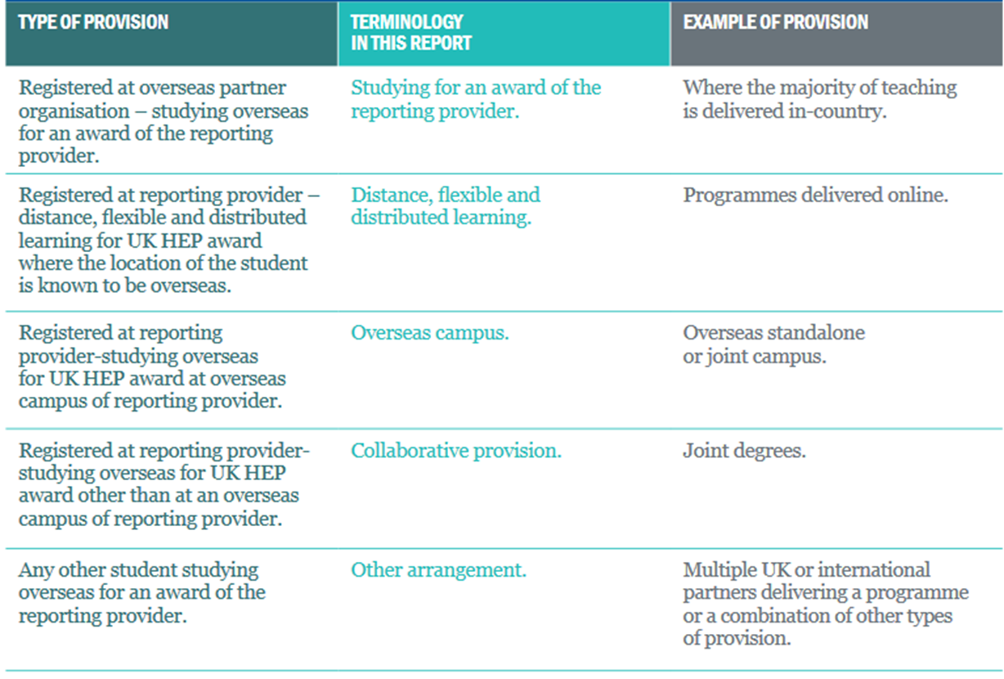
Transnational Education (TNE)
Types:
Notes:
Moving on to types then – in the UK a government agency called Higher Education Statistics Agency (HESA) collects data on UK HE TNE activities which is self reported by the Universities themselves, Universities UK International which I mentioned in the previous slide then collates this into annual reports looking at the trends for a particular academic year. The type of provision column is the definition HESA use, the middle column is a shorter definition implemented by UUKi to make it a bit clearer and less jargon/dense but still needs the third column to give an example!
One issue with TNE is that each country has a different understanding, different language and terminology so speaking about TNE really is difficult and prone to misunderstanding
There are even differences in understanding inside a country whereby different stakeholders, institutions, organisations and individuals working in TNE have differing ways of talking about the subject!
for example the term international branch campus or IBC is widely used in the UK however the concept of a campus is not present in every country – terms like multi location institution may be more well known
In recent years there has been a move away from the traditional model of TNE with country A delivering education in country B towards greater levels of two-way mobility between countries, as TNE is being developed around the world and is reaching maturity in some areas TNE has grown in diversity and complexity, rarely existing in just one form – combinations of modes of delivery or ‘blended learning’ is common. We are also seeing more forms of collaborative provision in the shape of partnerships, joint schools or institutes or dual degrees which allows the risk and cost to be shared between institutions involved.

Slide 10
Sending and Receiving Countries
Sending Countries – are those that deliver TNE degree programmes in another country
Receiving Countries – also known as host countries, are those that host another country’s TNE
Notes:
Sending countries are those which deliver TNE degree programmes in a host country. This may be collaborative or independent, and therefore the degree programme may be delivered in an institution in the host country which may include staff from the sending country, or fully online where the online course is developed by staff in the sending country.
For example, USA as a sending country has established a number of international branch campuses and partnerships in China, such as Duke-Kunshan University and New York University Shanghai.
Receiving (host) countries are those which host another country’s TNE, students from this country study here to obtain a degree or qualification from the sending country.
For example, Malaysia is the receiving country of a number of UK international branch campuses, such as University of Nottingham and Heriot-Watt. Both Malaysian students, and those from other countries such as Indonesia and Thailand will study for a UK degree in this receiving country.
A few countries both receive and send students, such as China. China has a number of partnerships with UK institutions, for example Lancaster University’s joint campus with Beijing Jiaotong University, and also hosts a branch campus from Nottingham University. China also sends TNE to the UK; Peking University has a campus in Oxford.
TNE students may obtain a degree from the sending country, a degree from the host country, or both.

Slide 11
Sending and Receiving Countries
Sending countries:
United Kingdom
United States of America
Australia
France
Germany
Receiving countries:
China
United Arab Emirates (incl. Abu Dhabi, Dubai and Ras al-Khaimah)
Malaysia
Singapore
Qatar
Notes:
This Resource Pack contains information on the top five global sending countries, and receiving countries for TNE shown on the slide, derived from the TNE data report produced by this group
We would hope to develop and expand the countries included in the resource pack and we hope it can be used as a template in developing knowledge about emerging countries.

Slide 12
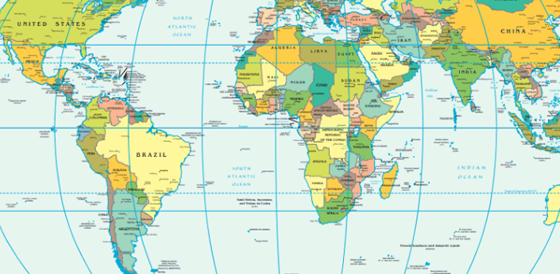
Country Profiles
Notes:
The sending country profiles are an introduction to the current statistics about TNE such as how many students are enrolled, types of TNE favoured, main locations of TNE and recent relevant government publications and policies that relate to TNE
Receiving country profiles give an overview of TNE in the country, the education landscape and goals for education including government policies on education, the network landscape in terms of NRENs and commercial providers and outlining information on technology in the country include availability of eduroam, firewalls, access and identify management, VPNs, data security etc.

Slide 13
Why support TNE as a NREN?
Notes:
Why support TNE as a NREN?
The UNESCO’s Sustainable Development Goal 4 relating to Education notes that ‘mobility in tertiary education is an asset and an opportunity and should be enhanced to develop student’s competencies and global competiveness. A well-established, properly regulated tertiary education system supported by technology, open educational resources and distance education can increase access, equity, quality and relevance and can narrow the gap between what is taught at tertiary education institutions including universities and what economies and societies demand’
In order for this to be realised initiatives will need to be established based on collaborations and organisations coming together which will need reliable and secure digital solutions that are able to keep pace with commercially-driven digital innovation, these would be unaffordable to education providers without shared innovation and implementation and this is where NRENs need to come in.
TNE aids national reform, growth of the local economy, opportunities for research collaboration and teaching partnerships and growth of the tertiary education landscape. Students benefit from increased employability, higher levels of student experience and can increase their language skills.
NRENs can play a crucial roles in TNE – with the demands and expectations of students changing, connectivity is expected 24/7 and needs to support a more digitally enhanced curriculum. Reliable and high performance connectivity is fundamental – allowing access to materials for staff and students and providing a seamless learning environment between campuses. The global network of NRENs, cooperating and working effectively in partnership, can meet the demands of supporting greater levels of TNE forecasted for the coming years. Almost all aspects of the learning experience for a TNE student depend on reliable, high-performance connectivity operating seamlessly between different countries and continents.

Slide 14
Benefits to NRENs
Strengthens ties with your members
Strengthens ties with the global community
Growth and expansion
Notes:
Supporting TNE means that a NREN can contribute to the growth and development of education around the world, benefitting from forming partnerships with organisations and institutions and ultimately supporting students and learners across the globe.
What are the benefits for a NREN:
Strengthen ties with your members and your communities and their plans for international expansion, allowing an avenue and opportunity for engagement and collaboration with members
Strengthens ties with the global community - establishing reciprocal partnerships such as bidirectional TNE arrangements which are beneficial to all countries involved, an NREN can engage with global stakeholders and partner organisations, become part of the international community and be more visible on the world stage
Growth and expansion - Increase value to a NREN’s members by presenting a strong value proposition – providing differentiation from commercial providers, gives justification for capacity building, any return on investment can be used to strengthen a NREN’s infrastructure and service offerings

Slide 15
Key Challenges
Lack of engagement from members
Lack of official data sources on TNE activities
Policy and regulatory landscape
Resources, time and money!
Notes:
Lack of engagement from members – members may be unaware how a NREN can support their TNE, they may automatically procure connectivity or digital services from commercial providers, a NREN will need to demonstrate value for money and unique selling points of TNE support services
Lack of official data on TNE means that it’s difficult to find information on TNE in particular countries
Policy and regulatory landscape may not be open to TNE, there is information available on this – the British Council publish an annual report analysing the national policies and regulatory frameworks of different countries to ascertain the environment they provide for international collaboration and engagement in HE including TNE which looks at factors of openness, quality assurance and recognition of qualifications and access and sustainability. Policy is difficult to influence from the bottom up and it is important for buy-in from senior NREN stakeholders and links into the government
Finally resources, time and money are always going to be key factors

Slide 16
TNE Data Sources
Notes:
As noted earlier data on TNE in different countries is difficult to obtain or simply doesn’t exist – currently only the UK, China, USA and Germany collect data on the subject and the differing definitions and terminology in play would make drawing comparisons difficult. Hopefully as TNE grows, access to better global TNE data is established.

Slide 17

TNE Activity: NREN Survey
Half of respondents didn’t collect information from their community institutions on TNE
83% hadn’t conducted a survey or other form of outreach on TNE activities in their community
All respondents said that there are no official data sources on TNE activities
80% said a survey developed by the SIG-TNE would be useful
Notes:
I thought it would be worth mentioning the piece of work that was conducted last year by the TNE SIG to find out from other European NRENs about TNE in their community, there wasn’t a high response to the survey but I think their responses highlight the issue we have around data collection on TNE – 100% of respondents said there were no official data sources on TNE and less than 20% of respondents had conducted a survey or other form of outreach on TNE
Fundamentally, to assist TNE in your community there needs to be an understanding if TNE is a priority, what types of TNE are there or what is being developed in the community, what are your institution’s aspirations – all this needs to be known and understood before you can start assisting them

Slide 18
Resources
GÉANT SIG-TNE Wiki Site
British Council – The Shape of Global Higher Education
Quality Assurance Agency International
The Observatory of Borderless Higher Education
TNE-Hub
Universities UK International
Notes:
In the meantime a starting point is attempting to gather data on TNE in your country from external sources
As mentioned previously the British Council’s Global Gauge report can help uncover your country’s approach to TNE
Other data sources may be your government – is there an education strategy and is internationalisation included, is TNE a priority, have priority countries for engagement been identified – you may need to engage with your ministry of education, research and science, IT and international trade to understand
Are there representative bodies for Universities or bodies similar to the British Council who work overseas? Are your quality assurance agencies involved in TNE?
From then it’s engaging with your members – are they interested in TNE? Are they working transnationally already? If so, in what forms and what help do they need from you?
The resource pack contains a lot of useful information on places to find data and other useful resources for NRENs for starting out with TNE – some of which are included on this slide - These resources are UK centric but we would be interested in collating information on resources available in other countries

Slide 19
Discussion

Slide 20
Questions
What is missing from the guide?
How would you like to contribute?
Do you feel this guide will be beneficial?
What do you know about TNE in your country – both sending and receiving?
Is TNE a priority for your government? For your institutions?
What data sources or key resources is missing?
What countries should we include in future editions?
Any general feedback?
Notes:
So now it’s over to you – I hope you’ve had sometime to take a look at the resource pack
Sorry to pick on you individually but I’m going to ask you to introduce yourself, your organisation and if you could pick at least one question to answer so I can record feedback that would be great

