Slide 1


Special Interest Group – Trans-National Education
Gyöngyi Horváth (GÉANT)
TNC19, Tallinn, Estonia, 19 June 2019
www.geant.org

Slide 2

Objectives
Present the outcomes of the European mapping of educational services
Present the new proposal for a Task Force on Education
Identify common topics

Slide 3


Slide 4
Objective of the survey
Create an overview of NRENs educational activities and services
Identify common goals to work together
Identify common challenges
Create a global vision and strategy
Put in place a working group to drive these efforts
Notes:
Education institutions use a wide range of education services, ranging from learning management platforms, to learning analytics and online testing systems. These services are of strategic importance to them.
However, the maturity levels of using those educational services vary, thus so far there have been not many joint efforts in this area. Some NRENs provide national support to institutions, others are not yet involved.
GÉANT believes there are opportunities for a collective pan-European approach on education services and activities: to aggregate our expertise and demand and support our community in enhancing their educational activities.
GÉANT is setting up a dedicated activity around educational services. We plan to address the commonalities and create a future vision for the benefit of the community.

Slide 5

Educational services & activities of NRENs
Additional activities and services beyond connectivity (fiber, network, wifi) to support educational institutions with their technological evolution: innovation challenges and opportunities.
Targeting:
  Teaching & learning communities
  Educational institutions

Slide 6

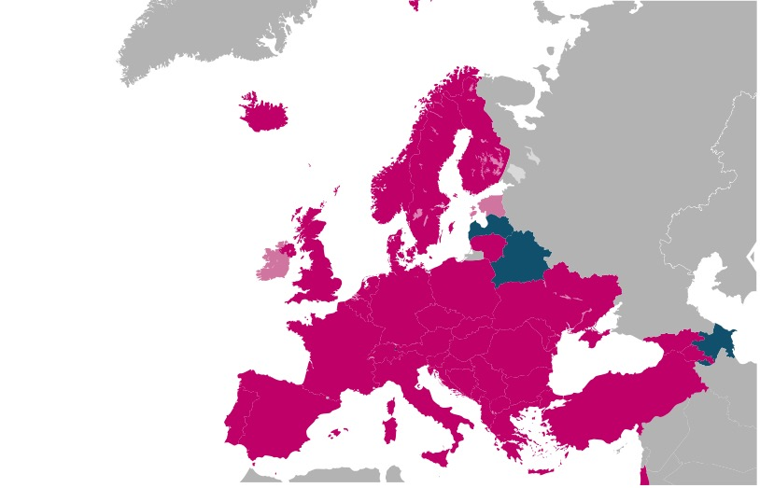
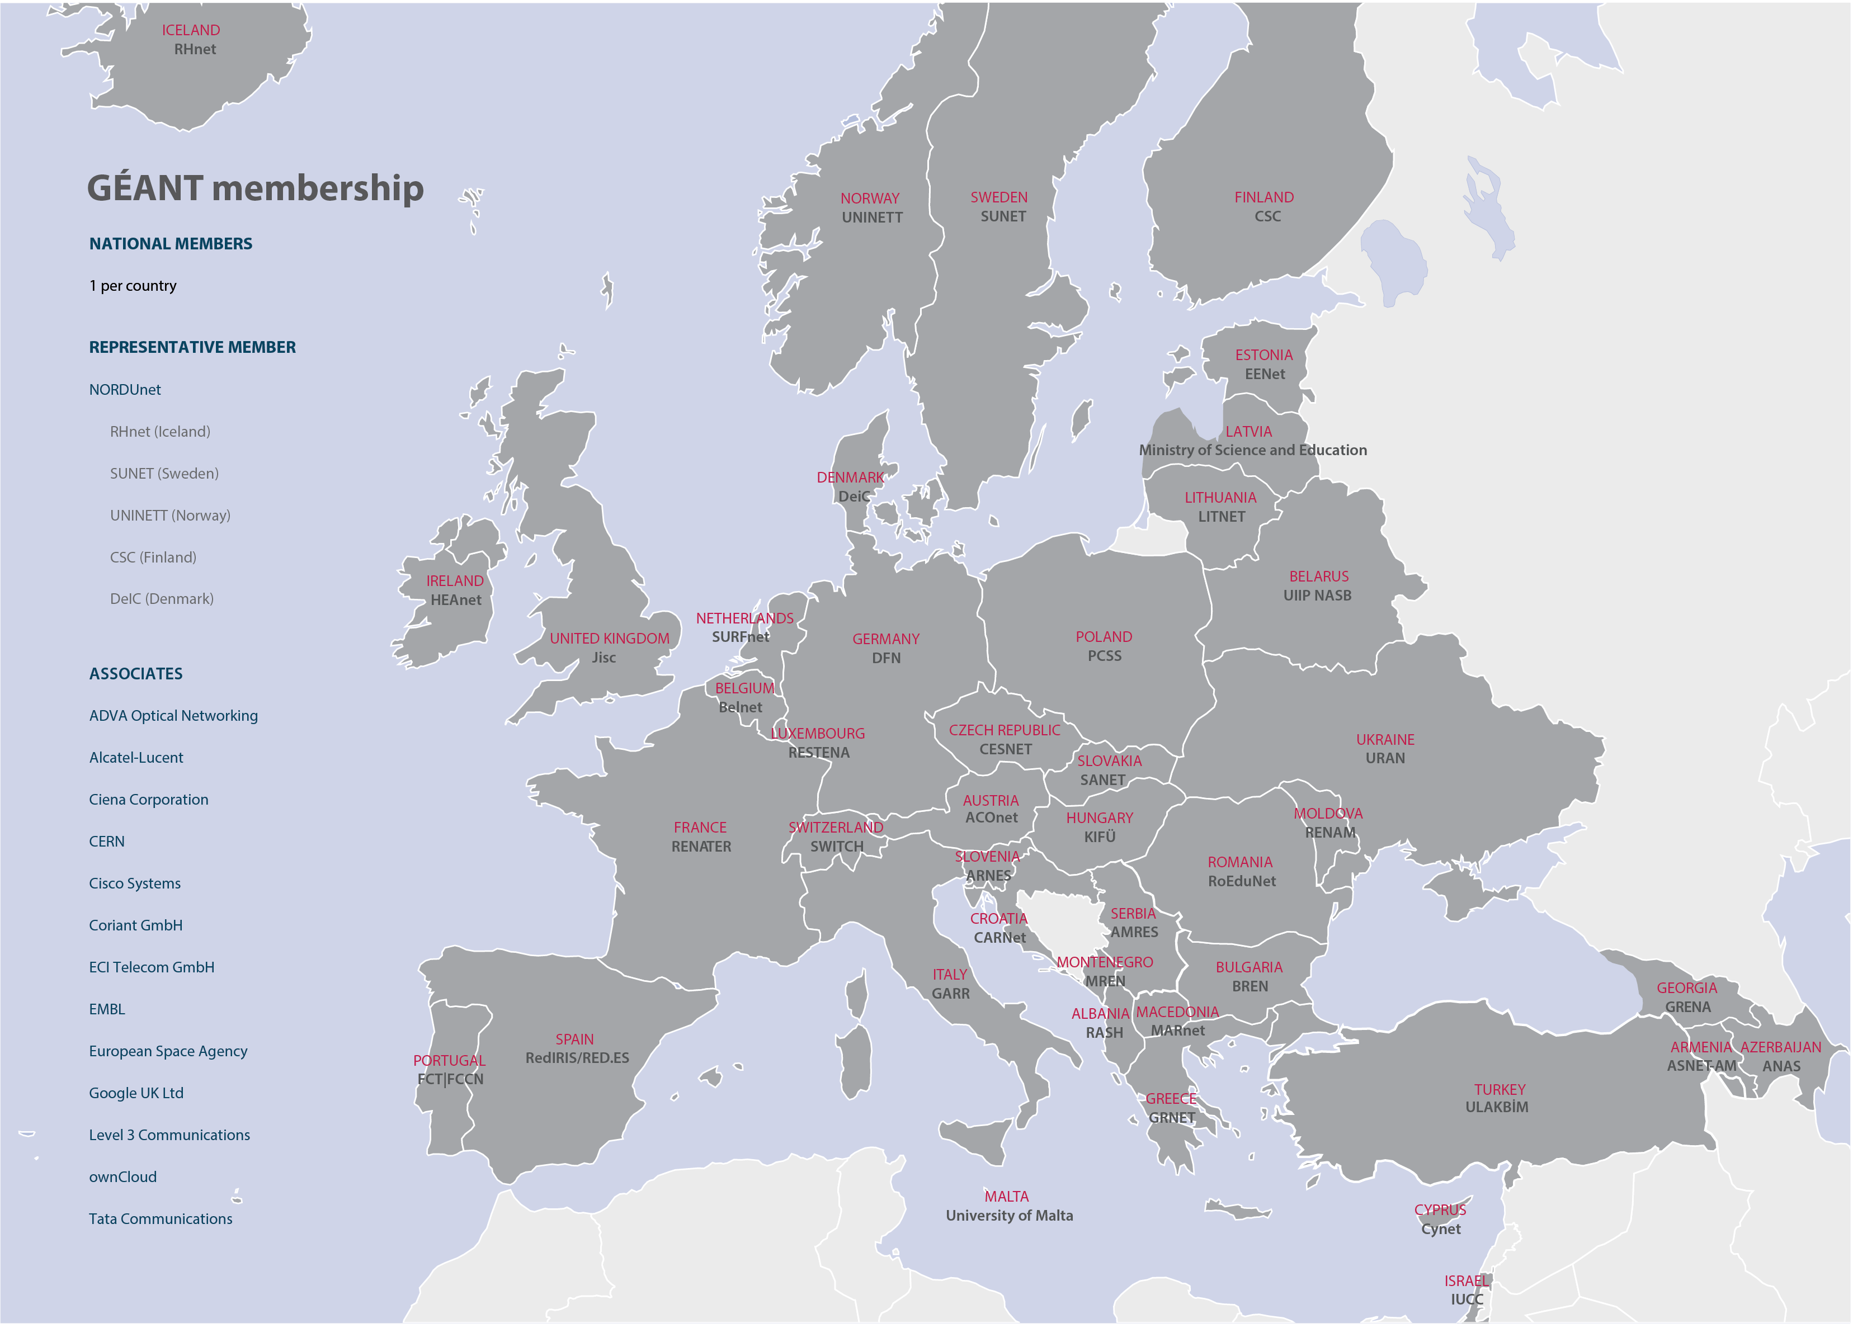
NREN responses
Notes:
43 NRENs in total 38 responded 2 incomplete 3 not responded.

Slide 7
NRENs provide educational services beyond connectivity

Slide 8

Educational services
Digital Learning Environment
Logistical Support for education
Online, blended and remote delivery of education
Providing e-Content
Learning Analytics
Educational staff training
Open badges, digital credentialling
Transnational education
Inhouse built tools by your NREN for digital learning
Digital assessment and testing

Slide 9
Levels of development of educational services in all NRENs
Notes:
Alternative slide using map
Refer to session 7D: edu* Tuesday
16:00-17:30
Small Hall

Slide 10
Number of services that each NREN provides
Notes:
Alternative slide using map

Slide 11
Educational service levels
Initiative level
Informal joint exploration of an idea by an expert group. In most cases there is some investment to explore this initiative further, supporting the NREN’s participation in this initiative.
Project level
Formal joint follow up of an initiative with a project owner and a budget.
Service level
An integrated service implemented by the NREN.
Notes:
Alternative slide using map

Slide 12
 | Digital learning environment | Logistical support for education | Online, blended and remote delivery of education in the home NREN country | Providing e-Content | Learning analytics | Digital assessment and testing | Educational staff skills training | Open badges, digital credentialing | Transnational education (delivery of your national education overseas) | Inhouse built tools by your NREN for digital learning
Albania
Armenia |  |  |  |  |  |  |  |  |  |  |  | did not respond
Austria |  |  |  |  |  |  |  |  |  |  |  | Do not provide
Azerbaijan |  |  |  |  |  |  |  |  |  |  |  | N/A
Belarus |  |  |  |  |  |  |  |  |  |  |  | No - Out of scope
Belgium |  |  |  |  |  |  |  |  |  |  |  | No - But interested
Bulgaria |  |  |  |  |  |  |  |  |  |  |  | Yes - Initiative level
Croatia |  |  |  |  |  |  |  |  |  |  |  | Yes - Project level
Cyprus |  |  |  |  |  |  |  |  |  |  |  | Yes - Service level
Czech Republic
Denmark
Estonia
Finland
France
Georgia
Germany
Greece
Hungary
Iceland
Ireland
Israel
Italy
Latvia
Lithuania
Luxembourg
Macedonia
Malta
Moldova
Montenegro
Netherlands
Norway
Poland
Portugal
Romania
Serbia
Slovakia
Slovenia
Spain
Sweden
Switzerland
Turkey
Ukraine
United Kingdom
Nordics

Slide 13
Transnational education

Slide 14
Notes:
1 - initiative
2 - project
3 – service
Digital learning environment

Slide 15

19 NRENs
22 NRENs
Notes:
Procurement:
Joint Activity: 13
Knowledge Sharing: 6
Out of scope: 3
Answer N/A: 21
OER:
Joint Activity: 16
Knowledge Sharing: 6
Out of scope: 4
Answer N/A: 17

Slide 16
34 NRENs
Notes:
SIG: 8 NRENS
Knowledge sharing: 26 NRENs

Slide 17
TF-EDU Main objective
The Task Force aims to establish collaborations across the education sector on commonly identified topic areas, providing a coordinated approach to improve NREN educational services and activities.

Slide 18
Objectives includes
Establishing a Taskforce as a trusted forum with members that actively participate and are involved in the results of the Taskforce;
Providing a platform to promote the sharing of best practices, tools and policies related to educational services and activities in our community. This may result in a repository or knowledge exchange activity.
Mapping NRENs individual educational services and activities with the aim of co-creating a roadmap for further collaborative activities;
Discussing, sharing ideas and giving feedback leading to a better understanding of common challenges and opportunities (e.g. lifecycles). Shared opinions can result in common standards that provide guidance for the wider community and NRENs; and
Liaising with other groups and projects within GÉANT when an education related area is discussed jointly and provide feedback on initiatives. As an example and first liaison would be with the GÉANT cloud activity to assist with developing services.

Slide 19
Next steps
Establish the Task Force officially
Joint workshop 7-8 October 2019, Budapest, Hungary:
  NRENs educational technologies
  SIG-TNE
  SIG-Multimedia
  Network Performing Arts Productions

Slide 20

Thank you
SUBSCRIBE TO OUR MAILING LIST: https://lists.geant.org/sympa/subscribe/tf-edu
www.geant.org
© GÉANT Association on behalf of the GN4 Phase 2 project (GN4-2).
The research leading to these results has received funding from
the European Union’s Horizon 2020 research and innovation programme under Grant Agreement No. 731122 (GN4-2).

