Slide 1
WP7. Pilot coordination and continuous risk assessment
Michał Zimniewicz
Poznan Supercomputing and Networking Center
Up2U Update Webinar
26th July 2019
Notes:
These slides present the status up to the second half of May

Slide 2
Pilots
Country | Training |  | Pilots
 | Schools | Teachers | Schools | Students
Germany
Greece | 10 | 80 | 5 | 50
Hungary | 8 | 66 | 3 | 42
Italy | 79 | 100 * | 6 | 72
Lithuania | 185 | 341 | 133 | 15.000
Poland | 26 | 47 | 11 | 300
Portugal | 7 | 50 * | 1 | ?
Spain | 6 | 17 | 1 | 100
* - training in progress
Notes:
Next, two periods of pilots are planned for all countries:
September-November
January-March

Slide 3
Pilot – Definition
Students using the Up2U Application Toolbox
to bridge the gap between secondary and higher education,
i.e. practice the key competences identified by WP5.
Notes:
An outcome of the WP5-WP7 meeting
The competences are: Critical thinking, collaboration, creative thinking, etc.

Slide 4
Internal KPI for Pilots
The official KPI – engaging 1000 schools
Collect web and learning analytics data on each school
Implement uniform pre- and post- surveys
for teachers and students in each school
Ask at least one teacher in each school
to define a collaborative assignment for students
and then send statistical assessment data back to us
Notes:
Internal KPIs to be able to evaluate what students do in pilots. Agreed with WP5. Details to be clarified in August.

Slide 5
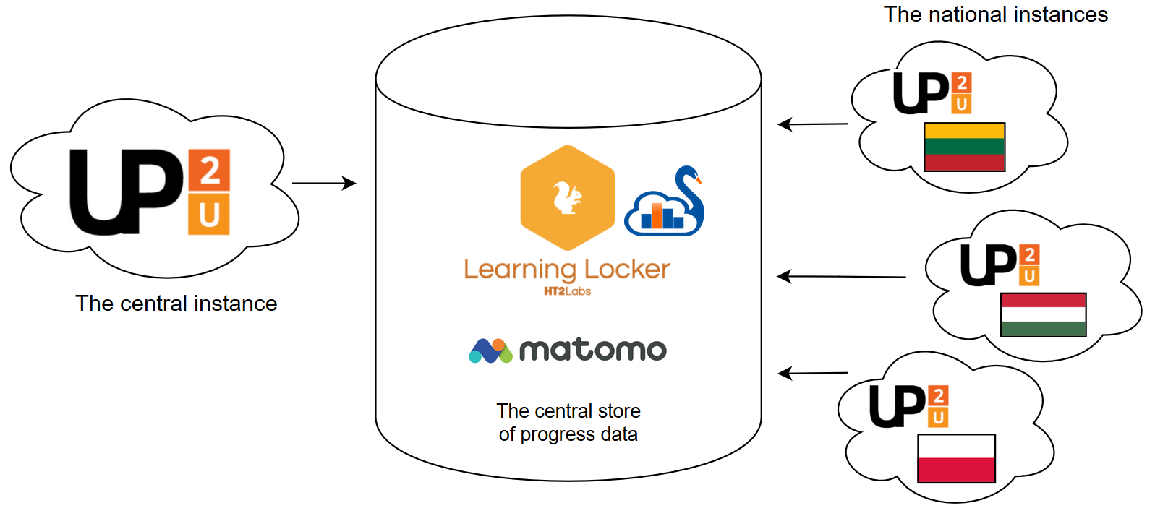
Evaluation across
Application Toolbox Instances
Notes:
Agreed upon (WP5-WP7) to implement this setup to support evaluation: Central and national instances to report data to central stores (Learning Locker, Matomo).

Slide 6
Technical Requirements for Pilots
Requirements for collecting data
Requirements for Learning Analytics
Mitigation of the lack of group management solution, esp. for LA
MVP suggestions on new tools and improvements
Notes:
These are technical topics to support pilots that were discussed in the WP5-WP7 meetings.

Slide 7
Quality Control
Functional testing
  Handling the recent upgrades of Moodle
  The upgrades of CERNBox, SWAN, Multiparty Meeting
  Report issues: https://wiki.geant.org/display/UP2U/Issue+tracking
Performance testing – first results, analysis in progress
  Infrastructure changes needed – Moodle and SeLCont
  Weak ability to handle concurrent users – CS, Swan, CERNBox
  Good performance – LL, Knockplop, MM
Notes:
Quality Control task is a continuous job to oversee the quality of technology outcomes. These are topics we focused on in the last period.

Slide 8
Risk Assessment
Some risks re. WP7 of high exposure:
Solving GDPR issues in the platform
No solution for group management
Missing LA implementation in different tools
Notes:
Critical risks re. WP7
Re. risks no. 2 & 3 – effect might be serious problems in collecting or evaluating LA data, thus evaluating pilots

