Slide 1
GDPR Update
Casper Dreef
GÉANT
Webinar #6 26/07/2019

Slide 2
Consent collection
KWS
  Consent collection at SSO level
  Integration flow chart created by GWDG
  Planning: KWS to advise the project after ‘guided tour’ on the platform
Moodle
  Update: Moodle 3.6.2
  Consent collection for Moodle only
  Minor age: central instance vs. on prem
  Intermediate solution
Notes:
KWS
SSO level: roll down to all tools including Moodle
Moodle
No roll down to other tools
Central instance: determine minor age: GDPR art.8 states 16, but member states are allowed to allocate their own age of consent as low as 13.
On prem the members will set the minor age conform local legislation
Intermediate solution until KWS is fully implemented

Slide 3
Policies
Privacy notice
  Data storage
  Updates
Cookie policy
  To be done
Notes:
Current discussions:
Data storage beyond the lifetime of the project:
Digital certificates
To be considered in sustainability plan
The Privacy notice should be updates after the extension request is officially approved

Slide 4
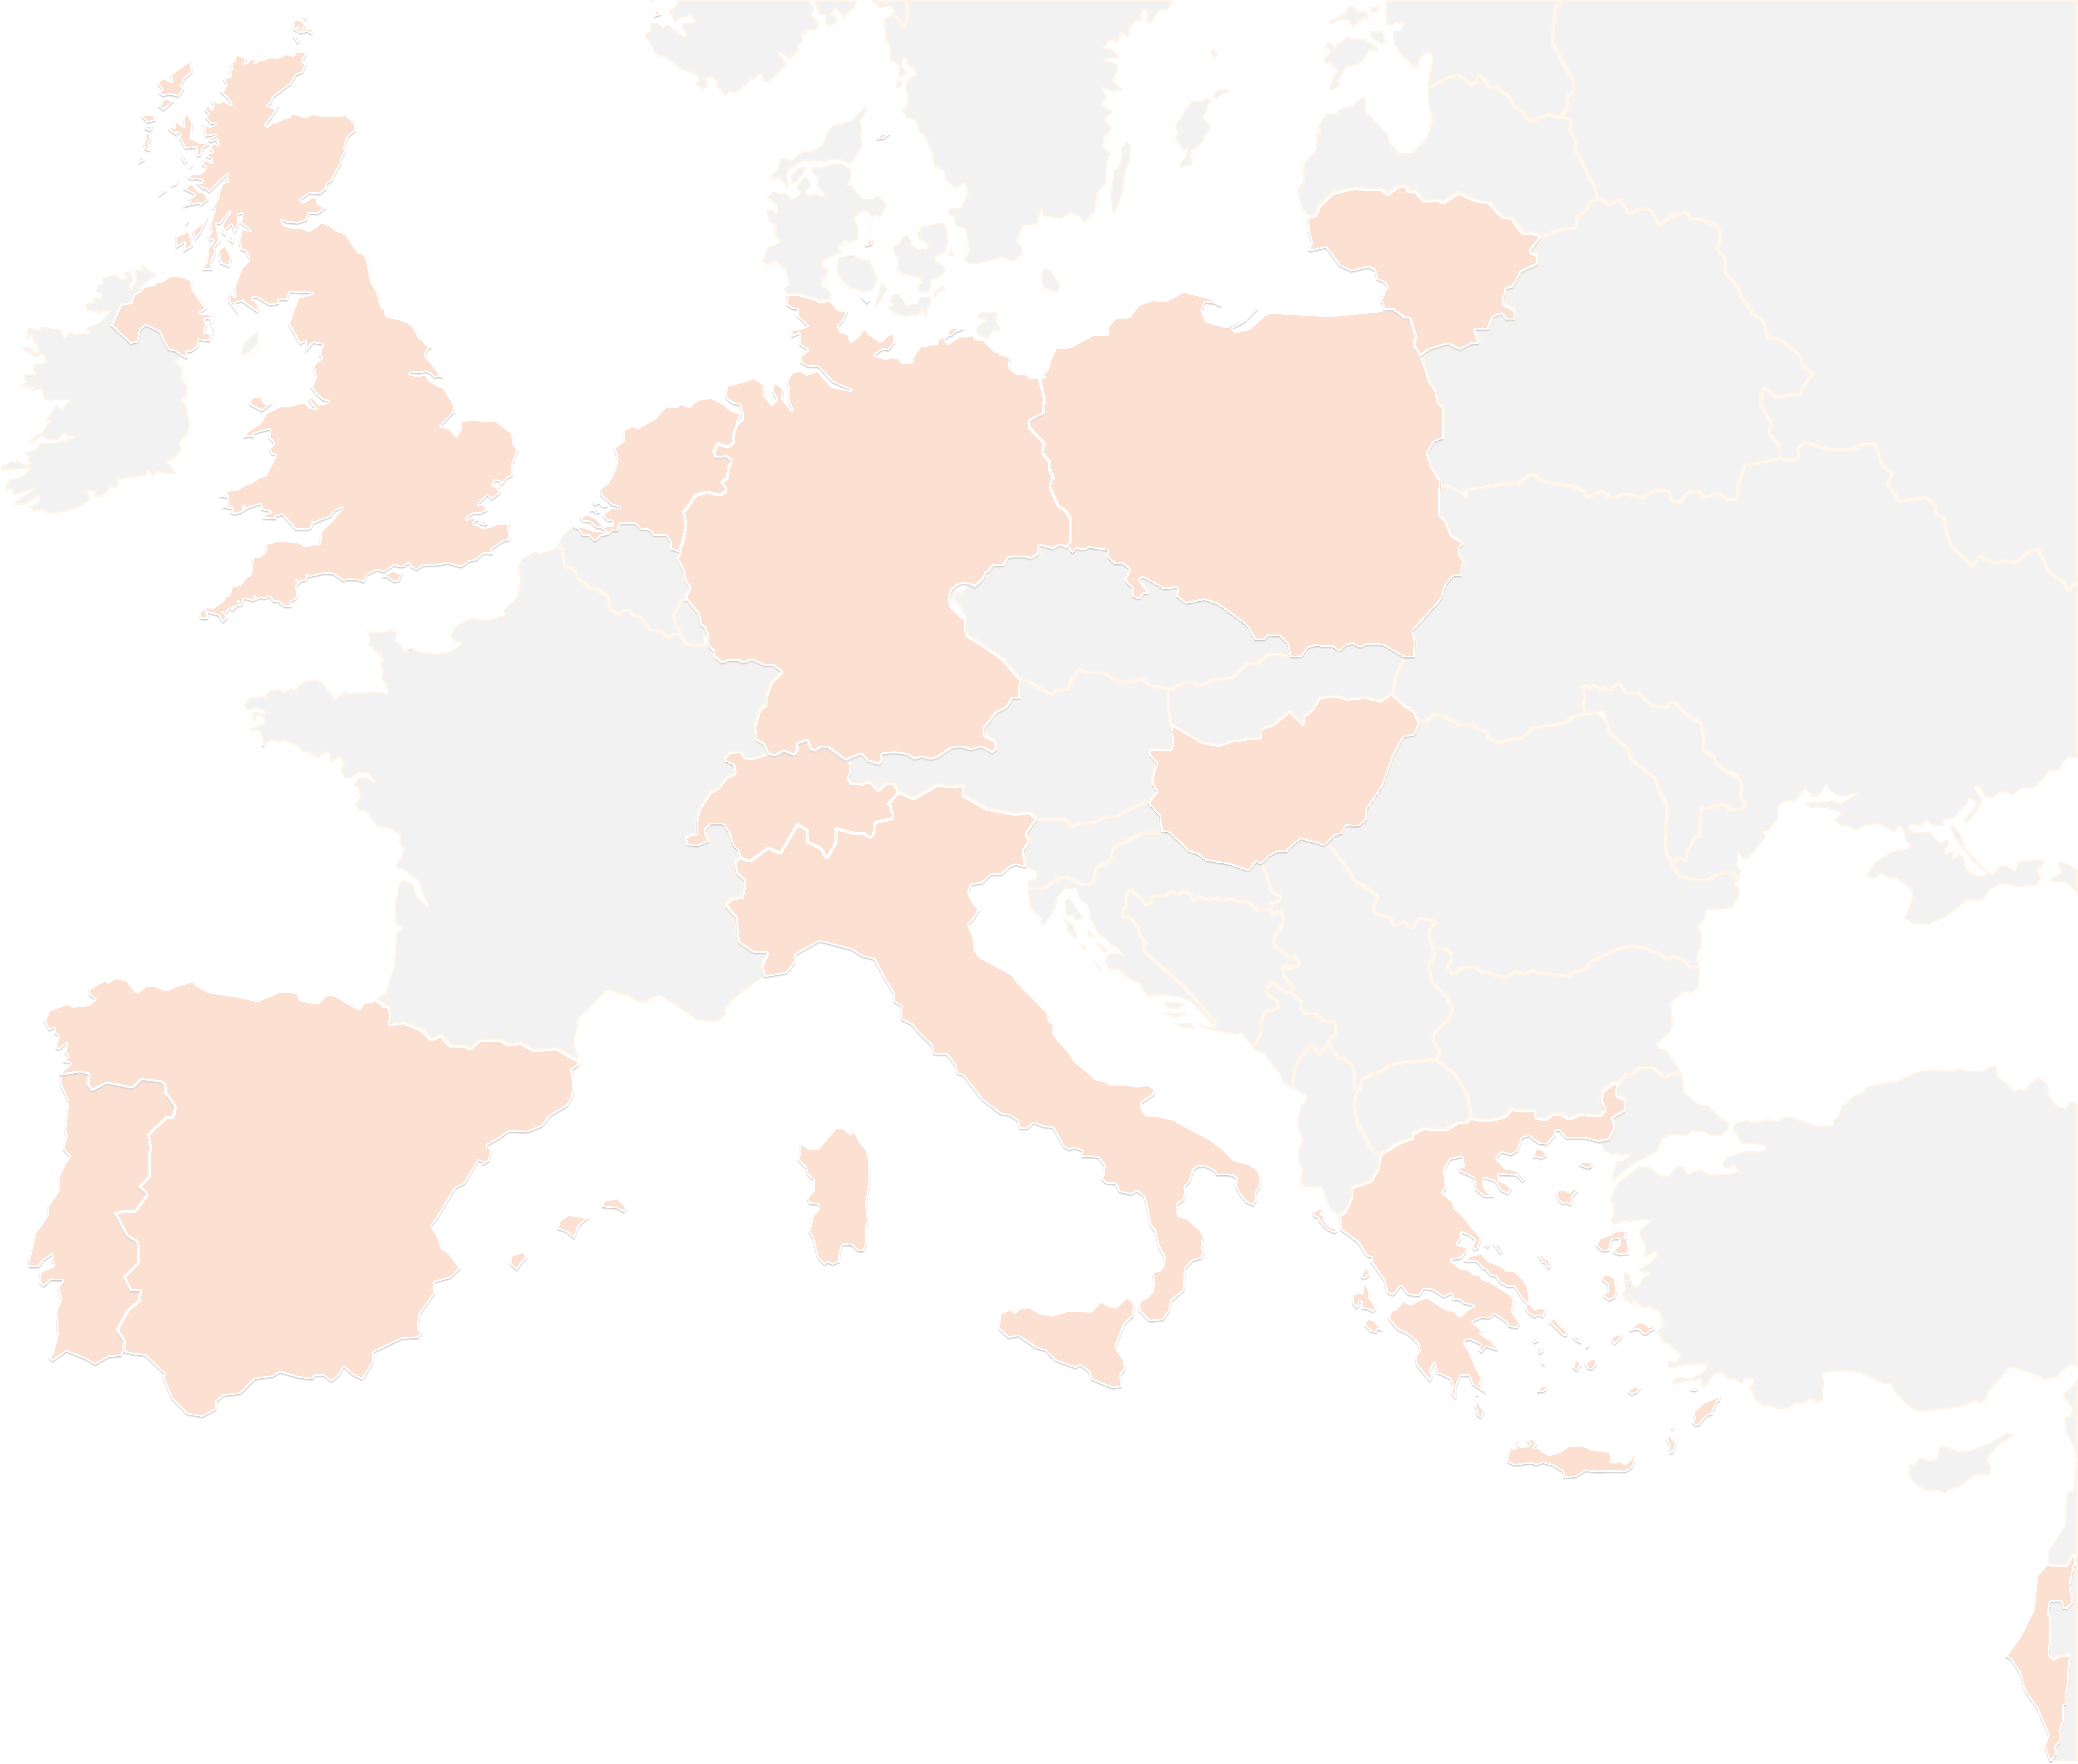
THANK YOU FOR YOUR ATTENTION!
contact@lists.up2university.eu
#up2universe

