Slide 1
WP5 - Learning Community Interactions
Eli Shmueli
IUCC- Inter-University Computation Center, Israel
Up2U WP5-WP7 Rome, 23rd-24th of July 2019,

Slide 2
Learning Communities, Social Networks
Communities
Education network staff
Groups on social media
Schoolnet
Twitter chats
Organised
(top-down / formal)
Emergent
(bottom-up / informal)
Networks
Notes:
To reach a wider range of communities and org…

Slide 3
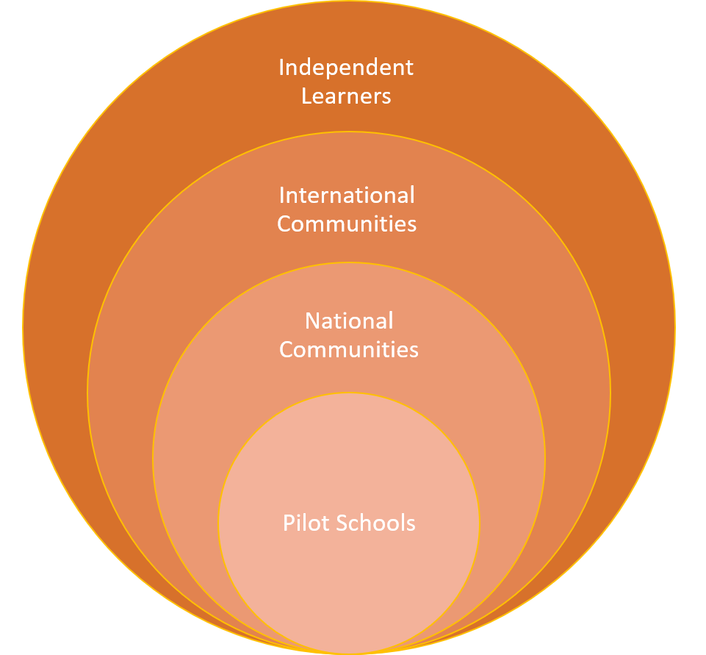
Wide range of learning communities
Pilot schools
Organizations, networks and communities on a national level
Organizations, networks and communities on an international level
Independent users (teachers and students)
Notes:
Wide range of learning communities that we can engage
The first community is the most important one that we suppers the pilot countries and the CPD teachers..
Intensive and demanding prosses Deep learning
Additional to the pilot countries we find that there is a NATIONAL …. INTERNATIONAL and Independent user.
Early adaptor and innovations teaches
----------

Slide 4
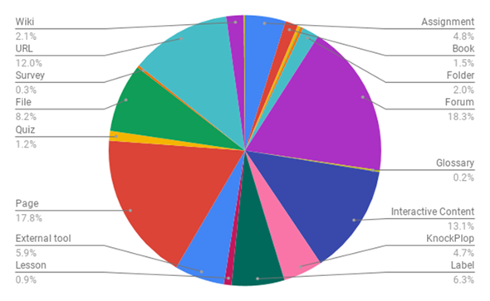
Teacher CPD
  Module 1- Implemented in pilot countries
  Module 2- Teachers will implement what they learned in classrooms
  Module 3- ‘Train the trainer’
OER Resources and interactive Activities and content
www.up2university.eu
4
Notes:
We talked about the teachers CPD and Module 1 2 3 and I like to point out in this graph that the courses contain a mixed content that supports interactions activities collaborations and external tools
-------
We supports the CPD

Slide 5
Local Practices from Pilot Countries
Country | CPD Modules - Local Initiative
Spain | Bottom Up approach - Small group of independent teachers whose schools not yet affiliated with Up2U
Lithuania | Fully online Module 1 instead of hybrid or f2f
Portugal and Italy | Combined Modules 1 and 2 to replace two sequential Modules
Several countries | Prefer to use their own local instance of Moodle rather than central instance
Notes:
We can see from the pilot countries that there is a different way of using the UP2U ecosystem
Central vs Extensions
We can reach more pilot countries

Slide 6
National & International
National teacher organizations and networks.
Organizations that promote pedagogy and learning technologies for teachers and schools.
Teacher professional development programmes.
Universities and colleges - Outreach programs
Government educational programs
GÉANT & NRENs
Content providers
OER repositories for schools
Educational EU
communities – Scientix, European Schoolnet

Slide 7
National Practices from partner countries
Country | National Initiative
Lithuania
Poland | Memoranda of understanding with four units of territorial division to promote pilots starting from September The regions: Nowy Tomyśl, Września, Krotoszyn, Poznań-Jeżyce 20-30 schools in the first step
Italy
Several countries
Notes:
We can see from the pilot countries that there is a different way of using the UP2U ecosystem
Central vs Extensions
We can reach more pilot countries

Slide 8
Independent Users
Independent teachers - want to use Up2U tools and content without participating in CPD.
Independent students - want to use Up2U enrichment content to smooth their transition to university.
Up2U needs flexibility - users can easily define their degree of engagement with Up2U content and tools, and use as small or as large a part of the ecosystem to meet their specific needs.
Notes:
Innovations teachers that can use content, scenario or tools to supports there learning methods

Slide 9

Task force
Engaging communities
Formulate a plan to enrich Up2U’s usability by engaging additional communities in Europe and involving them with the Up2U ecosystem
These communities include national and international teacher networks and organizations that support large numbers of schools, as well as communities of students in both formal and non-formal education programs.
Notes:
In the last few month we are promoting the engagement more communities
And we establish a cross WP’s Task Force

Slide 10
Steps to Engaging Community
Mapping different communities and organizations.
Establishing contact and exploring possible collaboration with these communities and organizations.
Cooperating with different communities to establish which aspects of Up2U ecosystem could interest them.
Notes:
We already starts the activities on those task
We assume that some of the communities can use some of the UP2U aspects such as tools, contents…

Slide 11
WP’s Cross Activities
WP’s and Partners | Learning communities
GEANT WP5 & WP1 | International teacher organizations and networks.
NREN’s WP5 & WP1 & WP2 | National teacher organizations and networks.
WP5 & WP7 & WP2 & WP8 | Organizations that promote pedagogy and learning technologies for teachers and schools.
Subject Matter Committee (SMC) and local members of Sub-SMC | Teacher professional development programmes.
U-HUB (TAU / Sapienza ) | Universities and colleges - Outreach programs
GEANT & NREN’s | Government educational programs
Notes:
Identifying and reaching a broader range of learning communities that can benefit from the Up2U ecosystem.

Slide 12
Cross WP’s Task Force
WP’s | Learning communities | Partners
GEANT WP5 & WP1 | International teacher organizations and networks. | Gyongyi, Casper, Eli, Stefano
NERN’s WP5 & WP1 & WP2 | National teacher organizations and networks. | Eli, Mary, Gytis, Michael, Barbara, Antonio, Marco, Gabriella
WP5 & WP7 & WP2 & WP8 | Organizations that promote pedagogy and learning technologies for teachers and schools. | Stefano, Ingrid, Michael, Gytis, Barbara, Faraz
Subject Matter Committee (SMC) and local members of Sub-SMC | Teacher professional development programmes. | Mary, Ingrid, Nadia, Stefano
U-HUB (TAU / Sapienza ) | Universities and colleges - Outreach programs | Ingrid, Jack, Stefano, Marco
GEANT & NREN’s | Government educational programs | Eli, Nelson, Ilias, Gyongyi, Casper

Slide 13
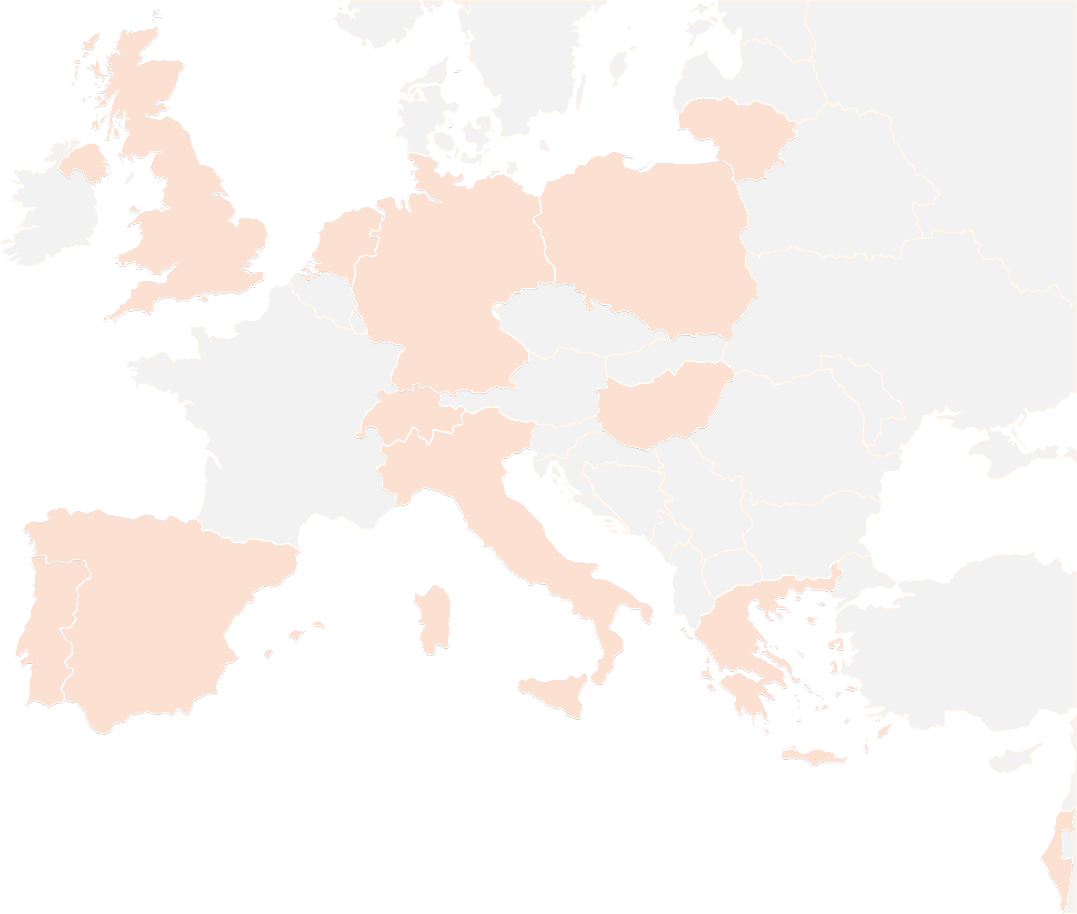
THANK YOU!
#up2universe

