Slide 1
WP1 Update
Casper Dreef
GÉANT
Webinar #6 26/07/2019

Slide 2
Past - Work done
Up2U Workplan
Amendments
Extension
Notes:
Up2U workplan has been approved by the EC. This requires;
Amendments to be made on Annex 1 part A and B of the Grant Agreement. In practice this means sections of the new workplan will be implemented or replace the original text. Changes include, but are not limited too:
Implementation of methodology
New due dates for deliverables;
Official request for extension of the project. The EC Finance department already stated they have no objections.
The amendments are currently under revision by GÉANT’s Tech authors

Slide 3
Future - Ongoing/Planned work
General Assembly
  Agenda:
  Please register here: https://eventr.geant.org/events/3144
Monthly reporting:
  Overall project
  Pilots
  Communication
  Finance
Notes:
The fifth GA will take place Wednesday 11 and Thursday 12 September in Poznan, Poland
Two full day meeting. Wednesday will focus on updates on:
workplan implementation by all WPs
Task Forces
Status of the pilot
On Thursday the focus will be on pedagogical implementations and cross-WP activities
Please, don’t forget to register!
Monthly reporting:
Regular reports
Finance: please send your Q10 reports to GÉANT and don’t forget to copy in Jan and/or the PCT!

Slide 4
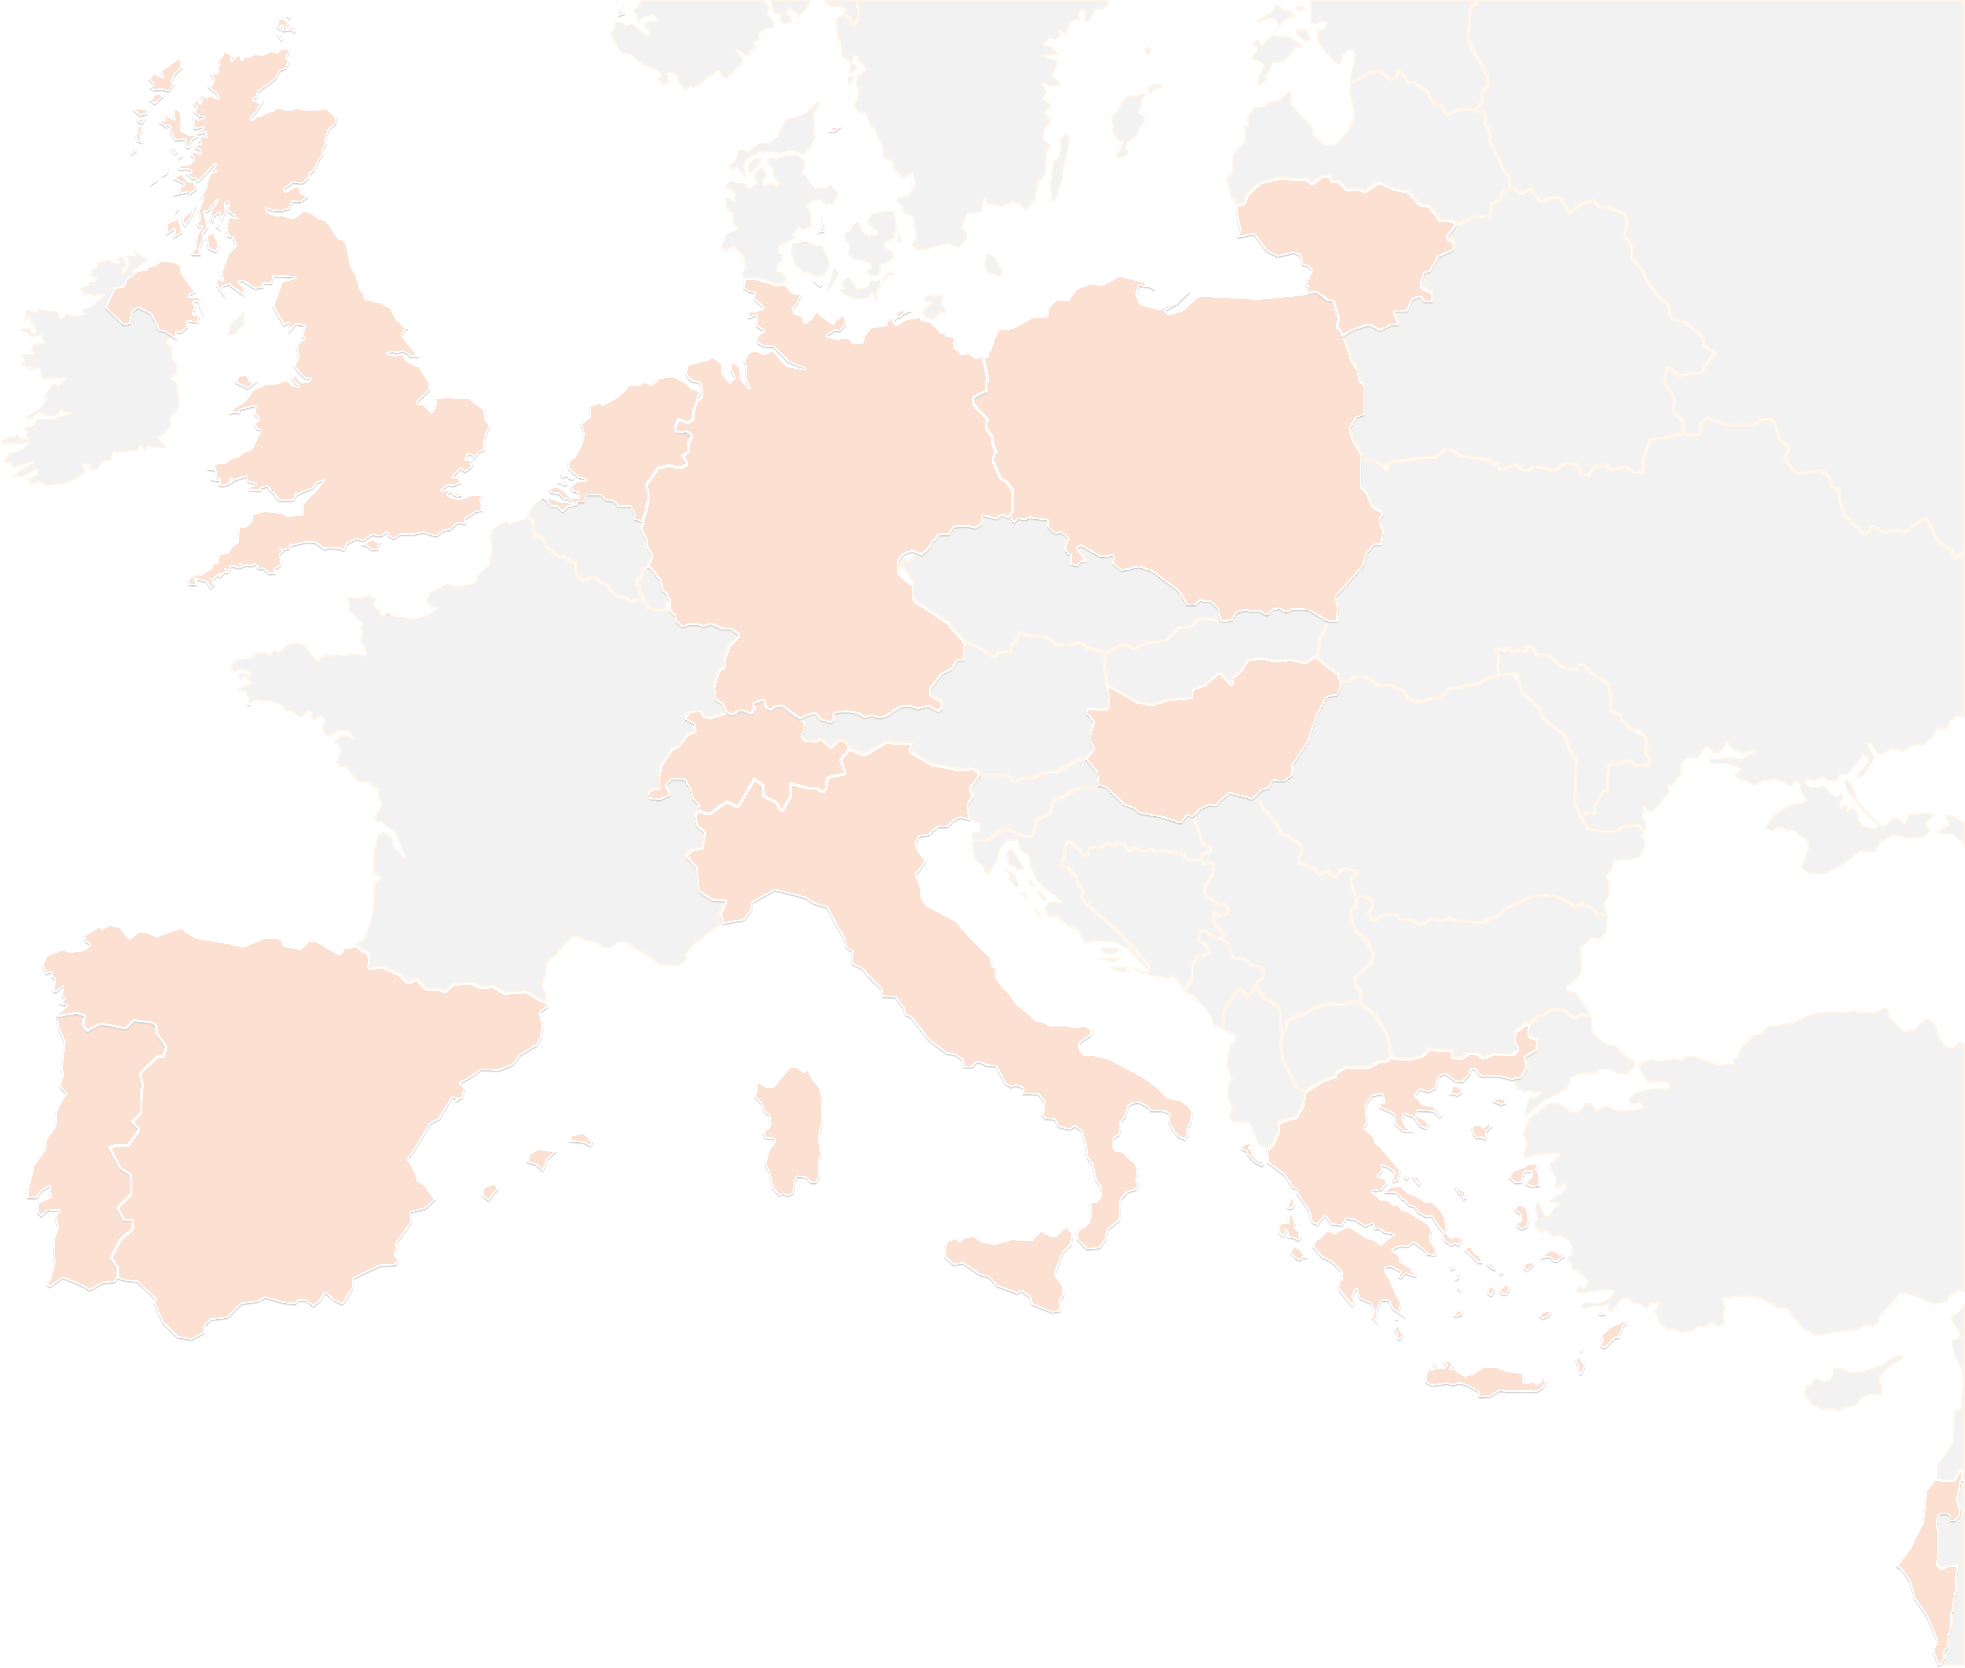
THANK YOU FOR YOUR ATTENTION!
contact@lists.up2university.eu
#up2universe

