Slide 1
WP1 Update
Casper Dreef
GÉANT
Webinar #6 26/07/2019

Slide 2
Past - Work done
Up2U Workplan
Amendments
Extension
Notes:
Up2U workplan has been approved by the EC. This requires;
Amendments to be made on Annex 1 part A and B of the Grant Agreement. In practice this means sections of the new workplan will be implemented or replace the original text. Changes include, but are not limited too:
Implementation of methodology
New due dates for deliverables;
The second important amendment to be made is the official request for extension of the project. The EC Finance department already stated they have no objections.
The amendments are currently under revision by GÉANT’s Tech authors

Slide 3
Future - Ongoing/Planned work
General Assembly
  Agenda:
  Please register here: https://eventr.geant.org/events/3144
Monthly reporting:
  Overall project
  Pilots
  Communication
  Finance
Notes:
The fifth GA will take place Wednesday 11 and Thursday 12 September in Poznan, Poland
Two full day meeting. Wednesday will focus on updates on:
workplan implementation by all WPs
Task Forces
Status of the pilot
On Thursday the focus will be on pedagogical implementations and cross-WP activities
Please, don’t forget to register!
Monthly reporting:
Regular reports
Finance: please send your Q10 reports to GÉANT and don’t forget to copy in Jan and/or the PCT!

Slide 4
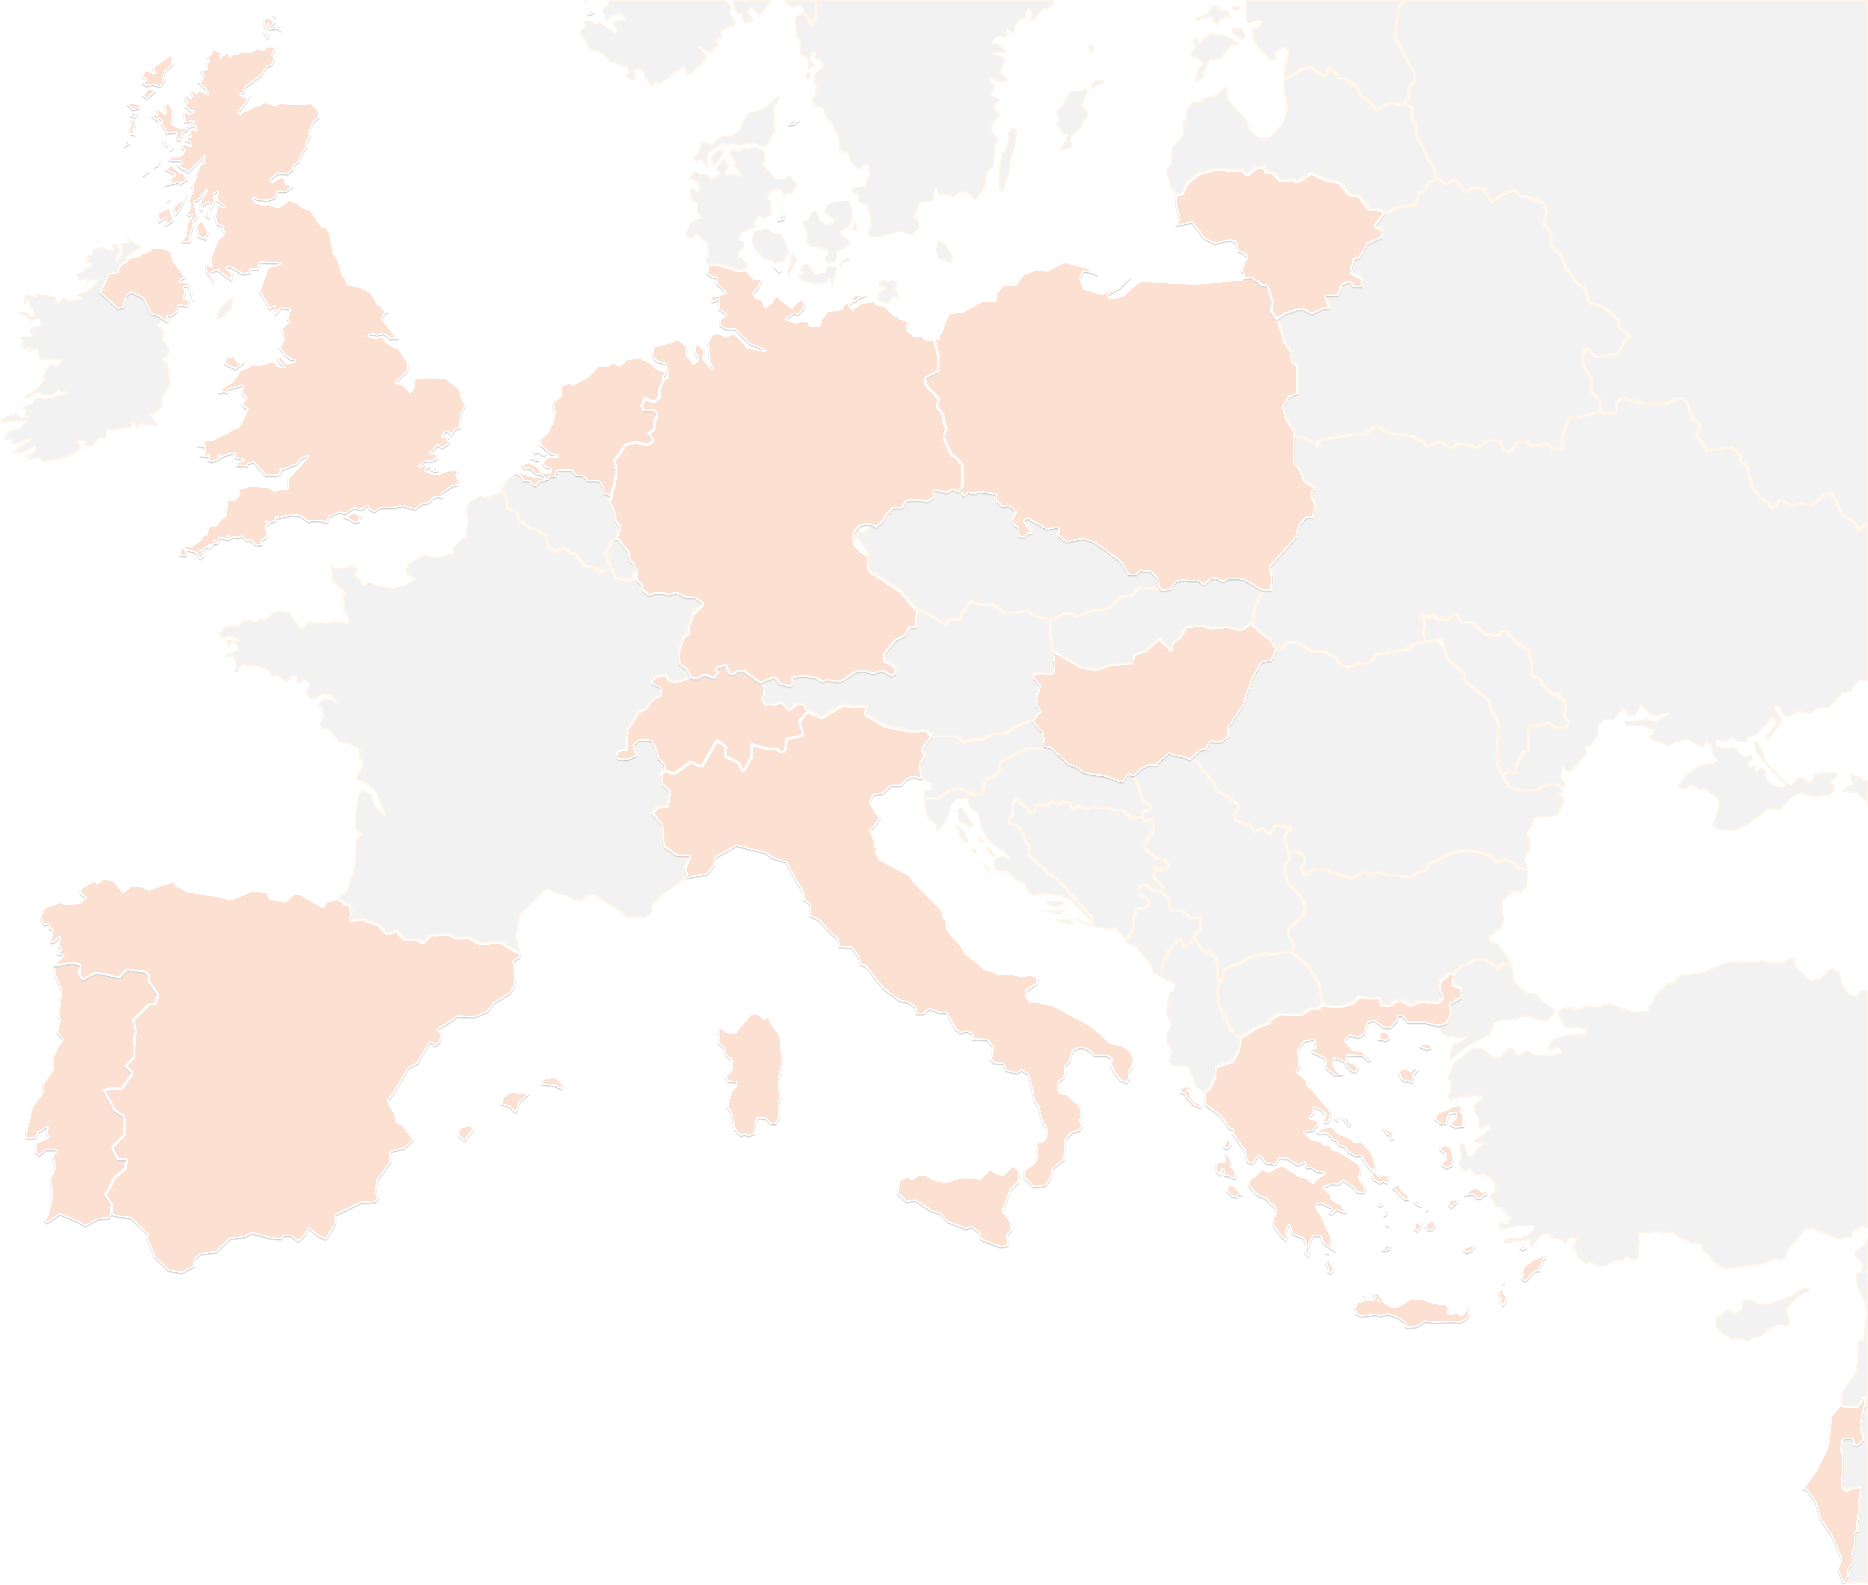
THANK YOU FOR YOUR ATTENTION!
contact@lists.up2university.eu
#up2universe

