Slide 1
WP4 Webinar Update
Up2U Update

Slide 2
Progress this period
Major update to production platform
  Moodle 3.6.2 and many fixes
Milestone: technical specification of Up2U platform
Student consent and age of majority
  Investigated integration of Moodle 3.6.x GDPR policy tools
Learning Analytics coordination
  Extending to other Up2U tools
Deployment/bundling of platform
  Which components need to be shared across deployments vs. local?
Notes:
Moodle 3.6.x has consent collection/policy management tools – investigating what can be achieved using these. Pending further details on KWS consent tool.
Coordinate effort/provide technical advice on extending non-Moodle tools to record xAPI learning activity
Discussion with KIFU about deploying the platform and which components are more useful to be run centrally vs. locally (e.g., central eduOER to provide single repository of resources, CERNBox/ownCloud can be central or federated (OCM), but SeLCont can be locally installed without issues)

Slide 3
Next steps
Learning analytics coordination
Consent & policy engine integration
Deployment bundling
Learning scenario collection

Slide 4
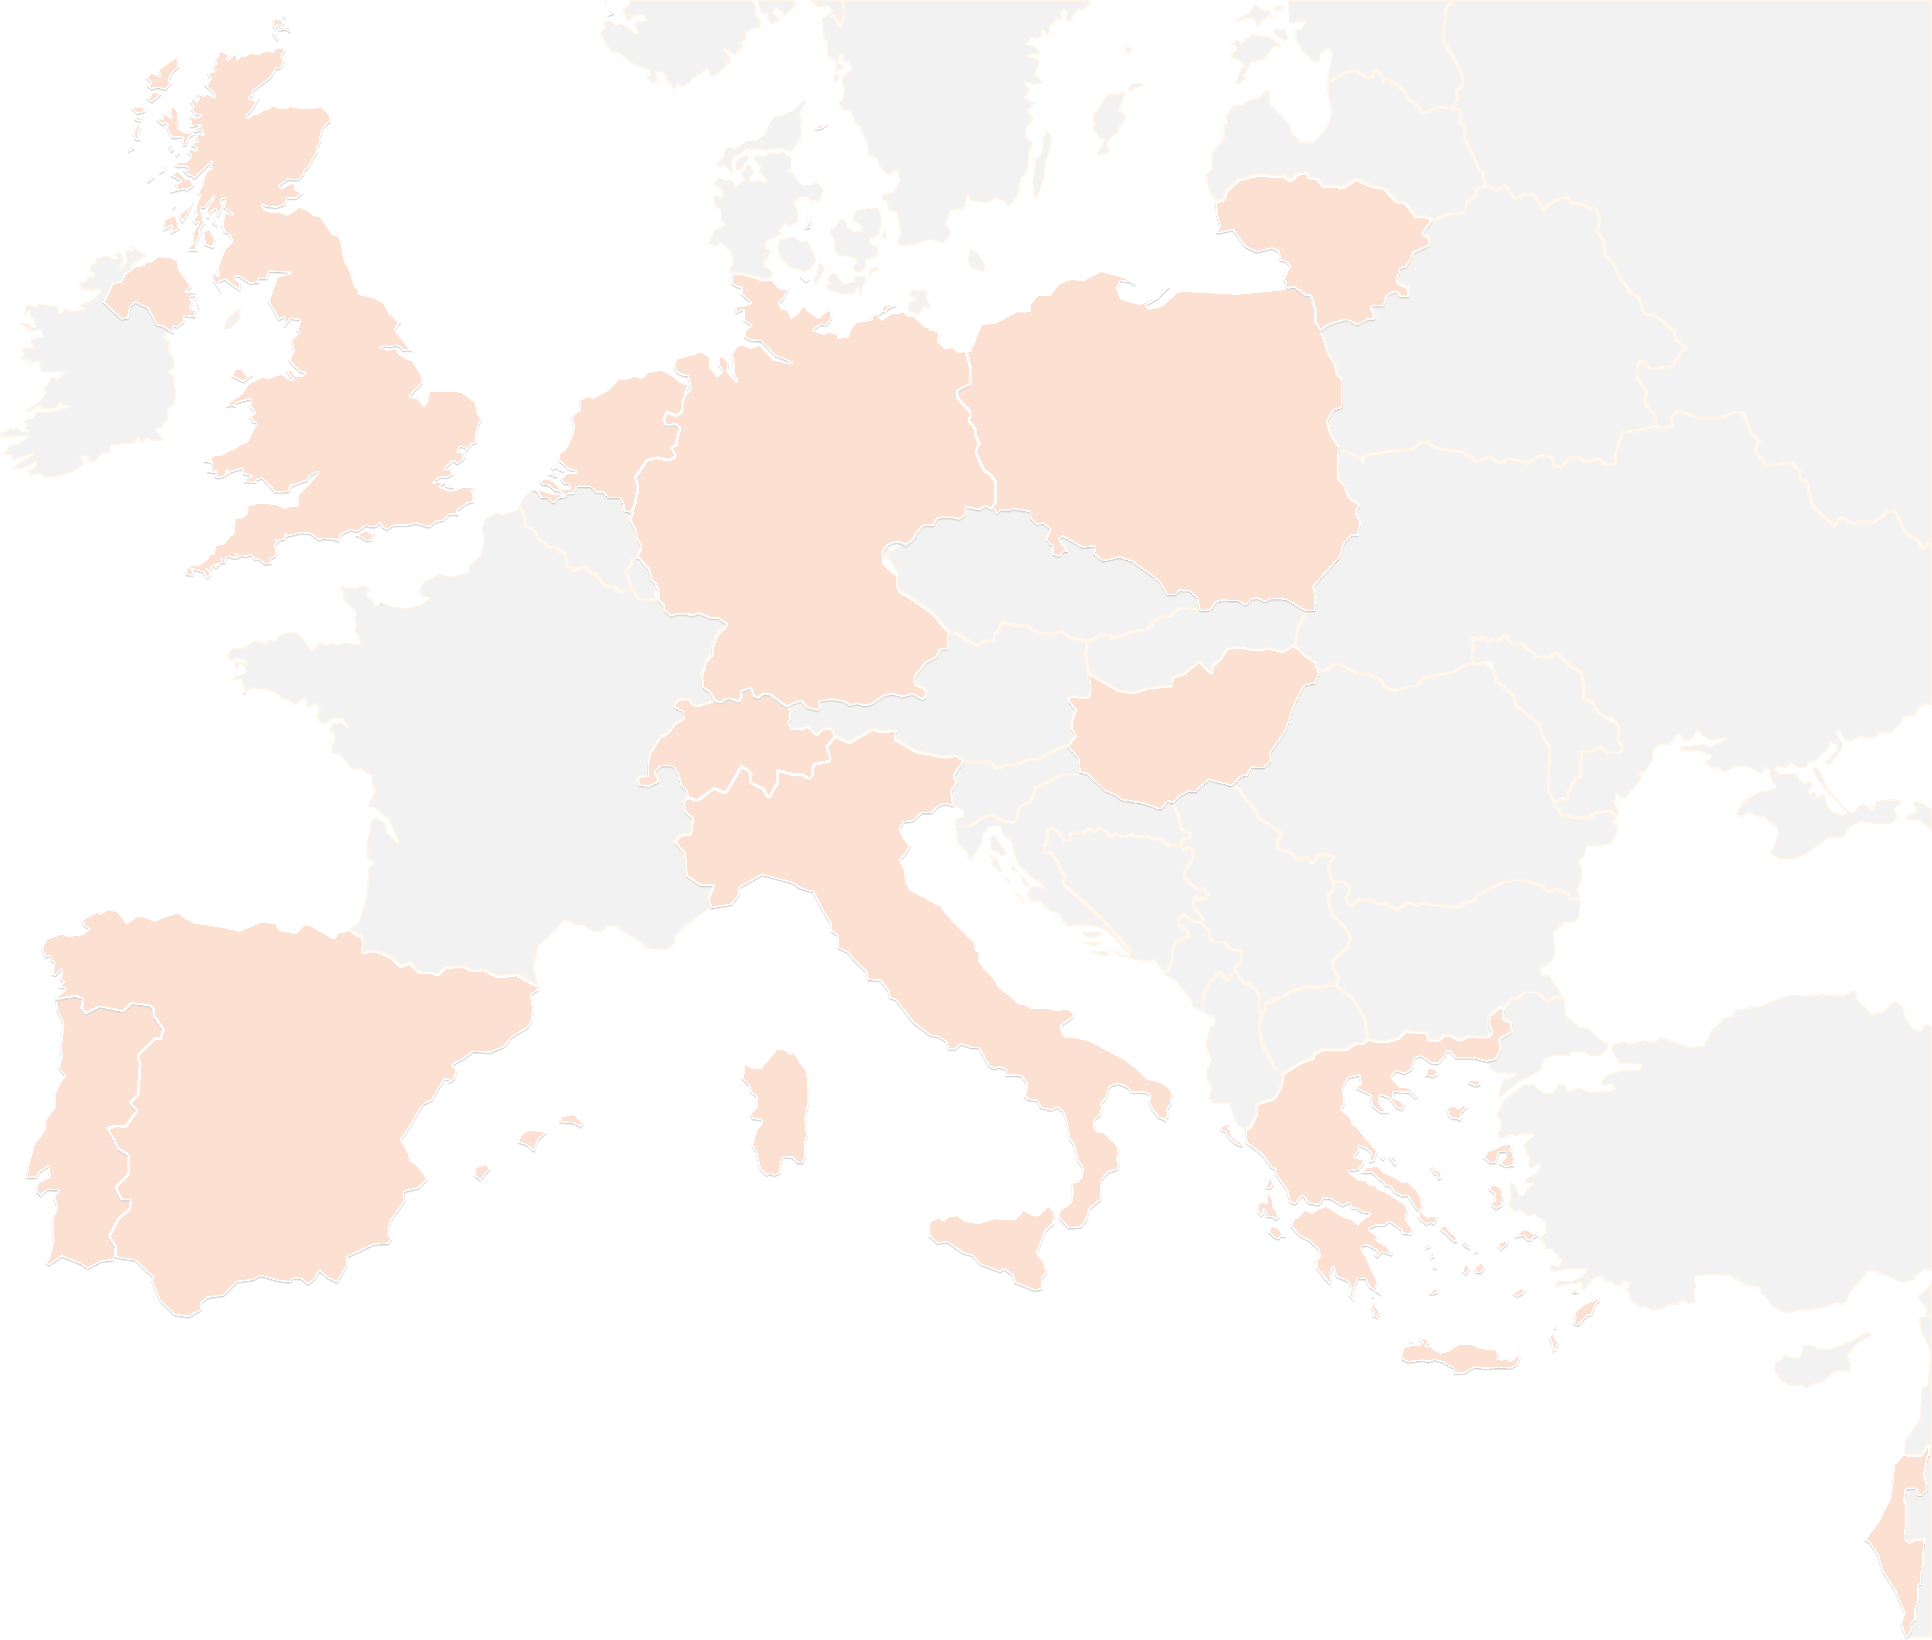
THANK YOU FOR YOUR ATTENTION!
wp4@lists.up2university.eu
#up2universe

