Slide 1
WP5 Webinar Update
Up2U Update

Slide 2
WP5 activity
Pedagogy coordination: planning the next cycle of pilots
  Elaboration of a Common Assessment Methodology
    4 Meetings of the UROMA team on assessment
    Remote meeting with TAU and support in completing D5.4 resumission
  WP5-WP7 preparation for a Meeting in Rome
    Remotely planning the meeting with contribution of each partner
    Setting the dates - preparing the most important issue to discuss
    Gathering attention from all the involved parterns
Notes:
From Github issue tracker

Slide 3
Pilots and international communities status
Pedagogical coordination of the next activities
  WP5-WP7 Meeting in Rome 23-24 July 2019 (a short deliverable will be prepared for next week)
    A review of all Pilots from Pilot Coordinators January 2019-July 2019
    Trouble and success collection
    Exchanging best practices
    Establishing a common Assessment Method to be implemented since September 2019 - to April 2020
  Operational “next steps document” prepared with 15+ items to be solved each one assigned to a team of owners
A structured agenda for the month August- September
A WP7-WP5 meeting in preparation for Posnan Meeting

Slide 4
Next steps
Finalise documentation of the Rome Meeting
  Proceedings with WP4-WP5 interaction to implement what is need to enhance Learning Analytics collection
Implement the actions planned in the Rome Agenda
Transfer to each Pilot Coordination team the results of the new agreements
  Implement Learning scenario (CFM in Moodle, and other planned alternatives )
Program and design new CPD
Program and design next Pilots

Slide 5
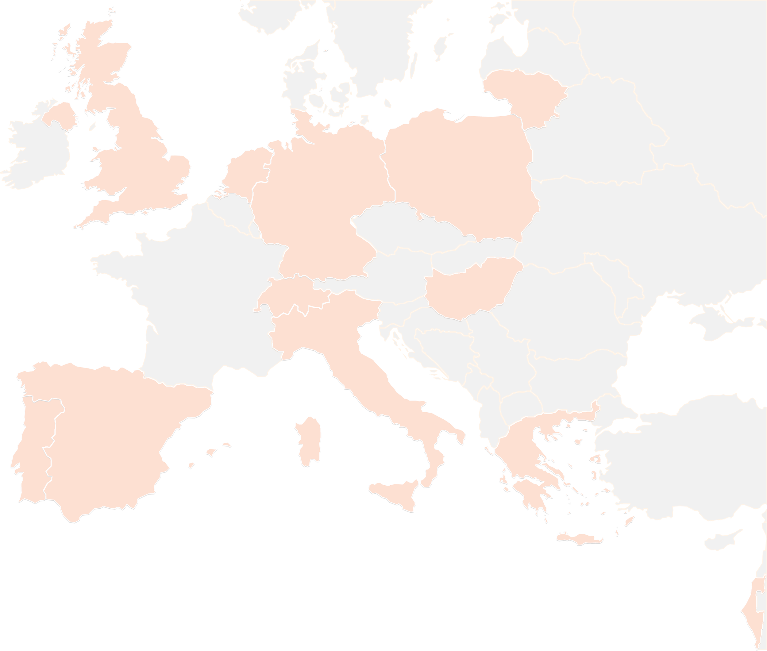
THANK YOU FOR YOUR ATTENTION!
See you in Posnan
wp5@lists.up2university.eu
#up2universe

