Slide 1
WP1 Update
Casper Dreef
GÉANT
Webinar #6 26/07/2019

Slide 2
Past - Work done
Up2U Workplan
Amendments
Extension
Notes:
Up2U workplan has been approved by the EC. This requires;
Amendments to be made on Annex 1 part A and B of the Grant Agreement. In practice this means sections of the new workplan will be implemented or replace the original text. Changes include, but are not limited too:
Implementation of methodology
New due dates for deliverables;
Official request for extension of the project. The EC Finance department already stated they have no objections.
The amendments are currently under revision by GÉANT’s Tech authors

Slide 3
Future - Ongoing/Planned work
General Assembly
  Agenda: https://wiki.geant.org/display/UP2U/5th+Up2U+General+Assembly
  Please register here: https://eventr.geant.org/events/3144
Monthly reporting:
  Overall project
  Pilots
  Communication
  Finance
Notes:
The fifth GA will take place Wednesday 11 and Thursday 12 September in Poznan, Poland
Two full day meeting. Wednesday will focus on updates on:
workplan implementation by all WPs
Task Forces
Status of the pilot
On Thursday the focus will be on pedagogical implementations and cross-WP activities
Please, don’t forget to register!
Monthly reporting:
Regular reports
Finance: please send your Q10 reports to GÉANT and don’t forget to copy in Jan and/or the PCT!

Slide 4
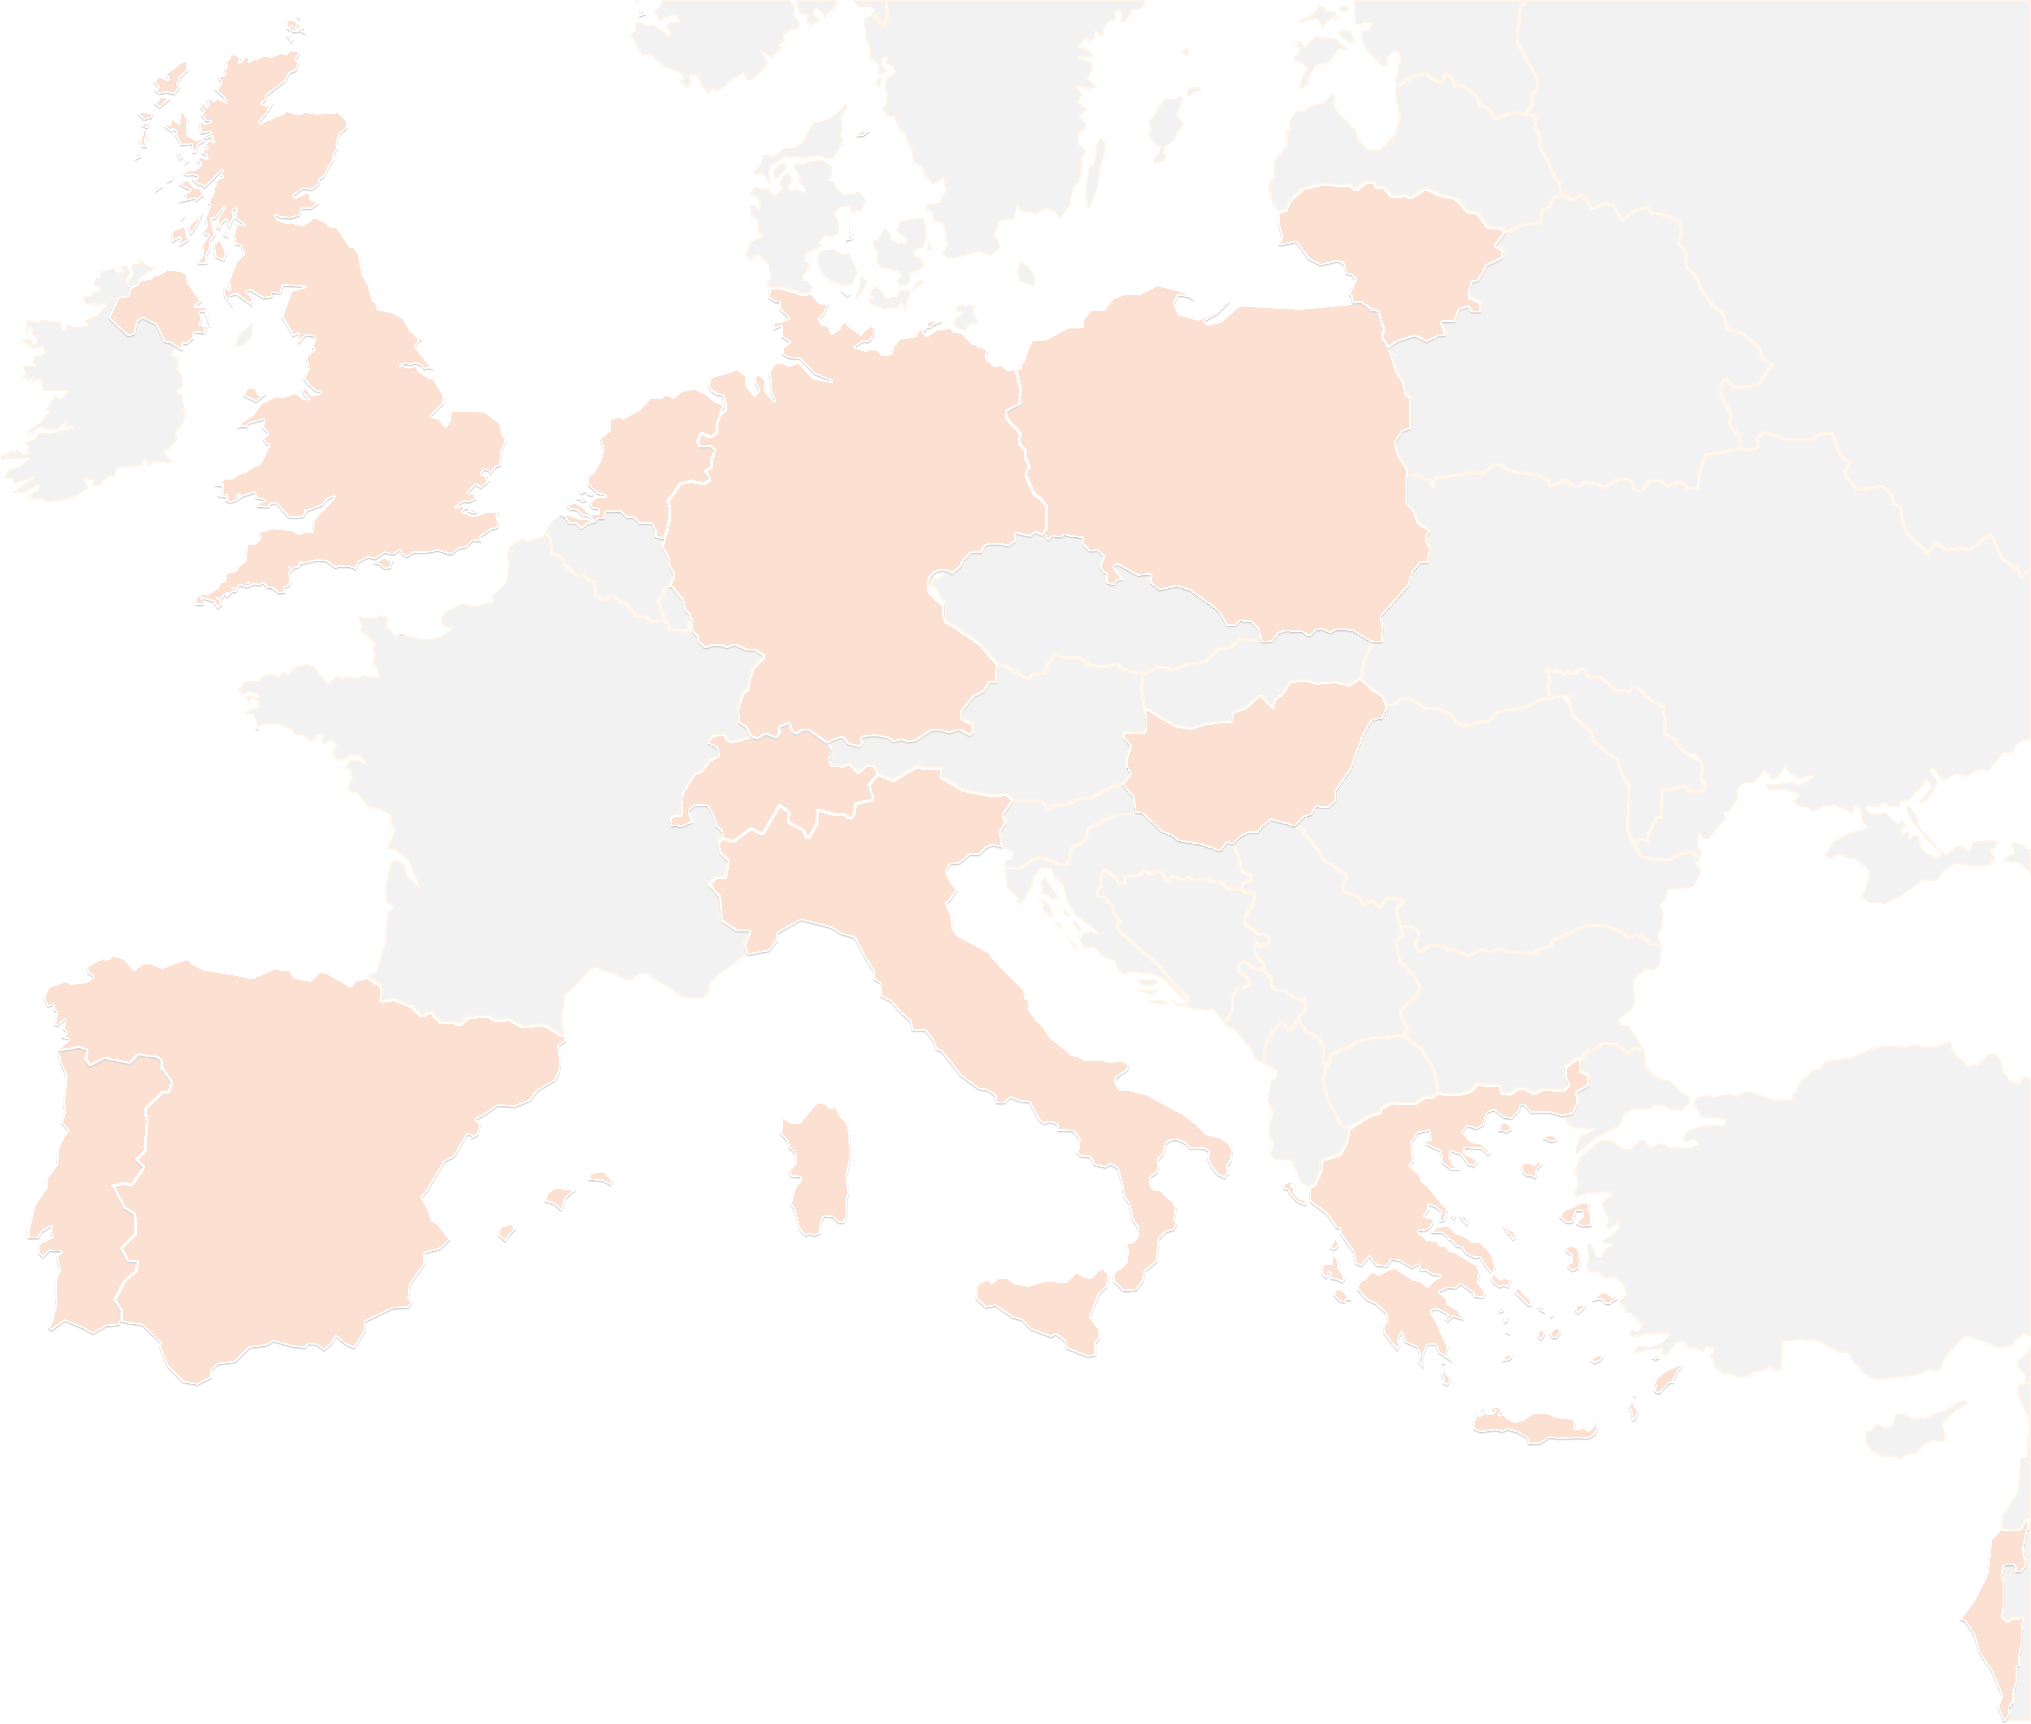
THANK YOU FOR YOUR ATTENTION!
contact@lists.up2university.eu
#up2universe

Slide 5
Up2U monthly webinar
WP2
Barbara Tóth
KIFÜ

Slide 6
Ongoing tasks, updates
  Motion graphics video will be launched during TNC with professional voiceover. Subtitles are welcome! Feel free to use it:
  https://www.youtube.com/watch?v=u2ryq9ytxZ0
  IT security flyers available on the website-translations are still welcome!
  Details please!
  We need to publish more news items on the website. This can only be done if you provide us information about the recent updates!

Slide 7
Reminders, requests
  We are collecting how much merch should we order to promote the project. Fill out this form please!
  Don’t forget to share information about your local and international events:
  Let us know if you have social media post or new item ideas! Share and promote our content please!

Slide 8
Up2U monthly webinar
WP3
Ilias Hatzakis
GRNET

Slide 9
TASK 3.3: OER
  NEW REPOS:
    LMU (Ludwig-Maximilians-Universität München)
    Smithsonian National Museum of Natural History
    Texas University
    Villanova University
    Arizona University
    South Florida University
    Kennesaw State University.
  We now have 54 repositories (24 HE and 30 K12 ).

Slide 10
TASK 3.2
OCM tests have been performed between OC and NC. There are still bugs that prevent a fully cross platform OCM interoperability. CERN is trying to fix them in the following weeks
Continuous improvement of CERNBOX and SWAN based on the feedback from pilots

Slide 11
TASK 3.1
Continuous improvement of the WebSSO.
Continuous bug fixing

Slide 12
WP4 Webinar Update
Up2U Update

Slide 13
Progress this period
Major update to production platform
  Moodle 3.6.2 and many fixes
Milestone: technical specification of Up2U platform
Student consent and age of majority
  Investigated integration of Moodle 3.6.x GDPR policy tools
Learning Analytics coordination
  Extending to other Up2U tools
Deployment/bundling of platform
  Which components need to be shared across deployments vs. local?
Notes:
Moodle 3.6.x has consent collection/policy management tools – investigating what can be achieved using these. Pending further details on KWS consent tool.
Coordinate effort/provide technical advice on extending non-Moodle tools to record xAPI learning activity
Discussion with KIFU about deploying the platform and which components are more useful to be run centrally vs. locally (e.g., central eduOER to provide single repository of resources, CERNBox/ownCloud can be central or federated (OCM), but SeLCont can be locally installed without issues)

Slide 14
Next steps
Learning analytics coordination
Consent & policy engine integration
Deployment bundling
Learning scenario collection

Slide 15
THANK YOU FOR YOUR ATTENTION!
wp4@lists.up2university.eu
#up2universe

Slide 16
WP5 Webinar Update
Up2U Update

Slide 17
WP5 activity
Pedagogy coordination: planning the next cycle of pilots
  Elaboration of a Common Assessment Methodology
    4 Meetings of the UROMA team on assessment
    Remote meeting with TAU and support in completing D5.4 resumission
  WP5-WP7 preparation for a Meeting in Rome
    Remotely planning the meeting with contribution of each partner
    Setting the dates - preparing the most important issue to discuss
    Gathering attention from all the involved parterns
Notes:
From Github issue tracker

Slide 18
Pilots and international communities status
Pedagogical coordination of the next activities
  WP5-WP7 Meeting in Rome 23-24 July 2019 (a short deliverable will be prepared for next week)
    A review of all Pilots from Pilot Coordinators January 2019-July 2019
    Trouble and success collection
    Exchanging best practices
    Establishing a common Assessment Method to be implemented since September 2019 - to April 2020
  Operational “next steps document” prepared with 15+ items to be solved each one assigned to a team of owners
A structured agenda for the month August- September
A WP7-WP5 meeting in preparation for Posnan Meeting

Slide 19
Next steps
Finalise documentation of the Rome Meeting
  Proceedings with WP4-WP5 interaction to implement what is need to enhance Learning Analytics collection
Implement the actions planned in the Rome Agenda
Transfer to each Pilot Coordination team the results of the new agreements
  Implement Learning scenario (CFM in Moodle, and other planned alternatives )
Program and design new CPD
Program and design next Pilots

Slide 20
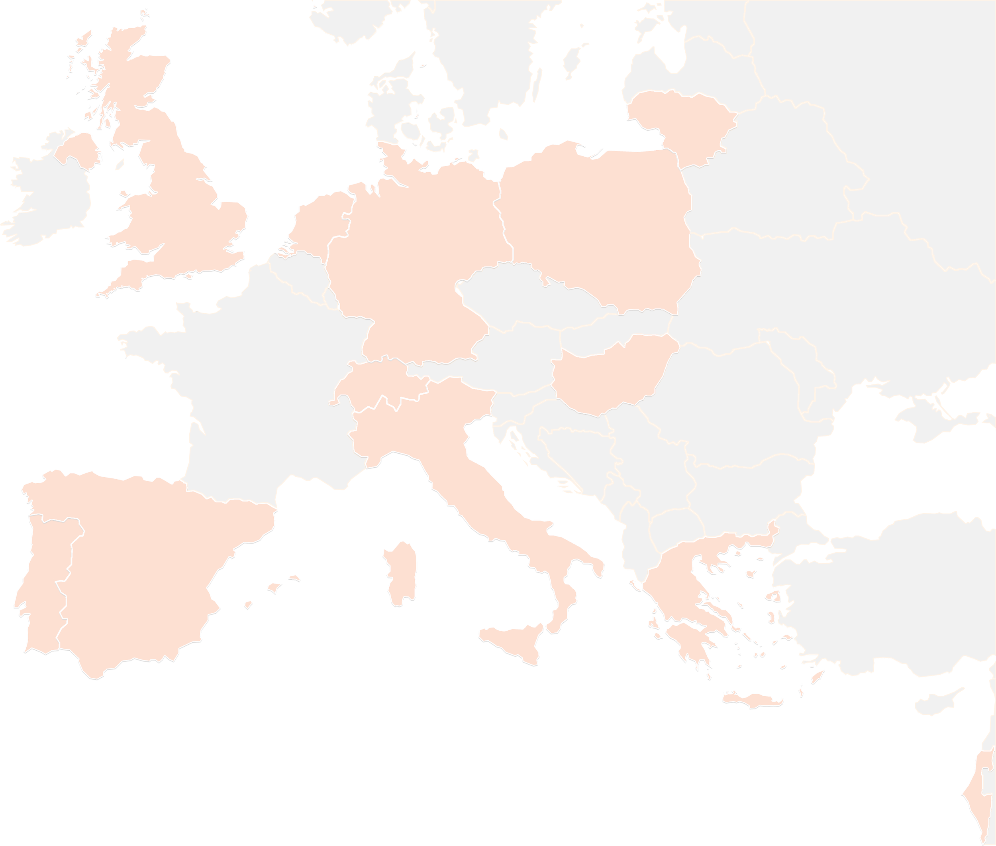
THANK YOU FOR YOUR ATTENTION!
See you in Posnan
wp5@lists.up2university.eu
#up2universe

Slide 21


Subject Matter Committee
26 July, 2019
Webinar – Up2U
Mary Grammatikou
mary@netmode.ntua.gr

Slide 22
Synchronization with the national SMCs
National SMCs will support the pilots on:
  Implementing the methodology that Up2U adopt
  Evaluating the Questionnaires (teachers and students)
  Analyzing how the Focus groups will be implemented
  Design and implement the LA to support the evaluation of the pilots
  Disseminating the project idea to several related projects in collaboration with the local Up2U organizations
Notes:
SMC works with the national communities to implement the pilot activities in all pilot countries. Small groups of teachers in each pilot country working together to make scenarios courses and analyze the evaluation through the surveys and interviews. Support the work on learning analytics for the evaluation phase and disseminate the up2u idea to related conferences by their participation

Slide 23
National SMCs meetings
In Greece one meeting in September on 30 of May 2019
  Dissemination through local events (Scientix in Greece)
  Webinar structure and discussion on the content and timeline
  Teachers feedback

Slide 24
SMC Next Steps
SMC will:
Work together with national members of SMC to the new methodology of evaluation the pilots’ results
Advice on the online education for the learning community
Advice on the Learning Analytics methodology to be an input for the evaluation
Cooperate with national SMCs to organize the method of learning the learners
Evaluate the pilots’ feedback
Notes:
In the future SMC will continue the work on the pilots and preparation of the evaluation and assessment. It will support the work on LA and how this input can support the evaluation. SMC will cooperate with national SMCs on implementing the pilots and evaluate the results.

Slide 25
Thank you!

Slide 26
WP6
_{UPDATE - July}
Gabriella Paolini
GARR

Slide 27
Security Guidelines translation
On going:
  Greek (just to edit the flyers)
  Hungarian (on translation)
  Lithuanian (a

Slide 28
#SecurityTuesday,
New video pills

Slide 29
GDPR on Moodle 3.6.2
New version installed on production platform
News in the Task force Update

Slide 30
WP7. Pilot coordination and continuous risk assessment
Michał Zimniewicz
Poznan Supercomputing and Networking Center
Up2U Update Webinar
26th July 2019
Notes:
These slides present the status up to the second half of May

Slide 31
Pilots
Country | Training |  | Pilots
 | Schools | Teachers | Schools | Students
Germany
Greece | 10 | 80 | 5 | 50
Hungary | 8 | 66 | 3 | 42
Italy | 79 | 100 * | 6 | 72
Lithuania | 185 | 341 | 133 | 15.000
Poland | 26 | 47 | 11 | 300
Portugal | 7 | 50 * | 1 | ?
Spain | 6 | 17 | 1 | 100
* - training in progress
Notes:
Next, two periods of pilots are planned for all countries:
September-November
January-March

Slide 32
Pilot – Definition
Students using the Up2U Application Toolbox
to bridge the gap between secondary and higher education,
i.e. practice the key competences identified by WP5.
Notes:
An outcome of the WP5-WP7 meeting
The competences are: Critical thinking, collaboration, creative thinking, etc.

Slide 33
Internal KPI for Pilots
The official KPI – engaging 1000 schools
Collect web and learning analytics data on each school
Implement uniform pre- and post- surveys
for teachers and students in each school
Ask at least one teacher in each school
to define a collaborative assignment for students
and then send statistical assessment data back to us
Notes:
Internal KPIs to be able to evaluate what students do in pilots. Agreed with WP5. Details to be clarified in August.

Slide 34
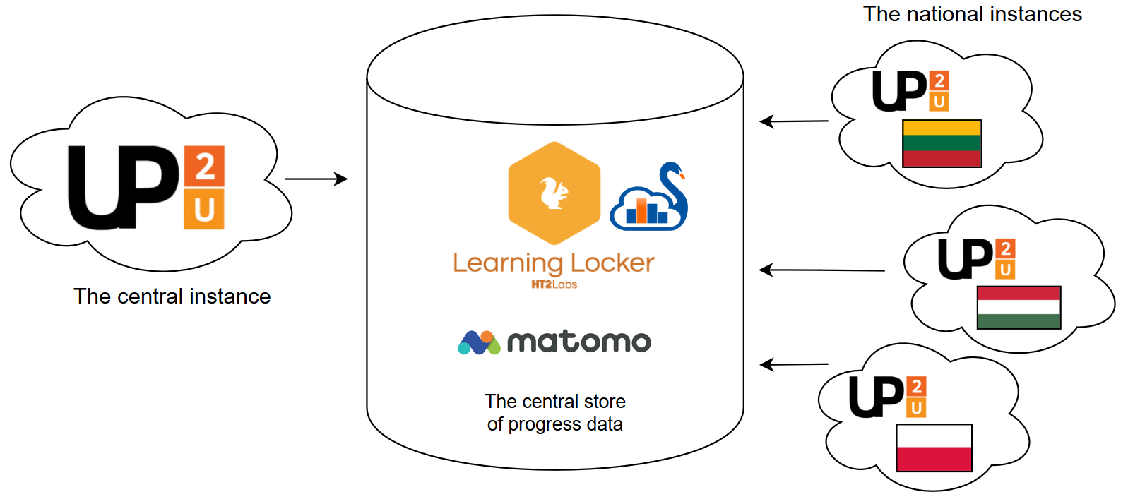
Evaluation across
Application Toolbox Instances
Notes:
Agreed upon (WP5-WP7) to implement this setup to support evaluation: Central and national instances to report data to central stores (Learning Locker, Matomo).

Slide 35
Technical Requirements for Pilots
Requirements for collecting data
Requirements for Learning Analytics
Mitigation of the lack of group management solution, esp. for LA
MVP suggestions on new tools and improvements
Notes:
These are technical topics to support pilots that were discussed in the WP5-WP7 meetings.

Slide 36
Quality Control
Functional testing
  Handling the recent upgrades of Moodle
  The upgrades of CERNBox, SWAN, Multiparty Meeting
  Report issues: https://wiki.geant.org/display/UP2U/Issue+tracking
Performance testing – first results, analysis in progress
  Infrastructure changes needed – Moodle and SeLCont
  Weak ability to handle concurrent users – CS, Swan, CERNBox
  Good performance – LL, Knockplop, MM
Notes:
Quality Control task is a continuous job to oversee the quality of technology outcomes. These are topics we focused on in the last period.

Slide 37
Risk Assessment
Some risks re. WP7 of high exposure:
Solving GDPR issues in the platform
No solution for group management
Missing LA implementation in different tools
Notes:
Critical risks re. WP7
Re. risks no. 2 & 3 – effect might be serious problems in collecting or evaluating LA data, thus evaluating pilots

Slide 38
UP2U WP8
Sustainability and Exploitation of Results

Slide 39
Sustainability Roadmap
Meeting (Probably on 31 July)
UP2U tools for Schools and NREN Services for Schools
How to convert Business models to actual business plans? Such as technical and pedagogical
How to design the service? Who will host? Centeralized or local or mixed?
and…
ADDED VALUE!

Slide 40
Update on Tasks!
Focus on competitive solutions and the advantages of Up2U’s solution by comparison as part of the ecosystem analysis. (Lead by GWDG)
Efforts will focus on implementing these business models in an effective, efficient and consistent manner (Lead by PSNC)
Focus on implementing NREN and Up2U tools for school business models and engage local NRENs or commercial providers (for countries where the local NREN is not interested in engaging with the project). (Lead by TELTEK)
Extending the community of schools interested in the Up2U platform (Learning Community Task Force)

Slide 41
Status of Deliverables
Deliverables | Topic | Status
D8.1 | Analysis of Up2U Ecosystem and Existing Business Models | Accepted
D8.2 | Draft Plan for Sustainability and Exploitation | Accepted
D8.3 | Up2U Business Models | Accepted
D8.4 | Final Report on Up2U Sustainability and Exploitation | M39 (May 2020)

Slide 42
TF - Learning Community Interactions
Eli Shmueli
IUCC- Inter-University Computation Center, Israel
Up2U WP5-WP7 Rome, 23rd-24th of July 2019,

Slide 43
Learning Communities, Social Networks
Communities
Education network staff
Groups on social media
Schoolnet
Twitter chats
Organised
(top-down / formal)
Emergent
(bottom-up / informal)
Networks
Notes:
To reach a wider range of communities and org…

Slide 44
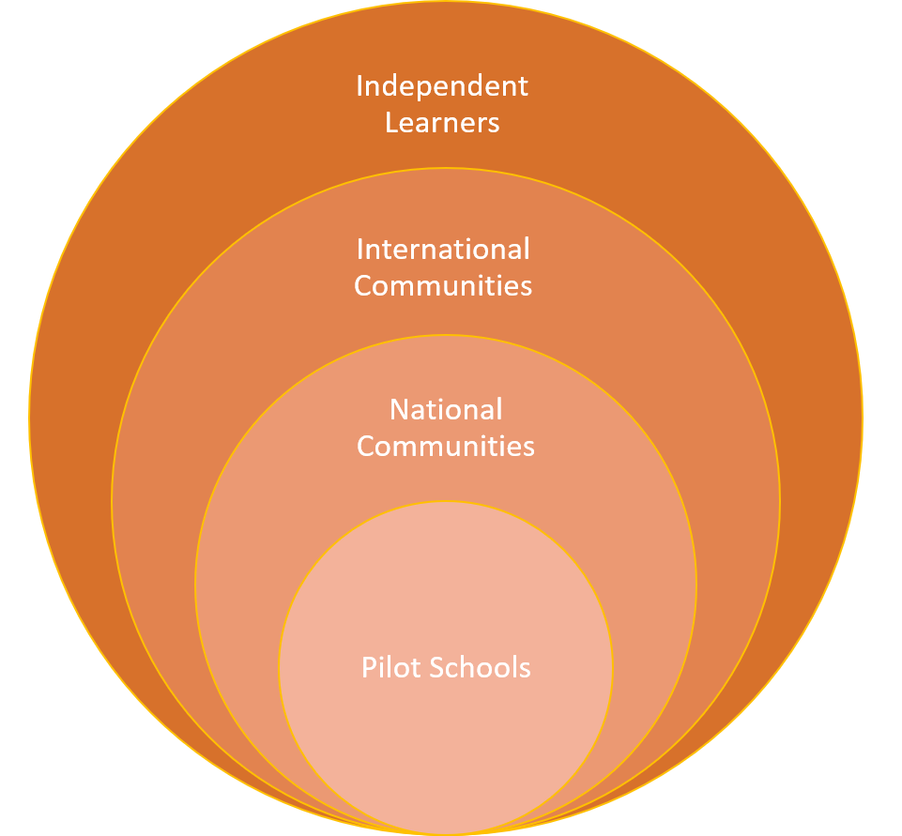
Wide range of learning communities
Pilot schools
Organizations, networks and communities on a national level
Organizations, networks and communities on an international level
Independent users (teachers and students)
Notes:
Wide range of learning communities that we can engage
The first community is the most important one that we suppers the pilot countries and the CPD teachers..
Intensive and demanding prosses Deep learning
Additional to the pilot countries we find that there is a NATIONAL …. INTERNATIONAL and Independent user.
Early adaptor and innovations teaches
----------

Slide 45
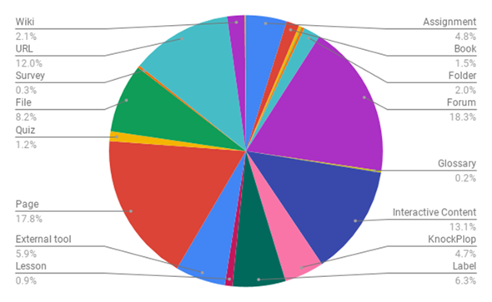
Teacher CPD
  Module 1- Implemented in pilot countries
  Module 2- Teachers will implement what they learned in classrooms
  Module 3- ‘Train the trainer’
OER Resources and interactive Activities and content
www.up2university.eu
45
Notes:
We talked about the teachers CPD and Module 1 2 3 and I like to point out in this graph that the courses contain a mixed content that supports interactions activities collaborations and external tools
-------
We supports the CPD

Slide 46
Local Practices from Pilot Countries
Country | CPD Modules - Local Initiative
Spain | Bottom Up approach - Small group of independent teachers whose schools not yet affiliated with Up2U
Lithuania | Fully online Module 1 instead of hybrid or f2f
Portugal and Italy | Combined Modules 1 and 2 to replace two sequential Modules
Several countries | Prefer to use their own local instance of Moodle rather than central instance
Notes:
We can see from the pilot countries that there is a different way of using the UP2U ecosystem
Central vs Extensions
We can reach more pilot countries

Slide 47
National & International
National teacher organizations and networks.
Organizations that promote pedagogy and learning technologies for teachers and schools.
Teacher professional development programmes.
Universities and colleges - Outreach programs
Government educational programs
GÉANT & NRENs
Content providers
OER repositories for schools
Educational EU
communities – Scientix, European Schoolnet

Slide 48
National Practices from partner countries
Country | National Initiative
Lithuania
Poland | Memoranda of understanding with four units of territorial division to promote pilots starting from September The regions: Nowy Tomyśl, Września, Krotoszyn, Poznań-Jeżyce 20-30 schools in the first step
Italy
Several countries
Notes:
We can see from the pilot countries that there is a different way of using the UP2U ecosystem
Central vs Extensions
We can reach more pilot countries

Slide 49
Independent Users
Independent teachers - want to use Up2U tools and content without participating in CPD.
Independent students - want to use Up2U enrichment content to smooth their transition to university.
Up2U needs flexibility - users can easily define their degree of engagement with Up2U content and tools, and use as small or as large a part of the ecosystem to meet their specific needs.
Notes:
Innovations teachers that can use content, scenario or tools to supports there learning methods

Slide 50

Task force
Engaging communities
Formulate a plan to enrich Up2U’s usability by engaging additional communities in Europe and involving them with the Up2U ecosystem
These communities include national and international teacher networks and organizations that support large numbers of schools, as well as communities of students in both formal and non-formal education programs.
Notes:
In the last few month we are promoting the engagement more communities
And we establish a cross WP’s Task Force

Slide 51
Steps to Engaging Community
Mapping different communities and organizations.
Establishing contact and exploring possible collaboration with these communities and organizations.
Cooperating with different communities to establish which aspects of Up2U ecosystem could interest them.
Notes:
We already starts the activities on those task
We assume that some of the communities can use some of the UP2U aspects such as tools, contents…

Slide 52
WP’s Cross Activities
WP’s and Partners | Learning communities
GEANT WP5 & WP1 | International teacher organizations and networks.
NREN’s WP5 & WP1 & WP2 | National teacher organizations and networks.
WP5 & WP7 & WP2 & WP8 | Organizations that promote pedagogy and learning technologies for teachers and schools.
Subject Matter Committee (SMC) and local members of Sub-SMC | Teacher professional development programmes.
U-HUB (TAU / Sapienza ) | Universities and colleges - Outreach programs
GEANT & NREN’s | Government educational programs
Notes:
Identifying and reaching a broader range of learning communities that can benefit from the Up2U ecosystem.

Slide 53
Cross WP’s Task Force
WP’s | Learning communities | Partners
GEANT WP5 & WP1 | International teacher organizations and networks. | Gyongyi, Casper, Eli, Stefano
NERN’s WP5 & WP1 & WP2 | National teacher organizations and networks. | Eli, Mary, Gytis, Michael, Barbara, Antonio, Marco, Gabriella
WP5 & WP7 & WP2 & WP8 | Organizations that promote pedagogy and learning technologies for teachers and schools. | Stefano, Ingrid, Michael, Gytis, Barbara, Faraz
Subject Matter Committee (SMC) and local members of Sub-SMC | Teacher professional development programmes. | Mary, Ingrid, Nadia, Stefano
U-HUB (TAU / Sapienza ) | Universities and colleges - Outreach programs | Ingrid, Jack, Stefano, Marco
GEANT & NREN’s | Government educational programs | Eli, Nelson, Ilias, Gyongyi, Casper

Slide 54
THANK YOU!
#up2universe

Slide 55
GDPR Update
Casper Dreef
GÉANT
Webinar #6 26/07/2019

Slide 56
Consent collection
KWS
  Consent collection at SSO level
  Integration flow chart created by GWDG
  Planning: KWS to advise the project after ‘guided tour’ on the platform
Moodle
  Update: Moodle 3.6.2
  Consent collection for Moodle only
  Minor age: central instance vs. on prem
  Intermediate solution
Notes:
KWS
SSO level: roll down to all tools including Moodle
Moodle
No roll down to other tools
Central instance: determine minor age: GDPR art.8 states 16, but member states are allowed to allocate their own age of consent as low as 13.
On prem the members will set the minor age conform local legislation
Intermediate solution until KWS is fully implemented

Slide 57
Policies
Privacy notice
  Data storage
  Updates
Cookie policy
  To be done
Notes:
Current discussions:
Data storage beyond the lifetime of the project:
Digital certificates
To be considered in sustainability plan
The Privacy notice should be updated after the extension request is officially approved

Slide 58
THANK YOU FOR YOUR ATTENTION!
contact@lists.up2university.eu
#up2universe

