Slide 1
National and International Timing
  Per Olof Hedekvist
  RISE Research Institutes of Sweden

Slide 2
Commonly used Acronyms
BIPM – Bureau International des Poids et Mesures
GUM – Guide to the Expression of Uncertainty in Measurement
UTC –Coordinated Universal Time
  UTC(k) – local realization of UTC
TAI – International Atomic Time
MJD – Modified Julian Date
  # of days since Sputnik launch
  1/1 2020 = MJD 58849
GNSS – Global Navigation Satellite System
  GNSS CV – Common View.

Slide 3
Time & frequency signal / data
- Requirements
Better silent than wrong
Traceable to common reference
  Known uncertainty
Multiple sources must be weighted with respect to stability
  Historical data determines weight.

Slide 4
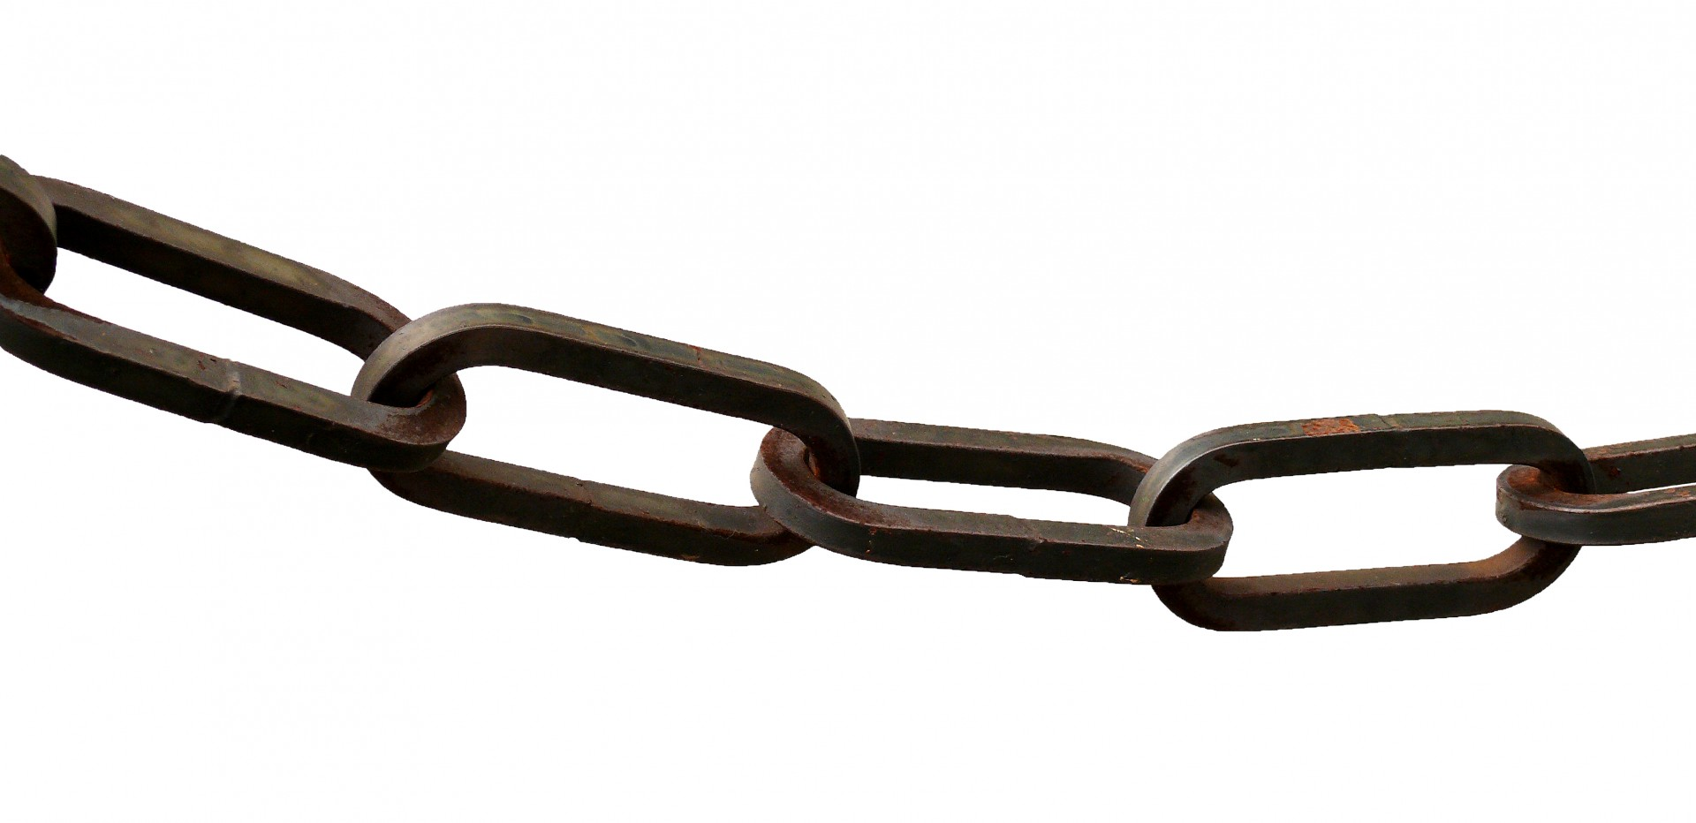
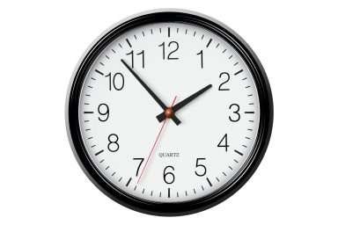
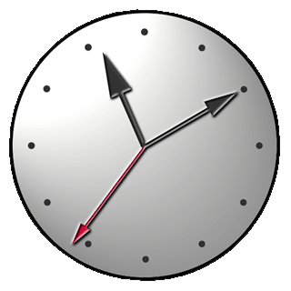
Time & frequency signal / data
- Traceability
Unbroken chain of information
Bidirectional
  Link-data not sufficient, client clock data is necessary
  Synch to GNSS signal not traceable
user
reference

Slide 5
UTC
International time since 1972
680 clocks in 88 labs (2018)
  Local realizations UTC(k)
Continuous comparison, data collected by BIPM
  Calculates weighted average
  Sends correction data to all participants
  Local timescales use data for improved UTC(k) realizations

Slide 6
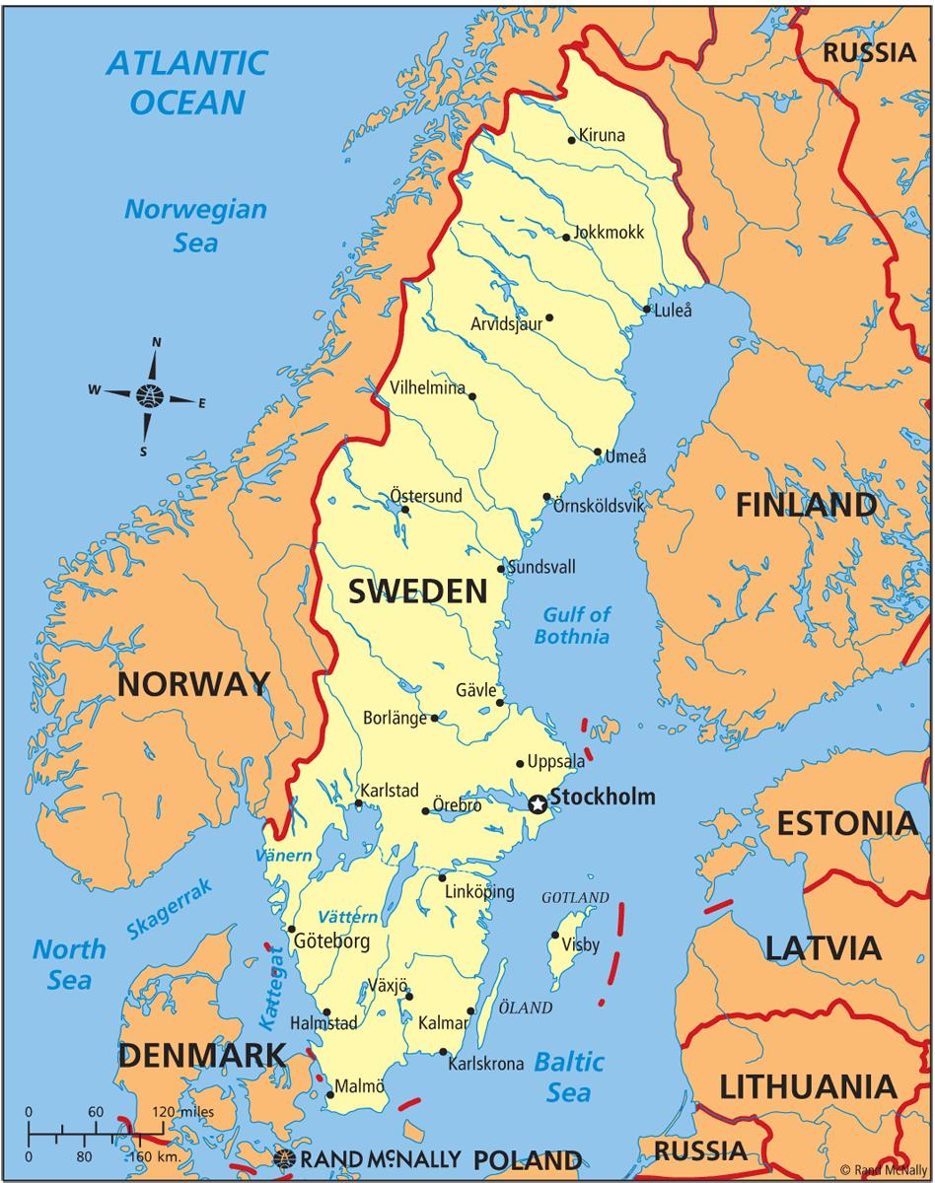
RISE (former SP)
Department of Measurement Science and Technologies
National Metrology Institute in Sweden
PNT-group
    5 members
    3 FET
UTC(SP) since 1/4 1996
Main site in Borås, additional site in Stockholm since 2013
T&F transfer using GNSS CV
TWSTFT station in Borås
Redundant fiber connection through SUNET
  10 GBE channel in 100 GBE wavelength.

Slide 7
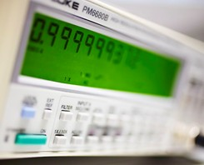
Cs and H-masers
25 clocks reported to BIPM
  8 H-masers (+2 in Sept. 2019)
  15 Cs high performance
  2 Cs standard performance

Slide 8
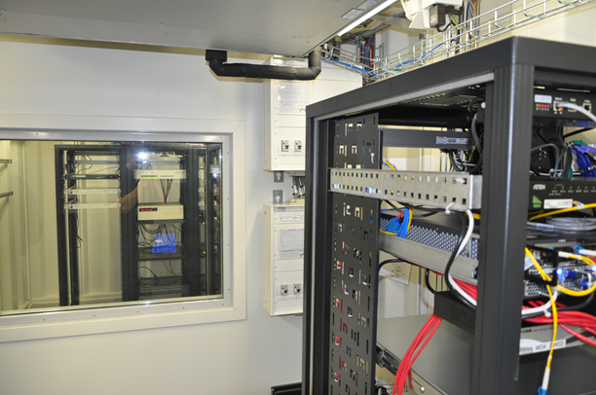
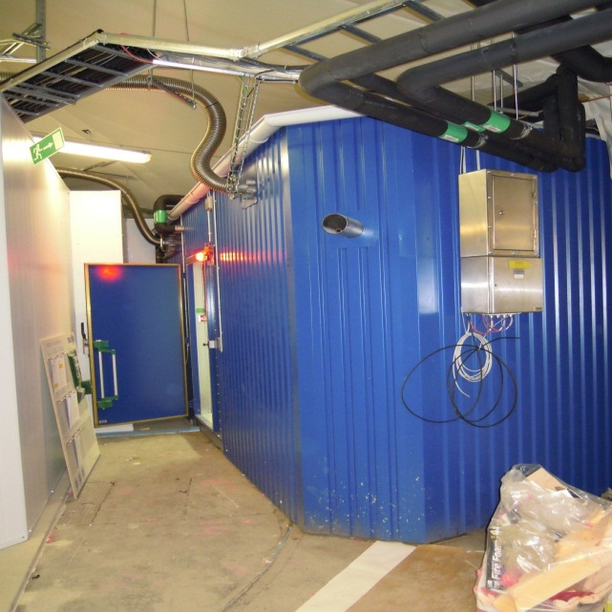
Secure clock site
Construction of clock labs in cavern
A dual Time and Frequency lab has been built in secured cavern
  Stockholm area
  > 15 m below surface level
  EM-shielded, vibration absorbers, shock wave protection
  UPS, batteries and 3 diesel generators
  Climate control, with redundancy
  Locations divided in two separate, identical labs
  Separate redundant power and cooling supply.
  3 Cs and 1 active HM in each lab
    5071A-001 and MHM2020
  Identical set of timing and communication equipment in both

Slide 9
RISE National Timescale UTC(SP)
Clock 1 SP
Correction
Clock 2 SP
Group-clock
UTC(SP)
GPS/TWSTFT
Clock N SP
Timeinterval-
counter
UTC(SP) – GPS/TWSTFT
UTC(SP) - Clock
BIPM
UTC(SP) – UTC
f(KL) – f(TAI)

Slide 10
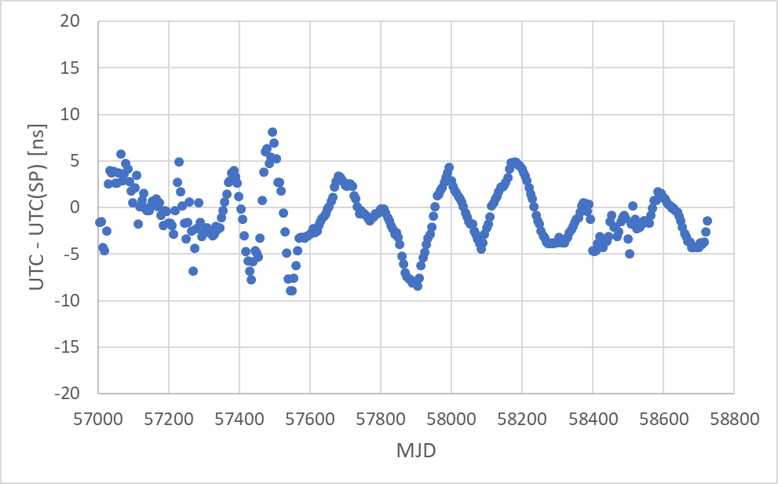
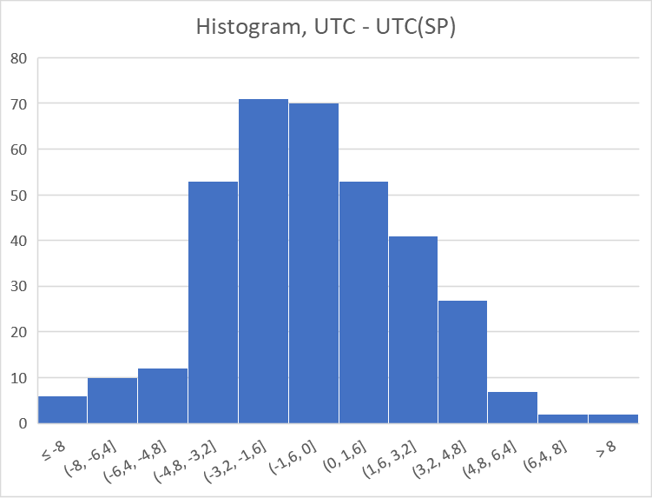
Historical deviation from UTC
Last 5 years within ± 10 ns from UTC
Standard deviation = 3,48 ns

Slide 11
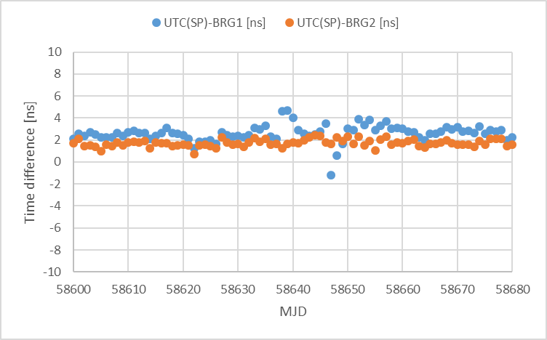
Traceable to UTC(SP)
Stockholm nodes generates timescales traceable to UTC(SP)
  BRG1 and BRG2
Continuous comparison, daily data log.
  BRG1: 2,63 ns offset, 0,77 ns STDEV (1σ)
  BRG2: 1,72 ns offset, 0,33 ns STDEV (1σ)
  Based on 80 days of data summer 2019

Slide 12
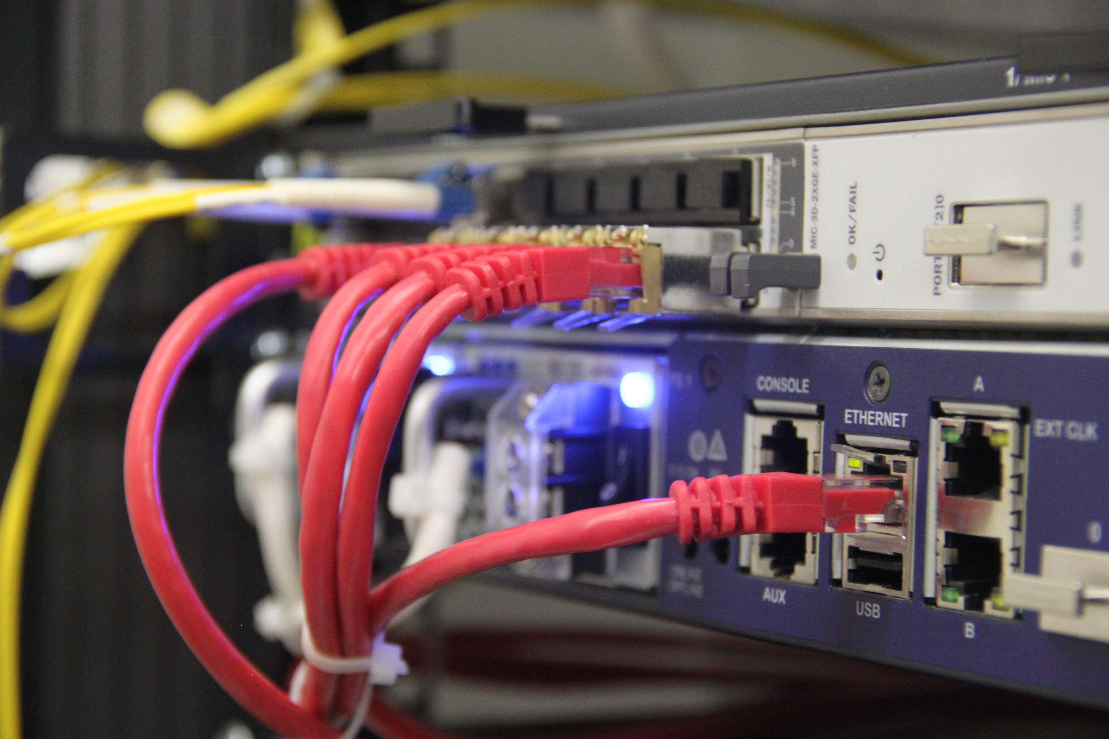
Communication and dissemination
Both sites connected to SUNET
3 ntp-servers in Borås
2 ntp-servers in Stockholm
Dissemination to external customers
  Telecom operators
  Defense
  Financial market
  Governmental authorities
WR under deployment for wider use

Slide 13

Communication and dissemination
Netnod
  5 Internet exchange nodes + one testnode
  2xCs at each site generates timescale traceable to UTC(SP)
  Internal communication can generate timescale based on 12 Cs if disconnected from external communication
  Dissemination to wider range of external customers
    NTP
    PTP
    NTS in development

Slide 14
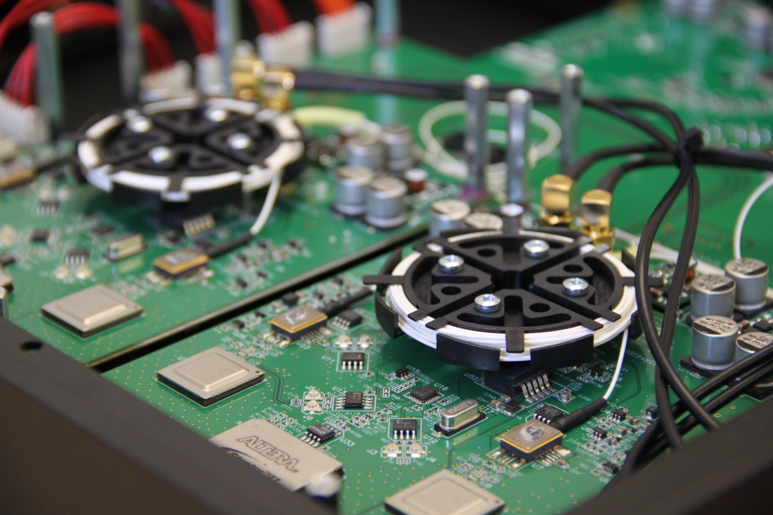
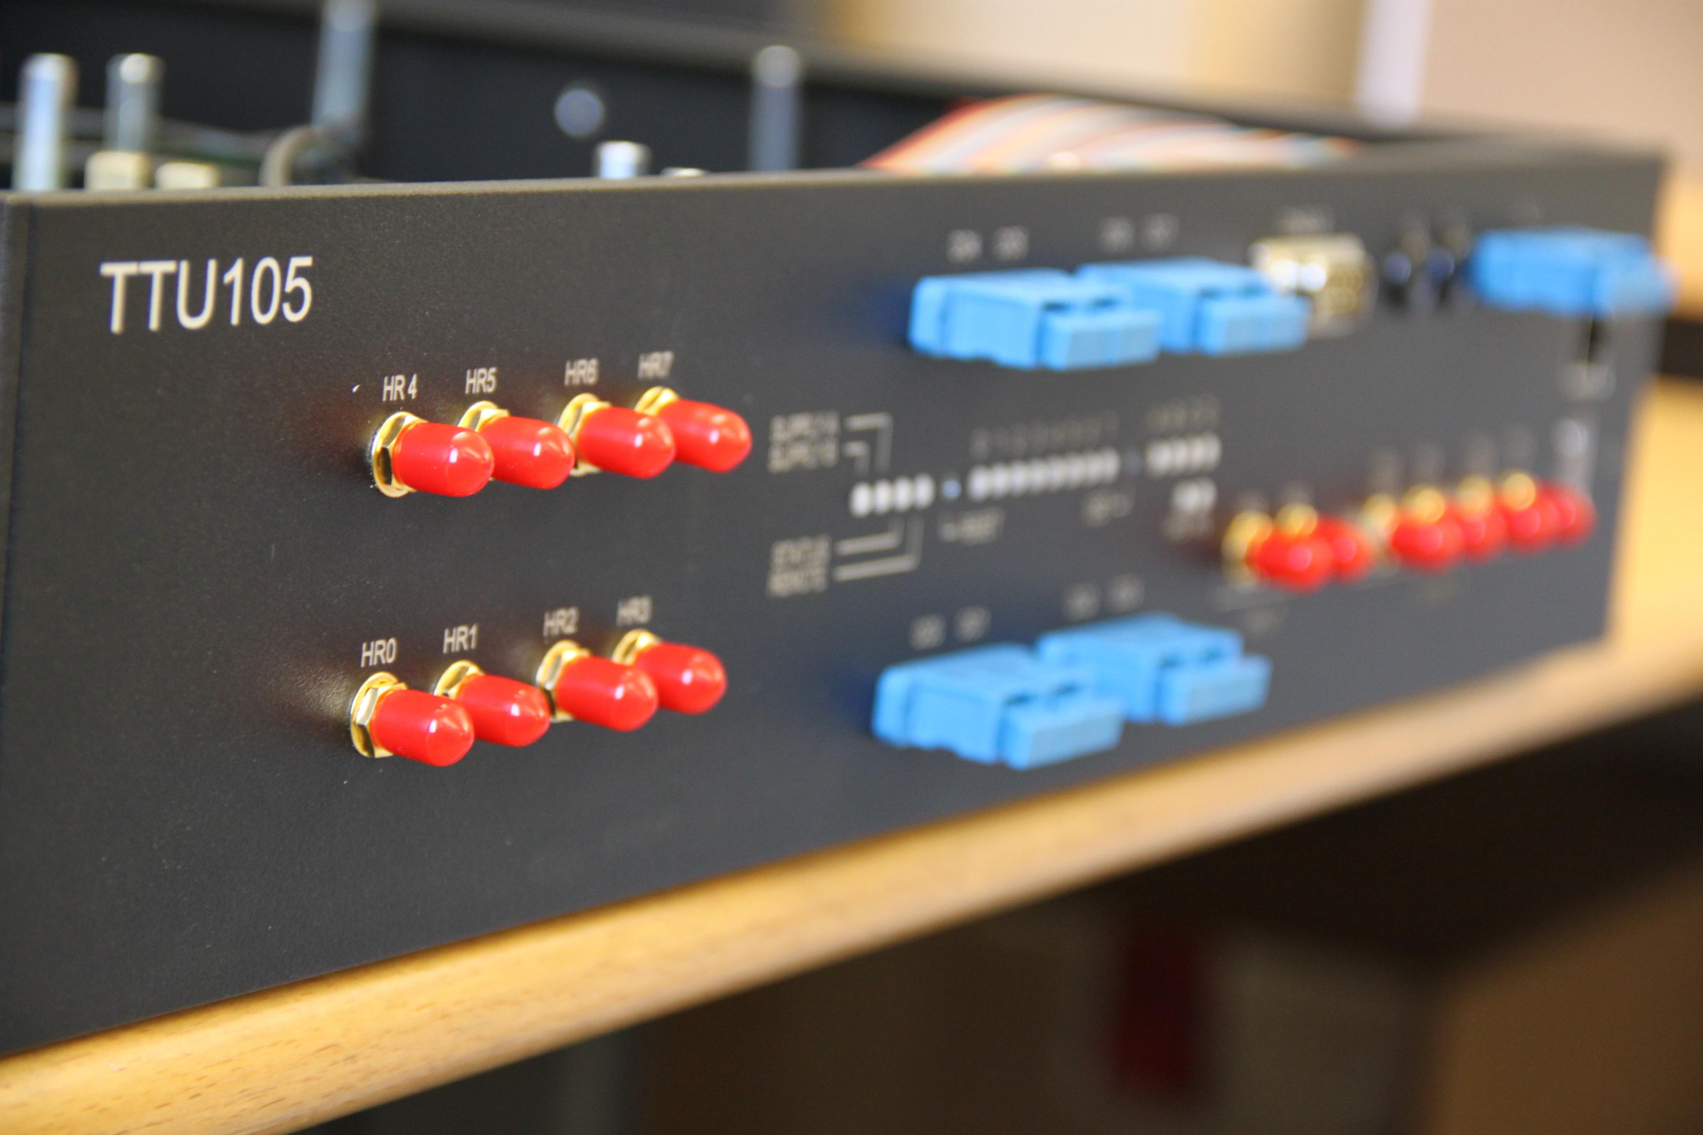
National Research Projects
Time transfer in SDH-networks
  Passive frame detection
  Operational in 10 Gb/s
  Bandwidth efficient
  Customized hardware
  Tested in SUNET
    Extended to MIKES
  2005-2015
Polarization effects in fiber transmission
  Evaluation of effects in polarization dependent receivers
  50 Hz + harmonics

Slide 15
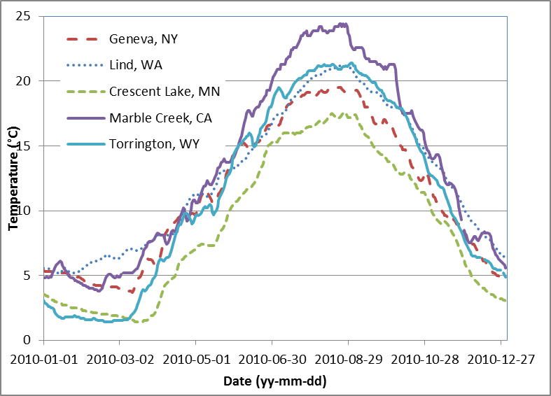
Temperature variations
Fiber influenced by temperature even when deployed in ground
Ground temperature (1 m depth) varies up to ± 10 °C over the year
  Data from USDA, Acriculture Services
  Largest variations in subarctic regions
Fiber deployed in air affected by daily temperature variations as well as fast movement by wind and rain.

Slide 16
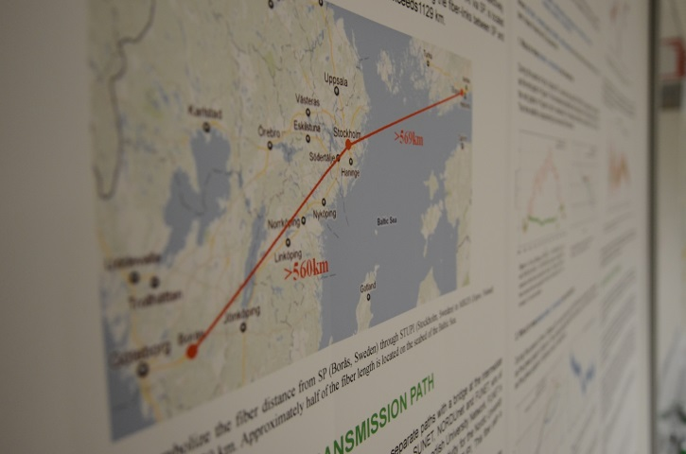
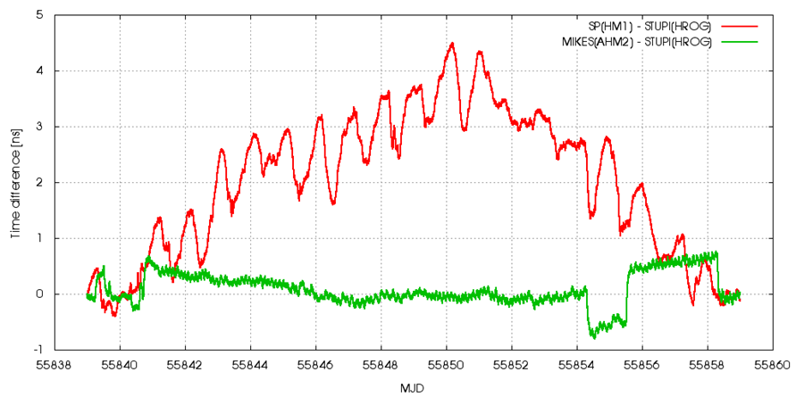
Environmental influences
Data from time transfer in Sweden – Finland
Borås – Stockholm, red curve
  Deployed in ground
  8 router stations above ground
Stockholm – Espoo, green curve
  Deployed at bottom of Baltic Sea
  No routers along line
  Discrepancies caused by human interference at endnodes.

Slide 17
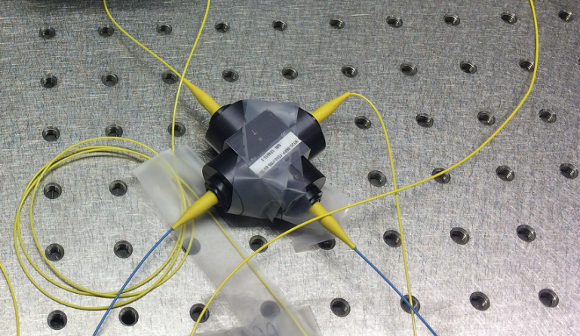
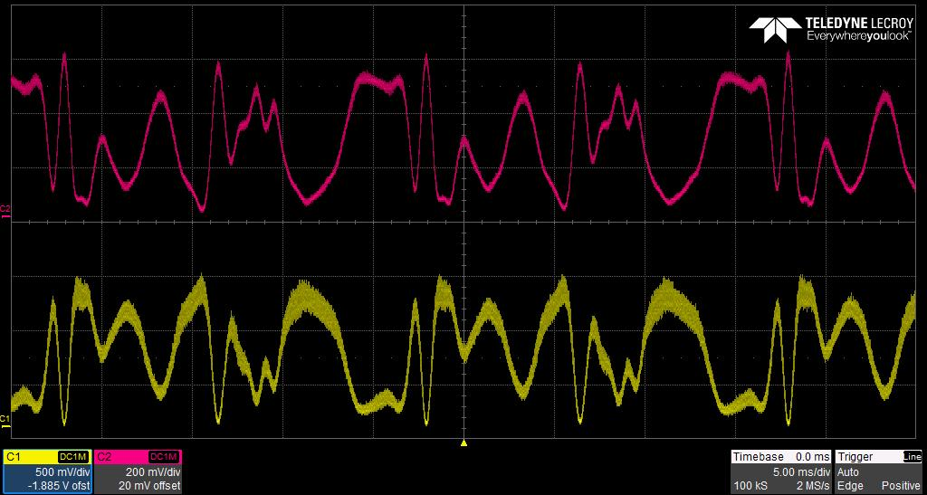
Polarization
Coherent transmission requires mixing with an optical LO at receiver.
  Very polarization sensitive process
  Datacom splits polarizations, detects both, and extract data through DSP.
  Polarization variation at n*50 Hz, when fiber is deployed near power lines
  Standard DSP introduces unknown variable delay

Slide 18
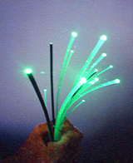
Limitations in duplex fibers
Unknown asymmetries limits time transfer performance
Constant asymmetries must be identified through alternative calibration technique
Asymmetric variations must be estimated through additional parameters

Slide 19
Limitations in simplex fibers
Maximum distance limited by attenuation
  Cannot be fully compensated by amplification
  Special installation in networks, not generally applicable
Any duplex sections must be within climate control
  Path lengths as identical as possible
  Asymmetry in wavelengths

Slide 20

EU Metrology research
Article 185 in EU research program
Fixed amount available to each country each year.
NMI and external partners in collaboration

Slide 21
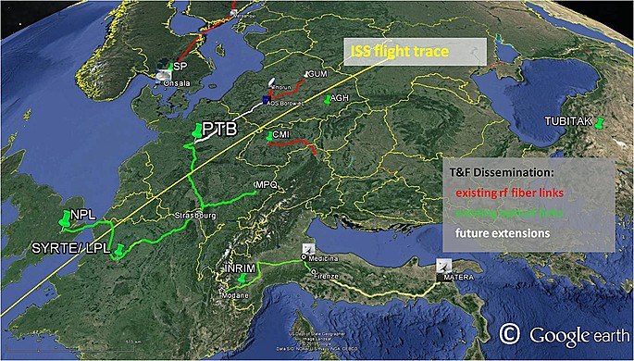
EU Fiber Research Projects
EURAMET EMRP/EMPIR
  NEAT-FT (2012 – 2015)
    TF in fiber between UTC(SP) and UTC(MIKE)
  OFTEN (2016 – 2019)
    Evaluation of real time TF in SUNET max distance and applied for TF to OSO
  TiFOON (2019 – …)
  WRITE (2018 – …)
Aim to connect NMIs and users in Europe with fiber for time and frequency dissemination

Slide 22

Fact sheet
JRP 18SIB06
TiFOON - TIme and Frequency Over Optical Networks
Advanced time/frequency comparison and dissemination through optical telecommunication networks
Kick-off | 1 June 2019
Duration | 3 years
Budget | Approx. 2 M€
Consortium NMI, Industry, NREN, Academic | 15 partners Coordinated by NPL

Slide 23
Overview
Aim
To advance fibre-based frequency transfer capabilities in Europe towards a universal tool for time and frequency metrology and beyond.
Motivation
Redefinition of the SI second
Fibre links enable the remote clock comparisons,
but reliability and availability are insufficient.
International time scales
Fibre-based time transfer offers performance and resilience beyond satellite techniques.
Economical sustainability
through combined optical frequency and time services in shared telecom fibre.
Applications beyond metrology
Fibre links will provide access to ultra-stable and accurate
optical time and frequency references.
Vision ≠ Reality

Slide 24
Wider Impact
Enhanced international time scales
Satellite navigation (e.g. Galileo)
Telecommunication networks
All-optical time keeping
Optical frequency standards, oscillators and signalling
Femtosecond timing?
Pan-European fibre network for T&F
Dissemination of state-of-the-art frequency standards
Secure traceable timing
Global challenges
Climate – Water – Energy

Slide 25
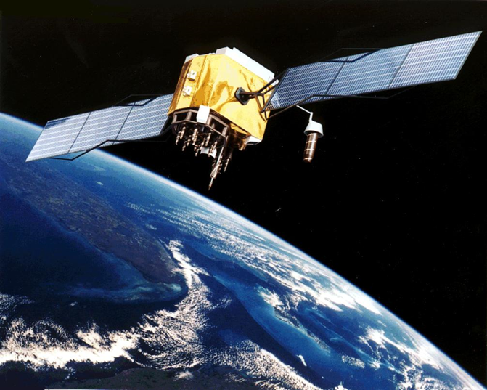
EU Galileo Research Projects
GSOp
  operation of GST (Galileo Time Scale).
  One of five UTC-lab supplying UTC(SP) GNSS and TW-data
GRC-MS
  monitoring quality and accuracy of GST through local receivers
3PfD
  Studies on Galileo PRS-signals

Slide 26
Time’s up
per.olof.hedekvist@ri.se

