Slide 2
Outlines
Introduction to time and frequency distribution
  Definitions of time
  Why do we need it?
Main use-cases, comparing atomic clock for National Metrologist Institute in Europe
  Redefinition of the second (SI)
  Existing alternatives to optical link?
Survey of the techniques (accuracy, TRL, etc.) and requirements to disseminate ultra-accurate time and ultra-stable frequency
Geneva at the crossroad of Europe
  Time and Frequency service(s) at multi-domain level in Europe (gateways)
  Advanced science cases and potential end-users at CERN

Slide 3
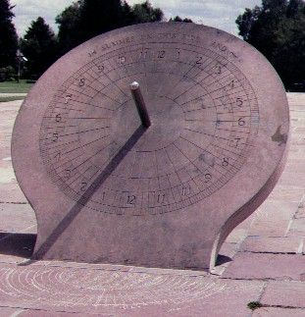
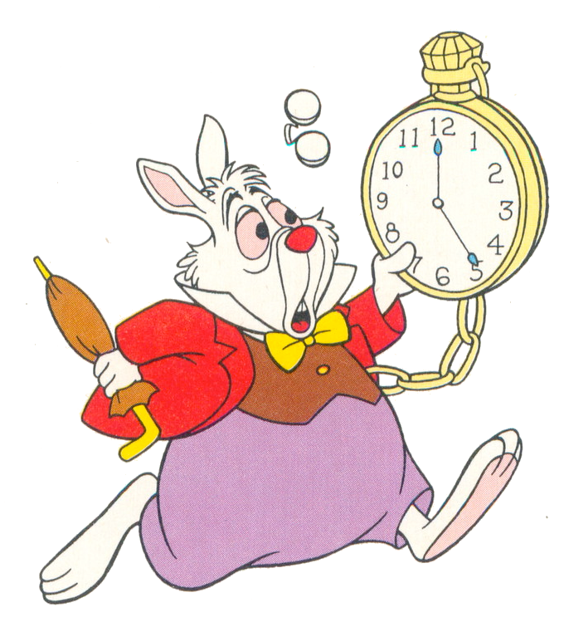
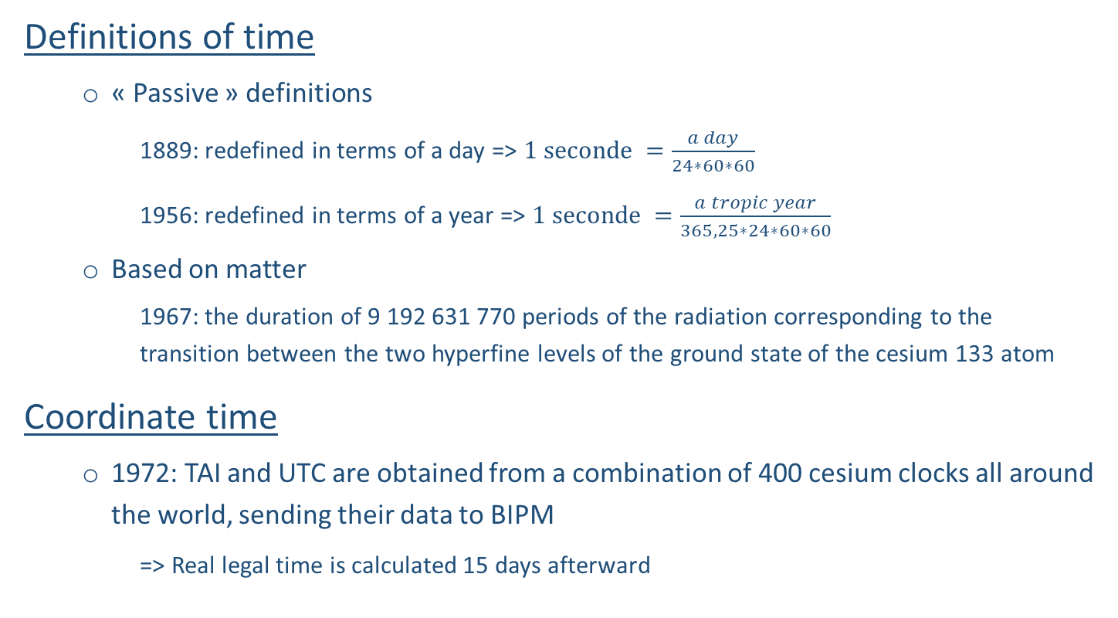
Introduction to time and frequency distribution
  Definitions of time
  « Passive » definitions
    1889: redefined in terms of a day => $1 seconde =\frac{a day}{24∗60∗60}$
    1956: redefined in terms of a year => $1 seconde =\frac{a tropic year}{365,25∗24∗60∗60}$
  Based on matter
    1967: the duration of 9 192 631 770 periods of the radiation corresponding to the transition between the two hyperfine levels of the ground state of the cesium 133 atom
Coordinate time
  1972: TAI and UTC are obtained from a combination of 400 cesium clocks all around the world, sending their data to BIPM
  => Real legal time is calculated 15 days afterward
Gnomon 2300 BCE

Slide 4
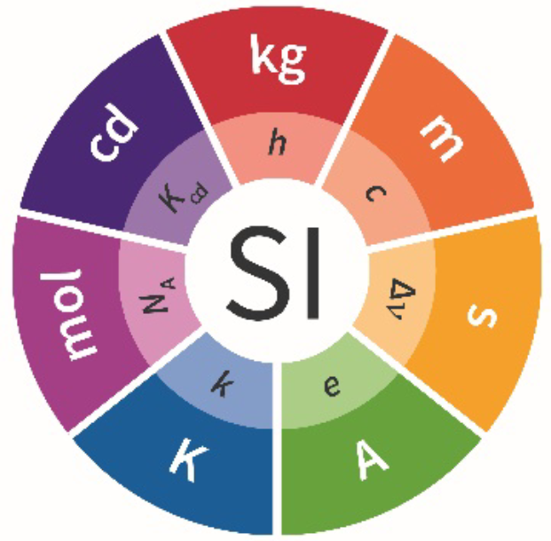
Introduction to time and frequency distribution
7 SI Base Unit with 7 constants to measure the world
Symbol | Name | Quantity | Definition
s | second | time | the caesium hyperfine frequency Cs
m | metre | length | the speed of light in vacuum c
kg | kilogram | mass | the Planck constant h NEW
A | ampere | electric current | the elementary charge e
K | kelvin | temperature | the Boltzmann constant k
mol | mole | amount of substance | the Avogadro constant N_{A}
cd | candela | luminous intensity | the luminous efficacy of a defined visible radiation Kcd
Notes:
The recommended practical system of units of measurement is the International System of Units (Système International d'Unités), with the international abbreviation SI.
What could be best achievable performances?

Slide 5
Introduction to time and frequency distribution
Why is frequency measurement so important?
Quantity | Definition | Numerical value constants | Uncertainty
time | the caesium hyperfine frequency Cs | 9 192 631 770 Hz | 10⁻¹³
length | the speed of light in vacuum c | 299 792 458 m.s⁻¹ | 4 × 10⁻⁹
mass | the Planck constant h | 6.626 070 15 × 10⁻³⁴ m.s-1 | 1×10⁻⁸
electric current | the elementary charge e | 1.602 176 634 × 10⁻¹⁹ m.s-1 | 2.3 × 10⁻¹⁰
temperature | the Boltzmann constant k | 1.380 649 × 10⁻²³ m.s-1 | 3.7 × 10⁻⁷
amount of substance | the Avogadro constant N_{A} | 6.022 140 76 × 10²³ lm.W⁻¹ | 4.5 × 10⁻¹⁰
luminous intensity | the luminous efficacy of a defined visible radiation Kcd | 683 lm.W⁻¹ | 10⁻⁴
Notes:
The recommended practical system of units of measurement is the International System of Units (Système International d'Unités), with the international abbreviation SI.
Time (derivating from frequency measurements) has the best uncertainty

Slide 6
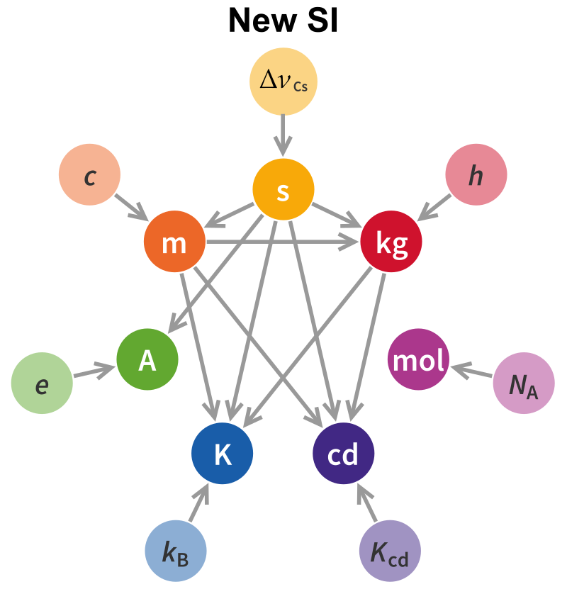
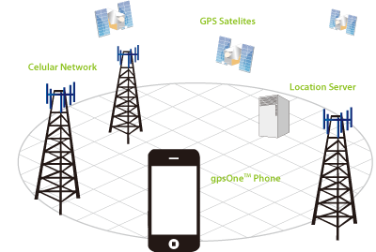
Introduction to time and frequency distribution
Why do we need time?
Time (derivating from frequency measurements) has the best uncertainty
Dependancy to time of other SI
  => 5 out of the 6 other SI are built on the second
=> In all scientific domain, best measurements can only be done when based on frequency measurements
Societal impact
  GNSS (Global Navigation Satellite System)
  Telecommunications (6G)
  Smart grid
    Those 3 markets generate $700 billion/year
    If any project can increase by 1%: $7billion/year

Slide 7
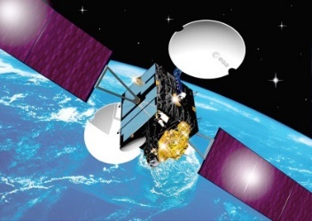
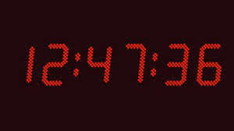

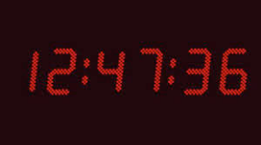
Main use-cases, comparing atomic clock for National Metrologist Institute in Europe
I was able to compare both signals to my own old reference
=> NMI « A » has better result
Clock comparisons to establish a new standard
better than cesium
GPS link
Cesium and rubidium clocks (GNSS)
GPS link
Hey fellow NMI, I got a new clock!
NMI A
NMI B
Distant sites
Me too! Let’s compare it to mine and have a look at their stability!
Notes:
Because we want to produce better clocks

Slide 8
Main use-cases, comparing atomic clock for National Metrologist Institute in Europe
It seems that your measurements have better quality than the transmission link… Can’t help you sorry…
…
Clock comparisons
  Plan A : Satellites
GPS link
Cesium and rubidium clocks (GNSS)
GPS link
Brand new clock with much better results
NMI A
NMI B
Distant sites
Me too! Let’s compare them again
Notes:
Because we want to produce better clocks

Slide 9
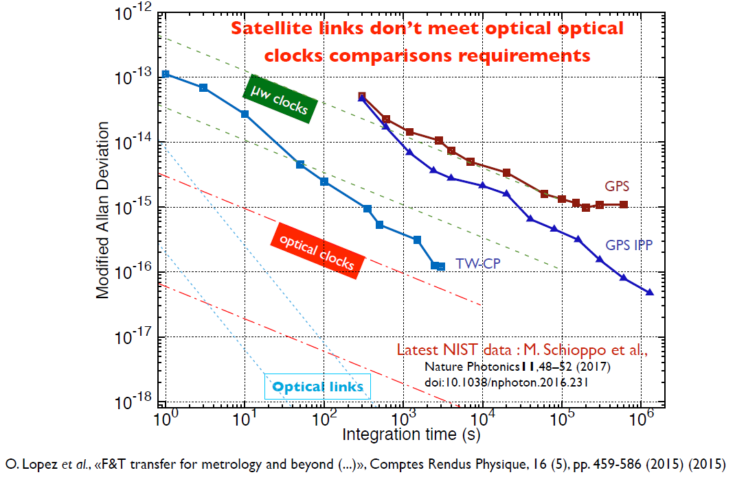
Main use-cases, comparing atomic clock for National Metrologist Institute in Europe

Slide 10
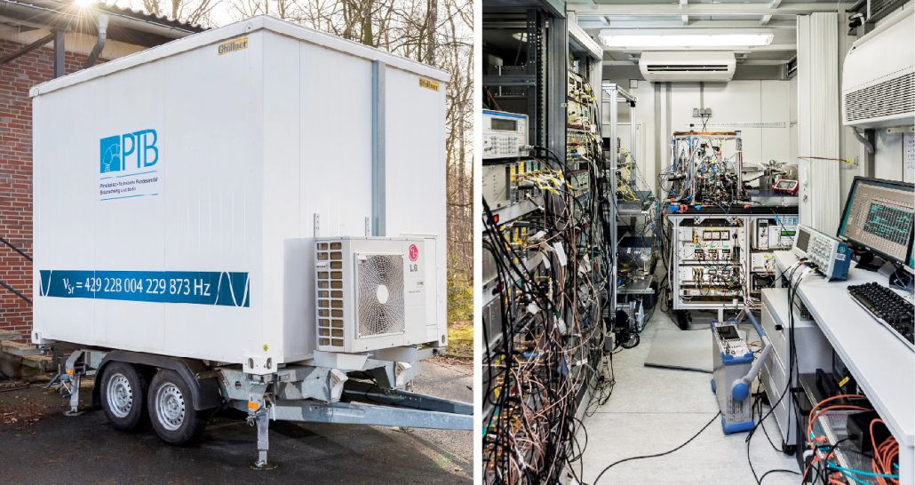

Main use-cases, comparing atomic clock for National Metrologist Institute in Europe
Clock comparisons
  Plan A: Satellites
  Plan B: Moving (complicated)
NMI A
NMI B
Distant sites
I come to you !

Slide 11
Main use-cases, comparing atomic clock for National Metrologist Institute in Europe
Metrological projects
LIFT | REFIMEVE+
OPTIME | EMRP (EURAMET)
EMPIR | ICOF
OFTEN | CESNET E-Infrastructure…
GEO-Q | CLONETS
OTFN | …
Clock comparisons
  Plan A: Satellites
  Plan B: Moving (complicated)
  Plan C: Technique through fibre…
  If only we could
NMI A
NMI B
Distant sites = connected trough educational fibre network + crossborder fibre

Slide 12
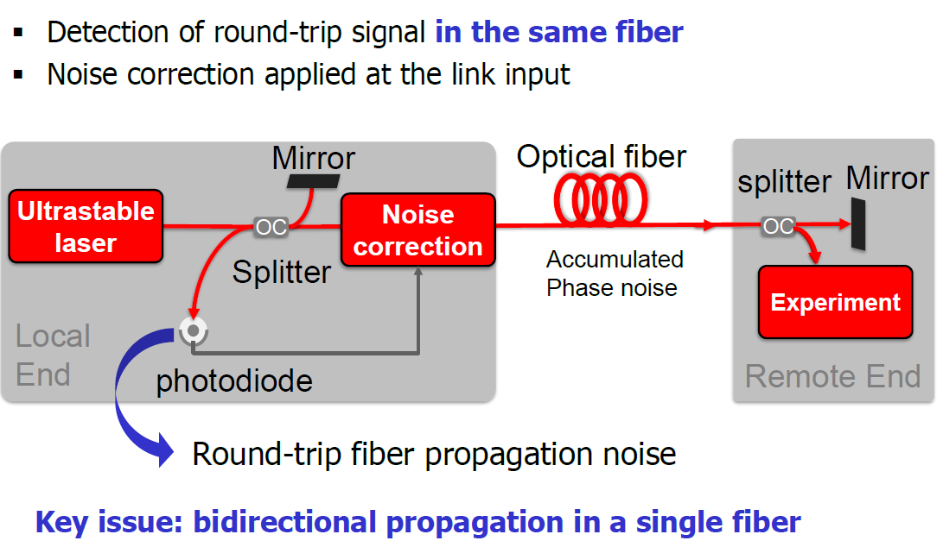
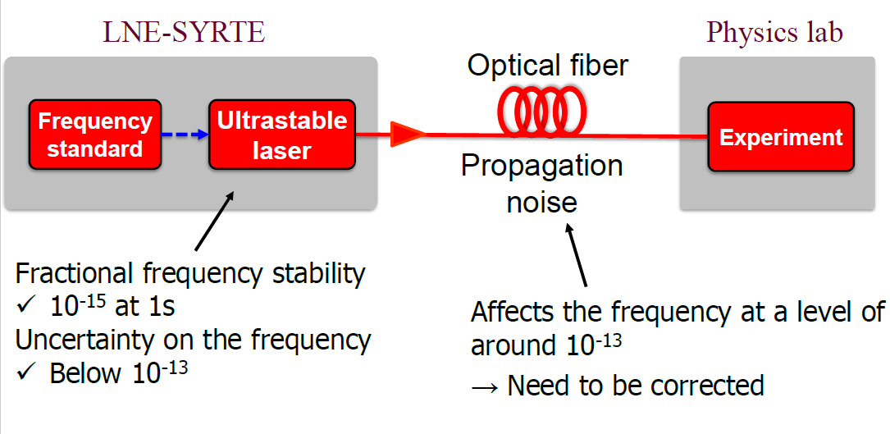
Main use-cases, comparing atomic clock for National Metrologist Institute in Europe
Clock comparisons
  Plan A: Satellites
  Plan B: Moving (complicated)
  Plan C: Technique through fibre, how so?

Slide 13
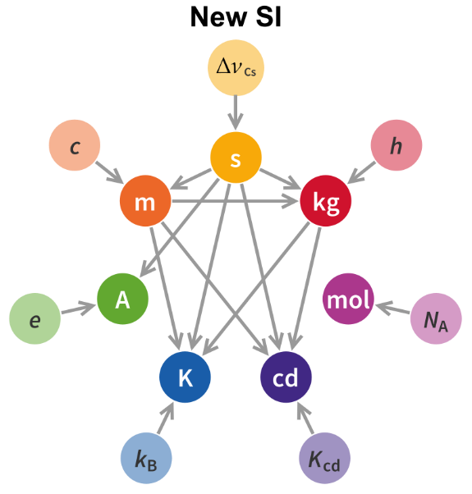
Early conclusions
The second is one of the SI Units
  And is the one measured with best uncertainty
Second is used to define 5 other SI Units
Cesium clocks were best rulers in 1967 (13 digits) but we may have find better ones, several candidates (17 digits) but we need to compare NMI before adopting a new standard.
Better time means will help all science domains
New optical clocks have 4 orders of magnitude better results
The only existing way to compare them is based on optical fibre. There is no alternative.

Slide 14
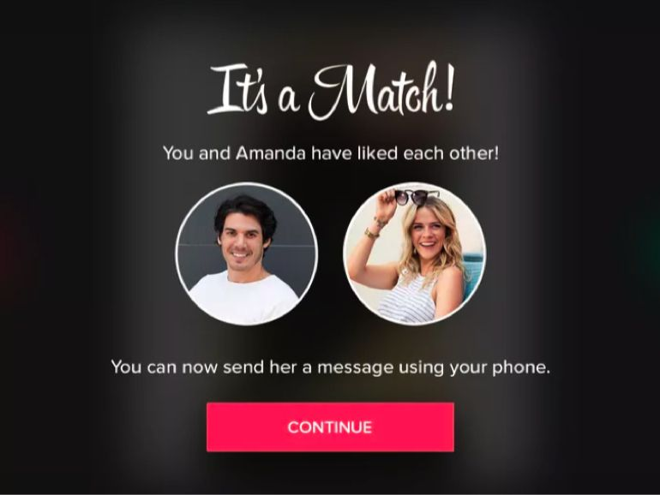
Situation in Europe
  1 country = 1 NMI => Europe has the best density of new atomic clocks in the world
    Numerous interconnections + small distances between NMI
    Require fibres…
  NRENs in Europe:
    They are incubators of revolutionary projects (IPv6, client/server and Cloud computing…)
    They constitute a distributed network across Europe
    Each NREN is connecting many Reasearch Infrastructure that want to benefit from such precise signals
You and NMI have liked each other!
NREN
NMI
You can now discuss and have an outstanding partnership for the greater good of Science!

Slide 15
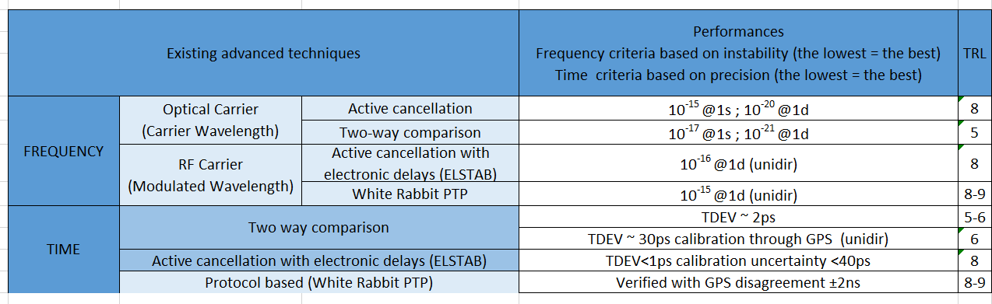
TRL of techniques
There has been several T/F projects during past 10 years to improve dissemination techniques
=> Up-time close to 80% in 2019, close to a service

Slide 16
Example of T/F setup, optical link
Point Of Presence
ILA #1
ILA #2
Point Of Presence
OOB monitoring
T/F #2
Bidir amplifier
T/F #2
Bidir amplifier
OOB monitoring
T/F #1
T/F #2
T/F #2
T/F #1
OOB monitoring
OOB monitoring
T/F #1
Bidir amplifier
T/F #1
Bidir amplifier
OOB monitoring
OOB monitoring
Géant
Telecom equipment
Mux
OADM
OADM
Géant amplifier
OADM
OADM
Géant amplifier
OADM
OADM
Mux
Géant
Telecom equipment
Demux
OADM
OADM
OADM
OADM
OADM
OADM
Demux
T/F#3
SyncE
1588
SyncE
1588
T/F#3
OSC client
IB - OSC
IB - OSC
T/F #1
Bidir amplifier
T/F #1
Bidir amplifier
OSC client
T/F #1
T/F #2
RLS
T/F #2
T/F #1
OOB monitoring
T/F #2
Bidir amplifier
T/F #2
Bidir amplifier
OOB monitoring
OOB monitoring
OOB monitoring
T/F signal194,4THz (44th channel)
T/F signal 194,3THz (43rd channel ideally)
OADM
OADM
Géant Telecom equipment with line side
Out Of Band monitoring
T/F#3
Optical grey transceiver for T/F signal
Fixed Optical Add-Drop Multiplexer (44th Channel)
Fixed Optical Add-Drop Multiplexer (C oband Channel)
In Band monitoring through extraction of OSC (Optical Supervisory Channel)
T/F #2
Optical transceiver for T/F signal in 194,4THz
T/F #1
Optical transceiver for T/F signal in C-Band (ideally 43rd Channel)
Routers with client-side signals (can en 10Gbps or 100Gbps…)
T/F #2
Bidir amplifier
Bidirectional EDFA amplifier for T/F signal #2
T/F #1
Bidir amplifier
Bidirectional L-band amplifier for T/F signal #1
OMS (optical Multiplexed Section)

Slide 17
Example of T/F setup, zoom in ILA
T/F #2
Bidir amplifier
FC/APC
FC/APC
10/100/1000Base-T
T/F #1
Bidir amplifier
FC/APC
FC/APC
10/100/1000Base-T
OADM
FC/APC
Géant amplifier
FC/APC
OADM
FC/APC
FC/APC
?
Raman amplifier
?
?
?
?
?
OADM
?
OSC client port
?
OADM
?
?
Raman amplifier
?
?
FC/APC
FC/APC
FC/APC
FC/APC
T/F #1
Bidir amplifier
FC/APC
FC/APC
10/100/1000Base-T
T/F #2
Bidir amplifier
FC/APC
FC/APC
10/100/1000Base-T

Slide 18
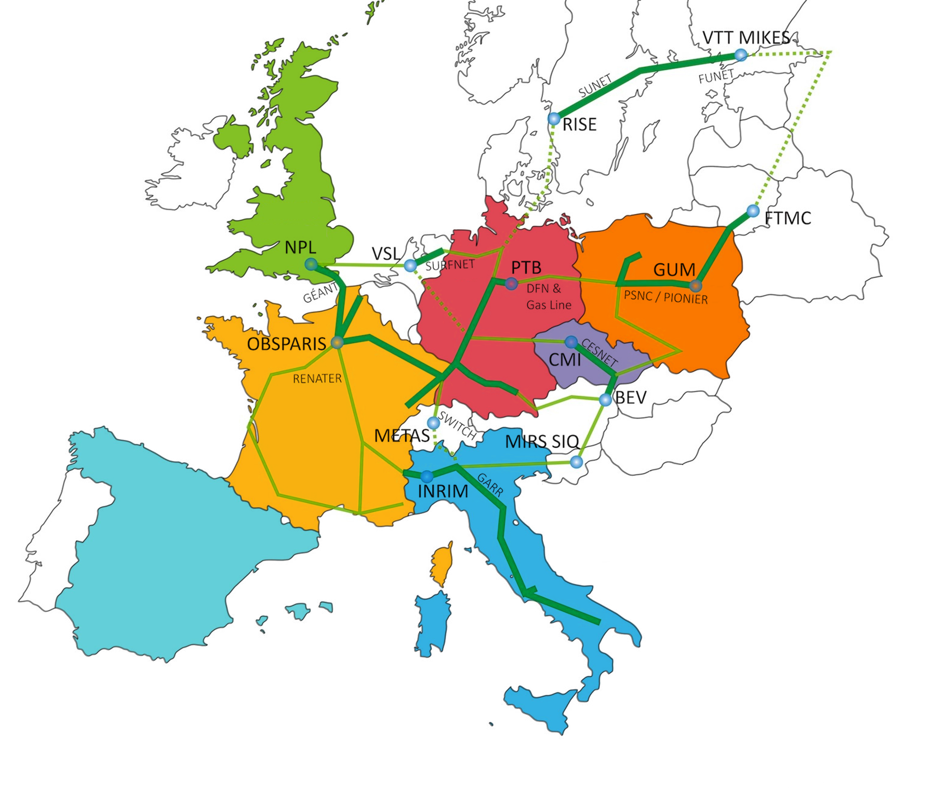


Some T/F Networks in Europe
Deployed
ICOF
About to be deployed
Optime
Future extensions
Notes:
Friendly competition

Slide 19
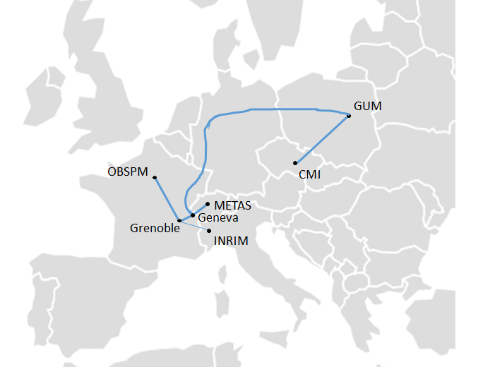





OTFN project to catalyze the emergence of metrological networks in Europe
  Objectives
  To study the challenges of creating a European T/F distribution service
  Focusing on holding several dissemination events
    More NRENs become aware of the potential of these new services for their users and communities.
Case of Geneva
At the crossroad of Europe
  RENATER, PSNC, GARR, SWITCH, NORDUnet, Géant
CERN
  Many potential end-users willing to have access to better precision

Slide 20




T/F services a new challenge for NREN to improve all science domains
1 - Time is a central unit in science
Future
standard
SI
Second
SI second
10⁻¹⁷
Current standard
2 – Better second improves all domain of science
10⁻¹³
3 – Comparisons through optical fibres required
2
Reasearch institutes
4 – Some RI institutes who can benefit from these services are connected to NREN
4
NMI
NREN #1
NREN #2
NMI
3
Notes:
Time is a central SI Unit
Improving its standard will impact measurement in all scientific domains
Necessity to run comparison campaigns in order to select the best optical clock to replace cesium clocks
Comparisons can only be made through optical fibre
NREN are key partner for those project
=> Europe is losing its leadership because scientists need fibres that we profide them too slowly

Slide 22
OADMs thin films
Common port
Bidirectionnal T/F services
Common port
Bidirectionnal T/F services
?
FC/APC
FC/APC
?
FC/APC
FC/APC
200GHz
100GHz
200GHz
100GHz
?
?
Express data port
Express data port

Slide 23

CLONETS project
Horizon 2020
Infos
Objectives:
to collect information (NMI, NREN, end-users);
to study applications beyond research infrastructures (societal applications);
to define roadmaps and strategies to support future European work;
  => economic potential of the future T/F market
create the environment necessary for future work (to define standards for international metrological network deployment);
to study the evolution of the partnership for a future exploitation phase of the created clock services network.
Acronym: CLONETS | Project ID: 731107
Topic: INFRAINNOV-2016 | Budget: 1 994 646 €
Start: 1st january 2017 | Duration: 30 months
Project manager: eva.bookjans@obspm.fr | Website: http://www.clonets.eu

Slide 24



















Icon set 1 (use them as much you can)
Users: Arts and Education
Users: Earth Observation
Users: Energy
Users: Health and Medicine
Users: Space
Users: Physics
User Groups
Efficiency
Cloud Services
Strategy and
Vision
Schedule
TFs and SIGs
Storage
Real-Time Communications
Professional
Services
Connectivity
and Network
GÉANT Logo
GÉANTPeople
GÉANT
Services
GÉANT
Network
GÉANT
Community
EU Logo
Research Programmes

Slide 25























Icon set 2 (use them as much you can)
Latin America
region
CAREN
region
Asia Pacific region
AC2 region
EUMED region
EaPConnect
region
North America
Compass
Location
Glue
Vision
Strategy & Vision
Campus
Service cogs 1
Service cogs 2
Finance
Pilot
Production
Developer
Journal/Library
Legal
NREN
Events

