Slide 1
Introducing Up to University
Name of presenter
Name of organization
Name of event

Slide 2
Objective
The “Up to University” (Up2U) Project aims to bridge the gap between secondary schools and universities by providing European schools with a Next Generation Digital Learning Environment (NGDLE) that helps high school teachers equip their students with the knowledge, skills and attitudes they will need to succeed at university.

Slide 3
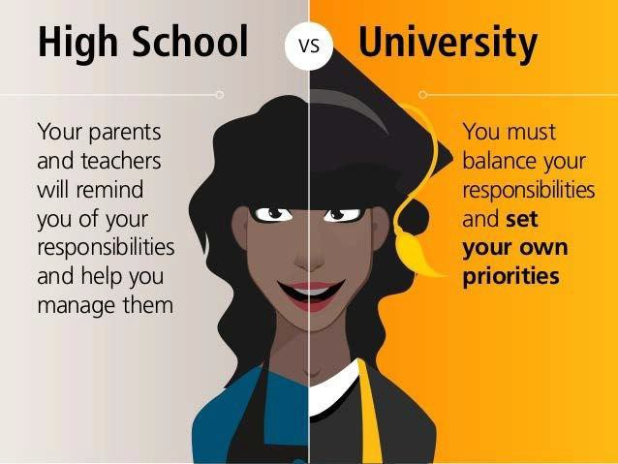
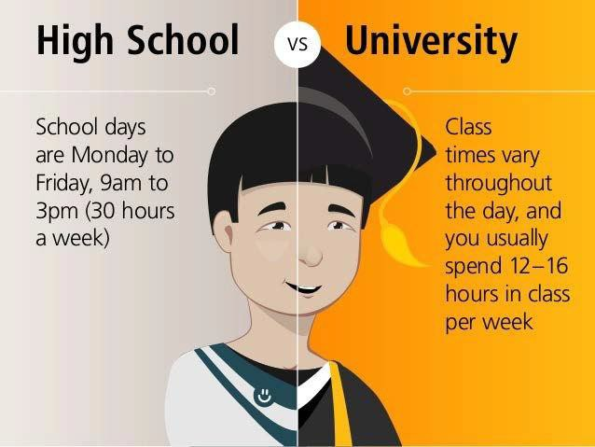
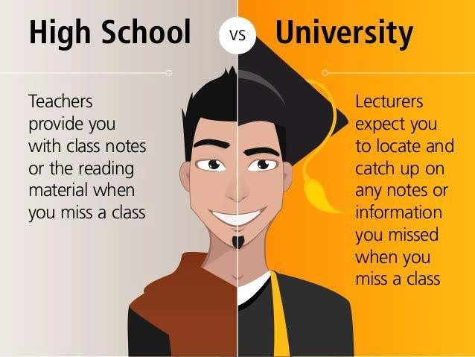
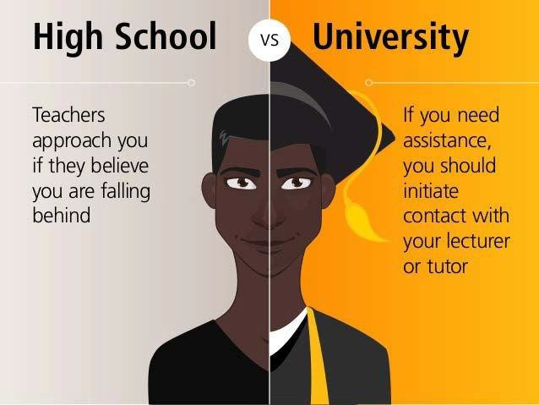
School vs. University
3

Slide 4
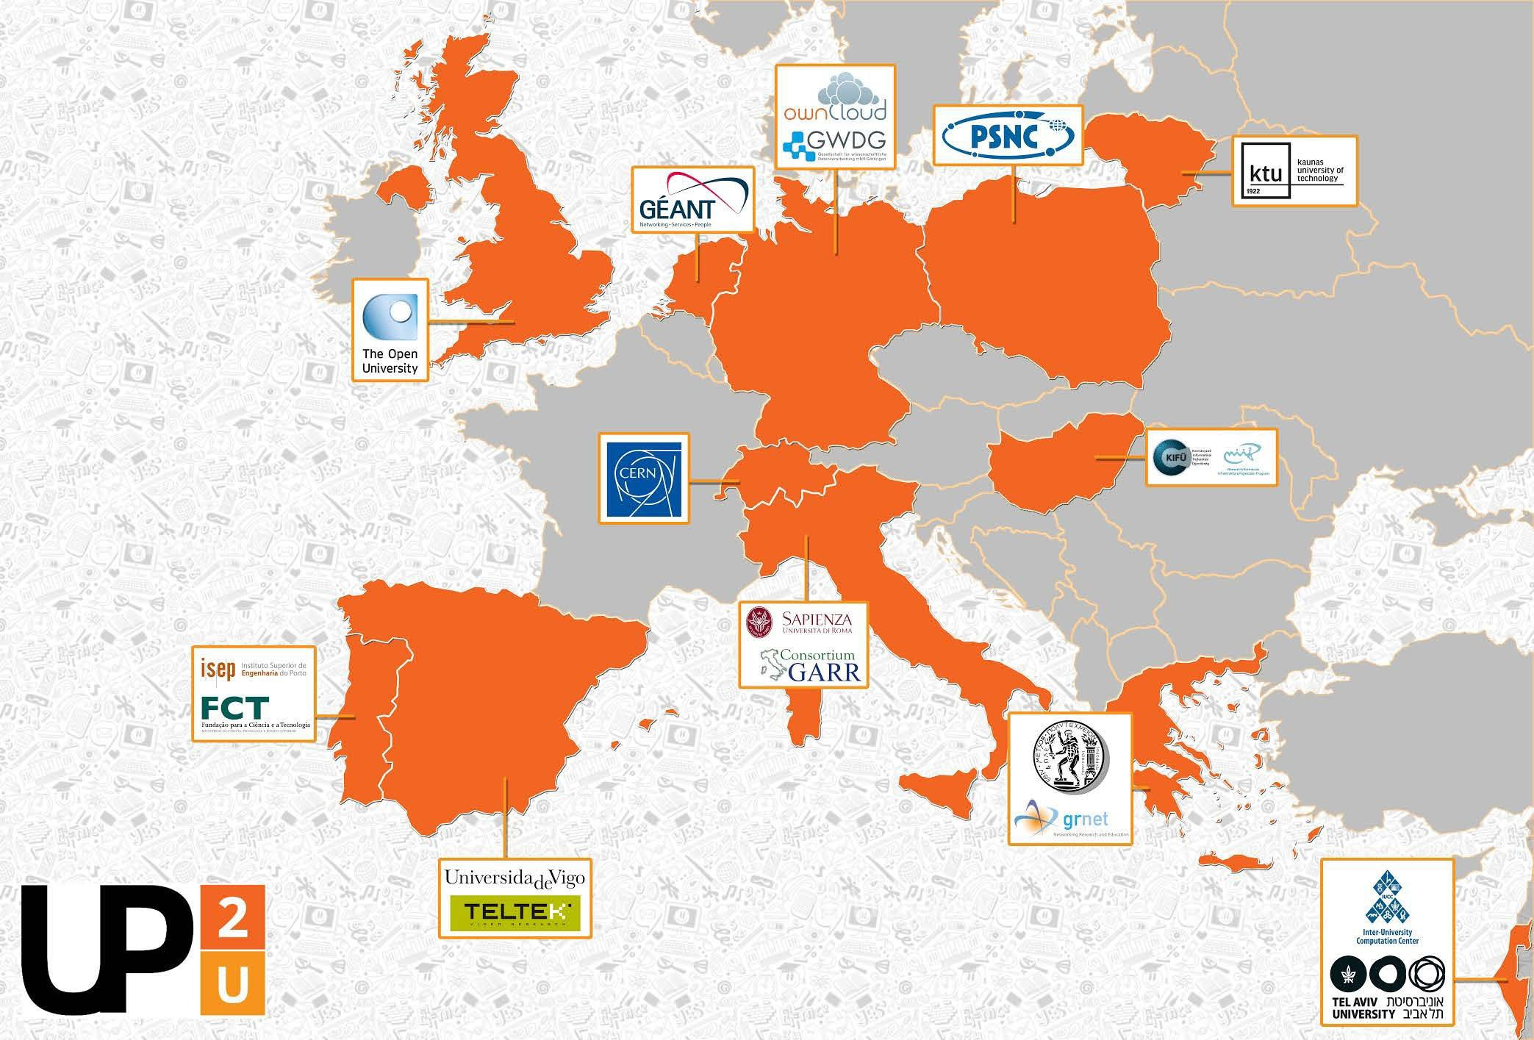
7
Up2U Consortium
18 partners
Universities
NRENs
Infrastructure providers
Commercials
12 countries
EU
Switzerland
Israel

Slide 5








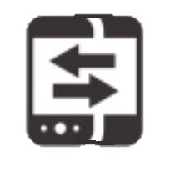

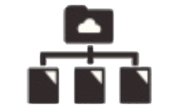

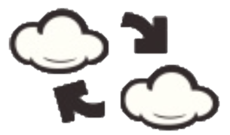





Up2U ECOSYSTEM
FORMAL LEARNING SPACE
INFORMAL LEARNING SPACE
LOR
Attend
INTERACTIVE LEARNING PATH
Search
LMS
Create
SIS
Assessment
Share
INFRASTRUCTURE
eduOER aggregation
WiFi eduroam
TO UNIVERSITY
Sync&Share ownCloud
’Always-on’ education
at school
in library
in museum
at home
on the go

Slide 6
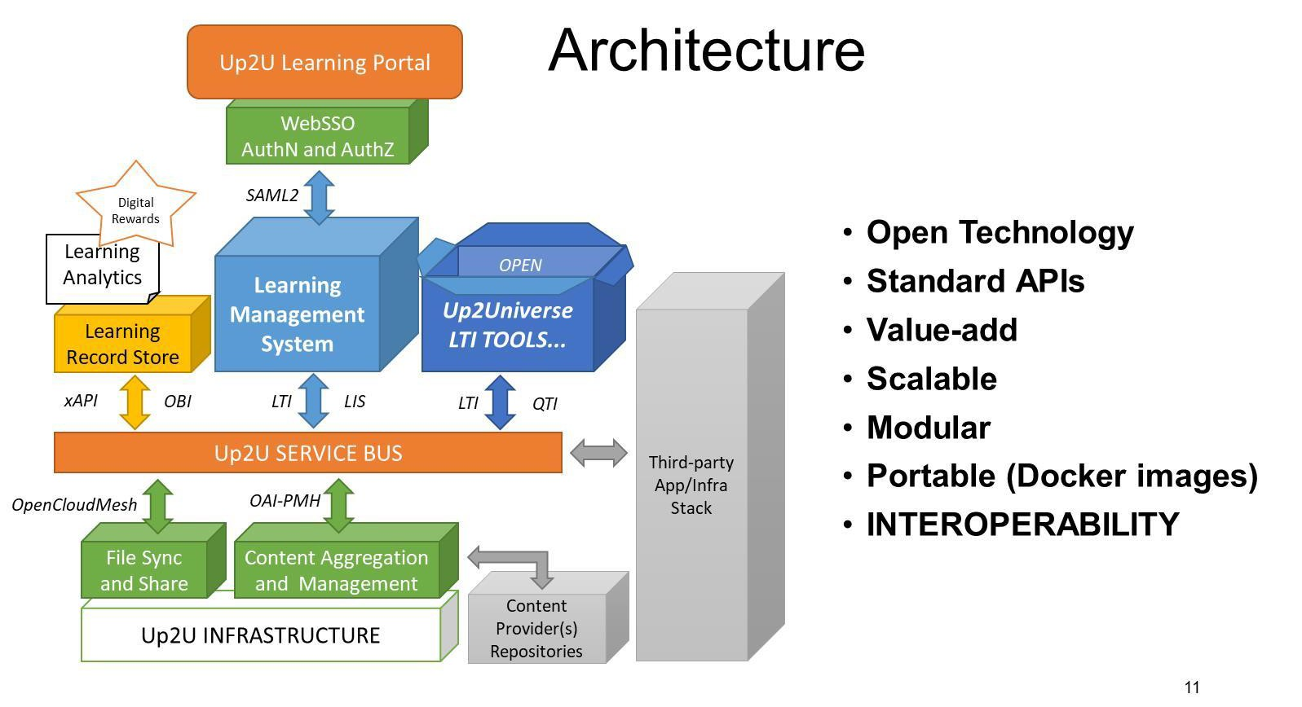
TNC18 Intelligent networks, cool edges?

Slide 7
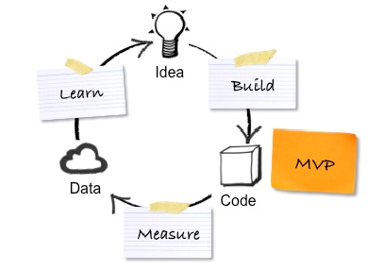
Minimum Viable Product
www.up2university.eu
7
Notes:
MVP approach: build-measure-learn feedback loop is designed to ensure that the project outcome continuously improves
7

Slide 8
21st Century Skills for Academic Learners and Up2U approach
The necessary and effective skills for the academic learner, are:
Critical Thinking & Problem Solving
Communication & Collaboration
Information, Media & Technology Literacy
Self-Direction
Learning to learn
By using the appropriate teaching models, the learner may improve these skills and this process will even encourage the development of necessary digital competences for better and successful functioning in the technological world of the 21st century

Slide 9
Up2U supports Modern Teaching Models and methodologies
Project Based Learning (e.g. Trello, wikis)
Place-Based Learning Education (e.g. Treasure hunt)
Experiential Learning (e.g. CernBox)
Flipped Classroom (e.g. WebRTC, SeLCont, eduOER)
Scenario-based learning (e.g. H5P)

Slide 10
Teaching models | 21st century skills for the academic learner | Technological solution | Technological tools
Project Based Learning (PBL) | Critical Thinking & Problem Solving Communication & Collaboration Information, Media & Technology Literacy | Mind maps Project management Content management system | Wikis (core) Trello (LTI) Group assignment (core)
Flipped Classroom | Self-Direction Information, Media & Technology Literacy | Interactive Presentation | WebRTC SelCont EduOER H5P
Experiential Learning | Critical Thinking & Problem Solving Communication & Collaboration Self-Direction | Remote & online labs Educational Games Simulation Reflection | EJS Remote LABs H5P CERNbox/SWAN
Place-Based learning Education (PBE) | Critical Thinking & Problem Solving Communication & Collaboration Self-Direction Information, Media & Technology Literacy | Maps/ GPS Social and community Augmented reality Mobile | Treasure hunt (M)
Scenario-based learning | Critical Thinking & Problem Solving Communication & Collaboration Self-Direction Information, Media & Technology Literacy | Wikis Timeline | Lesson (storyline scenario) H5P

Slide 11
Some Up2U Professional Development
Model in three Phases
Three main Phases for the Up2U Professional Development
  Phase One – Introduction to ecosystem
  Phase Two – Hands on Experience and students involvement
  Phase Three – “Train the Trainer”
Nine pilots in Up2U Professional Development program
  Combination of technology and pedagogy
  Combination of skills, educational needs, technological tools

Slide 12
Some of the Up2U Use Cases
An authenticated course creation in Up2U platform
Recording a lecture
Uploading a lecture & Making Assignments
Interactive video creation and exercises
Creation, storage and usage of open educational content in up2u repository
Virtual room communication

Slide 13
How to engage
Come and experiment with the Up2U NGDLE in the cloud!
Distributed private cloud installation at PSNC-Poland, GWDG-Germany
and GRNET-Greece.
Integrate components and functionalities into your LMS
Github & Dockerhub images, automated deployment and configuration,
documentation and support
Take the entire open-source platform and deploy it on-prem or in your preferred cloud
Integrated software stack in Docker containers

Slide 14
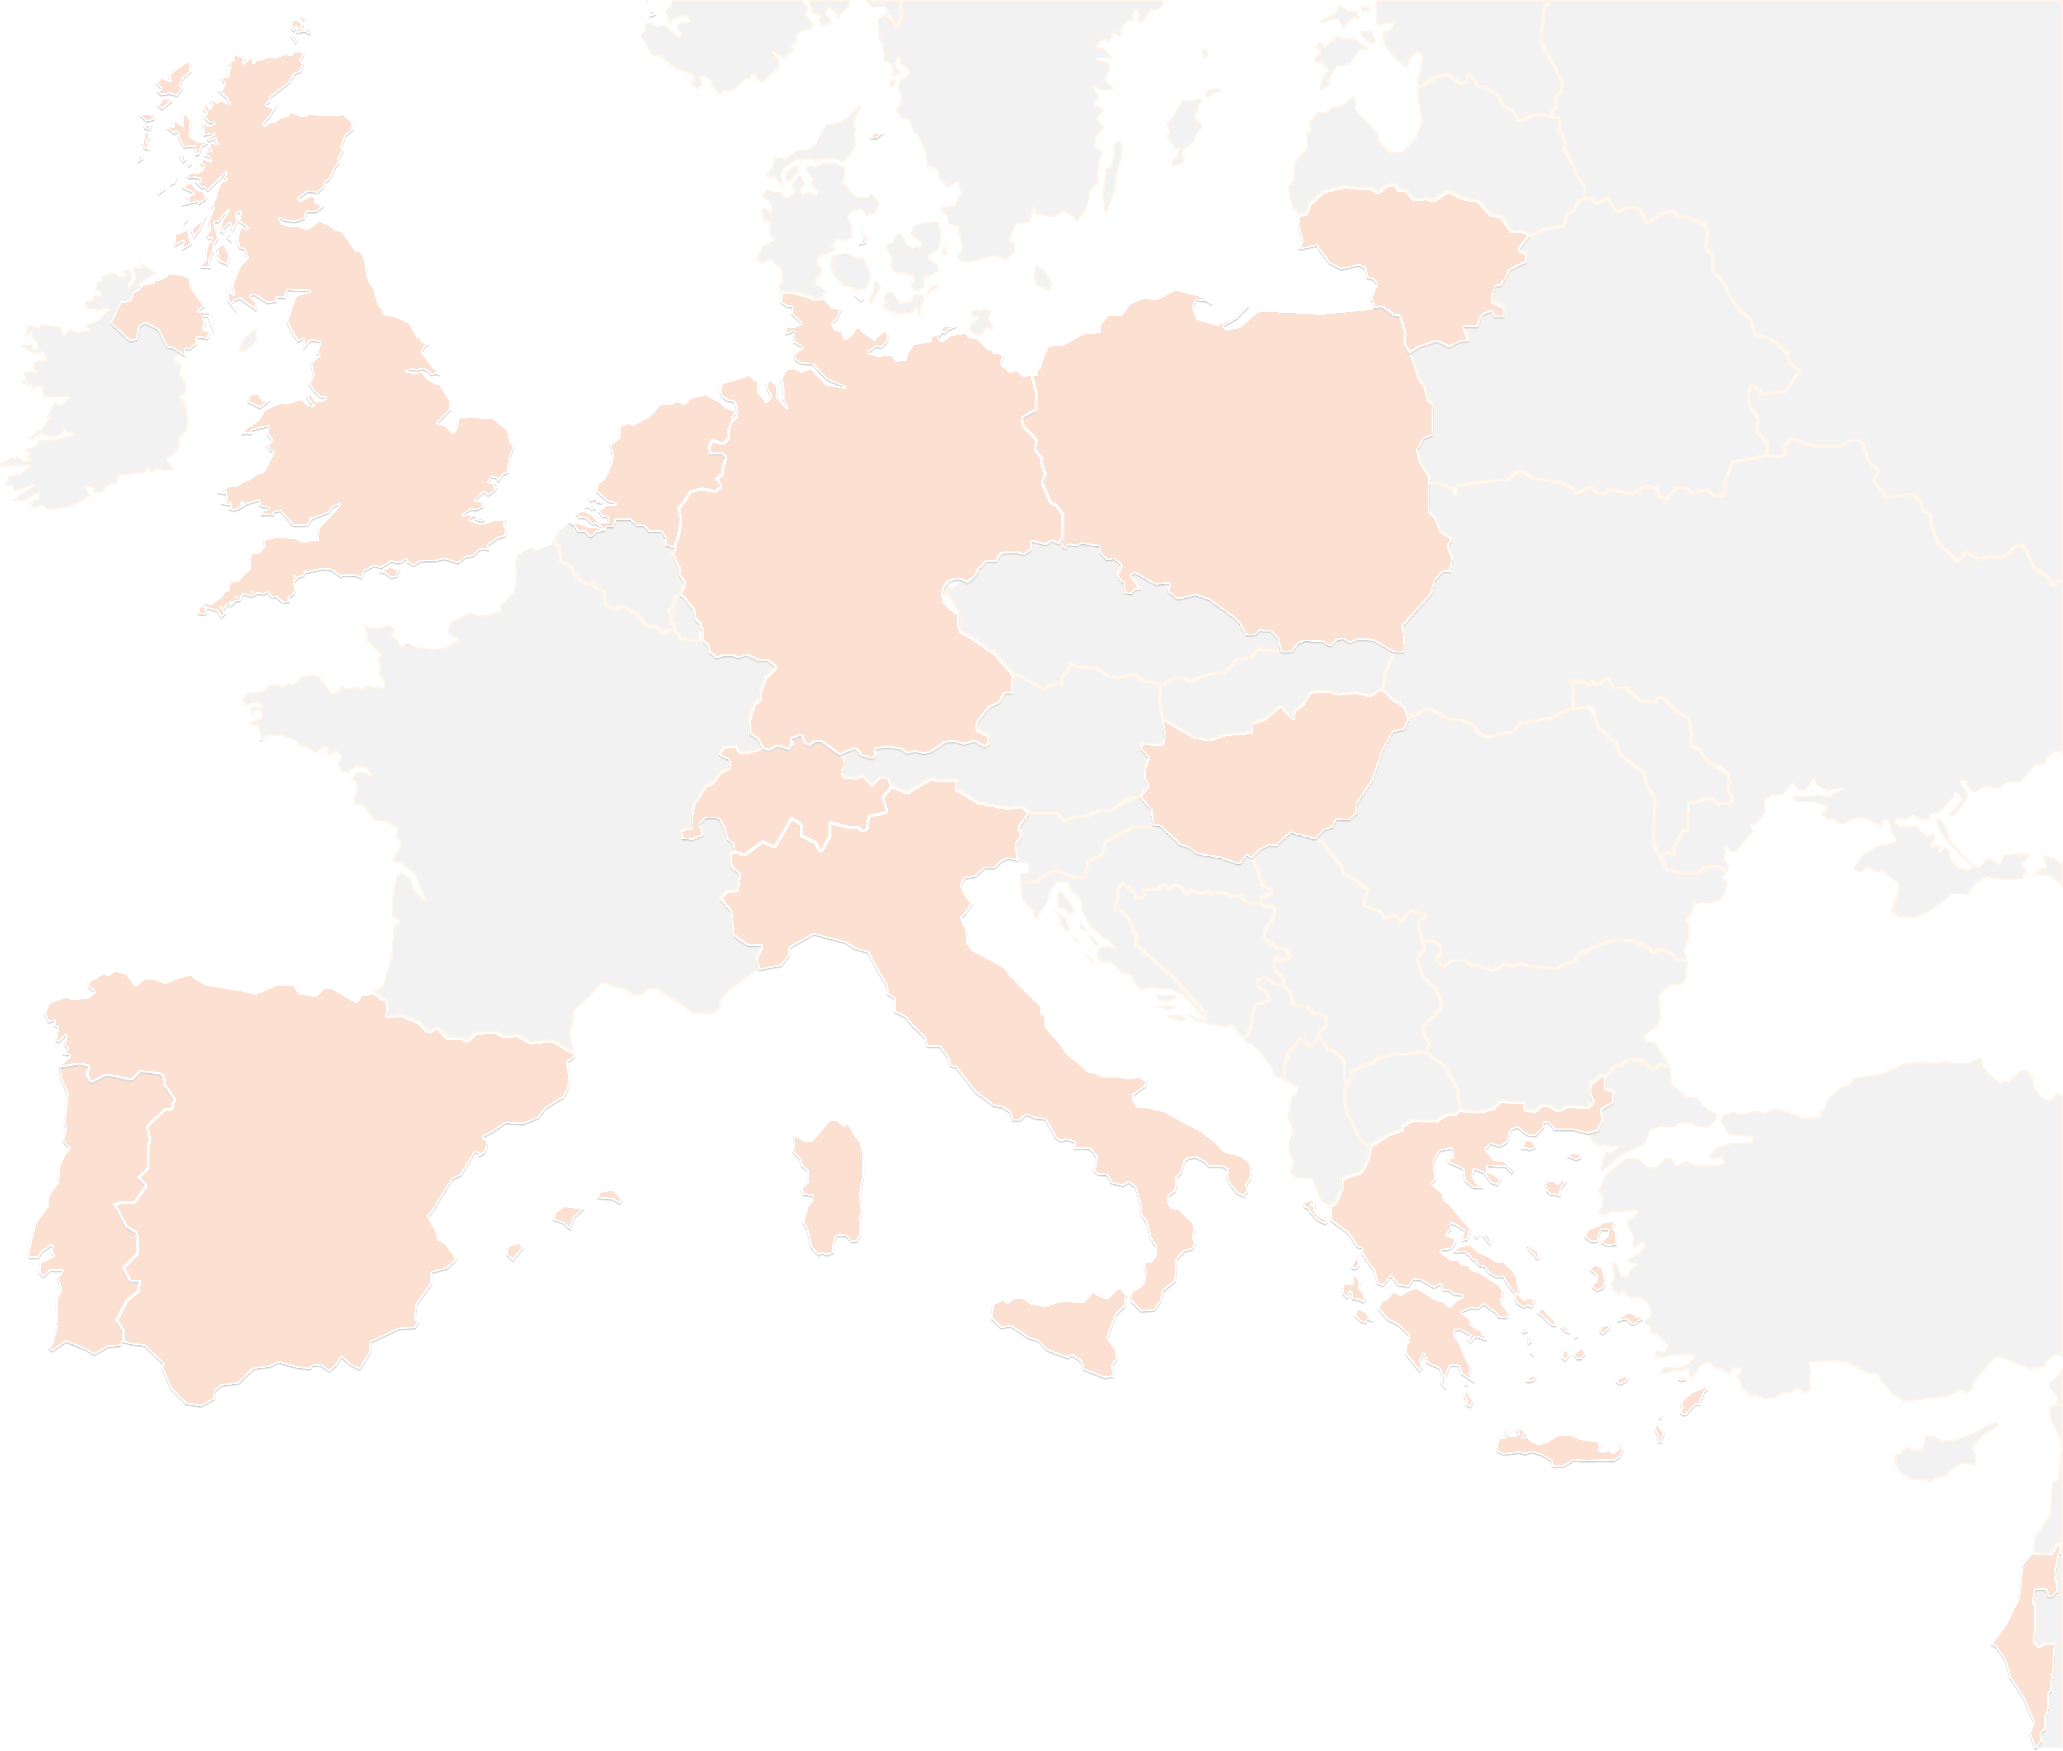
THANK YOU FOR YOUR ATTENTION!
contact@lists.up2university.eu
#up2universe

