Slide 1


NRENs educational technologies
Gyöngyi Horváth (GÉANT)
NTW19, Copenhagen, Denmark, 23 September 2019
www.geant.org

Slide 2

Notes:
Where is the E from NRENs? What are NRENs doing beyond connectivity in the area of education?
It was for us a hidden box… so we decided to explore in the European level what’s happening.

Slide 3

NRENs educational activities and services survey
OBJECTIVES:
Create an overview of NRENs educational activities and services
Identify common goals to work together
Identify common challenges
Create a global vision and strategy
Put in place a working group to drive these efforts
Notes:
Education institutions use a wide range of education services, ranging from learning management platforms, to learning analytics and online testing systems. These services are of strategic importance to them.
However, the maturity levels of using those educational services vary, thus so far there have been not many joint efforts in this area. Some NRENs provide national support to institutions, others are not yet involved.
GÉANT believes there are opportunities for a collective pan-European approach on education services and activities: to aggregate our expertise and demand and support our community in enhancing their educational activities.
GÉANT is setting up a dedicated activity around educational services. We plan to address the commonalities and create a future vision for the benefit of the community.

Slide 4

Educational services & activities of NRENs
Additional activities and services beyond connectivity (fiber, network, wifi) to supporting educational institutions with their technological evolution: innovation challenges and opportunities.
Targeting:
  Teaching & learning communities
  Educational institutions

Slide 5

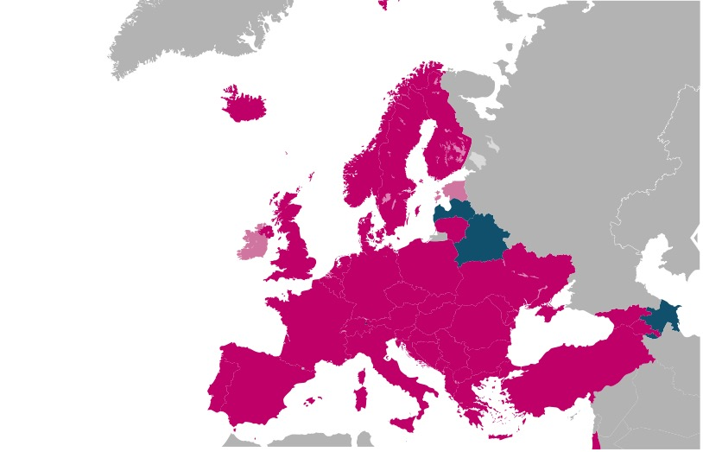
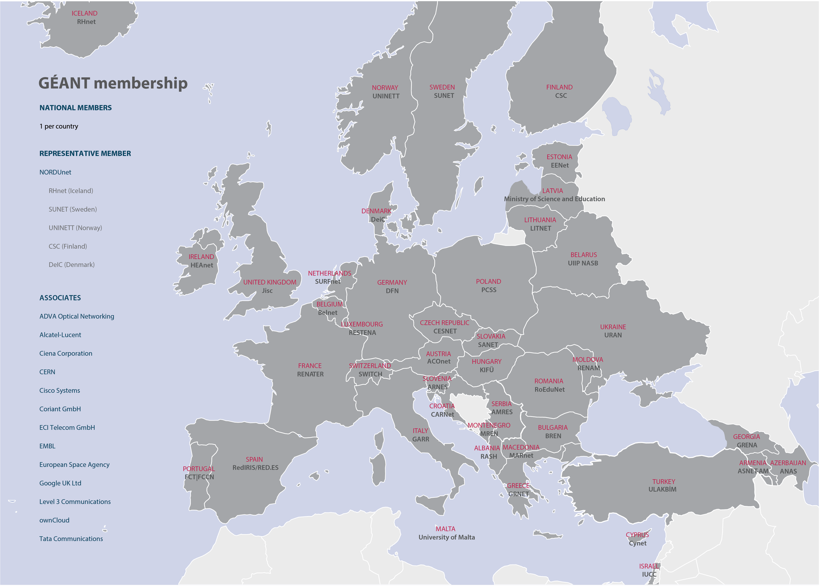
NREN responses
Notes:
43 NRENs in total 38 responded 2 incomplete 2 not responded.

Slide 6
NRENs provide educational services beyond connectivity

Slide 7
Levels of educational institutions supported by the NRENs
Notes:
Pre-primary: 3
Primary:13
Secondary:14
Higher Education: 34

Slide 8

Educational services
Digital Learning Environment
Logistical Support for education
Online, blended and remote delivery of education in home NREN country
Providing e-Content
Learning Analytics
Educational staff training
Open badges, digital credentialling
Transnational education
Inhouse built tools by your NREN for digital learning
Digital assessment and testing

Slide 9
Levels of development of educational services in all NRENs
Notes:
Alternative slide using map

Slide 10
Number of services that each NREN provides
Notes:
Alternative slide using map

Slide 11
Educational service levels
Initiative level
Informal joint exploration of an idea by an expert group. In most cases there is some investment to explore this initiative further, supporting the NREN’s participation in this initiative.
Project level
Formal joint follow up of an initiative with a project owner and a budget.
Service level
An integrated service implemented by the NREN.
Notes:
Alternative slide using map

Slide 12
 | Digital learning environment | Logistical support for education | Online, blended and remote delivery of education in the home NREN country | Providing e-Content | Learning analytics | Digital assessment and testing | Educational staff skills training | Open badges, digital credentialing | Transnational education (delivery of your national education overseas) | Inhouse built tools by your NREN for digital learning
Albania
Armenia |  |  |  |  |  |  |  |  |  |  |  | did not respond
Austria |  |  |  |  |  |  |  |  |  |  |  | Do not provide
Azerbaijan |  |  |  |  |  |  |  |  |  |  |  | N/A
Belarus |  |  |  |  |  |  |  |  |  |  |  | No - Out of scope
Belgium |  |  |  |  |  |  |  |  |  |  |  | No - But interested
Bulgaria |  |  |  |  |  |  |  |  |  |  |  | Yes - Initiative level
Croatia |  |  |  |  |  |  |  |  |  |  |  | Yes - Project level
Cyprus |  |  |  |  |  |  |  |  |  |  |  | Yes - Service level
Czech Republic
Denmark
Estonia
Finland
France
Georgia
Germany
Greece
Hungary
Iceland
Ireland
Israel
Italy
Latvia
Lithuania
Luxembourg
Macedonia
Malta
Moldova
Montenegro
Netherlands
Norway
Poland
Portugal
Romania
Serbia
Slovakia
Slovenia
Spain
Sweden
Switzerland
Turkey
Ukraine
United Kingdom
Nordics

Slide 13
Educational services per NREN and their levels

Slide 14
Notes:
1 - initiative
2 - project
3 – service
Digital learning environment

Slide 15
Notes:
Digital credentialing and LA could fit together in a joint collaborative project

Slide 16

19 NRENs
22 NRENs
Notes:
Procurement:
Joint Activity: 13
Knowledge Sharing: 6
Out of scope: 3
Answer N/A: 21
OER:
Joint Activity: 16
Knowledge Sharing: 6
Out of scope: 4
Answer N/A: 17

Slide 17
Future cooperation
Notes:
Alternative slide using map

Slide 18
34 NRENs
Notes:
SIG: 8 NRENS
Knowledge sharing: 26 NRENs

Slide 19
TF-EDU Main objective
The Task Force aims to establish collaborations across the education sector on commonly identified topic areas, providing a coordinated approach to improve NREN educational services and activities.

Slide 20
Objectives includes
Establishing a Taskforce as a trusted forum with members that actively participate and are involved in the results of the Taskforce;
Providing a platform to promote the sharing of best practices, tools and policies related to educational services and activities in our community. This may result in a repository or knowledge exchange activity.
Mapping NRENs individual educational services and activities with the aim of co-creating a roadmap for further collaborative activities;
Discussing, sharing ideas and giving feedback leading to a better understanding of common challenges and opportunities (e.g. lifecycles). Shared opinions can result in common standards that provide guidance for the wider community and NRENs; and
Liaising with other groups and projects within GÉANT when an education related area is discussed jointly and provide feedback on initiatives. As an example and first liaison would be with the GÉANT cloud activity to assist with developing services.

Slide 21
Next steps
Establish the Task Force officially
NREN educational technologies workshop 4-5 November 2019, Budapest, Hungary:
  NRENs educational technologies
  SIG-TNE

Slide 22
What is the GÉANT community?
In a nutshell: the education and research networks of Europe.
We connect educational institutions to each other and to the wider internet - not just technically, but in all the ways we need to help R&E happen.
We are networkers, T&I specialists, security experts, project managers, marketers and more.
We work with the academic community, the business community, governments and more to make this happen.

Slide 23
What do we do?
Enable collaboration for the development of the next generation of networking technologies and services.​
Explore emerging issues in R&E networking, develop strategies and solutions to address them.
Produce and test fresh and innovative ideas applied through specific research activities and initiatives.

Slide 24




Community Programme
Oversight by the GÉANT Community Committee:
https://wiki.geant.org/display/TTC.
How to propose a group:
https://wiki.geant.org/display/TTC/How+to+propose+a+GCP+activity
Task Forces and Special Interest Groups
Small project funding is available!
(Up to 50K a year)
Community Projects
How we assess groups:
https://wiki.geant.org/display/TTC/Reviewing+or+Exiting+a+GCP+Activity
Specialised Workshops
Notes:
The community programme is primarily financed by GEANT for the TF/SIGs but that it is fundamentally different because
oversight by GCC
does more stuff e.g. small project funding too.

Slide 25
You want to get more involved?
Join us 4-5 November 2019 at the next
NREN educational technologies workshop in Budapest, Hungary!
https://eventr.geant.org/events/3146
Notes:
You want to get more involved? Join us in 4-5 November at the next NREN educational technologies workshop in Budapest, Hungary!

Slide 26

Thank you
SUBSCRIBE TO OUR MAILING LIST: https://lists.geant.org/sympa/subscribe/tf-edu
www.geant.org
© GÉANT Association on behalf of the GN4 Phase 2 project (GN4-2).
The research leading to these results has received funding from
the European Union’s Horizon 2020 research and innovation programme under Grant Agreement No. 731122 (GN4-2).

