Slide 1
Up2University
Bridging the gap...
Erik Kikkenborg
NORDUnet
NORDUnet Technical Workshop 2019

Slide 2
Objective
The “Up to University” (Up2U) Project aims to bridge the gap between secondary schools and universities by providing European schools with a Next Generation Digital Learning Environment (NGDLE) that helps high school teachers equip their students with the knowledge, skills and attitudes they will need to succeed at university.

Slide 3
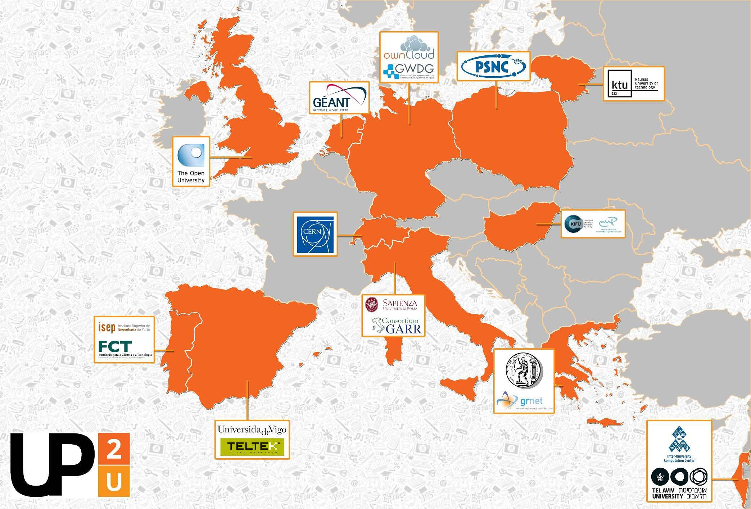
7
Up2U Consortium
18 partners
Universities
NRENs
Infrastructure providers
Commercials
12 countries
EU
Switzerland
Israel

Slide 4










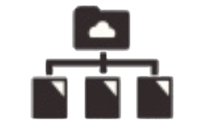

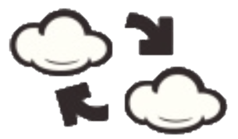





Up2U ECOSYSTEM
FORMAL LEARNING SPACE
INFORMAL LEARNING SPACE
LOR
Attend
INTERACTIVE LEARNING PATH
Search
LMS
Create
SIS
Assessment
Share
INFRASTRUCTURE
eduOER aggregation
WiFi eduroam
TO UNIVERSITY
Sync&Share ownCloud
’Always-on’ education
at school
in library
in museum
at home
on the go

Slide 5
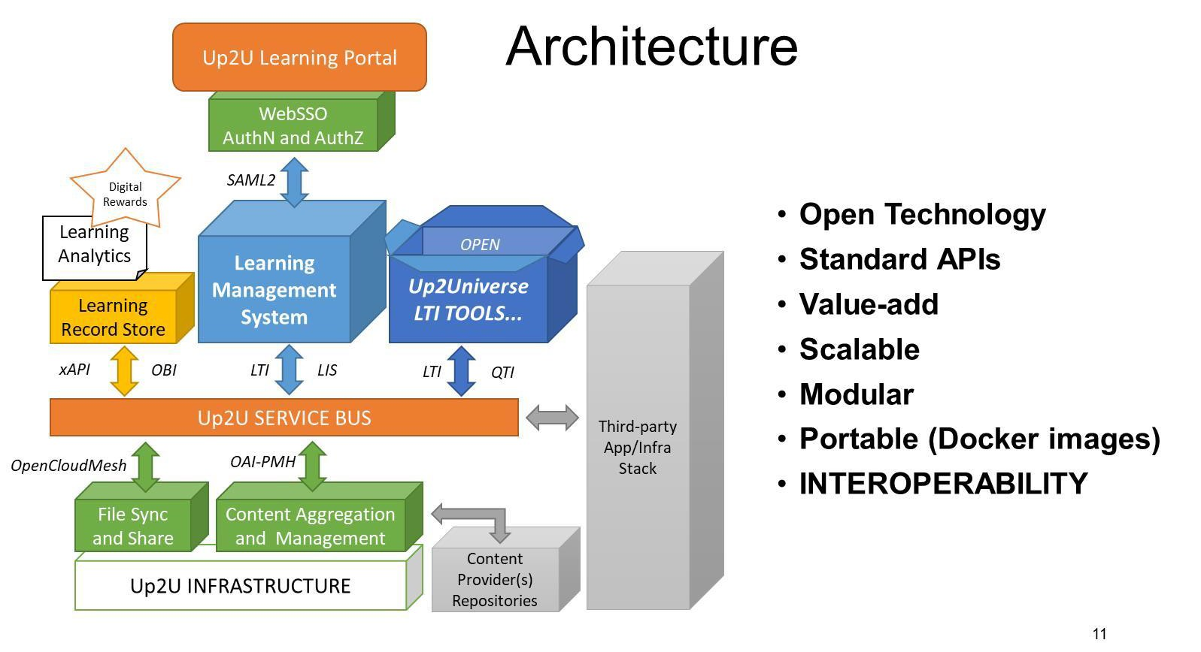
TNC18 Intelligent networks, cool edges?

Slide 6
Skills for Academic Learners Up2U approach
Critical Thinking & Problem Solving
Communication & Collaboration
Information, Media & Technology Literacy
Self-Direction
Learning to learn
Notes:
By using the appropriate teaching models, the learner may improve these skills and this process will even encourage the development of necessary digital competences for better and successful functioning in the technological world of the 21st century

Slide 7
Teaching Models, methodologies and tools used in Up2U
Project Based Learning (Trello, wikis)
Place-Based Learning Education (Treasure hunt)
Experiential Learning (CernBox)
Flipped Classroom (WebRTC, SeLCont, eduOER)
Scenario-based learning (H5P)

Slide 8
Some of the Up2U Use Cases
An authenticated course creation in Up2U platform
Recording a lecture
Uploading a lecture & making assignments
Interactive video creation and exercises
Creation, storage and usage of open educational content in Up2U repository
Virtual room communication

Slide 9
Up2U Continuous Professional Development
Three main Phases for the Up2U Professional Development
  Phase One – Introduction to ecosystem
  Phase Two – Hands on Experience and students involvement
  Phase Three – “Train the Trainer”
Nine pilots in Up2U Professional Development program
  Combination of technology and pedagogy
  Combination of skills, educational needs, technological tools

Slide 10
Added value of Up2U
Up2U for NRENs
  You can enrich your service portfolio and provide a learning platform for your K12 community!
  Easy login-we use SSO!
  Our solution is GDPR friendly by design.
  Have it your way-use the central Up2U instance or have yours on-prem!
  Internet connection is the only prerequisite of this platform.

Slide 11
Added value of Up2U
Up2U for universities
  Up2U drives up your enrolments with students ready for higher education.
  Up2U may help you reduce the dropout rate in first grade due to unexpected skills and technical requirements.
Up2U for collaborators(companies, content providers)
  Up2U gives you access to schools and provide a trusted and secure delivery vehicle for your content.
  Up2U gives you community feedback on your content and services via advanced learning analytics.
  Up2U provides an international network of potential users.

Slide 12
How to engage
Come and experiment with the Up2U NGDLE in the cloud
Distributed private cloud installation at PSNC-Poland, GWDG-Germany
and GRNET-Greece.
Integrate components and functionalities into your LMS
Github & Dockerhub images, automated deployment and configuration,
documentation and support
Take the entire open-source platform and deploy it on-prem or in your preferred cloud
Integrated software stack in Docker containers

Slide 13
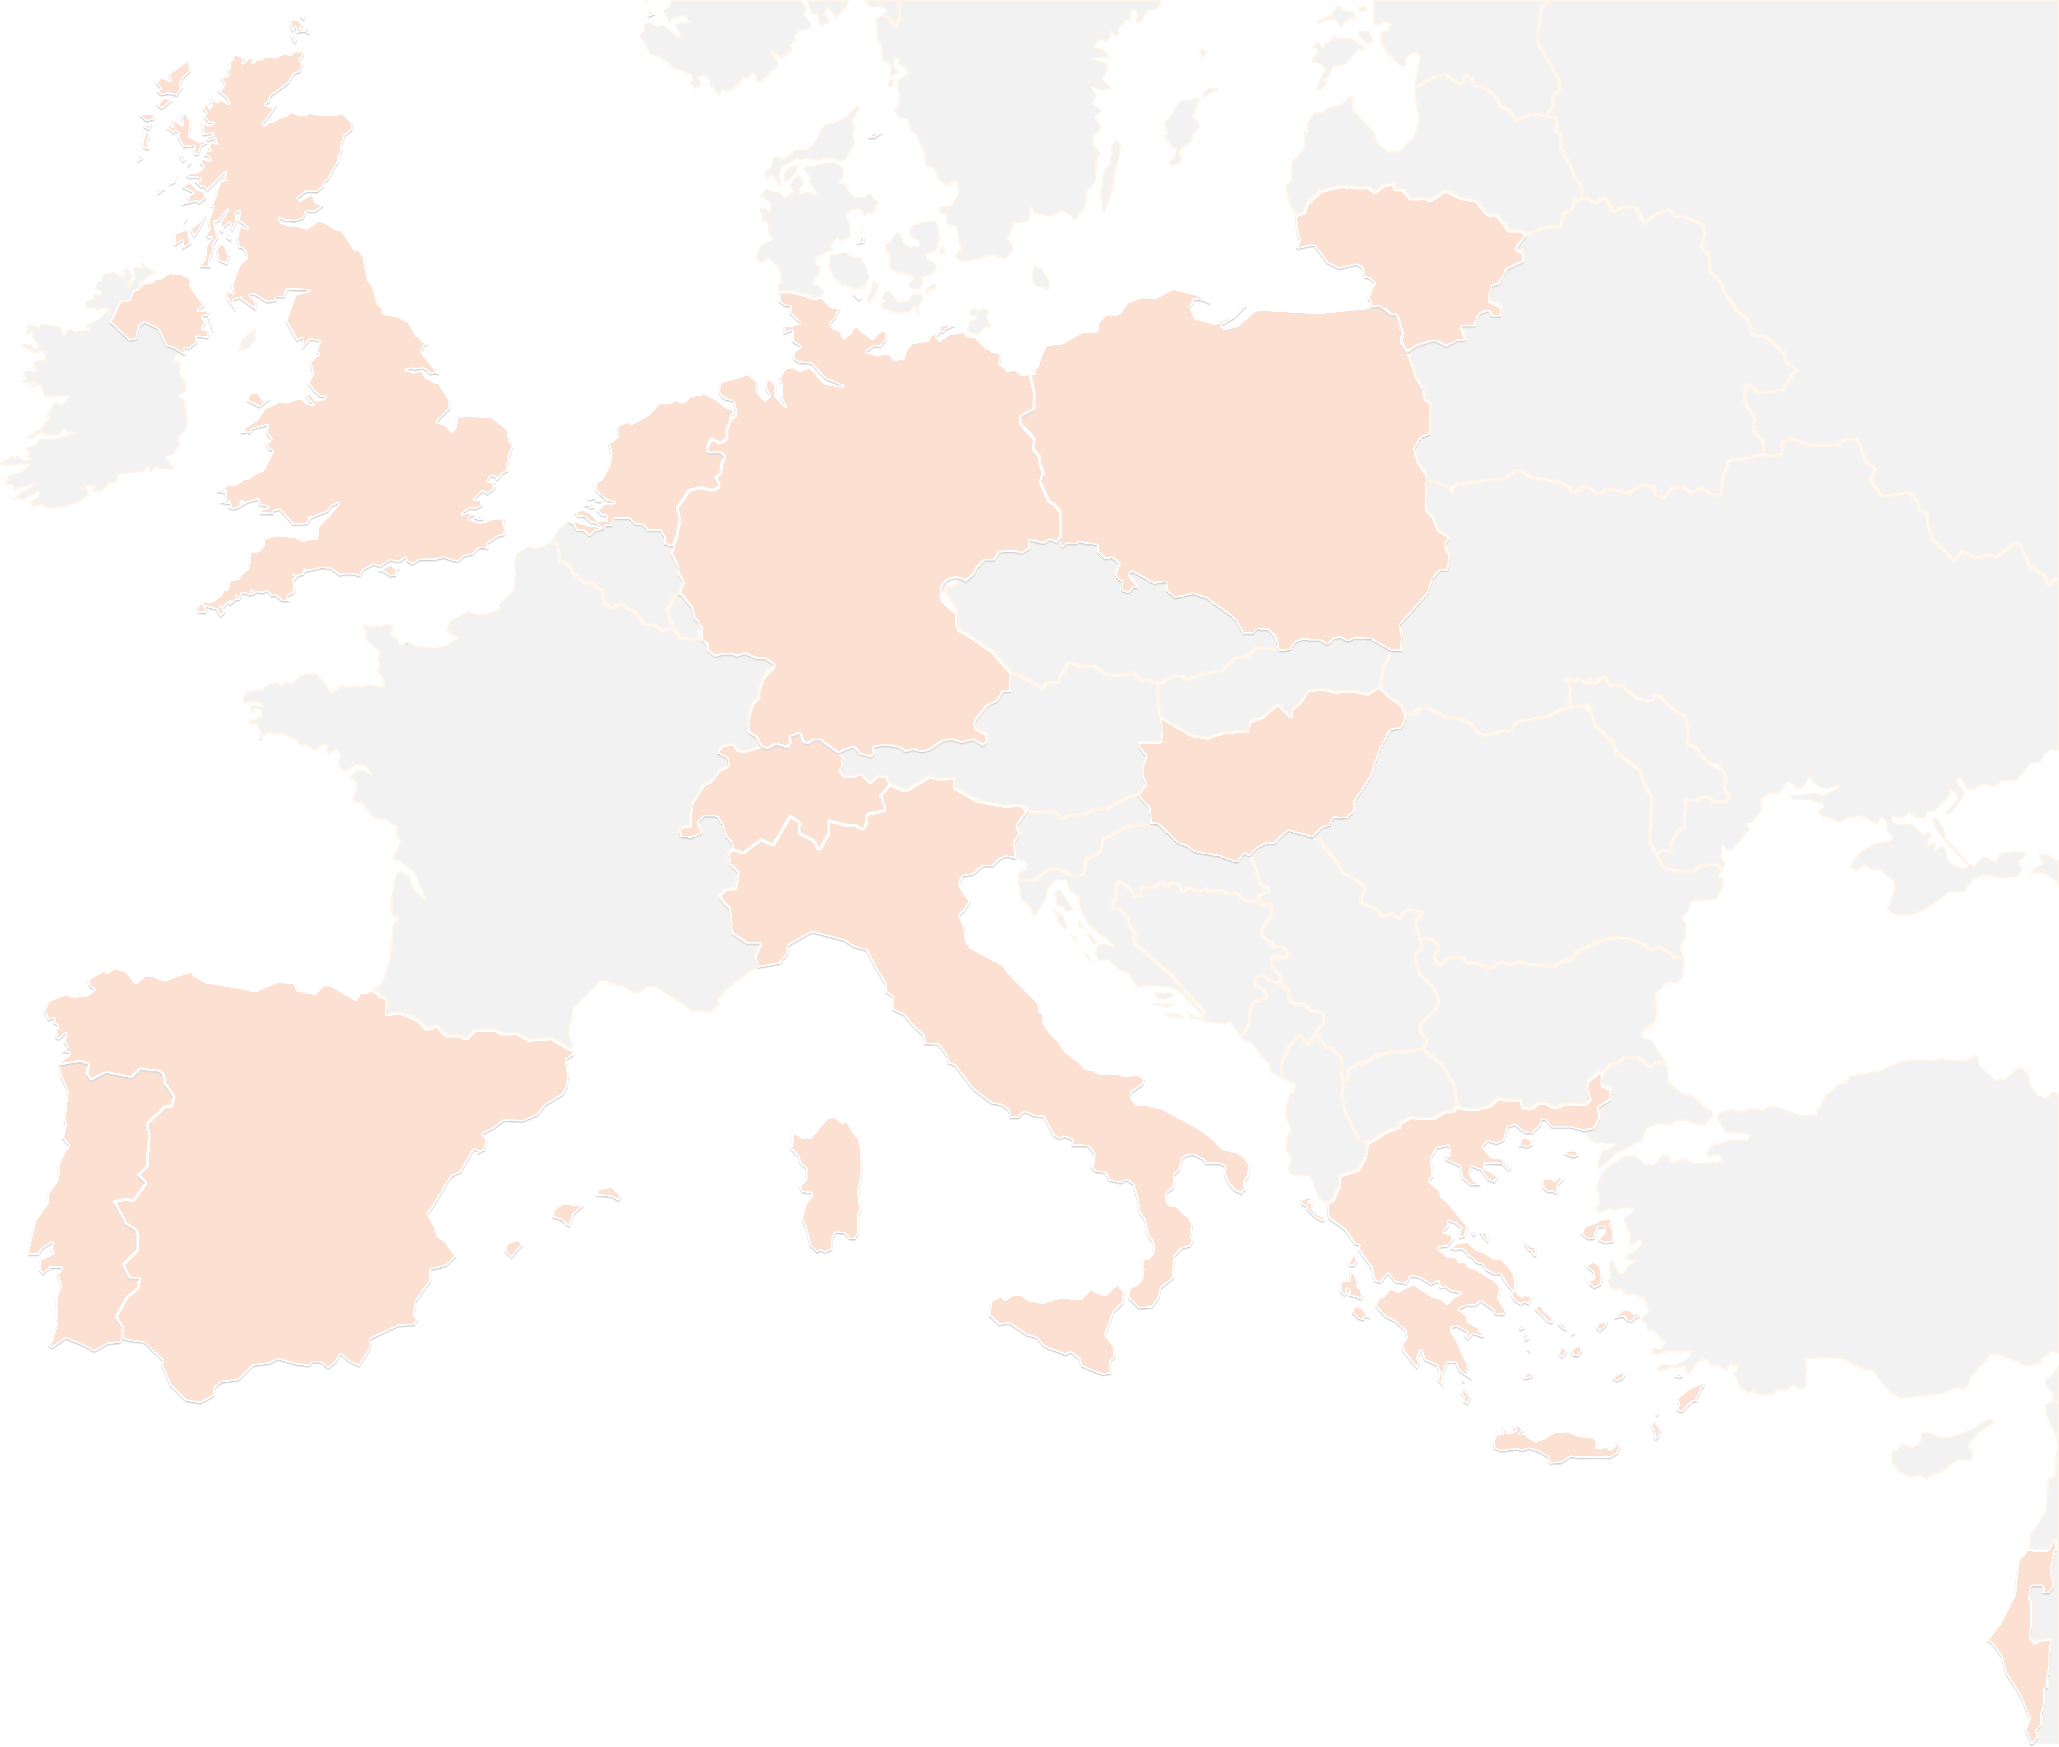
THANK YOU FOR YOUR ATTENTION!
contact@lists.up2university.eu
#up2universe

