Slide 1
Title
Name of presenter
Name of organization
Name of event

Slide 2
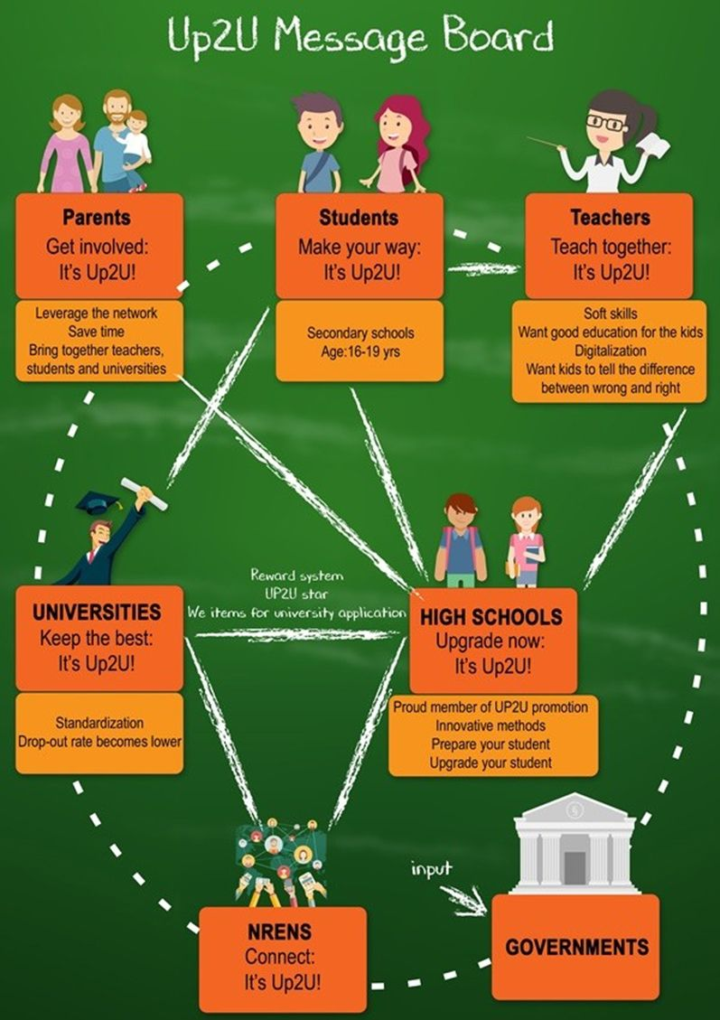

Goal: get engaged!

Slide 3
What worked for us so far?
.
Sadly, there is no solution that works for all.
Top-down: approach local/ central governments.
Bottom up: reach out to schools, principals, teachers and try to make them interested in the project.
Organize local workshops/conferences/training.
  Teachers do appreciate this, but usually it is up to the school management/principal to decide if they wan tot join or not.
  Accredited trainings are appreciated!
Give presentations/organize workshops in international conferences.

Slide 4
Up to University (Up2U) materials
.
General Flyer
IT Security Flyers
Roll-up
Promotional video
Poster (general)
Poster (NREN focus)
Introductory slides to the project
All these materials are accessible via the wiki page of the webinar!

Slide 5
Project website
The primary platform we use is the project website:
www.up2university.eu
Under the „Contact us“ we included the national coordiantors, so interested parties can put a face next to a contact. Here, we also indicated the pilot schools on a map.
We are would be happy to inlcude contacts of NRENs who are not part of the consortium.

Slide 6




Social media presence
Up2U is present on multiple social media platforms. We use #Up2U and #Up2Universe hashtags.
Please follow us on:
 | Up2Universe

Slide 7
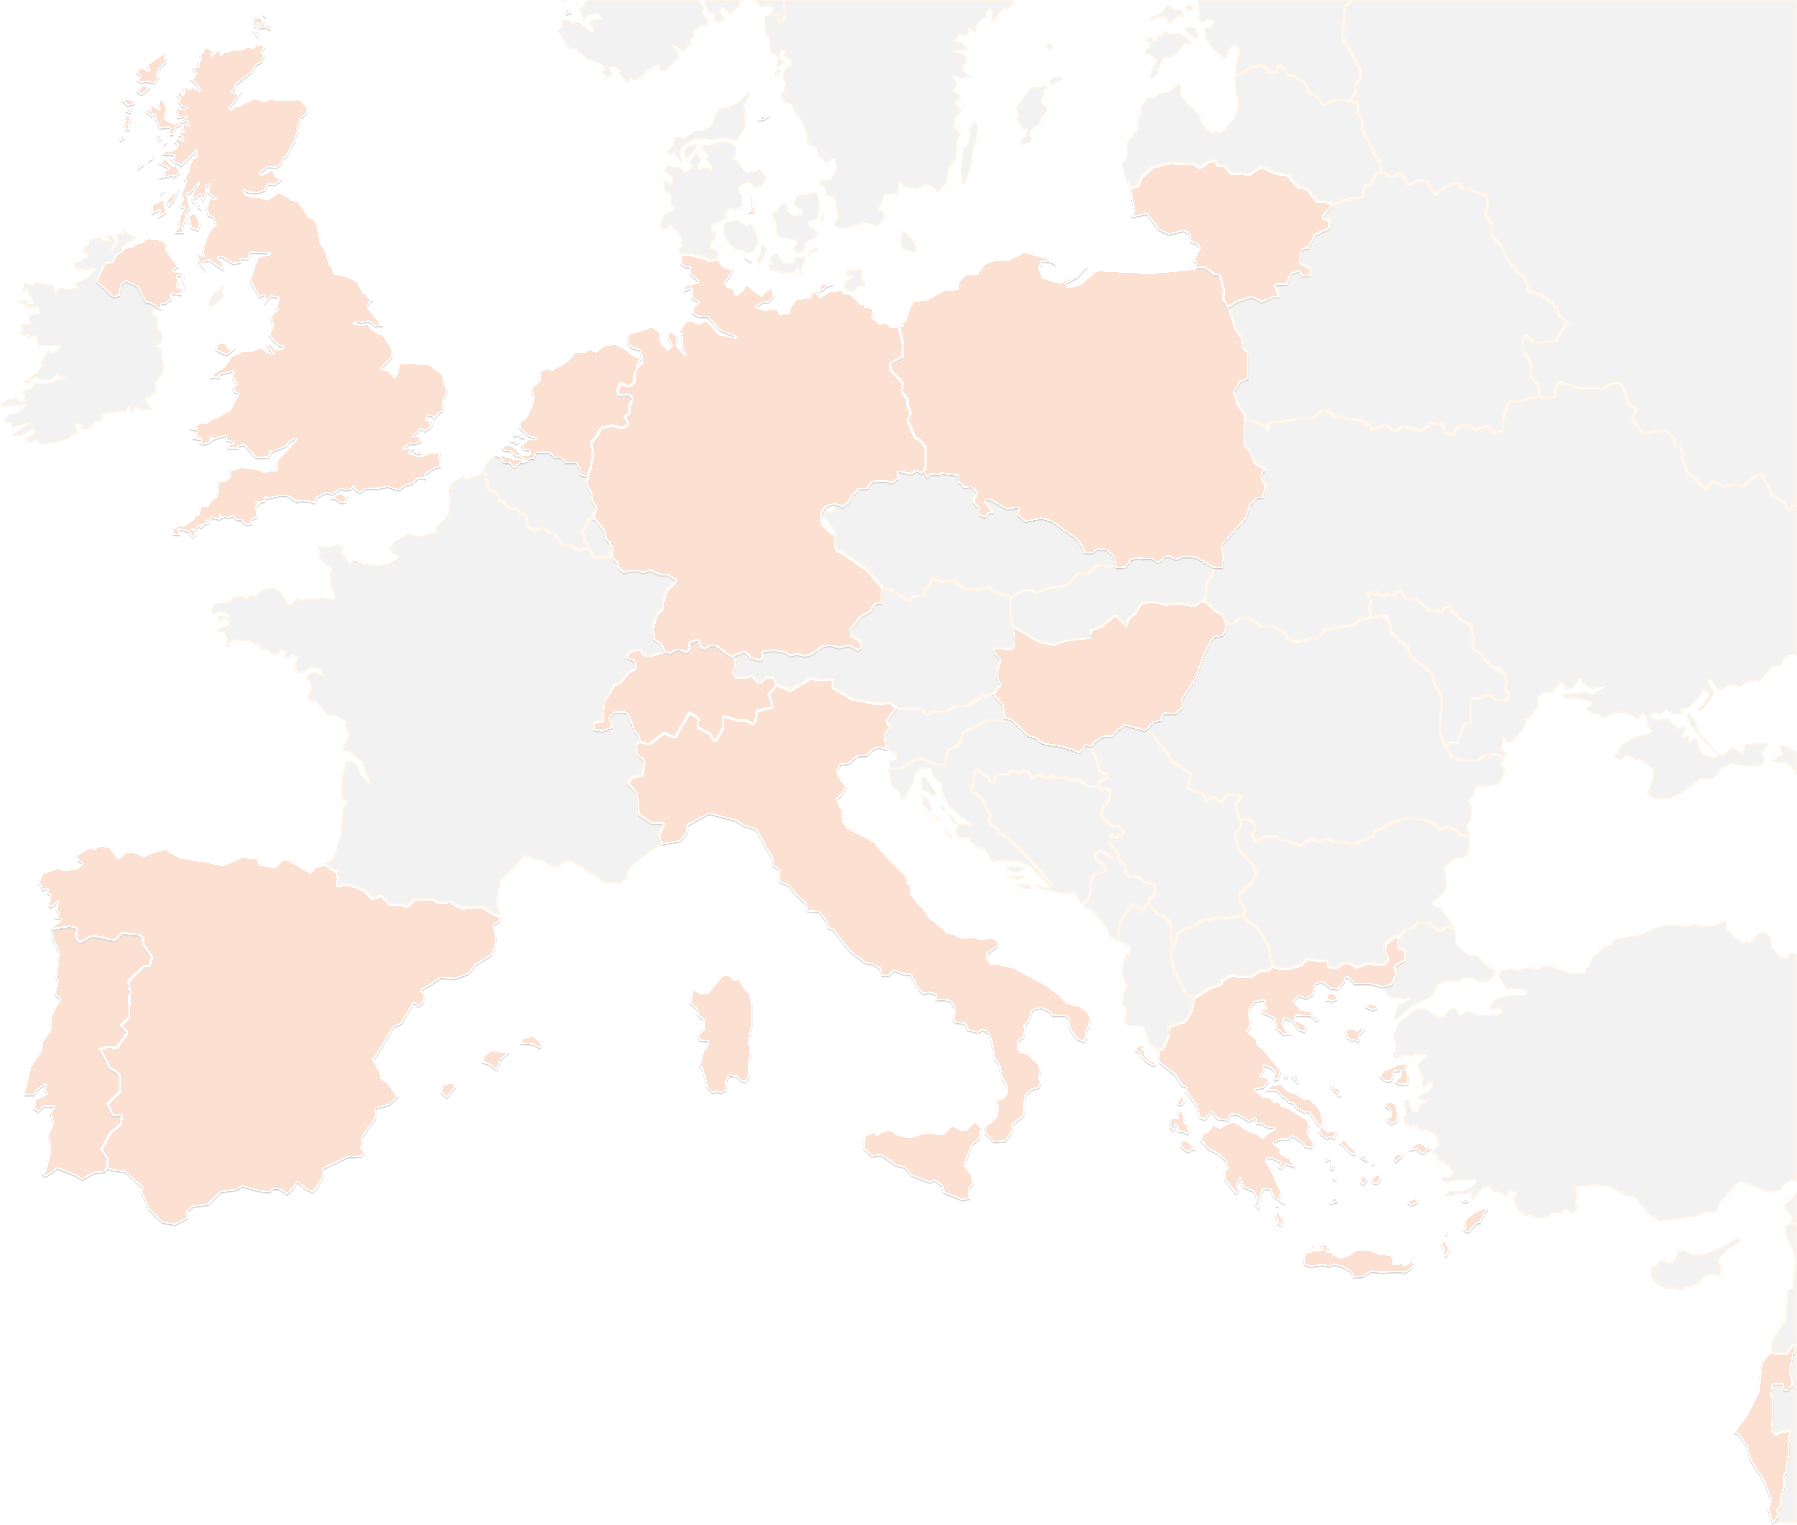
THANK YOU FOR YOUR ATTENTION!
contact@lists.up2university.eu
#up2universe

