Slide 1
WP7. Pilot coordination and continuous risk assessment
Michał Zimniewicz
Poznan Supercomputing and Networking Center
Up2U Update Webinar
6th November 2019

Slide 2
Pilots – Total Figures
Country | Training |  | Pilots
 | Schools | Teachers | Schools | Students
Germany | 2 | 10
Greece | 70 | 220 | 5 | 50
Hungary | 8 | 66 | 6 | 80
Italy | 79 | 100 | 6 | 79
Lithuania | 246 | 472 | 153 | 17.000
Poland | 56 | 70 | 15 | 306
Portugal | 7 | 50 | 2 | 120
Spain | 6 | 17 | 1 | 100
UK | In preparation
Isreal | Under discussion
Notes:
Some updates to pilot figures. First users in Germany.
Looking for other opprotunities for impact creation. Webinar preparations in UK. Israel under discussion. NREN webinar to engage new NRENs.

Slide 3
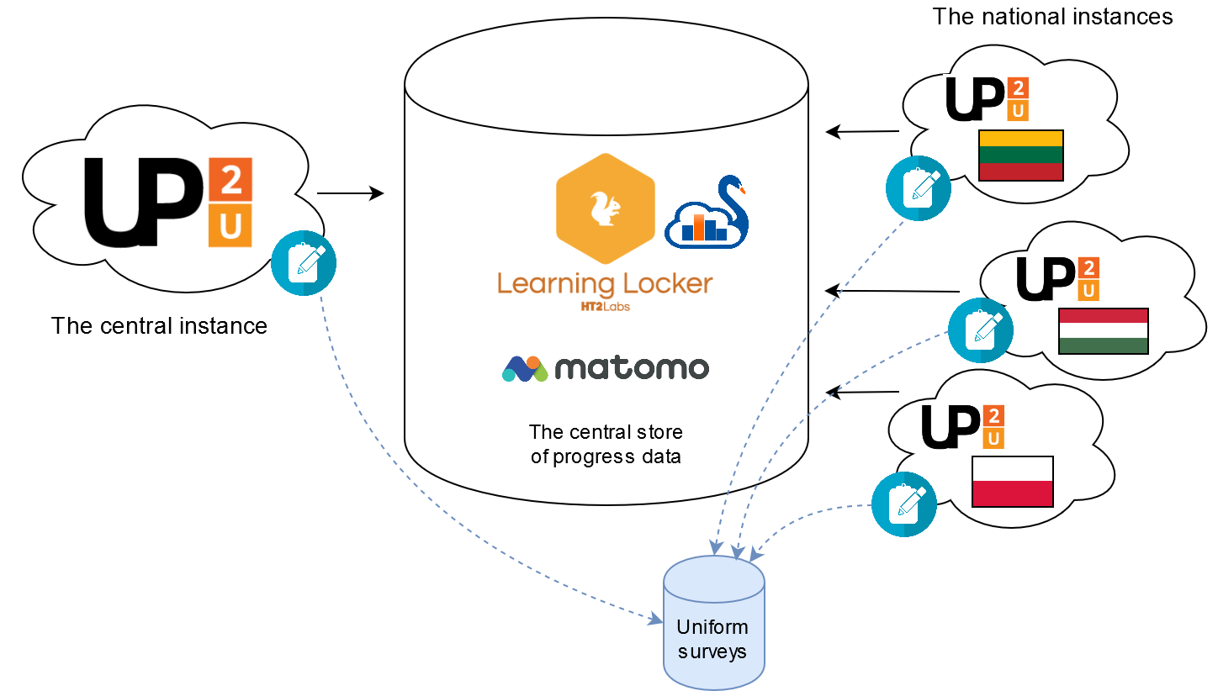
Pilot Evaluation
Notes:
Agreed between WP5&WP7:
Users are not forced to use any specific tools.
We follow the same evaluation process in all countries by uniform surveys and centrally-collected LA data. Evaluation materials are translated in most countries. Technical implementation in progress.

Slide 4
Priorities for WP3 & WP4
Regular meetings on particular issues
Collaboration on most urgent issues:
  Service availability issues in SSO
  Role management in Moodle
  Moodle-CERNBox integration
  Reporting xAPI statements
Regular support from the QA team for more frequent releases
Notes:
Regular and live support from QA is offered.

Slide 5
Risk Assessment
Chosen crucial risks related to WP7 goals:
Technical work in the project is focused on fixing bugs and not on improving tools
No added value seen by teachers in comparison to competitive solutions
GDPR consents not implemented
No solution for group management
Notes:
Re. risk #1 & 2 – weak uptake of the platform
Re. risk #4 – possibly serious problems in collecting or evaluating LA data, thus evaluating pilots

