Slide 1
Webinar #7
Up2U management team & TF leaders
Webinar #7 06/11/2019

Slide 2
Up2U monthly webinar
WP3
Ilias Hatzakis
GRNET

Slide 3
TASK 3.3: OER
  NEW REPOS:
    Loyola University of Chicago
    University of Coimbra
    ECIS (Educational Collaborative for International Schools)
    Georgia Institute of Technology
    Florida Department of Education
    Southwestern Community College (California)
  Re-harvest of the existing repositories in order to bring the newest items of them at the EduOER platform.

Slide 4
TASK 3.3: OER
Continuous Quality Checking of Open Educational Resources of EduOER platform in order to improve user experience.
FCCN (~400 items removed)
MANIOC (~1600 items removed)
  We now have 63 repositories (32 HE and 31 K12 ).

Slide 5
TASK 3.1
Continuous improvement of the WebSSO.
Continuous bug fixing
TASK 3.1,3.2,3.3
Submission of the final version of D.3.5 “Final Cloud Platform Overview”

Slide 6
WP1 & SMC Update
Casper Dreef
Webinar #7 06/11/2019

Slide 7
Amendment & extension
Under review by PO
No feedback on financial redistributions, but;
Semiofficially approved
Notes:
1: Received first comments from the PO and addressed these in the amendment
2: The PO indicated that the EC’s financial department didn’t had time yet to review the amendment
3: This because the reviewers and PO specifically asked for this extension to make sure the pilots are a success. More schools, more teachers, more students

Slide 8
Sustainability
Education services survey
Target: NRENs
Soft CPD
Results: CSC and ARNES showed interest
Notes:
1: map NREN activities regarding education services
2: use the results from this survey to target NRENs that offer educational services already, particularly those who serve secondary education
3: non-consortium partners will receive lightweight support in the form of Soft CPD
4: Until now 2 NRENs showed there interest: CSC in Finland and ARNES in Slovenia.

Slide 9
Subject Matter Committee
SMC synchronizes its work with the National SMCs
National SMCs support the pilots on:
  Working on the preparation of the material for the on line courses
  Evaluating the Questionnaires (teachers and students)
  Working with the Focus groups
  Disseminating the project idea to several related projects in collaboration with the local Up2U organizations
Notes:
SMC works with the national communities to implement the pilot activities in all pilot countries. Small groups of teachers in each pilot country working together to make scenarios courses and analyze the evaluation through the surveys and interviews. Support the work on learning analytics for the evaluation phase and disseminate the up2u idea to related conferences by their participation

Slide 10
Up2U monthly webinar
WP2
Barbara Tóth
KIFÜ

Slide 11
Ongoing tasks, updates
  We are preparing two flyers for the NRENS (will be ready in 2 weeks time):
    Step-by-step guide for NRENs
    Pilots in numbers
  We suggested upgrades for the Up2University Moodle (implementation in progress).
  INTED deadline: 21 November 2019
  Details please!
  We need to publish more news items on the website. This can only be done if you provide us information about the recent updates!
Notes:
We are preparing two flyers:
-one about the Step-by-step guide for NRENs (this supports our webinar for NRENs)
-another flyer for promoting the project with the nr-s from the NRENs
We collected ideas regarding how the learning platform can be updated-to make the look and feel more Up2U style and the UX better.
If you plan to submit a proposal for INTED 02-04 March 2019 (valencia, Spain) please let WP2 know.
Share your updates, so we can promote them!

Slide 12
Reminders, requests
  Don’t forget to share information about your local and international events:
  Let us know if you have social media post or new item ideas! Share and promote our content please!

Slide 13
WP4 Webinar Update
Up2U Update

Slide 14
Platform status & WP4 activity
Ongoing bugfixing and development
  Connection to Learning Record Store
  CERNBox issues on production
  SSO on development
  Learning Analytics extensions for Moodle and relevant tools
Cross-WP work on effort and coordination

Slide 15
Next steps
Fully test and resolve issues
Schedule next release
Continue communications on
  Learning scenarios
  Learning activity/xAPI data collection extensions

Slide 16
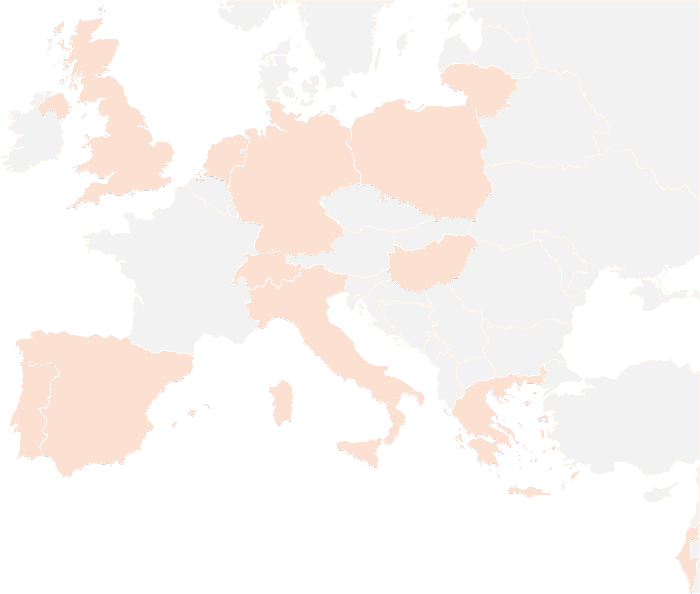
THANK YOU FOR YOUR ATTENTION!
wp4@lists.up2university.eu
#up2universe

Slide 17
WP5 7th Webinar Update activities in progress July-December 2019
Up2U Update 5th of November 2019

Slide 18
WP5 activity
Pedagogy coordination: starting Fall-19 cycle of pilots
  Implementation of a Common Assessment Methodology
    8 Meetings (starting from September) of the UROMA team on assessment
    Remote meeting with TAU, planning a f2f meeting in Rome or Tel Aviv
  WP5 preparation for a second WP5 Meeting
    Remotely planning the meeting with contribution of each partner
    Setting the dates - preparing the most important issue to discuss
    Gathering attention from all the involved partners
    Preparing list of documents and contents to be delivered as
    Assigning to each partner its role into the D5.5 final Deliverable
Notes:
From Github issue tracker

Slide 19
Pilots and international communities status
Pedagogical coordination of the next activities
  WP5 internal f2f meeting 14 of November in Rome or TaU to complete new Soft-CPD
  WP5 Meeting in Tel Aviv December 2019/January 2020 (a call for contribution will be prepared within 15 November)
    A review of all Pilots from Pilot Coordinators July 2019 – January 2020
    Trouble and success collection, Exchanging best practices
    Establishing and implementing a common Assessment Method to be tested since September 2019 - to April 2020
  Continuous Update of the Operational “next steps document” prepared with 12+ to-dos items, each assigned to specific owners
A structured agenda for the month September ’19 – January’20
Notes:
From Github issue tracker

Slide 20
Next steps (already started)
Deliverable 5.5: set the template and the role of contributors (started in Poznan, to be completed within 15 of November)
  New Course and Content availability in English
  New and enhanced Learning Analytics collection, suitable for teachers, in English and/or in national language
  A structured document where contributors will upload content with a strictly ordered method
Transfer to each Pilot Coordination team the results of the new agreements
  Implement Learning scenario (CFM in Moodle, and other planned alternatives ) - Finalize the design of new Soft CPD
  Start implementation next Pilots, formal and non-formal scenarios

Slide 21
Next steps (already started)
Dissemination activities
  Establishing partnership with national group of educational services providers
  Coordinating actions with external bodies
    F4F, T4F, P4F; Santa Cecilia; Sapyent, Loquis, Ammappalitalia
Outreach and communication to policy makers and potential stakeholders (in progress)
  Letter to a Minister of Education (english version, italian translation)
  Letter to be subscribed by Pedagogical Experts (in Italy and WorldWide)
  Letter to an activists organization (english)
  Letter to potential stakeholders

Slide 22
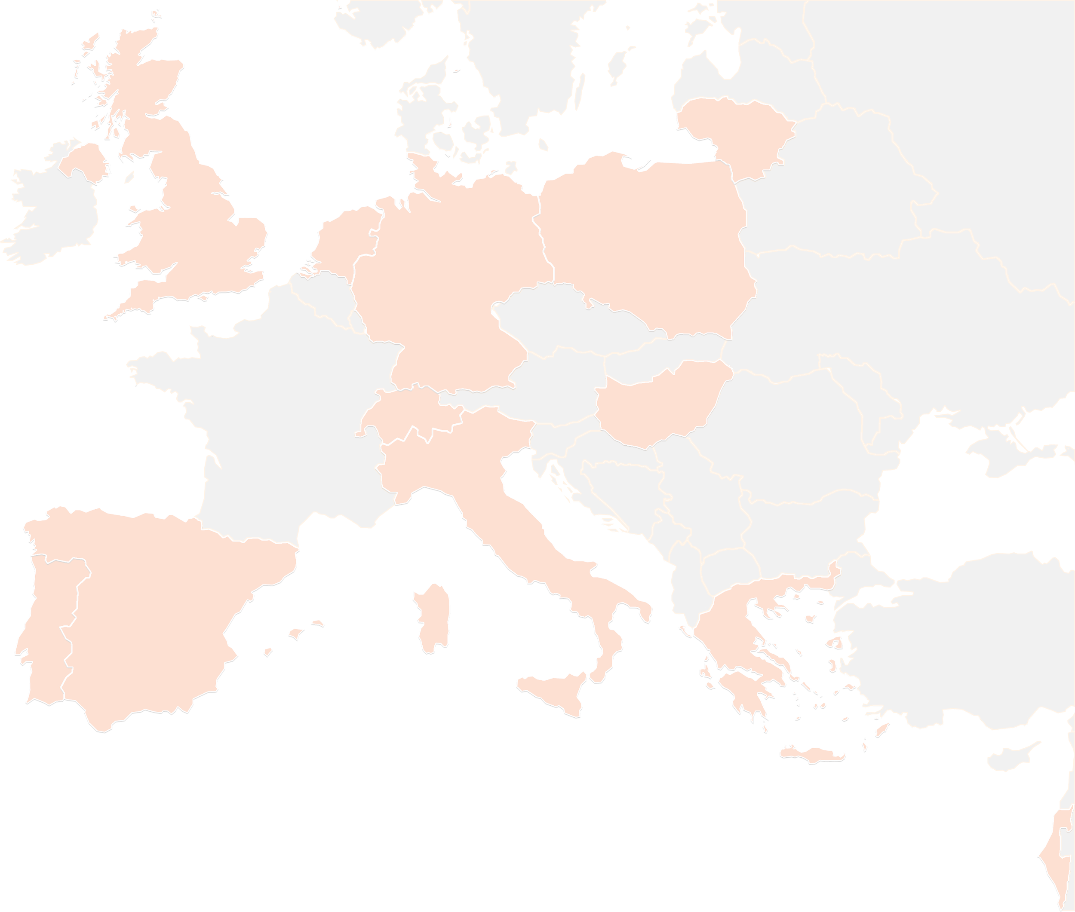
THANK YOU FOR YOUR ATTENTION!
wp5@lists.up2university.eu
#up2universe

Slide 23
WP6
_{UPDATE - November 2019}
Gabriella Paolini
GARR

Slide 24
Security Guidelines translation
The translations are ready for this national pilots:
  Greece
  Hungary
  Spain
  Poland
But…
No editing at the moment
We are waiting from WP2 the translations inside the UP2U Layout

Slide 25
Schools: how to deal with security and digital identities
The course is open on the UP2 platform with self enrolment
  https://learn.up2university.eu/course/view.php?id=48
  Few participants at the moment.
  Under Miscellaneous category – a bit hidden
  Promotion inside the national pilots

Slide 26
WP6 meeting
We have urged the participation to the wp6 meeting
  In the coming days
We need to define the teachers focus groups for each national pilot in order to analyse the impact of security directions.

Slide 27
WP7. Pilot coordination and continuous risk assessment
Michał Zimniewicz
Poznan Supercomputing and Networking Center
Up2U Update Webinar
6th November 2019

Slide 28
Pilots – Total Figures
Country | Training |  | Pilots
 | Schools | Teachers | Schools | Students
Germany | 2 | 10
Greece | 70 | 220 | 5 | 50
Hungary | 8 | 66 | 6 | 80
Italy | 79 | 100 | 6 | 79
Lithuania | 246 | 472 | 153 | 17.000
Poland | 56 | 70 | 15 | 306
Portugal | 7 | 50 | 2 | 120
Spain | 6 | 17 | 1 | 100
UK | In preparation
Isreal | Under discussion
Notes:
Some updates to pilot figures. First users in Germany.
Looking for other opprotunities for impact creation. Webinar preparations in UK. Israel under discussion. NREN webinar to engage new NRENs.

Slide 29
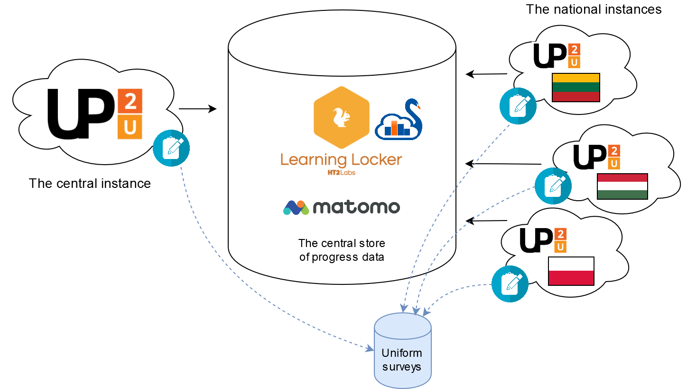
Pilot Evaluation
Notes:
Agreed between WP5&WP7:
Users are not forced to use any specific tools.
We follow the same evaluation process in all countries by uniform surveys and centrally-collected LA data. Evaluation materials are translated in most countries. Technical implementation in progress.

Slide 30
Priorities for WP3 & WP4
Regular meetings on particular issues
Collaboration on most urgent issues:
  Service availability issues in SSO
  Role management in Moodle
  Moodle-CERNBox integration
  Reporting xAPI statements
Regular support from the QA team for more frequent releases
Notes:
Regular and live support from QA is offered.

Slide 31
Risk Assessment
Chosen crucial risks related to WP7 goals:
Technical work in the project is focused on fixing bugs and not on improving tools
No added value seen by teachers in comparison to competitive solutions
GDPR consents not implemented
No solution for group management
Notes:
Re. risk #1 & 2 – weak uptake of the platform
Re. risk #4 – possibly serious problems in collecting or evaluating LA data, thus evaluating pilots

Slide 32
UP2U WP8
Sustainability and Exploitation of Results

Slide 33
Sustainability Plan
Centralized Model
Tasks and Activities:
Monthly Report about Activities and Plans
Regular Sustainability Meetings in WP8
Sustainability Meetings with PCT for Centralized Model
National and International Market Analysis
Reliable Cost Models
National Models
Other Models

Slide 34
Centralized Model
Cost Model Experiences in Hungary, Lithuania and Poland
National and International Market Analysis
Organized by GEANT.
Hosted by Other Partners (PSNC, etc.)

Slide 35
National Models
Lithuanian National Funding Status
Hungary National Funding Status
Poland National Funding Status
Greece Sustainability Plan
Italy Sustainability Plan
Portugal Sustainability Plan
Spain Sustainability Plan

Slide 36
Other Models
University as a Hub Business Model
Negotiation with CERN about the Possible Collaboration with the New Project
Technical Exploitation (Offered by GWDG)

Slide 37
TF- Learning Community
& Organizations
Eli Shmueli
IUCC- Inter-University Computation Center, Israel

Slide 38
National & International
National teacher organizations and networks.
Organizations that promote pedagogy and learning technologies for teachers and schools.
Professional teacher development programs
University and college outreach programs
Government educational programs
GÉANT & NRENs
Content providers
OER repositories for schools
Educational EU
communities – Scientix, European Schoolnet

Slide 39

Task force
Engaging communities
Formulate a plan to expand Up2U’s usability by engaging additional communities in Europe and involving them in the Up2U ecosystem.
These communities include national and international teacher networks and organizations that support large numbers of schools, as well as student communities in both formal and informal educational programs.
Notes:
In the last few month we are promoting the engagement more communities
And we establish a cross WP’s Task Force

Slide 40
Platform for the communities
Central place for teacher to share and exchanges ideas
Moodle forum plugin
English language
  Subgroup for local activity
Embed Facebook on the Moodle platform

Slide 41
National teacher organizations and networks
Israel Ministry of Education
Large number of schools
Central platform in Israel
Local virtual meeting and webinar for teachers

Slide 42
THANK YOU FOR YOUR ATTENTION!
#up2universe

