Slide 1
WP4 Webinar Update
Up2U Update

Slide 2
Platform status & WP4 activity
Ongoing bugfixing and development
  Connection to Learning Record Store
  CERNBox issues on production
  SSO on development
  Learning Analytics extensions for Moodle and relevant tools
Cross-WP work on effort and coordination

Slide 3
Next steps
Fully test and resolve issues
Schedule next release
Continue communications on
  Learning scenarios
  Learning activity/xAPI data collection extensions

Slide 4
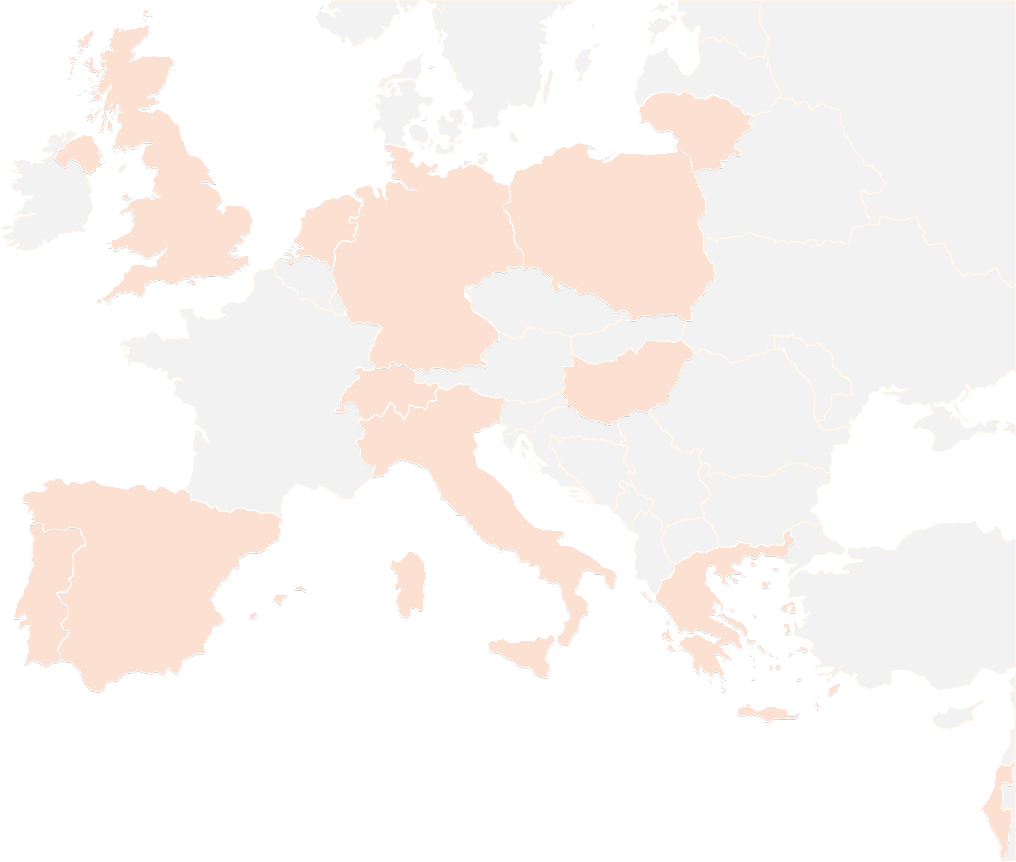
THANK YOU FOR YOUR ATTENTION!
wp4@lists.up2university.eu
#up2universe

