Slide 1
WP5 7th Webinar Update activities in progress July-December 2019
Up2U Update 5th of November 2019

Slide 2
WP5 activity
Pedagogy coordination: starting Fall-19 cycle of pilots
  Implementation of a Common Assessment Methodology
    8 Meetings (starting from September) of the UROMA team on assessment
    Remote meeting with TAU, planning a f2f meeting in Rome or Tel Aviv
  WP5 preparation for a second WP5 Meeting
    Remotely planning the meeting with contribution of each partner
    Setting the dates - preparing the most important issue to discuss
    Gathering attention from all the involved partners
    Preparing list of documents and contents to be delivered as
    Assigning to each partner its role into the D5.5 final Deliverable
Notes:
From Github issue tracker

Slide 3
Pilots and international communities status
Pedagogical coordination of the next activities
  WP5 internal f2f meeting 14 of November in Rome or TaU to complete new Soft-CPD
  WP5 Meeting in Tel Aviv December 2019/January 2020 (a call for contribution will be prepared within 15 November)
    A review of all Pilots from Pilot Coordinators July 2019 – January 2020
    Trouble and success collection, Exchanging best practices
    Establishing and implementing a common Assessment Method to be tested since September 2019 - to April 2020
  Continuous Update of the Operational “next steps document” prepared with 12+ to-dos items, each assigned to specific owners
A structured agenda for the month September ’19 – January’20
Notes:
From Github issue tracker

Slide 4
Next steps (already started)
Deliverable 5.5: set the template and the role of contributors (started in Poznan, to be completed within 15 of November)
  New Course and Content availability in English
  New and enhanced Learning Analytics collection, suitable for teachers, in English and/or in national language
  A structured document where contributors will upload content with a strictly ordered method
Transfer to each Pilot Coordination team the results of the new agreements
  Implement Learning scenario (CFM in Moodle, and other planned alternatives ) - Finalize the design of new Soft CPD
  Start implementation next Pilots, formal and non-formal scenarios

Slide 5
Next steps (already started)
Dissemination activities
  Establishing partnership with national group of educational services providers
  Coordinating actions with external bodies
    F4F, T4F, P4F; Santa Cecilia; Sapyent, Loquis, Ammappalitalia
Outreach and communication to policy makers and potential stakeholders (in progress)
  Letter to a Minister of Education (english version, italian translation)
  Letter to be subscribed by Pedagogical Experts (in Italy and WorldWide)
  Letter to an activists organization (english)
  Letter to potential stakeholders

Slide 6
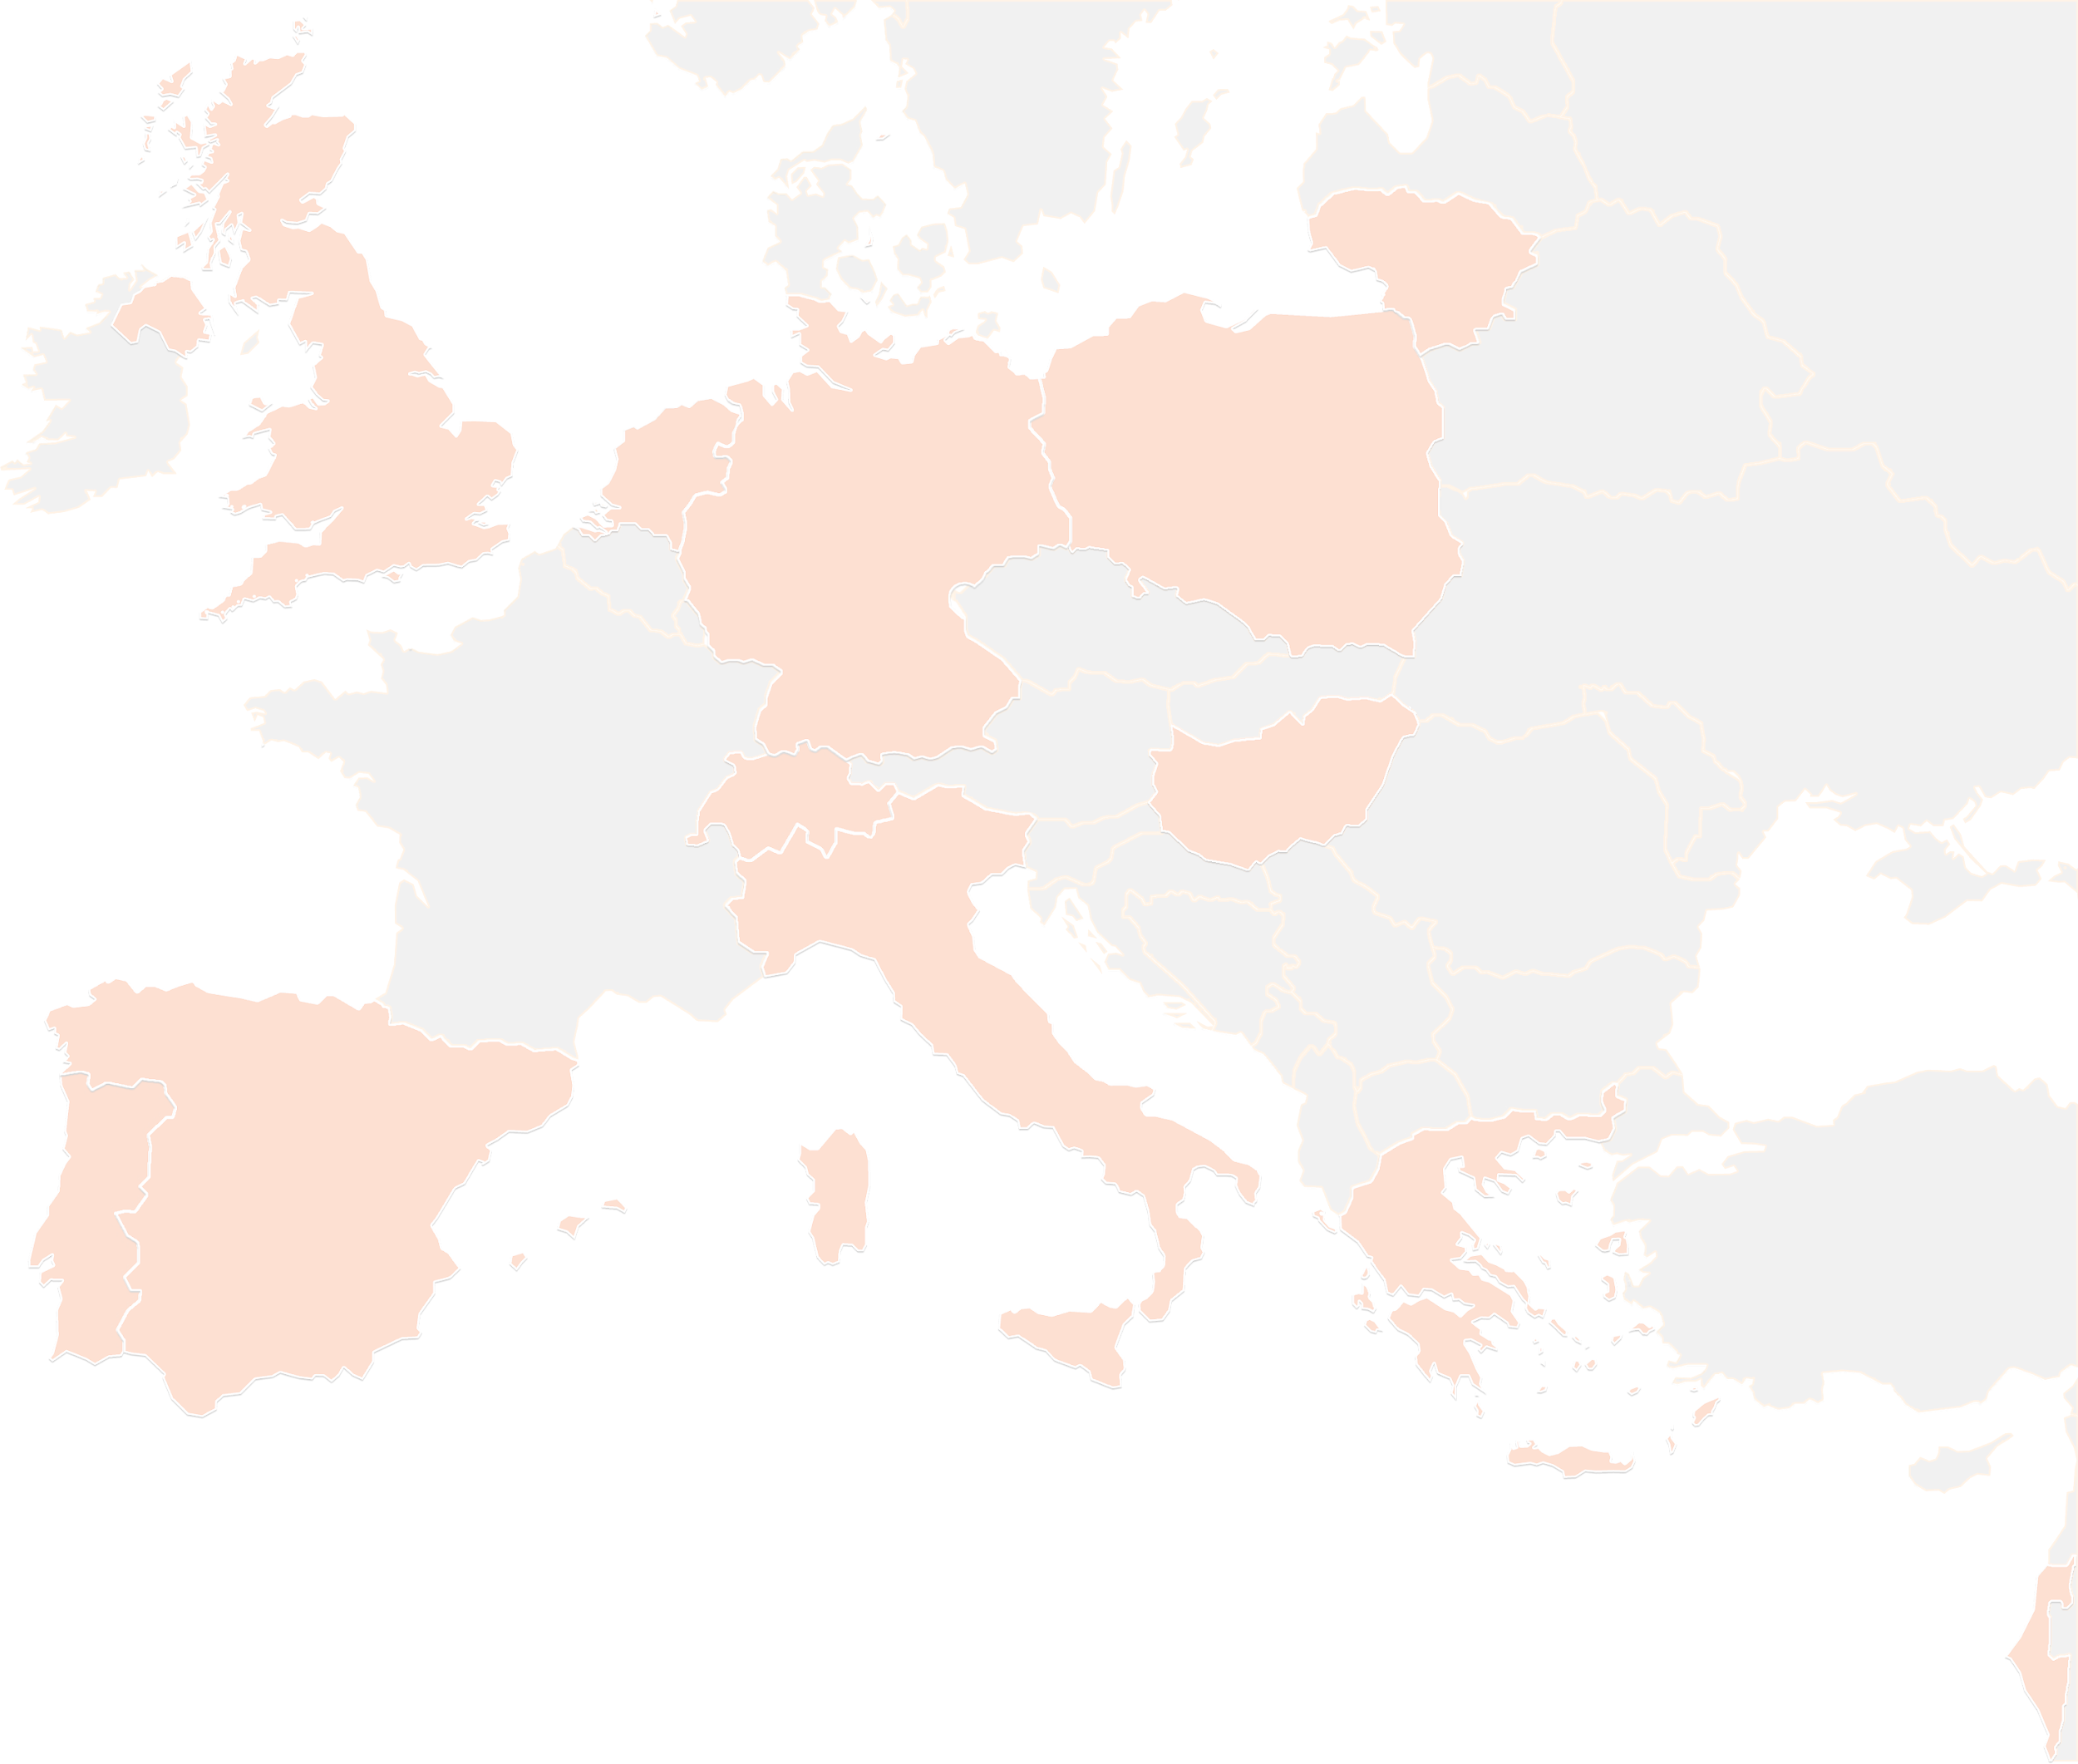
THANK YOU FOR YOUR ATTENTION!
wp5@lists.up2university.eu
#up2universe

