Slide 1


Community-based Trust Establishment
Sprint demo #3– 17th March 2020
Branko Marovic/Alan Lewis/Sergio Gomez
Q1 2020
Public
www.geant.org

Slide 2

Background
Follow-up on SFA Distributed Vetting
  Aim: Focus on a specific flow identified in cycle #1
    Community-based (Web of Trust Approach)
    Assumes a pre-existing trust fabric exists for R&E ☺
Identify and/or develop tools to support this approach
  Aim: Detail the workflow and develop a PoC demo
    Identify use cases
    Elaborate typical flows
    Design data model
    Investigate tools (platforms, pre-existing components)
    Develop PoC that integrates some of the fabric
    Demonstrate PoC and gather feedback on areas of applicability

Slide 3

Overall workflow
Initiation
Identity
Proofing
Identity
Verification
Issuance
Record keeping
Activation

Slide 4
High-LOA guest enrolment - Initiation
Token Registration demo

Slide 5
Identity Verification
ReadID
demo
F2F Vetting demo

Slide 6
Issuance/Activation
Issue Token demo

Slide 7

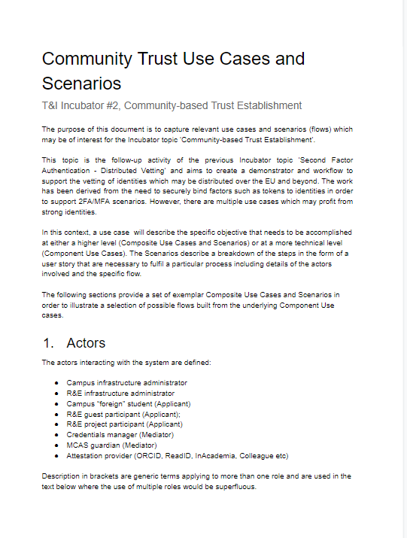
Activities status
Status
Overall flow defined
Functional architecture for PoC defined
Collaboration with SURFnet agreed
Use case identification underway
Initial PoC Management portal created
Integration with ReadID progressing
Discussions with interested communities








Slide 8

Looking ahead
There are a number of tasks underway and some still to complete until the topic is fully explored. In particular:-
  Fully identifying all the applicable use cases engaging with the community
  Agreeing the subset to be supported by the PoC demonstrator
  Identifying the various possible sub-flows for different use cases
  Building a working PoC demonstrator
  Creating a package for the community from the existing documentation
  Feedback of results to community

Slide 9

Current work documents
Distributed Vetting - Multi-Factor Authentication Report https://docs.google.com/document/d/1J2SfA1dcsrVHDMVtCtH4SToW_niRztc4UioWPbI60ro/edit#
Community trust vetting demonstrator https://docs.google.com/document/d/1Sk0u5BXdEpvXFzS-wrXD-dPil8UxeE3V5tbzez80oRg/edit#
Community Trust Use Cases https://docs.google.com/document/d/1lNbKJvdv6Yl_mgXi-9p6icsu6mAhNX1W7jIPDcuNflM/edit#
CommTrust Overall Flow https://wiki.geant.org/display/gn43wp5/CommTrust+Overall+Flow
CommTrust Components Flow https://wiki.geant.org/display/gn43wp5/CommTrust+Components+Flow

Slide 10

Thank you
www.geant.org
© GÉANT Association on behalf of the GN4 Phase 2 project (GN4-2).
The research leading to these results has received funding from
the European Union’s Horizon 2020 research and innovation programme under Grant Agreement No. 731122 (GN4-2).

Slide 11


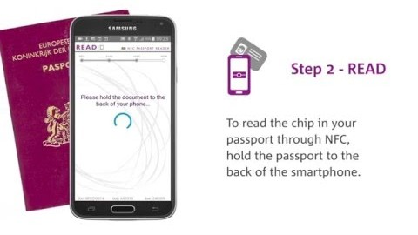
Identity Proofing
ReadID identity proofing solution
Reads ICAO 9303 compliant documents
Mobile app/SDK and SaaS backend
Facial matching – ‘liveness’ check
Here’s how it works

