Slide 1


  NFV PoC update
November, 2017
Wouter Huisman

Slide 2
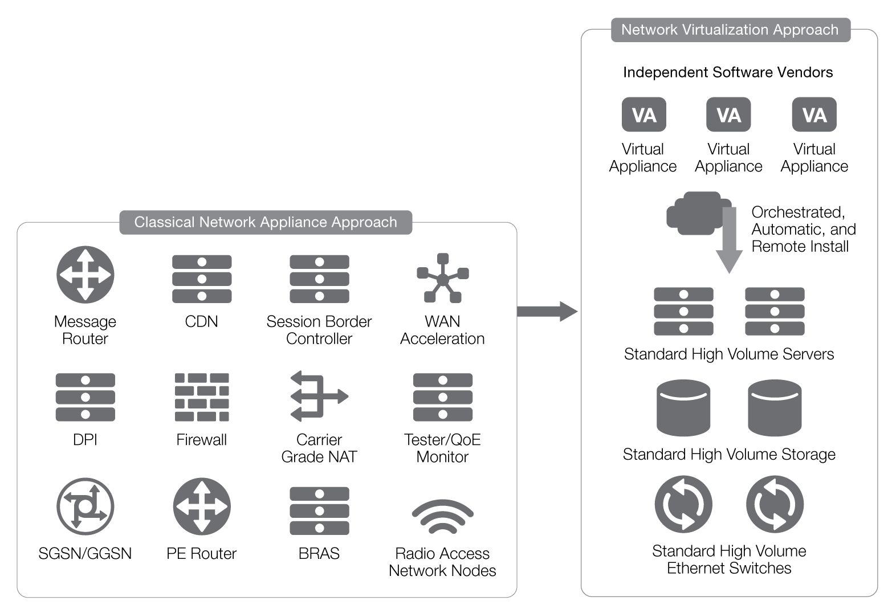
NFV?
Bron: F5 Networks Inc

Slide 3
Virtualization variants
Appliances
  FPGA/Asic optimized for packet handling
  Proven track record, predictable performance
  SW and HW same supplier
Commodity Servers
  COTS
  Very flexible, any VNF possible
  Performance dependent on deployment
  New developments in HW
    NICs with DPDK support
    smartNIC Netronome
  Docker or VMs

Slide 4
Deployment models
Centralized VM cluster
  More efficient and quickly ready for service
  Shared resources – more cost efficient
  Not suitable for all NFV functions
Distributed VM deployment
  Separate server at customer site or CPE with integrated x86
  Case by case deployment model

Slide 5
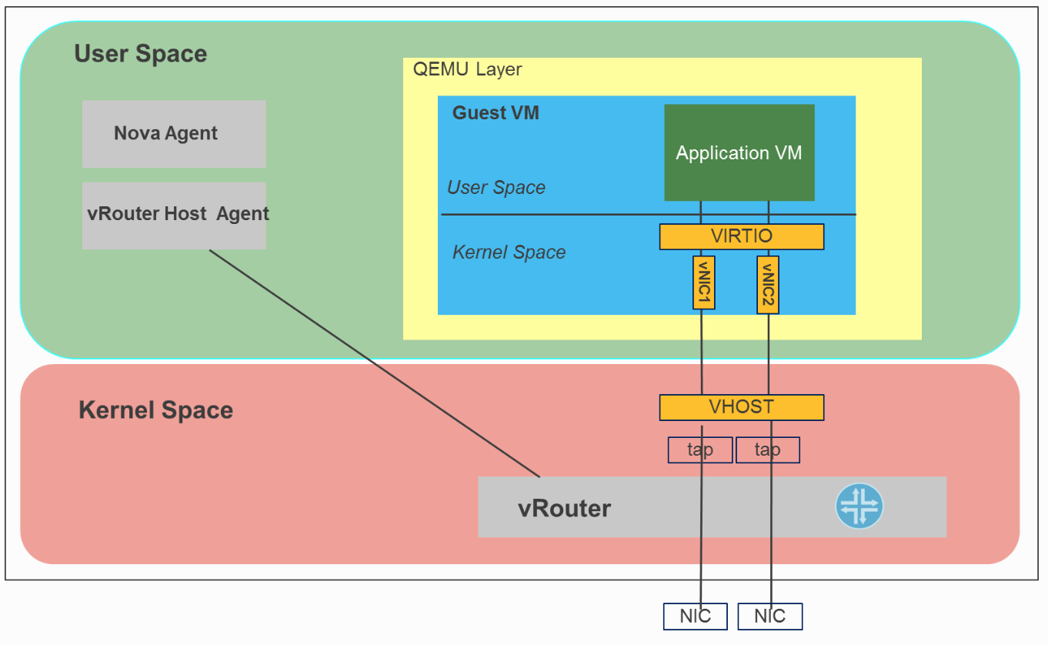
vrouter in standard deployments
Source: http://fuel-plugin-contrail.readthedocs.io/en/latest/dpdk.html

Slide 6
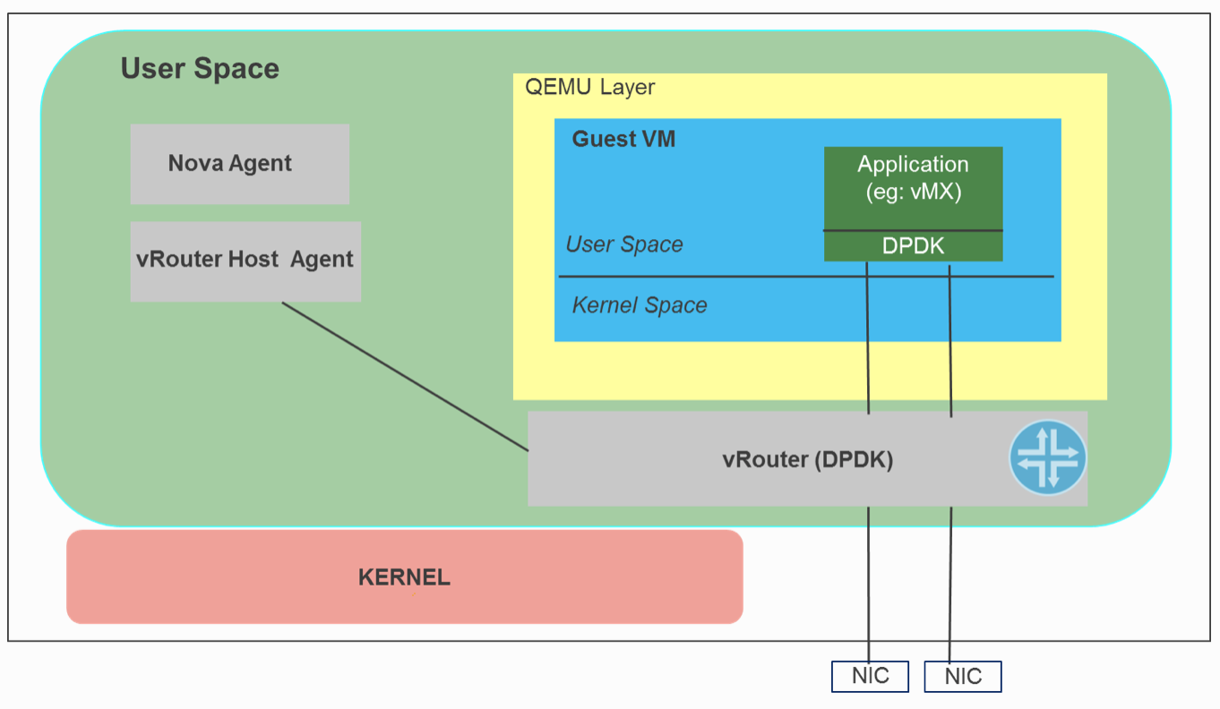
vrouter in DPDK deployments
Source: http://fuel-plugin-contrail.readthedocs.io/en/latest/dpdk.html

Slide 7
Virtual network functions – Why?
Customers
  Need for more external service
  No tender needed
    Flexibility
    Scalable
    No vendor lock-in
    Easy to test NFV without commitment
SURFnet
  Providing added value to customers/ new services
  Providing added value / unburden our customers

Slide 8
Virtual network functions – Why not?
Risks
  Little/no interest from customers
  Complex development cycle
  Performance issues VNF
    E2E services not realized easily
    Performance lower than anticipated
    Use VNF remains static
    Operationally difficult to manage

Slide 9
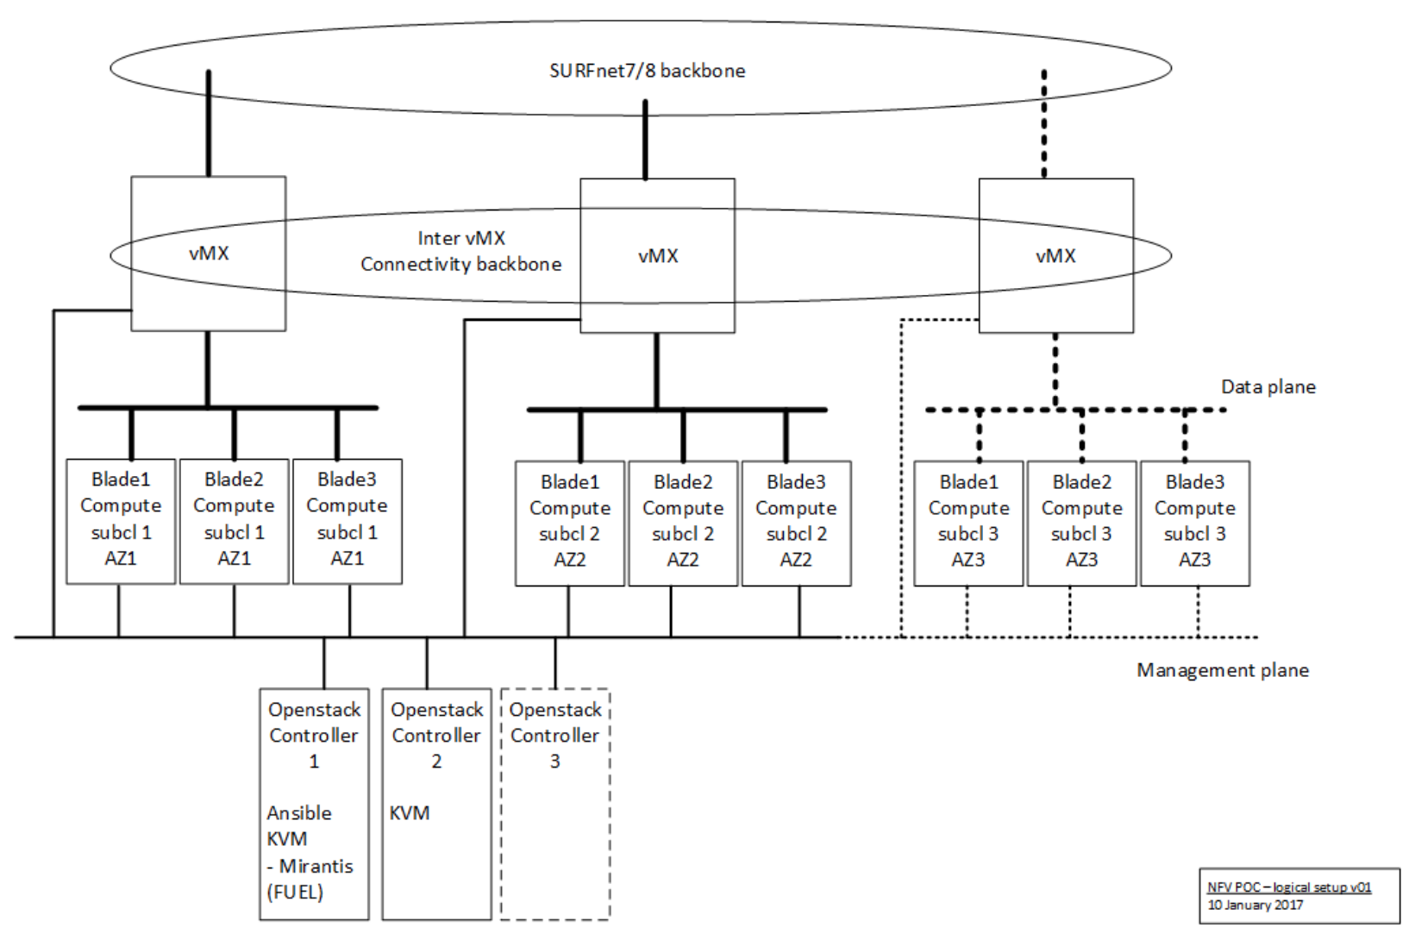
Logical NFV setup

Slide 10
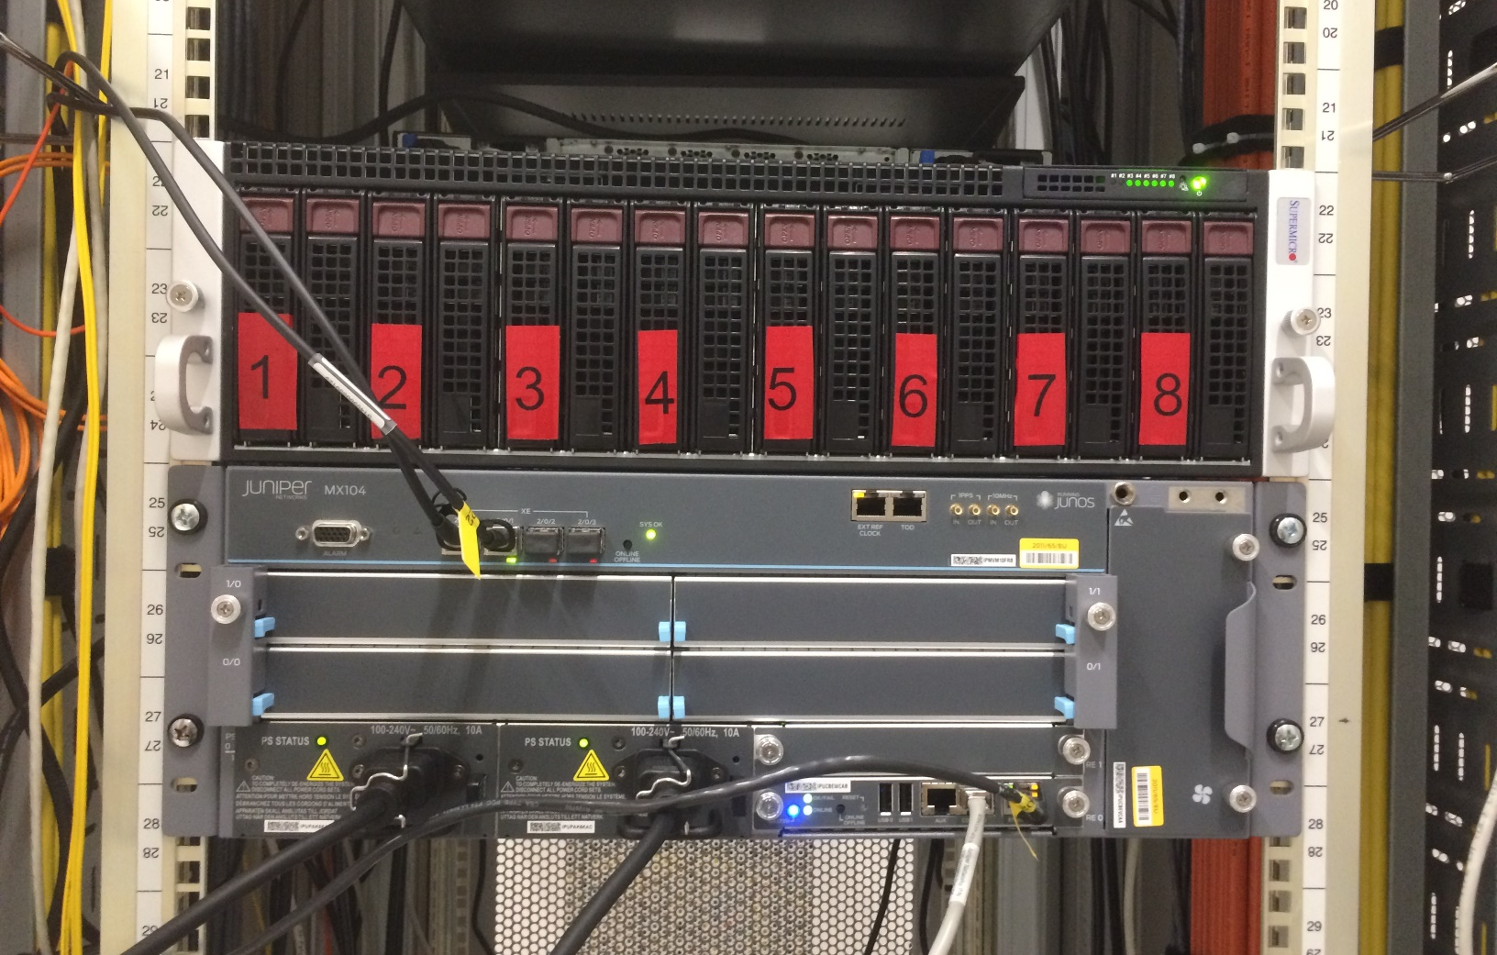
Front…

Slide 11
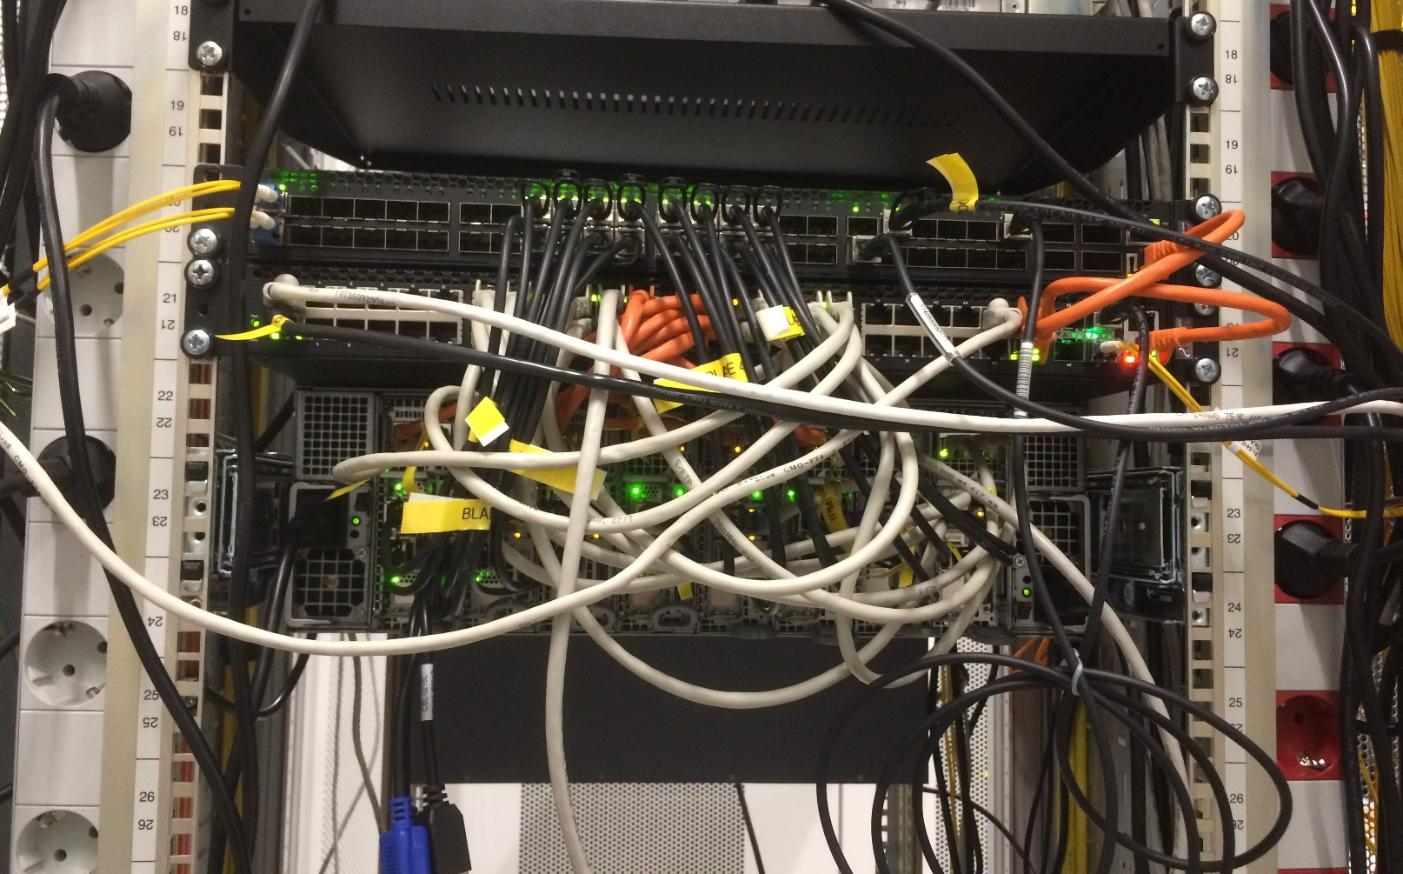
…back

Slide 12
Problems
vMX behaved slightly different than MX
DPDK NICs
  Mellanox NIC niet supported by Contrail 3.2/4
  Intel x710 NIC bug
L2 networking clearly less well supported → L3

Slide 13
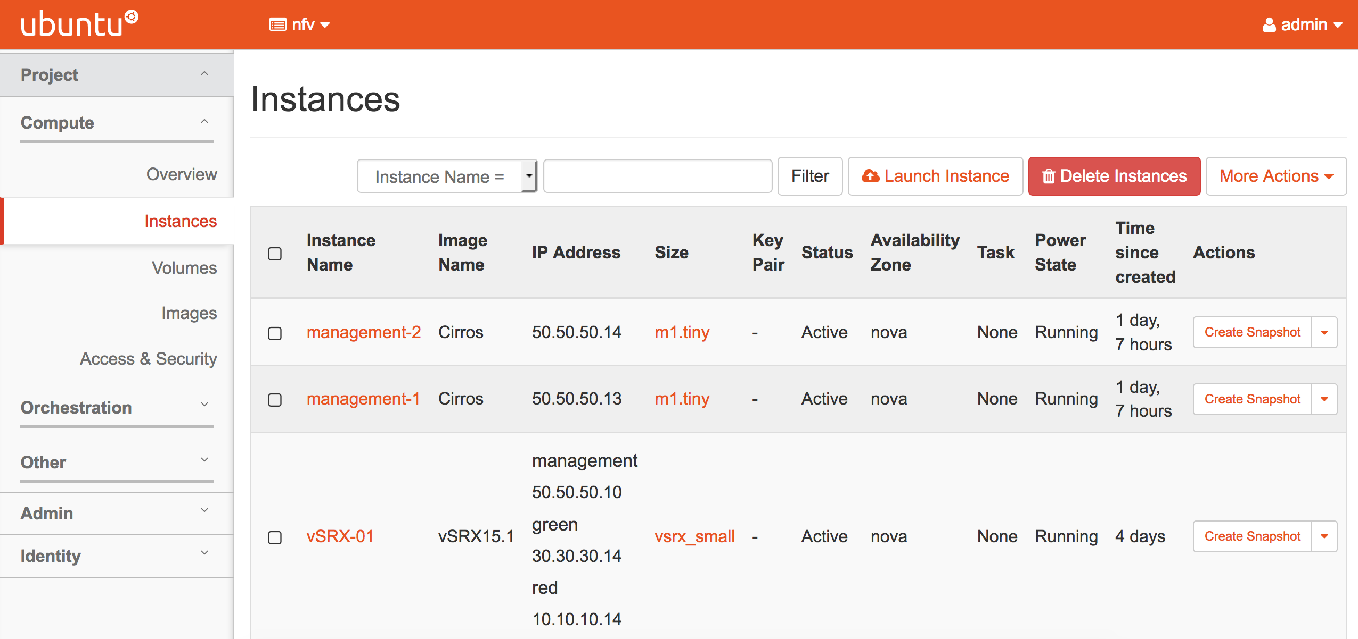
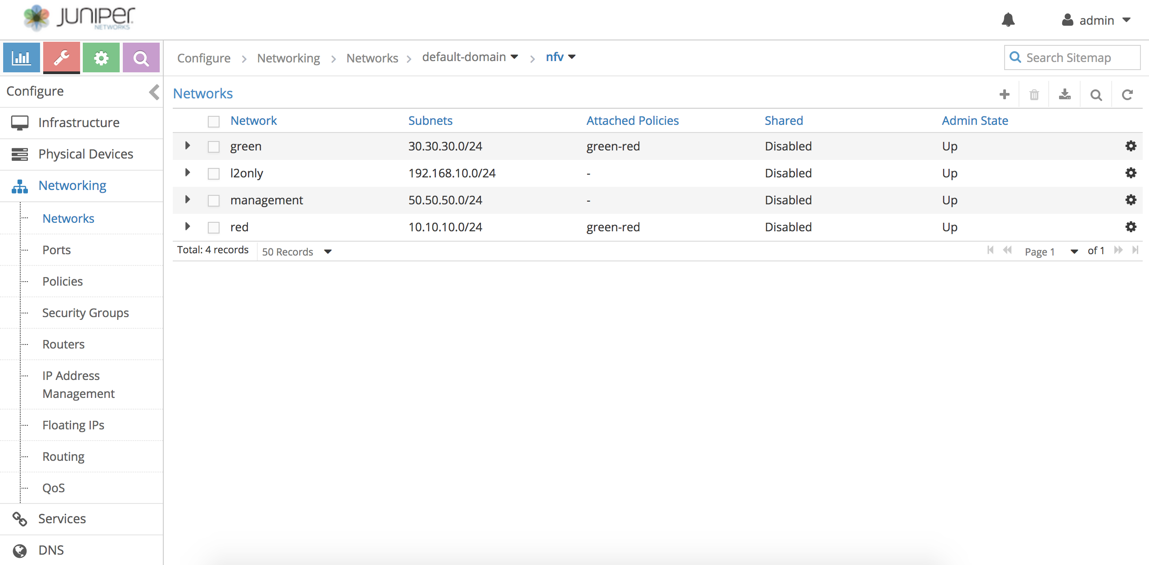
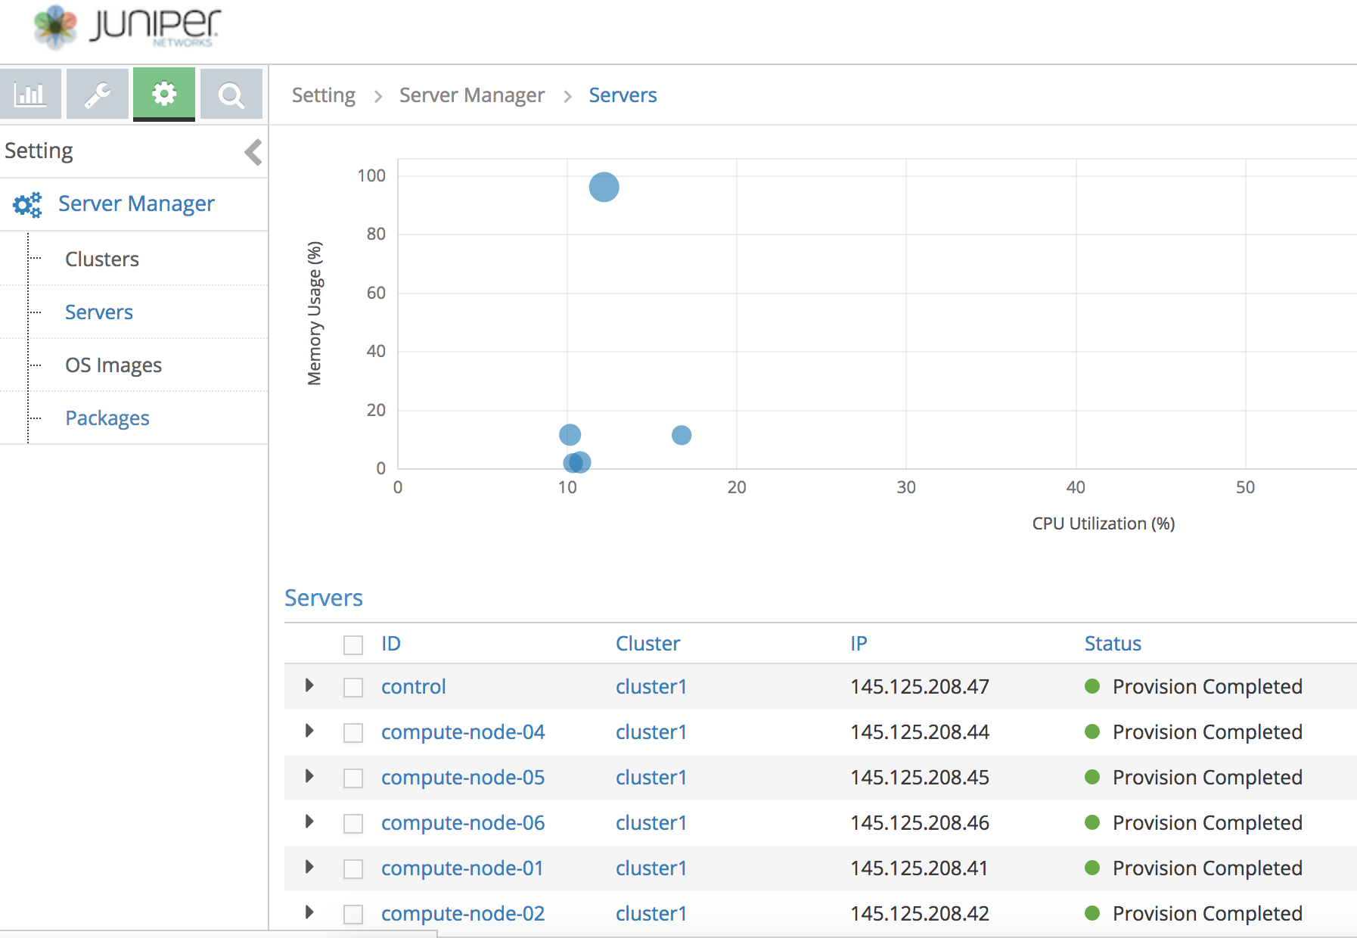
Overview components – take 2
Horizon GUI
Openstack
VM,NFV
blade
blade
blade
blade
blade
blade
blade
Adding hosts
Contrail
Server Manager
Pica8 switch
Contrail
Controller
networking
MX104
SN7/8

Slide 14
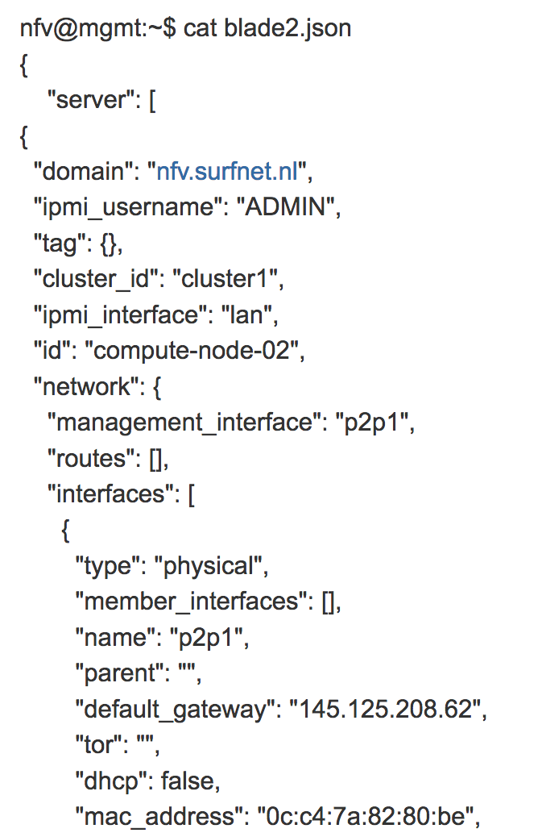
Contrail Server Manager
Load
  server-manager add server -f blade1.json
  Node name/IP adres/MAC adres/NIC IFs/DPDK/etc
Reimage
  server-manager reimage --server_id compute-node-01
Provision
  server-manager provision --server_id compute-node-01
  contrail_4_0_0_3053
Result: a new node with a Linux load in cluster1 configured with vrouter ready in Horizon/Contrail
Contrail
Server Manager

Slide 15
Contrail Controller
Create networks
Create security groups
Create policies
Connect Service Instance using Port Tuples
  VM spawning is split in two actions
Contrail
Controller

Slide 16
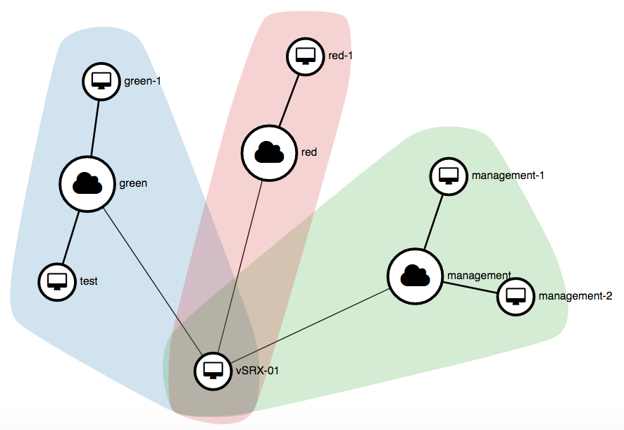
Horizon
VM spawnen
  Define name
  Template & settings
  Conect to network
  If needed, add Security Groups
Horizon GUI
Openstack

Slide 17
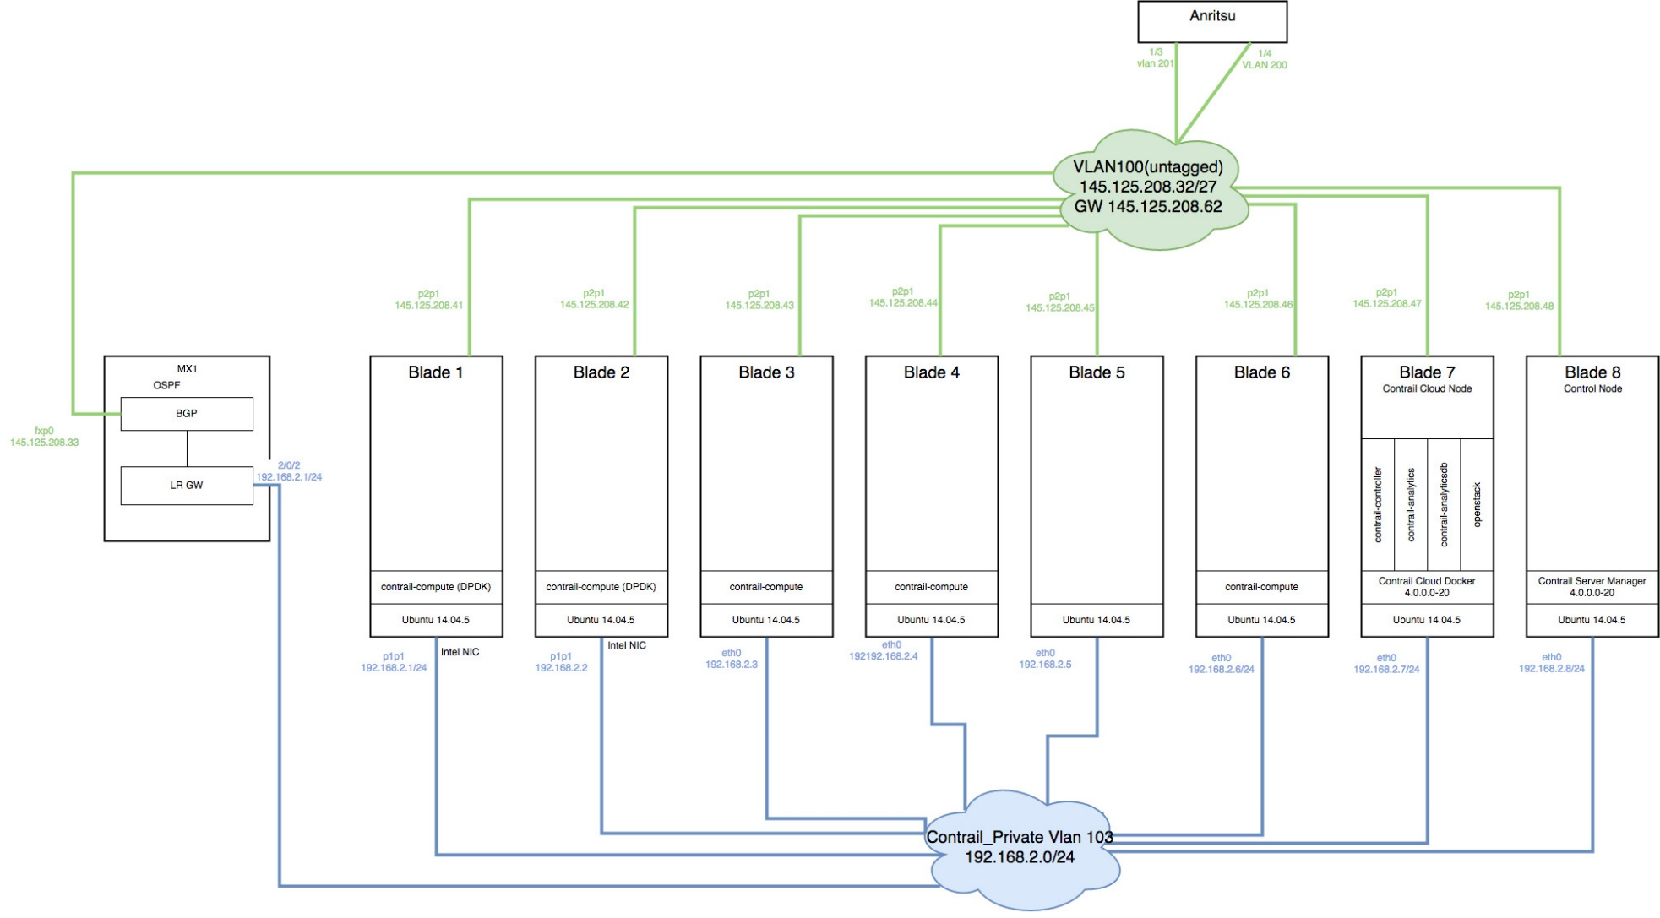



Demo physical layout
vSRX-1
Horizon GUI
Openstack
Contrail
Server Manager
red-2
green-1
red-1
green-2
Contrail
Controller
right
left

Slide 18
Logical layout
192.168.20.12
192.168.20.13
192.168.10.12
Cirros
Green-1
Cirros
Green-2
Cirros
Red-1
vrouter
vrouter
vrouter
MPLSoUDP

Slide 19
Ping between 2 networks
192.168.20.12
192.168.20.13
192.168.10.12
Cirros
Green-1
Cirros
Green-2
Cirros
Red-1
vrouter
vrouter
vrouter
policy
MPLSoUDP

Slide 20
Ping via FW to remote network
192.168.20.12
192.168.20.13
192.168.10.12
Cirros
Green-1
Cirros
Green-2
Cirros
Red-1
vrouter
vrouter
vrouter
policy
MPLSoUDP
vrouter
vSRX

Slide 21
Service stitching
192.168.20.12
192.168.20.13
192.168.10.12
Cirros
Green-1
Cirros
Green-2
Cirros
Red-1
vrouter
vrouter
vrouter
policy
MPLSoUDP
vrouter
vrouter
VNF1
VNF2

Slide 22

Security Group
192.168.20.12
192.168.20.13
192.168.10.12
Cirros
Green-1
Cirros
Green-2
Cirros
Red-1
Security group:
Only 30.30.30.0/24
vrouter
vrouter
vrouter
policy
MPLSoUDP
vrouter
vSRX

Slide 23
To be investigated
Networking architecture
  Scalability, automated
Throughput
  Different FW vendor
Failover
Operating VNF by SURFnet
Configuration by customers
Orchestration

