Slide 1


PRESENTATION

Slide 2














100+ unique network platform
Discovery & Reconcile interfaces

Slide 3

Business Challenges providers face:
Operational issues:
Many scattered separate data sources – no single truth
No network discovery and reconciliation
Low data quality and duplicated records
No visibility on incorrect configurations in network
No (proper) relations between network platforms
Poor OSS/BSS integration
No good asset control
No process control
No track on vendor performance
Business impact:
Unexpected and expensive outages
Long Service Delivery lead times
SLA and contract violations
Lost track of assets
High OPEX
High network CAPEX
Difficulties in solving network problems
No control of vendors and contracts
Lower customer satisfaction

Slide 4

How IMS can help to solve this:
One Single Truth for all physical and logical resources in the networks
Clear view of live network assets, its utilization and configuration
Automatic Discovery and synchronization of live network, improved quality
Single Point of Failure calculation
Automatic Planned Work Impact analysis
Plan new network build just ahead of demand curve, improve capacity planning
Quicker Time to repair, improved “trouble to resolve” processes
Optimized processes with IMS workflow
Vendor management, manage KPI’s and improve SLA’s
Linked to BSS/OSS systems, reduce double keying and data pollution
Support efficient day to day network operations

Slide 5
General Information

Slide 6
Network Inventory Data
Platforms supported:
MPLS, IP, MPLS-TP, Ethernet, PTN
WDM/OTN
Fiber, FTTH/GPON
SDH/SONET/PDH
Mobile (2G,3G,4G, 5G)
WiFi
Radio/Microwave
xDSL
SDN/NFV
Voice/VoIP
ATM/FR
VSAT
DCN
Sync
Etc..
The following details are registered:
Customers
Locations (Customer Sites and PoP's)
Floor plans
Equipment
Cards
Ports
Circuits/Connections
Products and Services
Cell Details and Licenses
Leased Lines
DDF/ODF and patch panels (ISP&OSP)
IP addresses (IPAM)
Voice routes and logical ports
Network overviews
Contacts
Vendors
Contracts

Slide 7
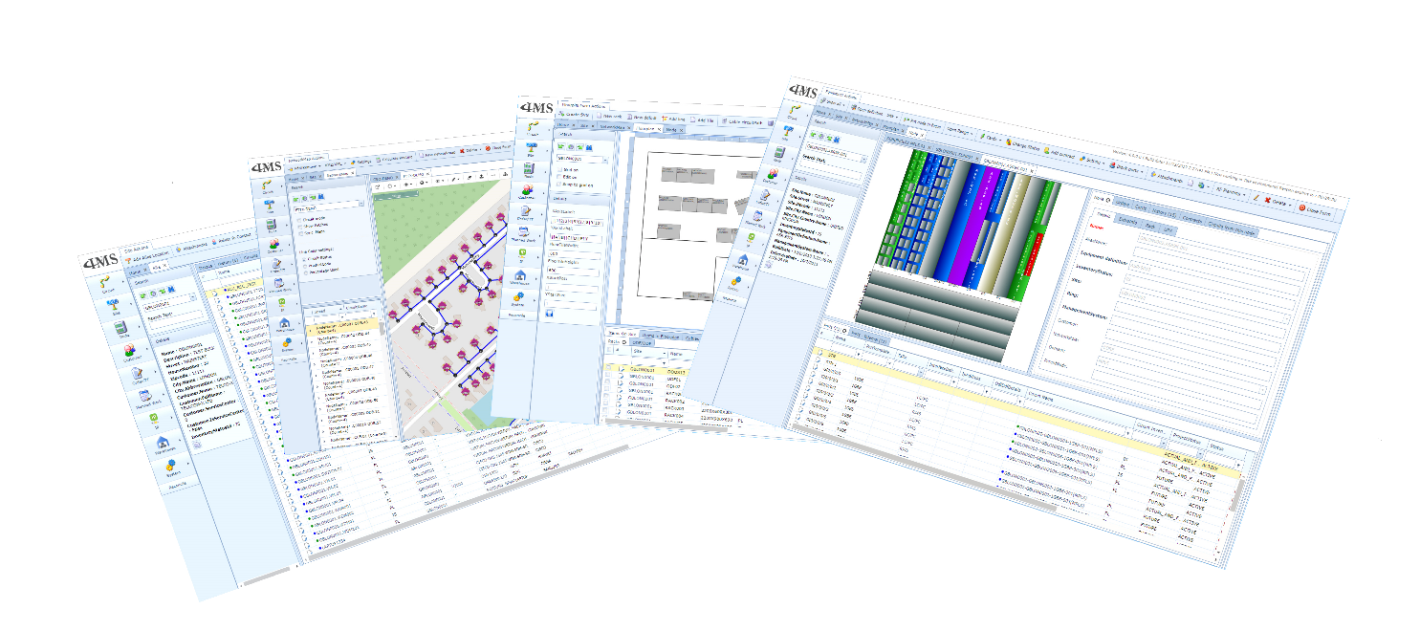
Network Inventory Data
Functionalities:
Inventory Management
Network Planning
Workflow / Order Management
Trouble Ticket Management
Stock, Spare & Asset Management
Floor plan management
Reporting
Visualization:
End to End Graphical connection
GIS and Graphical Network overviews
Dashboards
Network Analysis:
Capacity Management
Planned Work impact analysis
Single Point of Failure calculations
Network Integration:
Network Discovery and Reconciliation
Automatic Provisioning in Network
Management System
The following processes are supported:
Service Delivery/Network Configuration
Fault handling
Capacity Management
Warehouse and Spare Management
Leased Line and Interconnect Mgmt
Vendor and contract Management
Life cycle Management
Asset Management
Supports all processes to run a modern
CSP engineering centre

Slide 8
Demo

